Slide 1
1T2: Introduction to
Audio Signal Processing
Xavier Serra
Universitat Pompeu Fabra, Barcelona
&
Stanford University
Notes:
Welcome everyone to the course on Audio Signal Processing for Music Applications!!
This is an introductory class to audio signal processing.

Slide 2
Index
What is audio signal processing?
Applications:
  storage, data compression, effects and transformations, synthesis, description.
Notes:
In this lecture we introduce the concept of audio signal processing and then go over some common music applications of signal processing.
....
This should give you a flavor of the potential of the field.

Slide 3
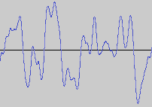

What is audio signal processing?
Intentional alteration of sound
Control
Audio signal
processing
system
Notes:
We can define audio signal processing as the engineering field that focuses on the computational methods for intentionally altering sounds.
...
Since audio signals, sounds, may be electronically represented in either digital or analog formats, signal processing may occur in either domain. Analog processors operate directly on the electrical signal, while digital processors operate mathematically on the binary representation of that signal.

Slide 4
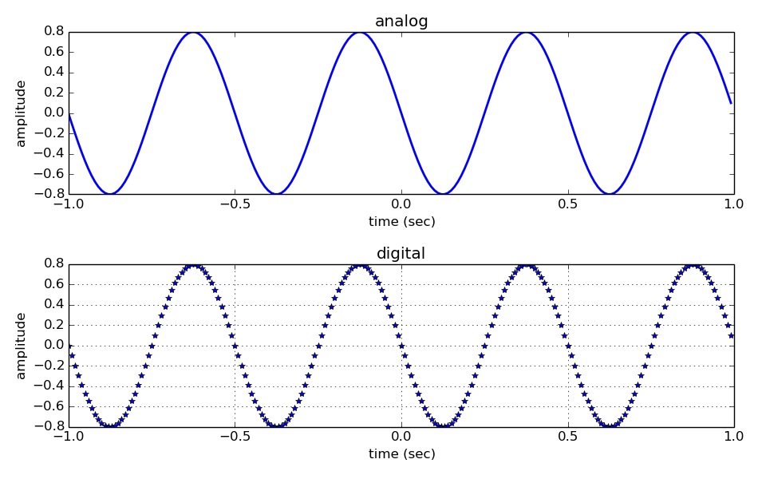
Analog versus digital signals
Notes:
An analog sound is usually electrical; a voltage level representing the air pressure waveform of the sound. It is a continuous function, like the one shown in this top plot.
On the other hand, a digital representation expresses the pressure waveform as binary numbers, thus as a discrete function, like the one shown in this bottom plot.
The digital representation permits the use of microprocessors and computers. Although the conversion from analog to digital can be prone to loss, most modern audio systems use this approach because the techniques of digital signal processing are much more powerful and efficient than the ones based on analog techniques.

Slide 5
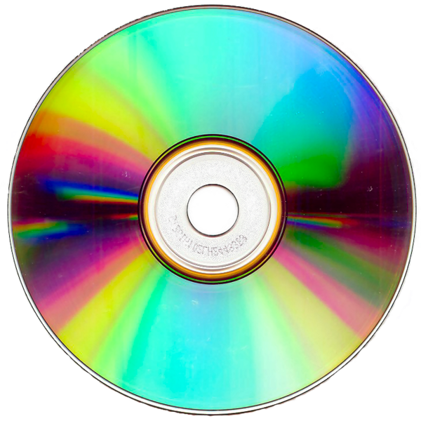
Applications: Storage
http://commons.wikimedia.org/wiki/File:CD-ROM.png
Notes:
Now let's start going through some common applications of the audio signal processing techniques.
One such application is the storage of sounds, thus their recording and reproduction.
The digital representation of sound waves, such as spoken voice, environmental sounds or music can be recorded as electrical or mechanical inscriptions in a media and can then be recreated from these inscriptions.
...

Slide 6


Applications: Data compression
perceptual
audio coder
http://commons.wikimedia.org/wiki/File:Gnome-mime-audio-x-mp3.png
http://commons.wikimedia.org/wiki/File:Gnome-mime-audio-x-wav.png
Notes:
Another signal processing application is data compression, or also called audio coding.
The goal here is to reduce the bandwidth requirement of digital audio streams and the storage size of audio files.
There are two types of compression techniques, the ones called lossless,with which we do not lose any information, and the ones called lossy, in which some information is lost, but hopefully the information lost is not perceptually relevant.
...
A number of the basic techniques that we will cover are very much behind audio compression systems.

Slide 7
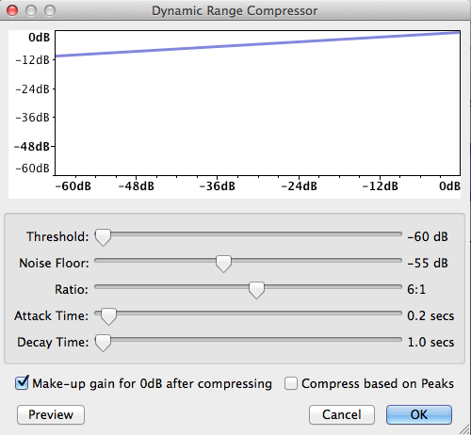
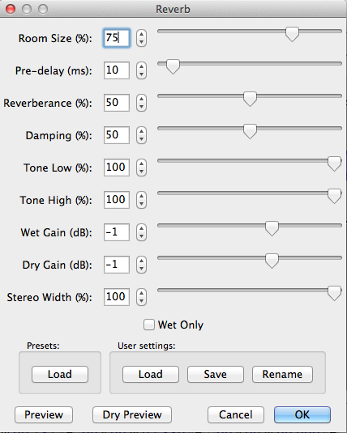
Applications: Transformations
[from
Audacity]
Others: echo, equalizer, flanger, phaser,
chorus, pitch shift, time stretching,
voice effects, 3D audio effects, morphing, ....
Notes:
A large group of applications relate to performing sound transformations. This type of applications are used in post-production and in musically creative usages.
...
In this course we will target a few of these applications and most of the methods explained have a lot of possibilities in this area.

Slide 8
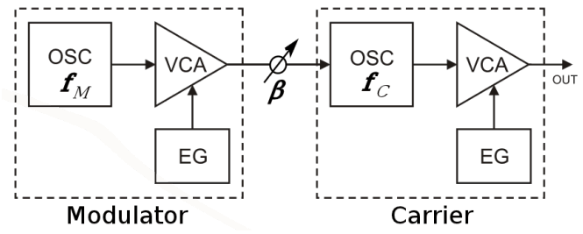

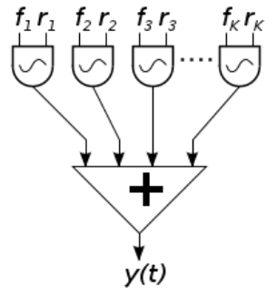
Applications: Synthesis
Subtractive synthesis
FM synthesis
Others: granular synthesis,
physical modeling, waveshaping,
sampling, spectral synthesis, ...
http://commons.wikimedia.org/wiki/File:Karplus-strong-schematic.png
http://commons.wikimedia.org/wiki/File:2op_FM.svg
http://commons.wikimedia.org/wiki/File:Additive_synthesis.svg
Additive synthesis
Notes:
One of the traditional uses of signal processing is related to sound synthesis, thus with the aim to generate sounds, either by imitating existing sounds or for creating new timbres.
...
We will develop and use some of these techniques in our course, specially additive and subtractive synthesis.

Slide 9
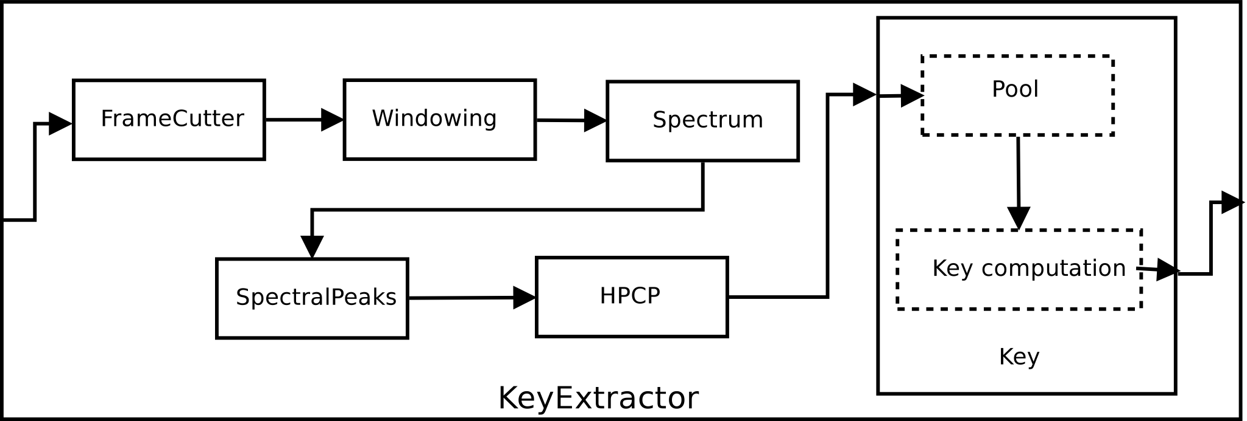
Applications: Description
Low-level: loudness, timbre, pitch, ..
Mid-level: rhythm, harmony, melody, …
High-level: genre, emotions, similarity, …
Notes:
The last group of applications that I want to mention are related to sound description; techniques for analyzing audio signals with the goal to describe and model meaningful characteristics of the sound.
This is a topic that has expanded enormously in the last few years and that is very relevant in the field of information retrieval.
...
The automatic description of sounds will be an important application of the topics covered in this course. We will not be able to go over the extraction of mid and high level features of a signal, but the discussions that we will have on the analysis of low level features are at the basis of the general topic of sound and music description.
This is all for applications.

Slide 10
References and credits
More information in:https://en.wikipedia.org/wiki/Audio_signal_processing
Audacity: http://audacity.sourceforge.net
Slides and code released using the CC Attribution-Noncommercial-Share Alike license or the Affero GPL license and available from https://github.com/MTG/sms-tools
Notes:
A good overview reference is the audio signal processing entry in Wikipedia.
All the software that we will use in class is open source, like the program Audacity.
...

Slide 11
1T2: Introduction to
Audio Signal Processing
Xavier Serra
Universitat Pompeu Fabra, Barcelona
&
Stanford University
Notes:
This is all for this lecture.
I tried to give a very brief overview of what audio signal processing is, giving examples of some application areas.
Hopefully this has motivated you to continue in the course and that is worth the effort that you will have to dedicate to it.
See you in the next class.

