Slide 1
6T2: Fundamental frequency detection
Xavier Serra
Universitat Pompeu Fabra, Barcelona
&
Stanford University
Notes:
Welcome again to the course on Audio Signal Processing for Music applications.
In the last lecture we introduced the harmonic model and mentioned that in order for it to work we need to be able to detect the fundamental frequency of a sound, what we call the pitch of the sound.
We will use the terms fundamental frequency and pitch interchangeably, but strictly speaking they refer to different concepts. F0 is a signal processing concept, pitch is a perceptual concept.

Slide 2
Index
F0 detection in time domain
  monophonic signals
F0 detection in frequency domain
  monophonic and polyphonic signals
Notes:
Many methods have been proposed to identify the fundamental frequency, f0, of a sound.
These methods can be grouped into the ones that work directly on the time domain signal and the ones that work on the frequency domain representation, on the spectrum.
...

Slide 3
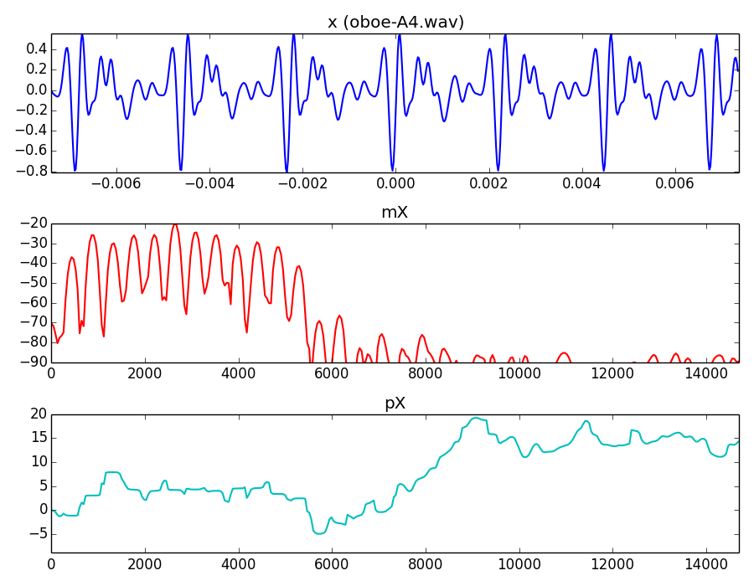
Notes:
To understand the concept of F0 detection let's look at some sounds and their spectra.
..

Slide 4
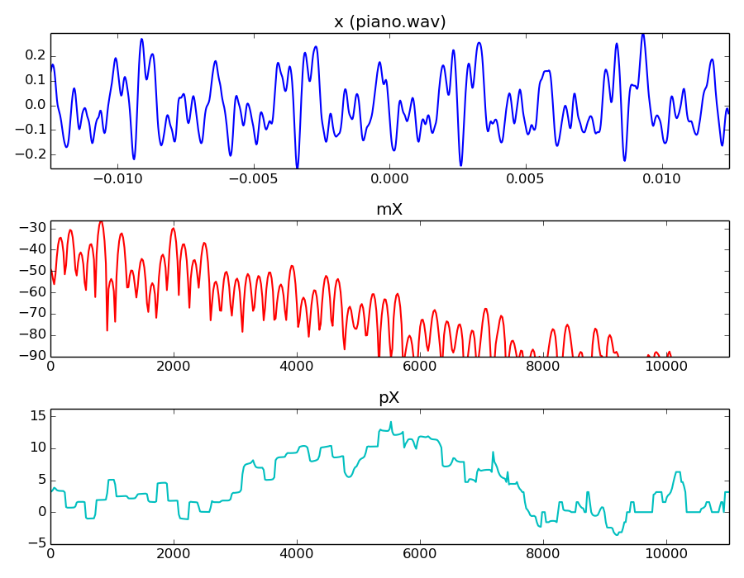
Notes:
A single note of a piano has a clear pitch, thus it should be easy to detect its f0.
In the time domain it is hard.
It the frequency domain it is easier.
...

Slide 5
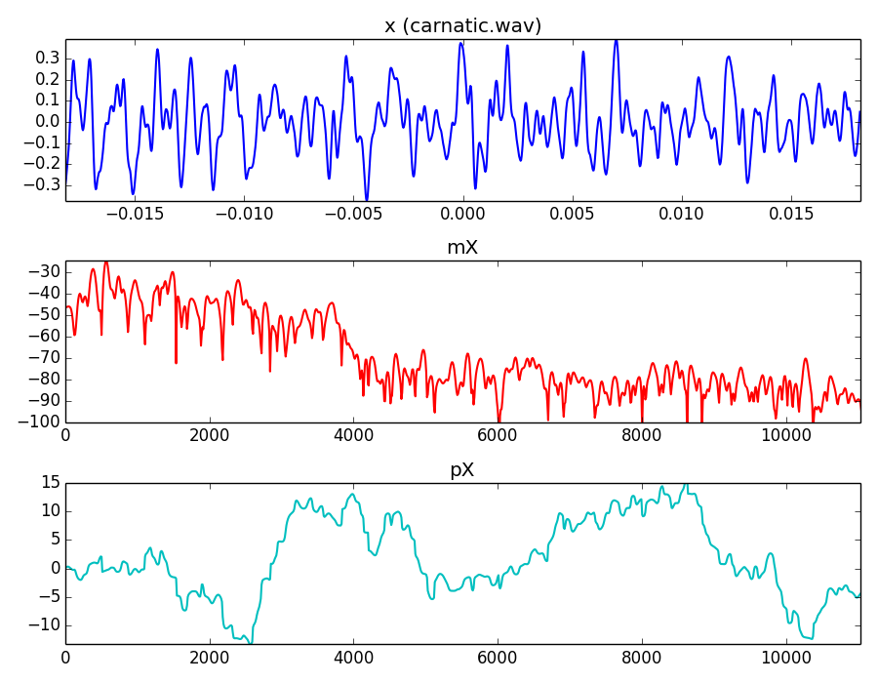
Notes:
This is a polyphonic signal. Let's hear it.
There are several sound sources, but the voice is the most prominent one.
To detect the F0 of the voice in the time domain it is close to impossible. In the spectrum it is still difficult, but feasible.
...

Slide 6
F0 detection in time domain
Autocorrelation function (with tapering)
Notes:
To detect the f0 in the time domain we basically have to identify the length of its repiting periodic cicle.
The autocorrelation function is a mathematical tool for finding repeating patterns. It is the cross-correlation of a signal with itself. Informally, it is the similarity between samples as a function of the time lag between them.
...

Slide 7
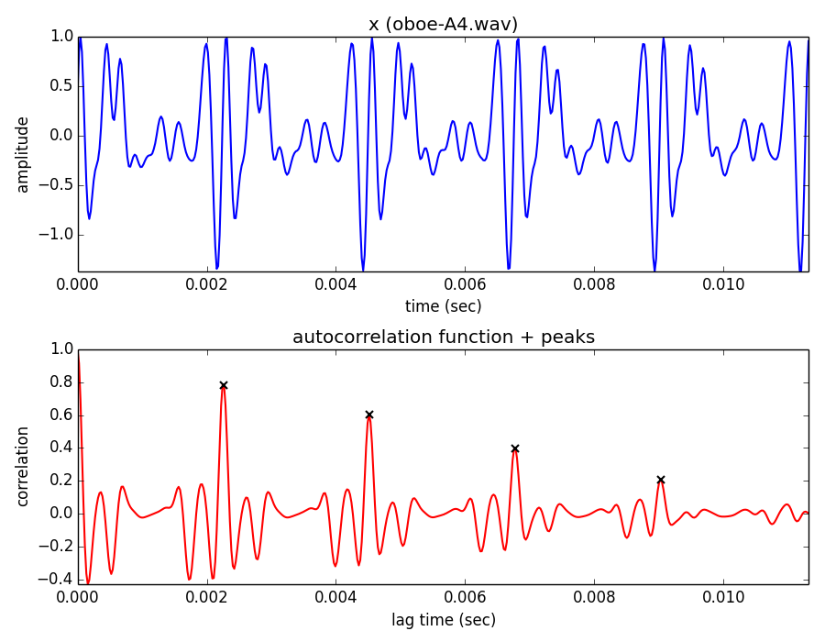
Notes:
For the case of an oboe sound, the autocorrelation function behaves quite nicely.
...

Slide 8
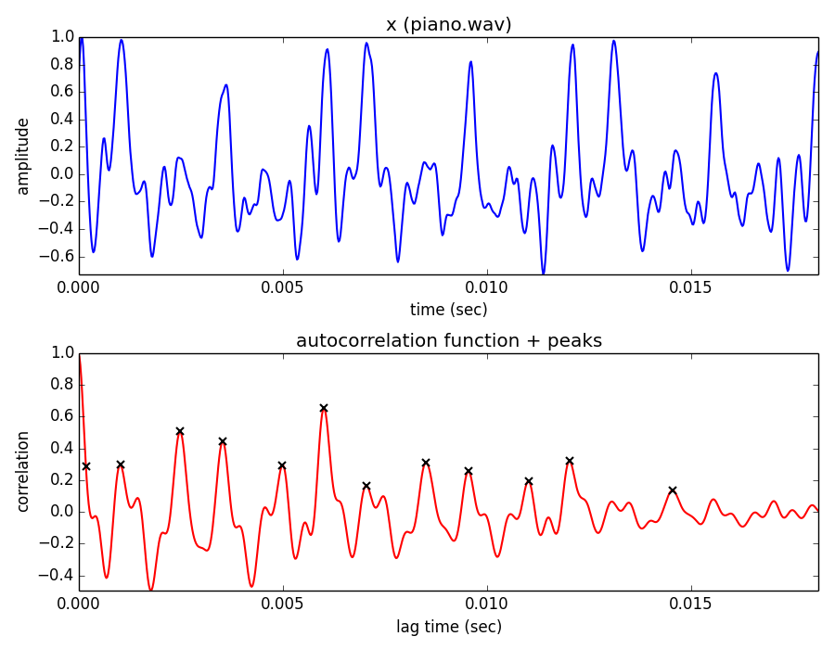
Notes:
For a piano sound, it is not so well behaved.
..

Slide 9
YIN Algorithm (Cheveigné and Kawahara, 2002)
Based on the difference function
Notes:
A method similar to the autocorrelation is the one proposed by Cheveigné and Kawahara, named YIN. It is based on the difference function.
This function is zero when l is equal to the cicle length. Thus we have to find the minima of the function.
...

Slide 10
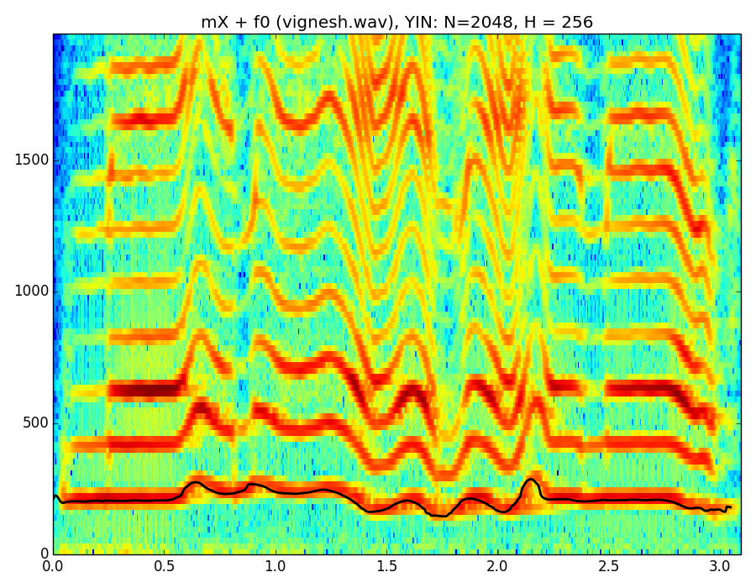
Notes:
Here we see the result of the YIN algorithm, the F0 value, for a vocal sound. The F0 values is superposed to the spectrogram of the sound.
...
But this type of methods does not work for many sounds, specially it idoes not work in polyphonic signals. So we have to go to the frequency domain.

Slide 11
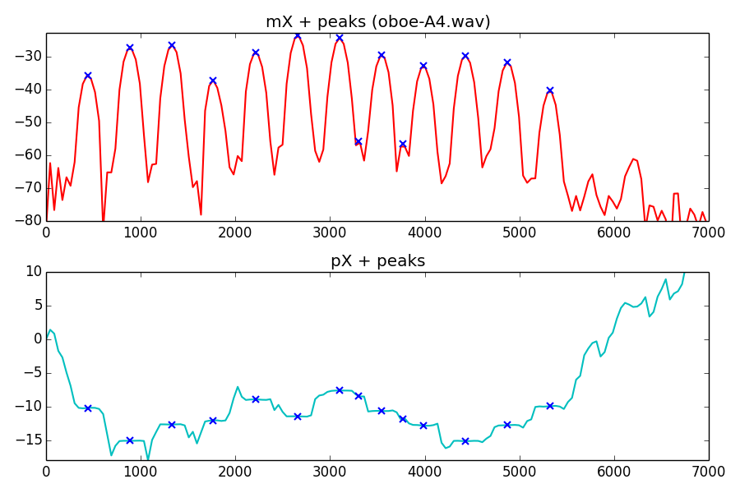
F0 detection in frequency domain
Notes:
What is the F0 of a sound in the spectrum?
We have seen how to identify the sinusoids and the partials of a sound. For example in the oboe sound
....
if we can identify which ones of these partials are harmonic we will be able to figure out which is the fundamental frequency.
...

Slide 12
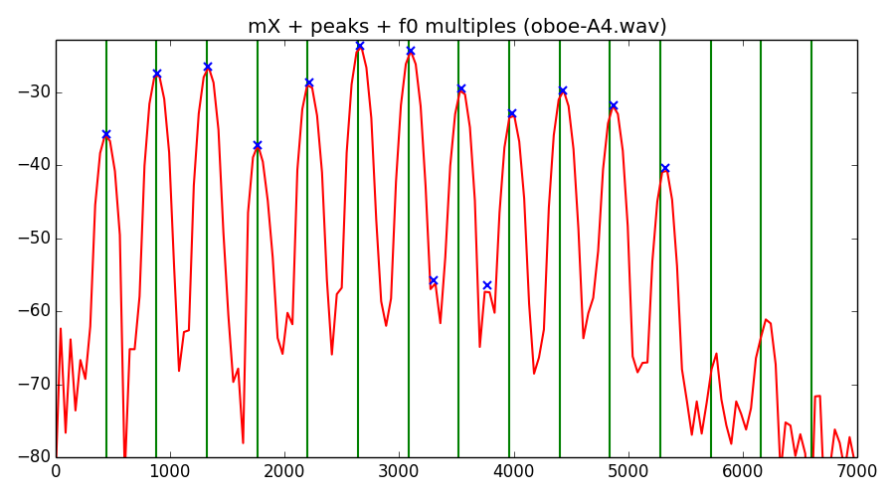
F0 in the spectrum
The F0 can be defined as the common divisor of the harmonic series that best explains the spectral peaks.
Notes:
The F0 in the spectrum of a sound can be defined as the common divisor of the harmonic series that best explains the spectral peaks.
....

Slide 13
Pattern matching
Two-way mismatch algorithm (Maher and Beauchamp, 1994)
7F0
6F0
5F0
4F0
3F0
2F0
F0
predicted
measured
Notes:
The F0 detection problem in the frequency domain can be formulated as a pattern matching problem, in which we have to find the pattern of the harmonic series that best fits the spectrum.
The two-way mismatch algorithm proposed by Maher and Beauchmap does that.
The concept of two-way mismatch is that it finds the difference between the measured peaks and an ideal harmonic series, predicted peaks, and viceversa.
...

Slide 14
Total error:
Maher and Beauchamp propose:
Notes:
The error between measured and predicted is computed in a similar way.
...

Slide 15
 | Errp->m | Errm->p | Errtotal
50Hz | 122.58 | -3.0 | 7.49
100Hz | 32.0 | -3.0 | 3.83
200Hz | 10.0 | 30.66 | 4.2
TWM error calculation from the frequencies: 200, 300, 500, 600, 700, 800.
Notes:
Let's put an example to explain how this algorithm works.
...

Slide 16
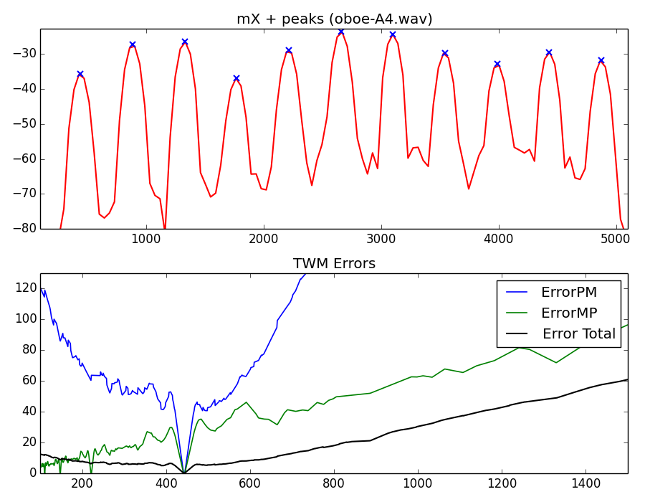
Notes:
and let's see these error functions for a particular sound, our already used oboe sound.
...

Slide 17
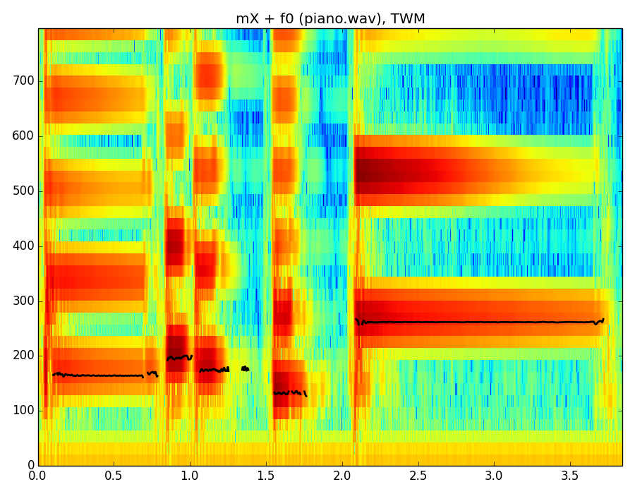
Notes:
Here we see the found fundamental frequency of a piano phrase using the two-way mismatch algorithm.
...
In polyphonic signals this is much harder.

Slide 18
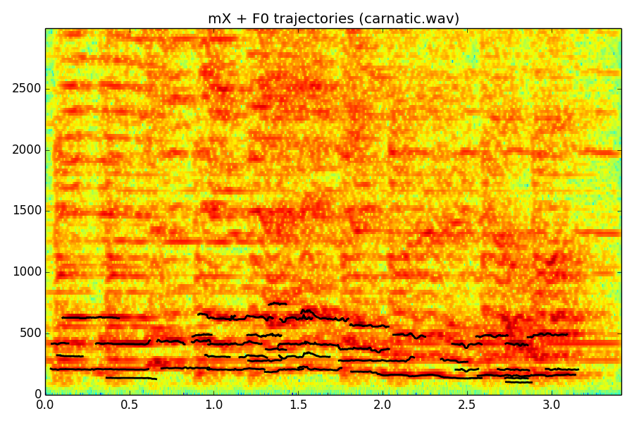
F0 in polyphonic signals
Notes:
A polyphonic signals can have many sounds sources, both harmonic and inharmonic.
The idea in F0 detection in polyphonic signals is to identify the fundamental frequencies of all the harmonic instruments that are playing together. Thus to find all the harmonic series that are present at every frame.
...

Slide 19
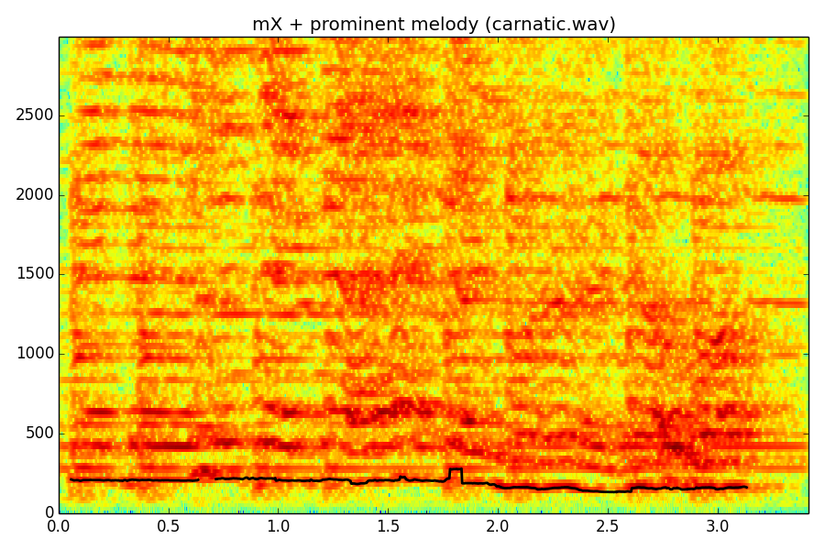
Prominent pitch in polyphonic signals
(Salamon and Gómez, 2012)
Notes:
We will not go into the details of any algorithm but let me show the results of one of them.
...

Slide 20
References and credits
More information in:
  http://en.wikipedia.org/wiki/Fundamental_frequency
  http://en.wikipedia.org/wiki/Pitch_detection_algorithm
  http://en.wikipedia.org/wiki/Autocorrelation
F0 detection algorithms:
  A. de Cheveigné and H. Kawahara. “YIN, a fundamental frequency estimator for speech and music,” J. Acoust. Soc. Am. 111, 1917 (2002).
  R. C. Maher and J. W. Beauchamp, “Fundamental frequency estimation of musical signals using a Two-Way Mismatch procedure,” J. Acoust. Soc. Am., vol. 95., no. 4, pp. 2254-2263 (1994).
  J. Salamon and E. Gómez, "Melody extraction from polyphonic music signals using pitch contour characteristics," IEEE Transactions on Audio, Speech, and Language Processing, vol. 20, no. 6, pp. 1759–1770 (2012).
Sounds from: http://www.freesound.org/people/xserra/packs/13038/
Slides and code released using the CC Attribution-Noncommercial-Share Alike license or the Affero GPL license and available from https://github.com/MTG/sms-tools
Notes:
The best references for the algorithms that I mentioned in this class are the original articles in which they were proposed.
...

Slide 21
6T2: Fundamental frequency detection
Xavier Serra
Universitat Pompeu Fabra, Barcelona
&
Stanford University
Notes:
In this lecture we have presented different approaches to the problem of fundamental frequency detection.
This is a research problem that has not been completely solved yet, specially for complex signals. In order to not make things too complicated we will focus on monophonic signals, but the concepts that we will explain should work for any type of signal.
By combining the harmonic model that I presented in the previous lecture with the f0 detection just presented we can analyze and synthesize harmonic signals. But things are not finished yet.... see you in the next lecture for a discussion on methods that go beyond this.

