Slide 1
9T2: Sound/music description
Xavier Serra
Universitat Pompeu Fabra, Barcelona
&
Stanford University
Notes:
Welcome back...
This week we are talking about the application of audio analysis in the description of sounds.
In the last lecture we talked about audio features, presenting various spectral-based analysis methods with which we can obtain features of a sound that might be relavant for descriving it.
In this lecture we want to go beyond the idea of describing single sounds and introduce the concept of descriving collections of sounds.

Slide 2
Index
Introduction: music information plane
Description of sound recordings
Description of sound collections
Description of music recordings
Description of music collections
Notes:
We will first present the idea of the music information plane, and then we will distinguish between sounds and music, with the aim of developing methodologies that are either relevant to the more generic concept of sound or to the more specific concept of music.
We will first talk about sounds ...

Slide 3
Introduction: music information plane
cognitive | emotion, music style, semantic concepts
formal | melody, key, tonality | rhythmic patterns, tempo, meter | instrument, voice | articulation
perceptual | successive and simultaneous intervals | time (beat) | timbre (spectral envelope) | dynamics
sensorial | pitch | time | timbre | loudness
physical | frequency | duration (onset) | spectrum (centroid) | intensity
Notes:
This is the music information plane to understand what we mean by music description in our context.
We consider different abstraction levels, starting from the physical level, the lowest one, and going up towards the cognitve level.
At the physical level ...

Slide 4
Description of sound recordings
Timbre related features: spectral centroid, MFCC, high-frequency content, spectral flux, spectral flatness, spectral contrast, spectral entropy, ...
Dynamics related features: loudness, average level, ..
Pitch related features: pitch, pitch salience, ...
Morphological features: envelope, onset rate, ...
Notes:
We focus on the lower levels of description, hopefully reseaching a high enough level that is of relevance to user applications.
If we want to describe sounds in a generic way, sounds like the ones we find in freesound, we can group the audio features that we talked about in the last lecture into different types of categories.
.....
From these descriptions, what is interesting now is how to describe collections of sounds.

Slide 5
Description of sound collections
Similarity between sounds
Clustering of sounds
Classification of sounds
Notes:
When we talk about sound collections, there are many things that we could analyze and describe. We will focus on three concepts.

Slide 6
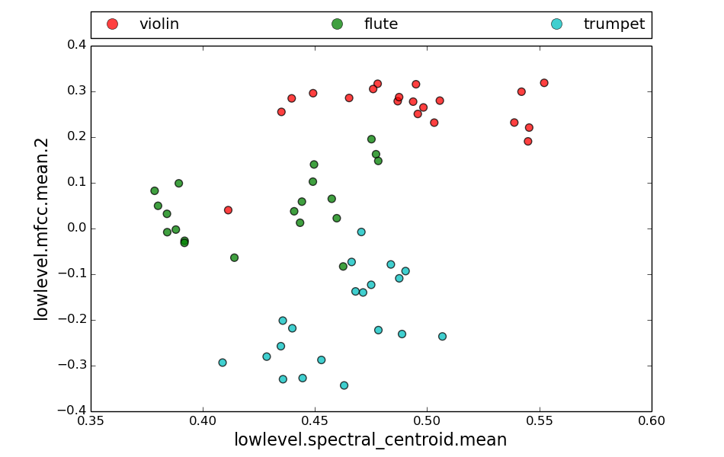
Sound collections
Notes:
We consider a sound as a set of audio features, each feature having a numerical value.
In order to properly describe a sound we have to use many features, but for clarity let's simplify it.
If we consider two features for every sound we can plot a collection of sounds as points in a 2 dimensional space. Each feature being one dimension.

Slide 7
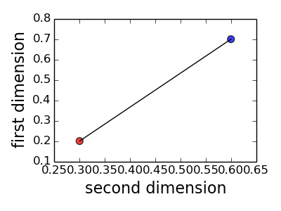
Similarity between sounds
Euclidian distance
Notes:
The most fundamental thing to measure in such a sound space is the distance between sounds, that is, the distance between points in the space.

Slide 8
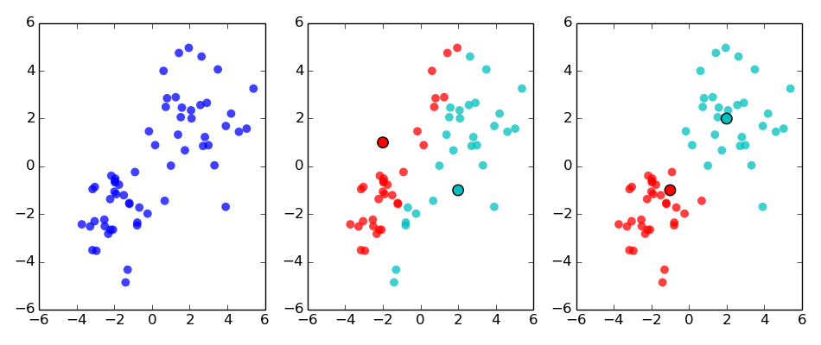
Clustering of sounds
K-means
Notes:
Once we know how to measure the distance between sounds, we can cluster the sounds.
K-means is a clustering algorithm. If we give to the algorithm the desired number of clusters it will create the cluster and return the mean value of each one.
k-means clustering aims to partition n observations into k clusters, in which each observation belongs to the cluster with the nearest mean. This mean serves as a prototype of the cluster.
The problem is computationally difficult (NP-hard); however, there are efficient heuristic algorithms that are commonly employed and that converge quickly to a local optimum.

Slide 9
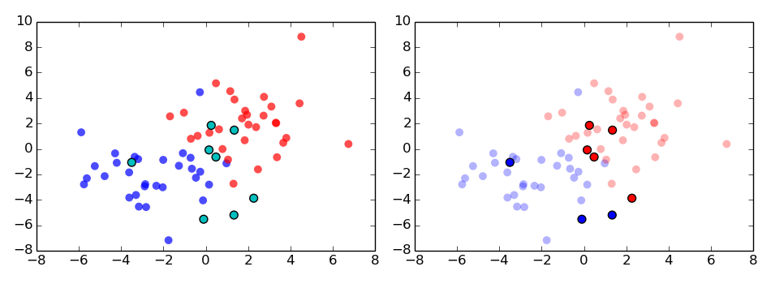
Classification of sounds
K nearest neighbors classifier (KNN)
target
examples
N target
class labels
K
class
label
query
compute
distance
sort
distance
take top
results
take majority
vote
Notes:
K nearest neighbors classifer, KNN, is an algorithm used for classification.
The KNN rule classifies a sound by assigning to it the class that is most frequently represented among the k nearest samples.

Slide 10
Description of music recordings
Timbre related descriptors: Instrument characterization; Instrumentation characterization; Remixing characterization, ...
Melody/harmony related descriptors: Motive, phrase patterns; Tonic, chords, key, mode, raga, makam, ....
Rhythm related descriptors: Rhythmic pattern; Beat, tempo, downbeat, measure, metric cycle,...
Structure related descriptors: Sections, movements, ...
Notes:
If we now go to musical sounds,recordings of pieces of music, the features to be analyzed should be more specific and more related to musically meaningful concepts.
We start by defining categories of features, or descriptors, that are relevant musically.
...
These descriptors cannot be obtained by just performing audio analysis. We normally start from audio features, but then we have to develop models, from a combination of features, that can capture the essence of each concept. This is beyond the aim of this class.

Slide 11
Description of music collections
Musical facets similarity
  Rhythm similarity
  Instrumentation similarity
  Melodic similarity
  Harmonic similarity
  Structural similarity
  ...
Classification based on musical concepts
  Genre, style
  Artists, school
  ...
Notes:
If we go to music collection it is even harder.
The description of music collections can be very complex if we want to do musically relevant tasks. This is a very active research topic within the Music Information Retrieval field.
The concept of similarity has to be taken to a musical level.

Slide 12
References and credits
http://en.wikipedia.org/wiki/Music_information_retrieval
http://en.wikipedia.org/wiki/Euclidean_distance
http://en.wikipedia.org/wiki/K-means_clustering
http://en.wikipedia.org/wiki/K-nearest_neighbors_algorithm
Slides and code released using the CC Attribution-Noncommercial-Share Alike license or the Affero GPL license and available from https://github.com/MTG/sms-tools
Notes:
Given that this is an open research problem, the references come from research papers, typically from the MIR field.

Slide 13
9T2: Sound/music description
Xavier Serra
Universitat Pompeu Fabra, Barcelona
&
Stanford University
Notes:
In this lecture we have opened the door into a huge research field that aims at automatically describing and organizing large collections of sounds and music recordings.
We just introduced some of the basic concepts and specfic methodologies that can be used to start working on this topic.
In the programming lectures we will show examples of how to actually do some of all this, but clearly we cannot make justice to this field of research.
However I hope you got a taste of it.

