Slide 1
Audio Signal Processing for
Music Applications: Introduction
Xavier Serra
Universitat Pompeu Fabra, Barcelona
Notes:
Welcome everyone to this first lecture of the course on Audio Signal Processing for Music Applications!!
I will give an overview of what we understand for audio signal processing, giving the broad context to the more specific topics that we will cover in the course.

Slide 2
Index
What is audio signal processing?
Applications:
  storage, level compression, data compression, enhancement, effects and transformations, synthesis, description.
Notes:
I will first define audio signal processing and then go over the most common applications of interest to music that are based on signal processing techniques.
...

Slide 3
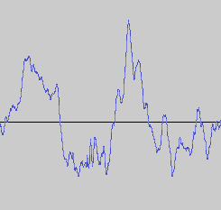
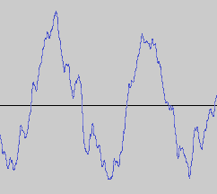
What is audio signal processing?
Definition: intentional alteration of sound
Control
Audio signal
processing
system
Notes:
We define audio signal processing as the engineering field that focuses on the computational methods for intentionally altering sounds.
...
Since audio signals may be electronically represented in either digital or analog format, signal processing may occur in either domain. Analog processors operate directly on the electrical signal, while digital processors operate mathematically on the binary representation of that signal.

Slide 4
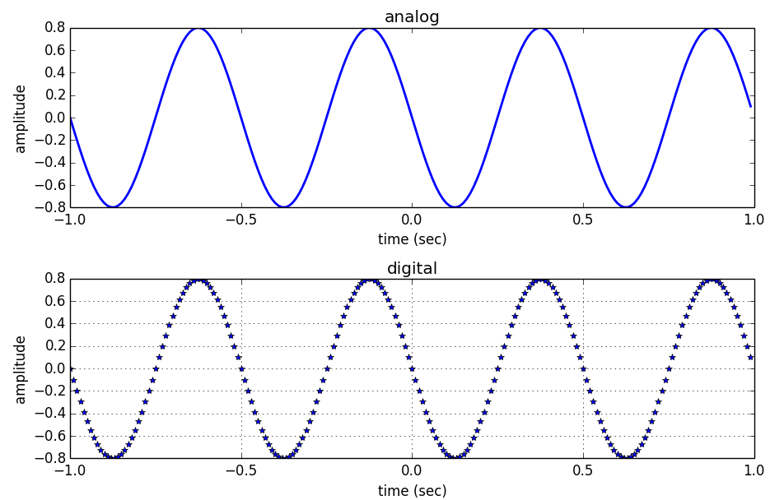
Analog versus digital signals
Notes:
An analog sound is usually electrical; a voltage level representing the air pressure waveform of the sound. Thus it is a continuous function, like the one shown in this top plot.
On the other hand, a digital representation expresses the pressure waveform as binary numbers, thus it is a discrete function, like the one shown in this bottom plot.
The digital representation permits the use of microprocessors and computers. Although the conversion from analog to digital can be prone to loss, most modern audio systems use this approach because the techniques of digital signal processing are much more powerful and efficient than the ones based on analog techniques.

Slide 5
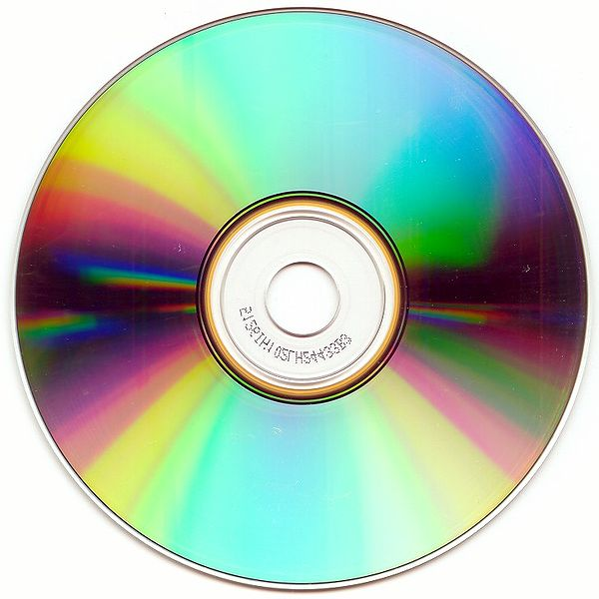
Applications: Storage
http://commons.wikimedia.org/wiki/File:CD-ROM.png
Notes:
Now let's start going through the applications of audio signal processing.
One such application is the storage of sounds, thus their recording and reproduction.
The digital representation of sound waves, such as spoken voice, environmental sounds or music can be recorded as electrical or mechanical inscriptions in a media and can then be recreated from these inscriptions.
However this is a topic that is not so relevant for our course, so I will not go into it any further.

Slide 6
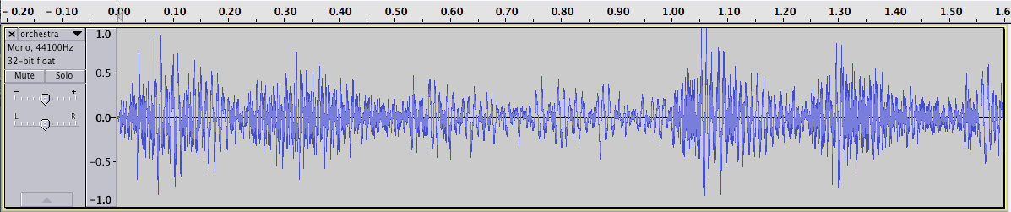
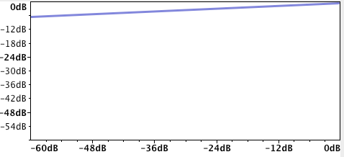
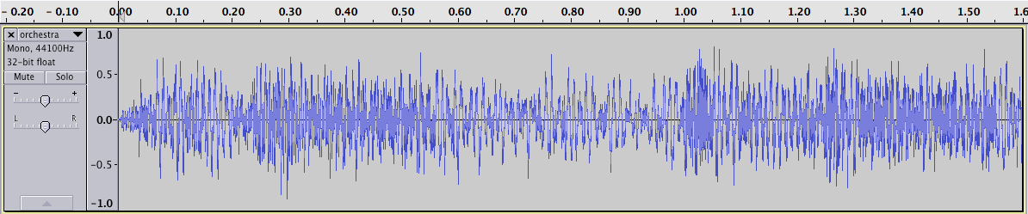
Applications: Level compression
[using Audacity]
Notes:
Another common audio signal processing application is dynamic level compression.
This is a process that reduces the dynamic range of an audio signal, that is, it narrows the difference between high and low audio levels or amplitudes.
...
Level compression is commonly used during sound recording, live sound reinforcement, and broadcasting.
Again this is a topic that we will not emphasize in this course.

Slide 7


Applications: Data compression
perceptual
audio coder
http://commons.wikimedia.org/wiki/File:Gnome-mime-audio-x-mp3.png
http://commons.wikimedia.org/wiki/File:Gnome-mime-audio-x-wav.png
Notes:
Another signal processing application is data compression, or also called audio coding.
The goal here is to reduce the bandwidth requirement of digital audio streams and the storage size of audio files.
There are two types of compression techniques, the ones called lossless, which do not lose any information, and the ones called lossy, in which some information is lost, but hopefully the information lost is not perceptually relevant.
...
In this course we will not discuss this application, but a number of the basic techniques that we will cover are very much behind audio compression systems.

Slide 8
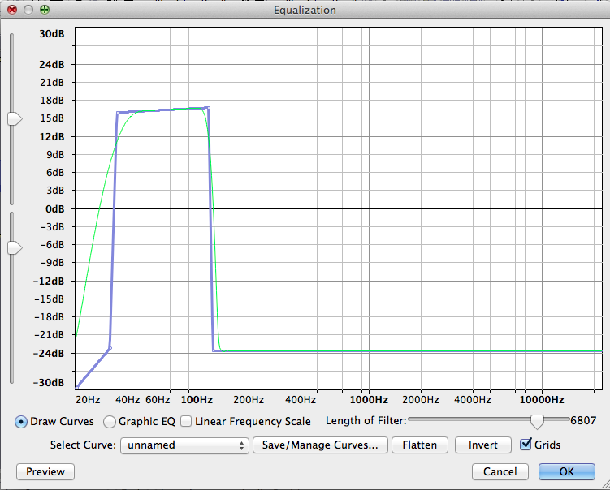
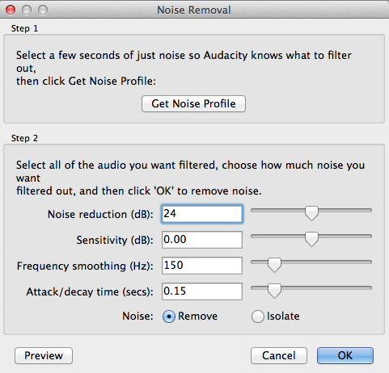
Applications: Enhancement
[using Audacity]
Notes:
Sound enhancement is another application, which is a process that aims to improve the quality of a sound.
Such quality improvements can be done by filtering, equalizing, canceling the noise background, or removing echo or reverberation.
...
Again this is a topic that we will not directly cover but that uses a number of the basic methods that we will describe.

Slide 9
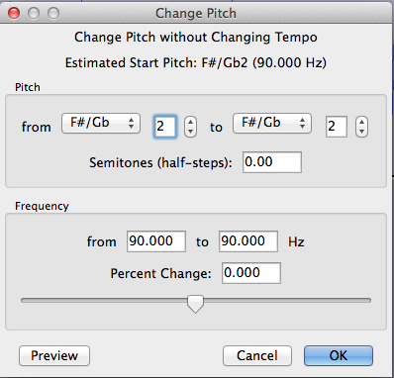
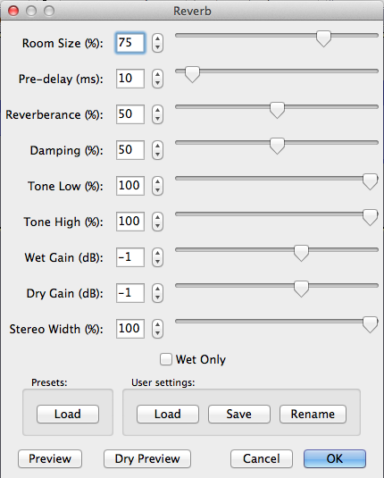
Applications: Transformations
[using
Audacity]
Others: Echo, Reverb, Flanger, Phaser,
Chorus, Pitch shift, Time stretching,
Voice effects, 3D audio effects, Morphing, ....
Notes:
A large group of applications relate to performing sound transformations. This type of applications are used in post-production and in other more creative usages.
...
In this course we will target quite a few of these applications and most of the methods explained have a lot of possibilities in this area.

Slide 10


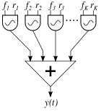
Applications: Synthesis
Subtractive synthesis
FM synthesis
Others: Granular synthesis,
Physical modeling, Waveshaping,
Sampling and Spectral synthesis, ...
http://commons.wikimedia.org/wiki/File:Karplus-strong-schematic.png
http://commons.wikimedia.org/wiki/File:2op_FM.svg
http://commons.wikimedia.org/wiki/File:Additive_synthesis.svg
Additive synthesis
Notes:
One of the traditional uses of signal processing is related to sound synthesis, thus with the aim to generate sounds, either by imitating existing sounds or for creating new timbres.
...
We will develop and use some of these techniques in our course, specially additive and subtractive synthesis.

Slide 11
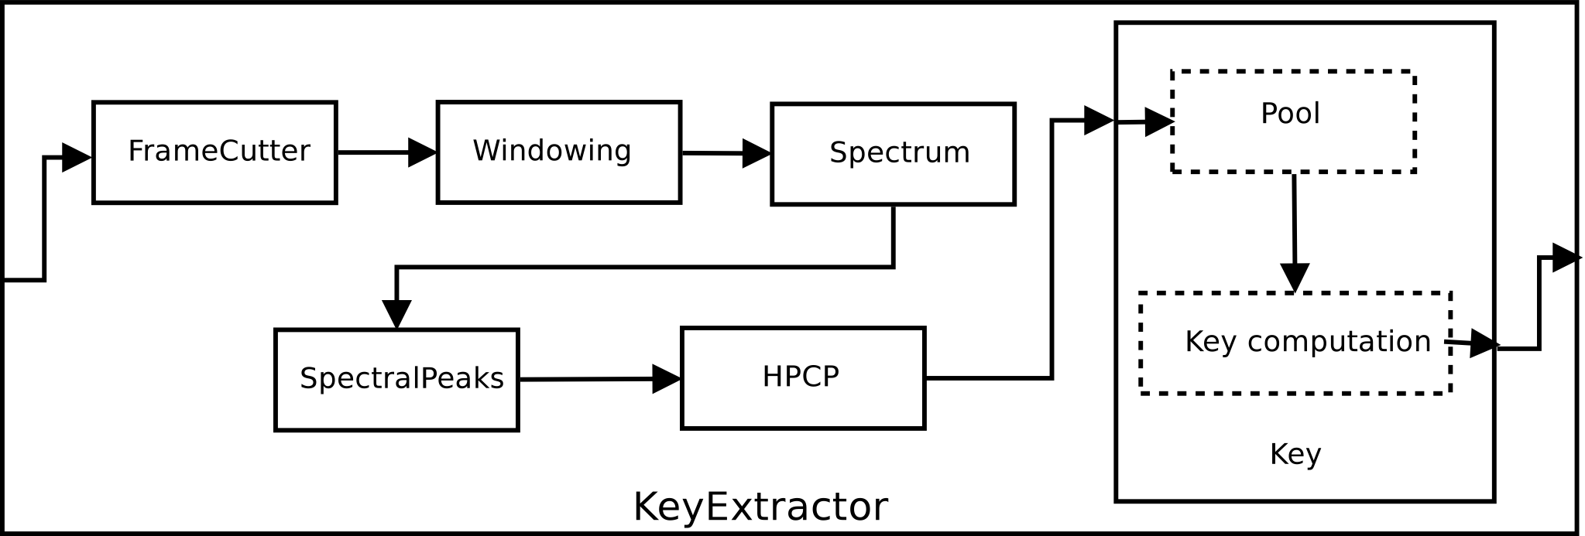
Applications: Description
Low-level: loudness, timbre, pitch, ..
Mid-level: rhythm, harmony, melody, …
High-level: genre, emotions, similarity, …
Notes:
The last group of applications that I will mention in this lecture are related to sound description; techniques that aim to analyze a sound signal with the goal to describe and model meaningful characteristics of the sound.
This is a topic that has expanded enormously in the last few years and that is very relevant in the field of information retrieval.
...
The automatic description of sounds will be an important application for this course. We will not be able to go over the extraction of mid and high level features of a signal, but the discussions that we will have on the analysis of low level features are at the basis of the general topic of sound and music description.
This is all for applications.

Slide 12
References and credits
More information on this topic in Wikipedia:https://en.wikipedia.org/wiki/Audio_signal_processing
Sounds used taken from Freesound: http://www.freesound.org/people/xserra/packs/13038/
Some examples generated using Audacity: http://audacity.sourceforge.net
All slides and code produced for this course are released using the CC Attribution-Noncommercial-Share Alike license or the Affero GPL license and available from https://github.com/MTG/sms-tools
Notes:
I want to finish by mentioning that all the materials I will use and produce in this course are available under open licenses.
...

Slide 13
Audio Signal Processing for
Music Applications: Introduction
Xavier Serra
Universitat Pompeu Fabra, Barcelona
Notes:
This is all for this first lecture. I have done a quick overview of the field of audio signal processing, too bad that we will not be able to cover everything.
From now on we will focus on several core signal processings methodologies and we will exemplify them within a few music application areas.
I hope I have been able to interest you in following the course.
Thanks for you attention!!

