Slide 1
Fourier Transform theorems and properties
Xavier Serra
Music Technology Group
Universitat Pompeu Fabra, Barcelona
http://mtg.upf.edu

Slide 2
Index
Linearity
Shift
Evenness
Convolution
Phase unwrapping
Zero padding
Power & amplitude in dB
Fast Fourier Transform (FFT)
FFT and zero-phase

Slide 3
Linearity

Slide 4
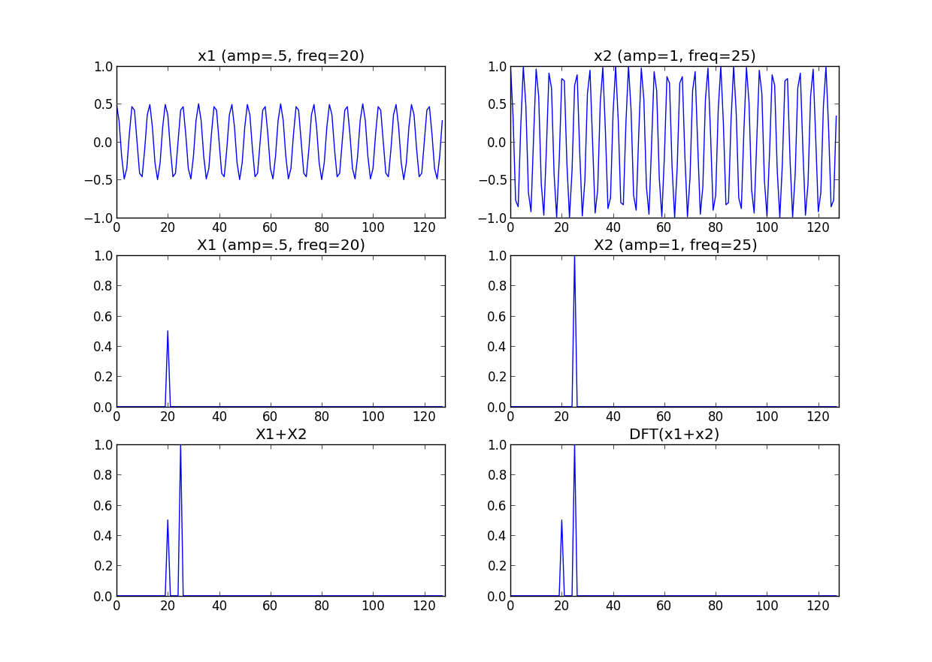

Slide 5
import matplotlib.pyplot as plt
import numpy as np
from scipy.fftpack import fft, ifft
a = 0.5
b = 1.0
k1 = 20
k2 = 25
N = 128
x1 = a*np.exp(1j*2*np.pi*k1/N*np.arange(N))
x2 = b*np.exp(1j*2*np.pi*k2/N*np.arange(N))
plt.subplot(321)
plt.plot(np.arange(0, N, 1.0), np.real(x1))
plt.subplot(322)
plt.plot(np.arange(0, N, 1.0), np.real(x2))
X1 = fft(x1)
mX1 = abs(X1)/N
plt.subplot(323)
plt.plot(np.arange(0, N, 1.0), mX1)
X2 = fft(x2)
mX2 = abs(X2)/N
plt.subplot(324)
plt.plot(np.arange(0, N, 1.0), mX2)
plt.subplot(325)
plt.plot(np.arange(0, N, 1.0), mX1+mX2)
X = fft(x1+x2)
mX= abs(X)/N
plt.subplot(326)
plt.plot(np.arange(0, N, 1.0), mX)

Slide 6
Shift

Slide 7
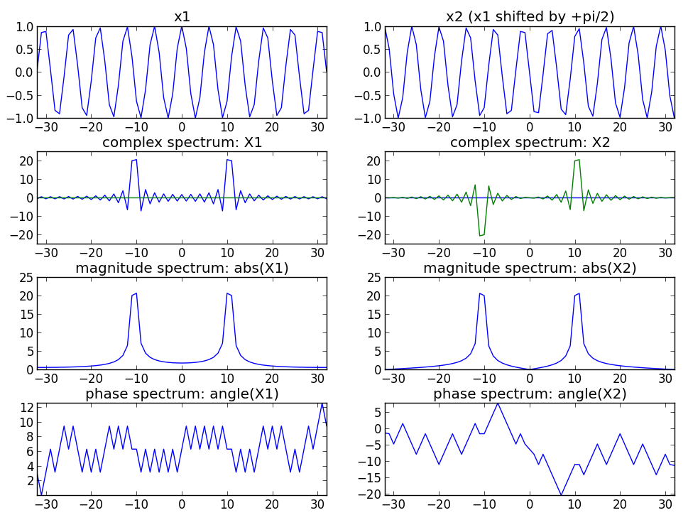

Slide 8
import numpy as np
import matplotlib.pyplot as plt
N = 64
k0 = 10.5
x = np.cos(2*np.pi*k0/N*np.arange(-N/2, N/2+1))
plt.subplot(4,2,1)
plt.plot(np.arange(-N/2, N/2+1), x)
for k in range(-N/2, N/2+1):
s = np.exp(1j*2*np.pi*k/N*np.arange(-N/2, N/2+1))
X = np.append(X, sum(x*np.conjugate(s)))
plt.subplot(4,2,3)
plt.plot(np.arange(-N/2, N/2+1), np.real(X))
plt.plot(np.arange(-N/2, N/2+1), np.imag(X))
plt.subplot(4,2,5)
plt.plot(np.arange(-N/2, N/2+1), abs(X))
plt.subplot(4,2,7)
plt.plot(np.arange(-N/2, N/2+1), np.angle(X))
X = np.array([])
x = np.cos(2*np.pi*k0/N*np.arange(-N/2, N/2+1)+np.pi/2)
plt.subplot(4,2,2)
plt.plot(np.arange(-N/2, N/2+1), x)
for k in range(-N/2, N/2+1):
s = np.exp(1j*2*np.pi*k/N*np.arange(-N/2, N/2+1))
X = np.append(X, sum(x*np.conjugate(s)))
plt.subplot(4,2,4)
plt.plot(np.arange(-N/2, N/2+1), np.real(X))
plt.plot(np.arange(-N/2, N/2+1), np.imag(X))
plt.subplot(4,2,6)
plt.plot(np.arange(-N/2, N/2+1), abs(X))
plt.subplot(4,2,8)
plt.plot(np.arange(-N/2, N/2+1), np.angle(X))

Slide 9
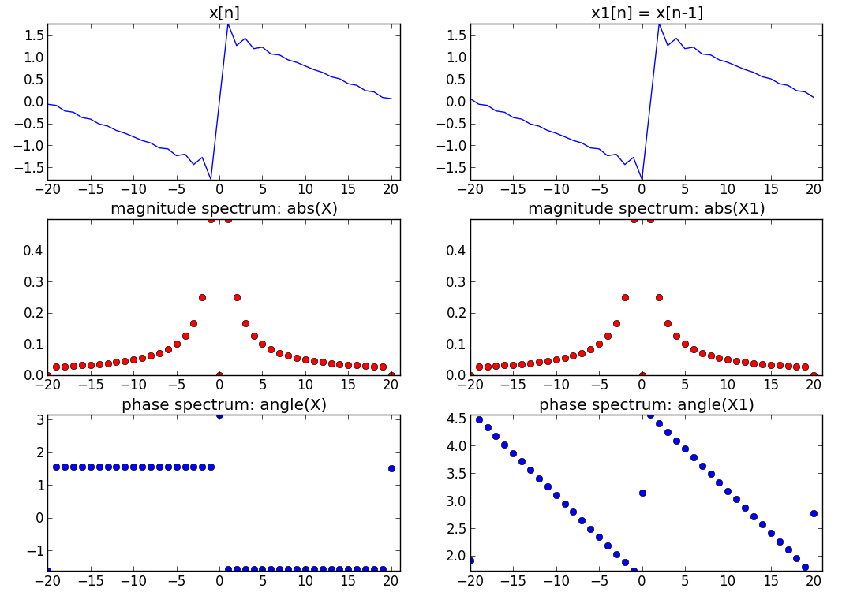

Slide 10
import numpy as np
import matplotlib.pyplot as plt
from scipy.fftpack import fft, fftshift
N = 41
nsines = 20
for k in range(1,nsines):
x = x + (1.0/k)*np.sin(2*np.pi*k/N*np.arange(-(N-1)/2.0, (N+1)/2.0))
plt.subplot(3,2,1)
plt.plot(np.arange(-(N-1)/2.0,(N+1)/2), x)
for k in range(N):
s = np.exp(1j*2*np.pi*k/N*np.arange(-(N-1)/2.0, (N+1)/2.0))
X = np.append(X, sum(x*np.conjugate(s)))
plt.subplot(3,2,3)
plt.plot(np.arange(-(N-1)/2.0,(N+1)/2), abs(fftshift(X))/N, 'ro')
plt.subplot(3,2,5)
plt.plot(np.arange(-(N-1)/2.0,(N+1)/2), np.angle(fftshift(X)), 'bo')
for k in range(1,nsines):
x = x + (1.0/k)*np.sin(2*np.pi*k/N*np.arange(-(N-1)/2.0-1, (N+1)/2.0-1))
plt.subplot(3,2,2)
plt.plot(np.arange(-(N-1)/2.0,(N+1)/2), x)
for k in range(N):
s = np.exp(1j*2*np.pi*k/N*np.arange(-(N-1)/2.0, (N+1)/2.0))
X = np.append(X, sum(x*np.conjugate(s)))
plt.subplot(3,2,4)
plt.plot(np.arange(-(N-1)/2.0,(N+1)/2), abs(fftshift(X))/N,'ro')
plt.subplot(3,2,6)
plt.plot(np.arange(-(N-1)/2.0,(N+1)/2), np.unwrap(np.angle(fftshift(X))),'bo')

Slide 11
Evenness

Slide 12
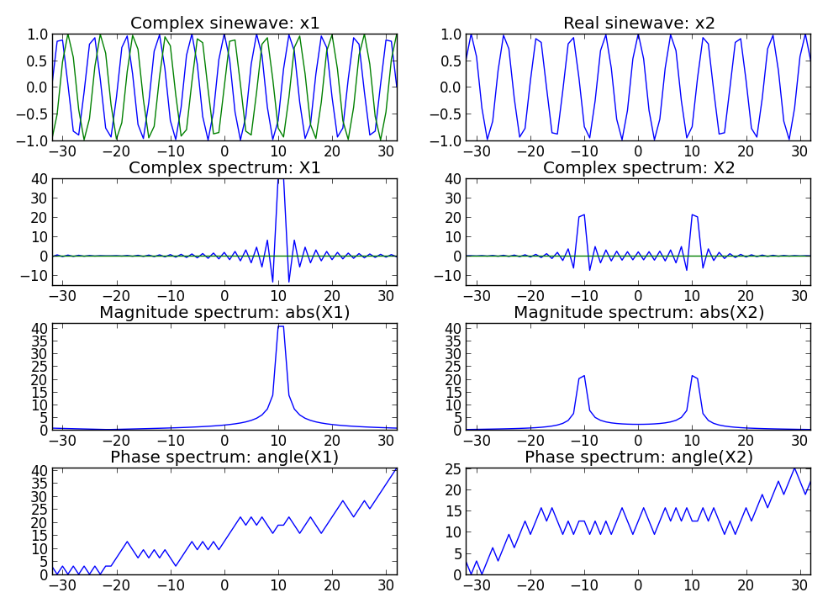

Slide 13
mport numpy as np
import matplotlib.pyplot as plt
N = 64
k0 = 10.5
x = np.exp(1j*2*np.pi*k0/N*np.arange(-N/2, N/2+1))
plt.subplot(4,2,1)
plt.plot(np.arange(-N/2, N/2+1), np.real(x))
plt.plot(np.arange(-N/2, N/2+1), np.imag(x))
for k in range(-N/2, N/2+1):
s = np.exp(1j*2*np.pi*k/N*np.arange(-N/2, N/2+1))
X = np.append(X, sum(x*np.conjugate(s)))
plt.subplot(4,2,3)
plt.plot(np.arange(-N/2, N/2+1), np.real(X))
plt.plot(np.arange(-N/2, N/2+1), np.imag(X))
plt.subplot(4,2,5)
plt.plot(np.arange(-N/2, N/2+1), abs(X))
plt.subplot(4,2,7)
plt.plot(np.arange(-N/2, N/2+1), np.angle(X))
x = np.cos(2*np.pi*k0/N*np.arange(-N/2, N/2+1))
plt.subplot(4,2,2)
plt.plot(np.arange(-N/2, N/2+1), x)
for k in range(-N/2, N/2+1):
s = np.exp(1j*2*np.pi*k/N*np.arange(-N/2, N/2+1))
X = np.append(X, sum(x*np.conjugate(s)))
plt.subplot(4,2,4)
plt.plot(np.arange(-N/2, N/2+1), np.real(X))
plt.plot(np.arange(-N/2, N/2+1), np.imag(X))
plt.subplot(4,2,6)
plt.plot(np.arange(-N/2, N/2+1), abs(X))
plt.subplot(4,2,8)
plt.plot(np.arange(-N/2, N/2+1), np.angle(X))

Slide 14
Convolution

Slide 15
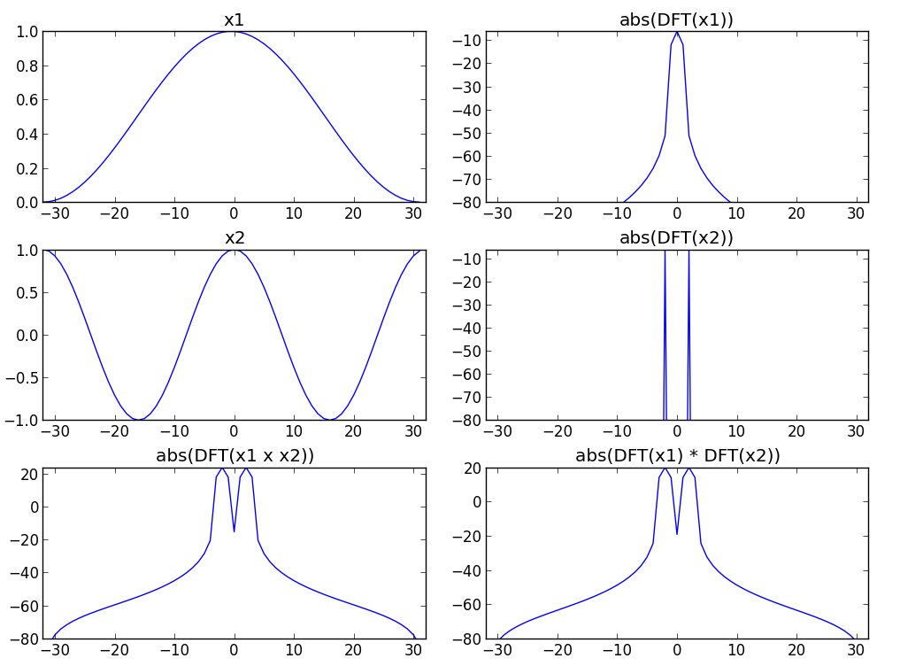

Slide 16
import matplotlib.pyplot as plt
import numpy as np
from scipy.fftpack import fft, fftshift
M = 64
N = 512
x1 = np.hanning(M)
x2 = np.cos(2*np.pi*2/M*np.arange(M))
y1 = x1*x2
mY1 = 20 * np.log10(np.abs(fftshift(fft(y1, M))))
plt.subplot(3,2,1)
plt.plot(x1)
plt.subplot(3,2,3)
plt.plot(x2)
plt.subplot(3,2,5)
plt.plot(mY)
Y2 = np.convolve(fftshift(fft(x1, M)), fftshift(fft(x2, M)))
mY2 = 20 * np.log10(np.abs(Y2))
mX1 = 20 * np.log10(np.abs(fftshift(fft(x1, M)))/M)
mX2 = 20 * np.log10(np.abs(fftshift(fft(x2, M)))/M)
plt.subplot(3,2,2)
plt.plot(mX1)
plt.subplot(3,2,4)
plt.plot(mX2)
plt.subplot(3,2,6)
plt.plot(mY2[M/2:M+M/2])

Slide 17
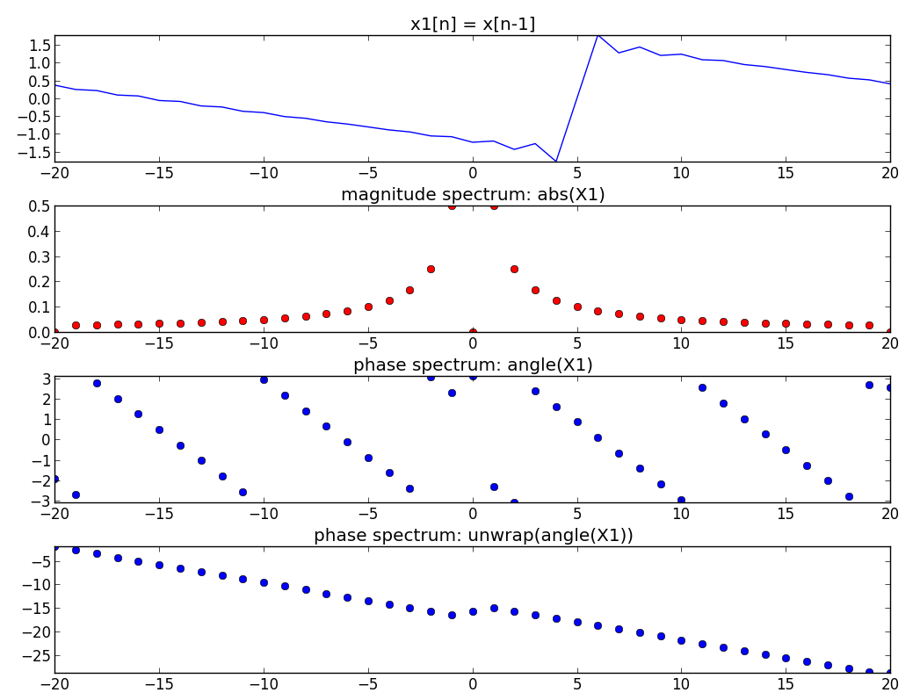
Phase unwrapping

Slide 18
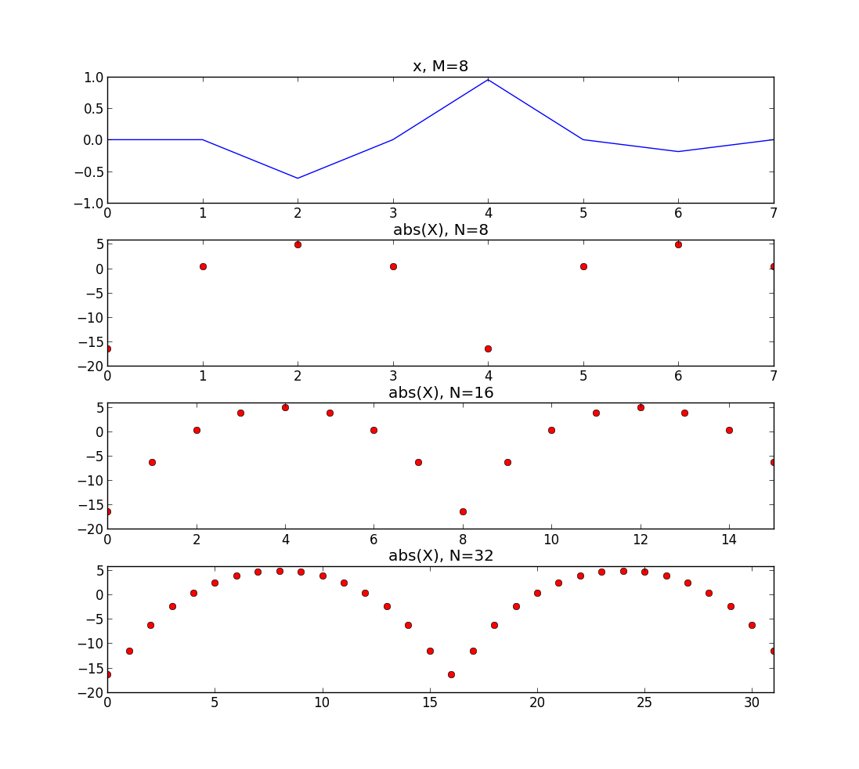
Zero-padding

Slide 19
import numpy as np
import matplotlib.pyplot as plt
from scipy.fftpack import fft, fftshift
M = 8
N1 = 8
N2 = 16
N3 = 32
x = np.cos(2*np.pi*2/M*np.arange(M)) * np.hanning(M)
plt.subplot(4,1,1)
plt.plot(x, 'b')
mX = 20 * np.log10(np.abs(fftshift(fft(x, N1))))
plt.subplot(4,1,2)
plt.plot(mX, 'ro')
mX = 20 * np.log10(np.abs(fftshift(fft(x, N2))))
plt.subplot(4,1,3)
plt.plot(mX, 'ro')
mX = 20 * np.log10(np.abs(fftshift(fft(x, N3))))
plt.subplot(4,1,4)
plt.plot(mX, 'ro')

Slide 20
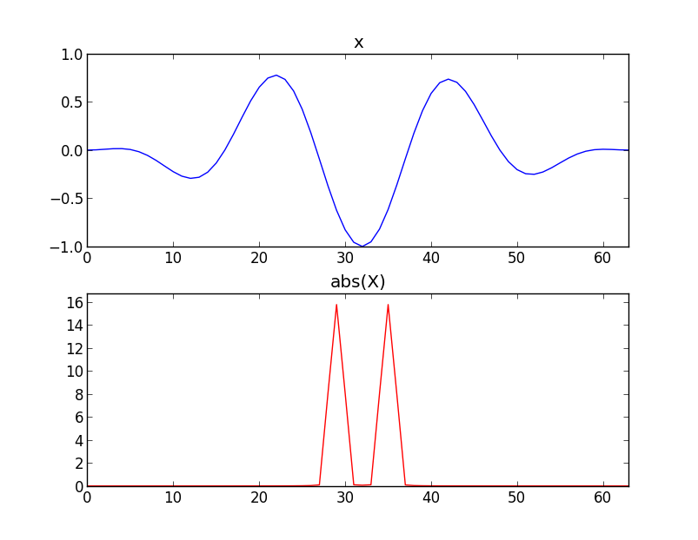
Power

Slide 21
import numpy as np
import matplotlib.pyplot as plt
from scipy.fftpack import fft, fftshift
M= 64
N = 64
x = np.cos(2*np.pi*3/M*np.arange(M)) * np.hanning(M)
plt.subplot(2,1,1)
plt.plot(x, 'b')
powerx = sum(np.abs(x)**2)
print powerx
mX = np.abs(fftshift(fft(x, N)))
plt.subplot(2,1,2)
plt.plot(mX, 'r')
powerX = sum(mX**2) / N
print powerX

Slide 22
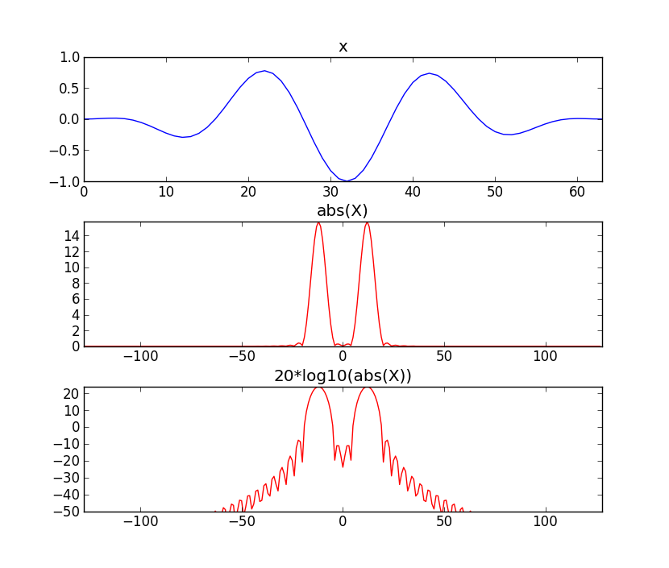
Amplitude in Decibels

Slide 23
import numpy as np
import matplotlib.pyplot as plt
from scipy.fftpack import fft, fftshift
M= 64
N = 256
x = np.cos(2*np.pi*3/M*np.arange(M)) * np.hanning(M)
plt.subplot(3,1,1)
plt.plot(x, 'b')
mX = np.abs(fftshift(fft(x, N)))
plt.subplot(3,1,2)
plt.plot(np.arange(-N/2,N/2,1), mX, 'r')
mX = 20 * np.log10(mX)
plt.subplot(3,1,3)
plt.plot(np.arange(-N/2,N/2,1), mX, 'r')

Slide 24

Fast Fourier Transform
The most common version uses the Coley-Tukey algorithm. It breaks down recursively the DFT of a power of 2 size into two pieces of size N/2.

Slide 25
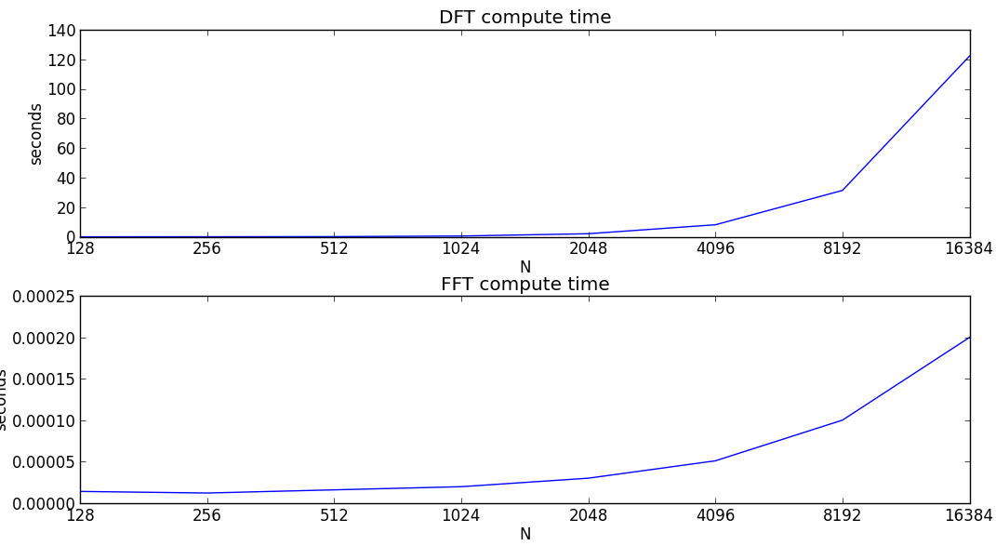
Ns = 2**np.arange(7,15)
for N in Ns:
str_time = time.time()
for k in range(N):
s = np.exp(1j*2*np.pi*k/N*np.arange(N))
X = np.append(X, sum(x*np.conjugate(s)))
timeDFT = np.append(timeDFT, time.time()-str_time)
for N in Ns:
str_time = time.time()
X = fft(x)
timeFFT = np.append(timeFFT, time.time()-str_time)

Slide 26
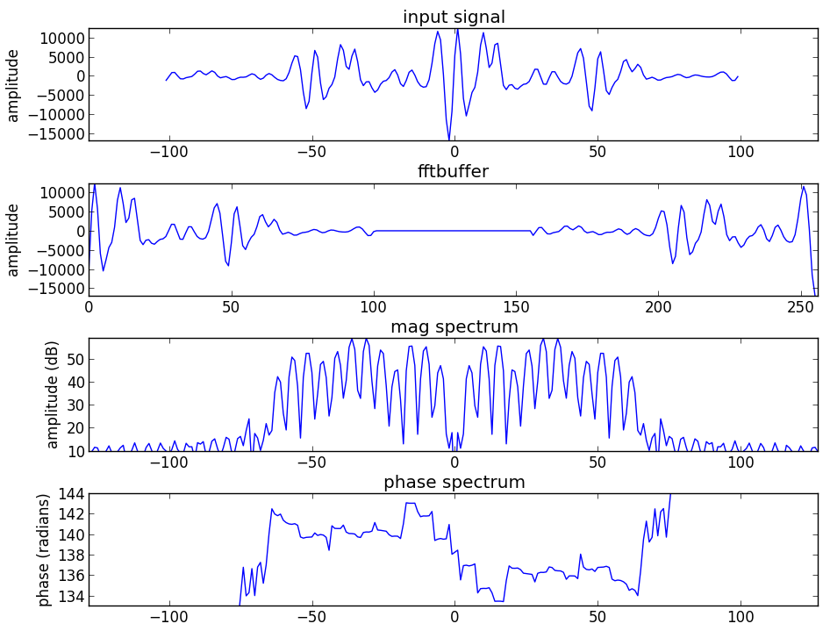
FFT and zero-phase

Slide 27
import matplotlib.pyplot as plt
import numpy as np
from scipy.io.wavfile import read
from scipy.fftpack import fft, fftshift
(fs, x) = read('oboe.wav')
N = 256
M = 201
hN = N/2
hM = (M+1)/2
start = .8*fs
xw = x[start-hM:start+hM-1] * np.hamming(M)
plt.subplot(411)
plt.plot(np.arange(-hM, hM-1), xw)
fftbuffer = np.zeros(N)
fftbuffer[:hM] = xw[hM-1:]
fftbuffer[N-hM+1:] = xw[:hM-1]
plt.subplot(412)
plt.plot(np.arange(0, N), fftbuffer)
X = fftshift(fft(fftbuffer))
mX = 20 * np.log10(abs(X)/N)
pX = np.unwrap(np.angle(X))
plt.subplot(413)
plt.plot(np.arange(-hN, hN), mX)
plt.subplot(414)
plt.plot(np.arange(-hN, hN), pX)

Slide 28
References
https://ccrma.stanford.edu/~jos/mdft/
https://en.wikipedia.org/wiki/Fast_Fourier_transform
Full code of plots and accompanying labs available at:https://github.com/MTG/sms-tools

Slide 29
Credits
All the slides of this presentation are released under an Attribution-Noncommercial-Share Alike license.

