Slide 1
4T2: The Short-Time Fourier Transform
(2 of 2)
Xavier Serra
Universitat Pompeu Fabra, Barcelona
&
Stanford University
Notes:
Welcome again to the course on Audio Signal Processing for Music Applications.
In the first part of this lecture we started talking about the Short-time Fourier transform.
Now we will continue with it.

Slide 2
Index
STFT and analysis window
Window size
FFT size
Hop size
Time-frequency compromise
Inverse STFT
STFT system
Notes:
We will cover quite a few topics, but each one is very short.
...

Slide 3
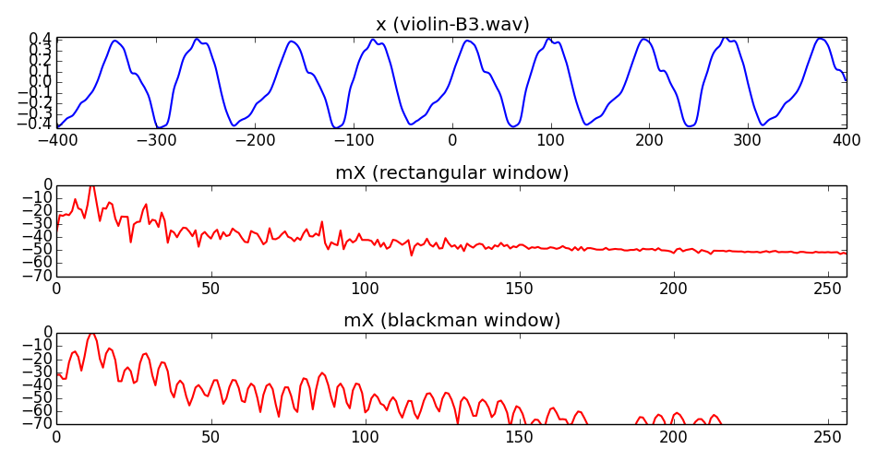
STFT and analysis window
Notes:
We saw this equation in the first part of the lecture.We now know that the STFT is the time-varying version of the DFT.
Windowing is the key concept to understand in the STFT.
...

Slide 4
STFT and analysis window
Notes:
We saw this equation in the first part of the lecture.We now know that the STFT is the time-varying version of the DFT.
Windowing is the key concept to understand in the STFT.
...

Slide 5
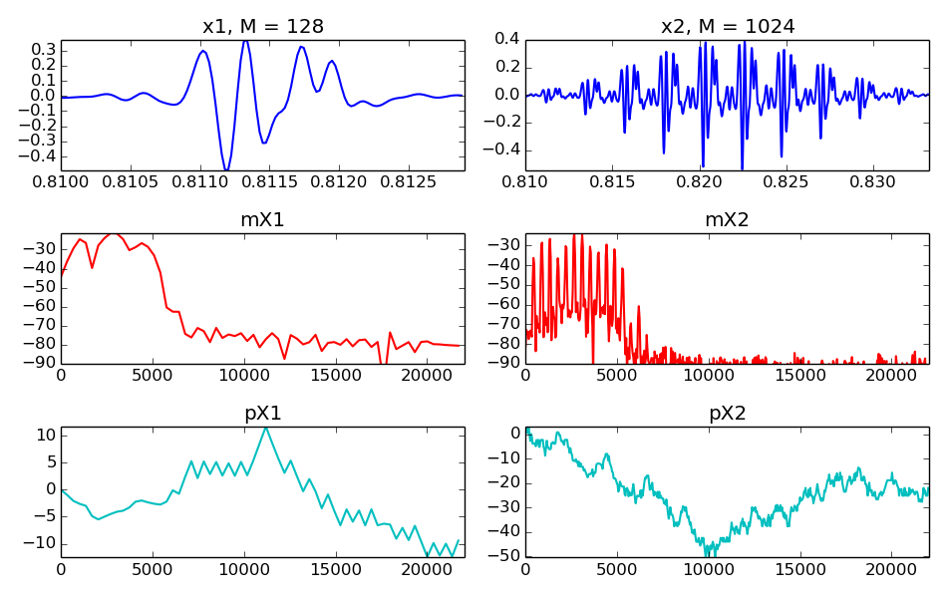
Window size
Notes:
We talked about the different types of windows in the last class.
These windows can have any size, but, what is the effect of the size?
...

Slide 6
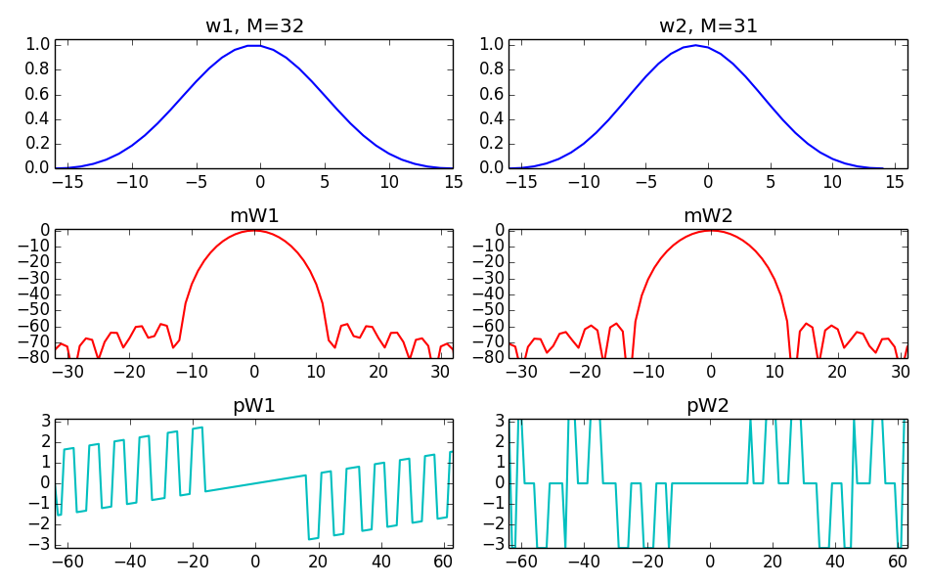
Even-odd size window
Notes:
One sample more or less in the window size has a significant effect.
...

Slide 7
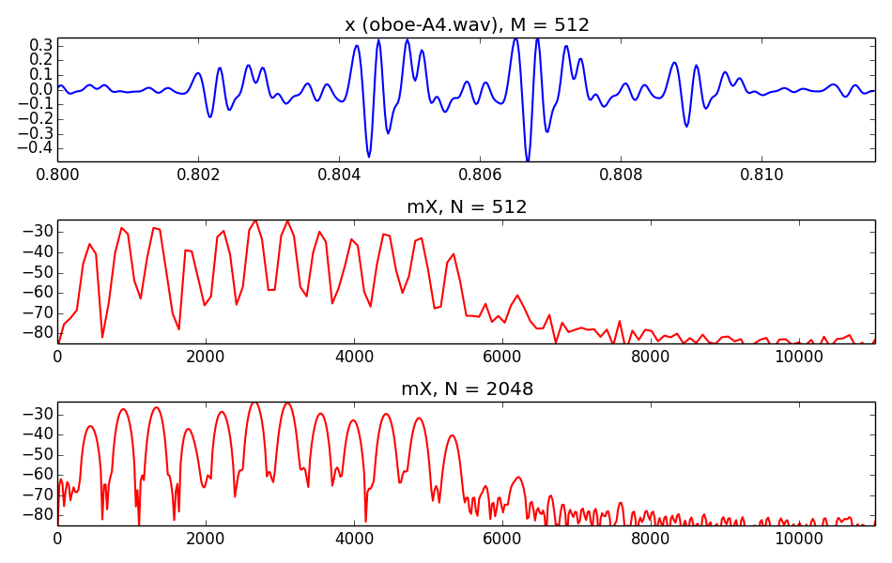
FFT size
Notes:
The window size has been chosen acording to some resolution criteria. Now we have to choose the FFT size, which has to be a power of two.
...

Slide 8
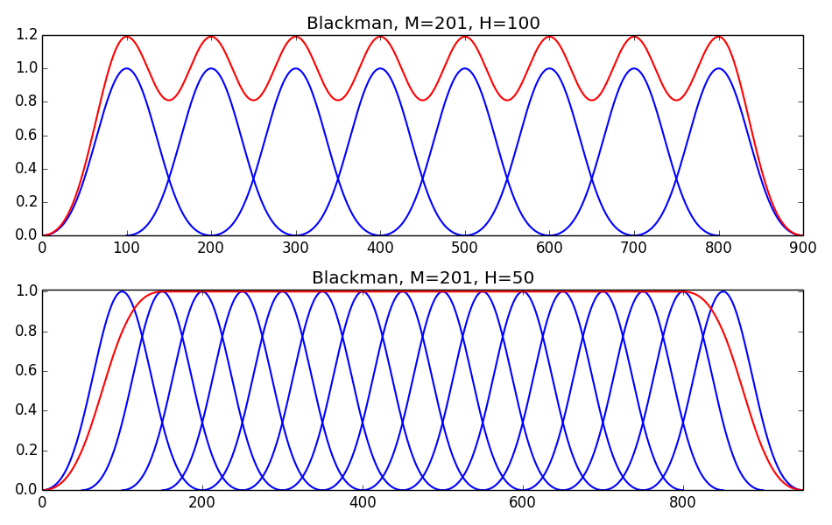
Hop size
Notes:
The final step in the STFT analysis loop, is the time advancement, the hoping.
The window advances H samples after each DFT.
...

Slide 9
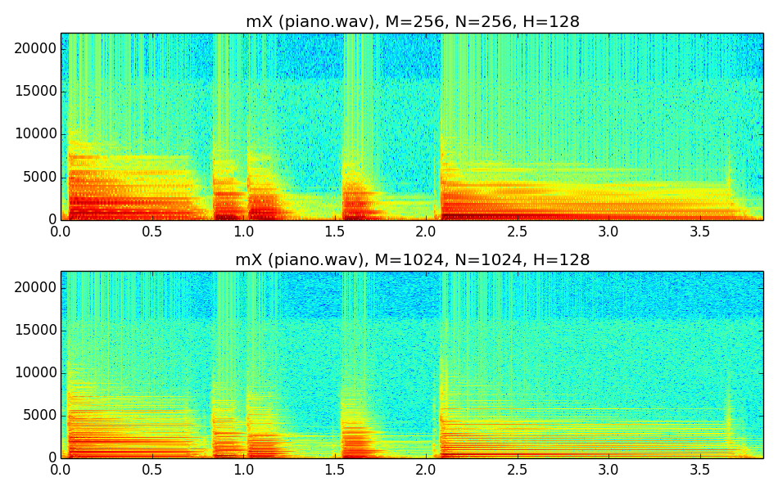
Time-frequency compromise
Notes:
Now we can put all these concepts together to analyze a real and complex signal, like a piano phrase.
Choosing all parameters in the STFT has a number of effects in the output, the most important one is what we call the time-frequency compromise.
...

Slide 10
Time-frequency compromise
Notes:
Now we can put all these concepts together to analyze a real and complex signal, like a piano phrase.
Choosing all parameters in the STFT has a number of effects in the output, the most important one is what we call the time-frequency compromise.
...

Slide 11
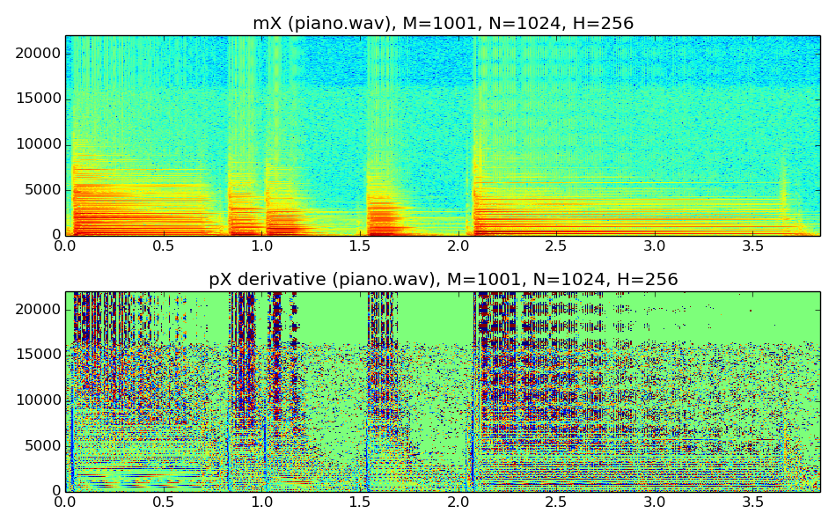
Amplitude and phase spectrogram
Notes:
Typically we only show the amplitude, or magnitude, spectrogram, but the phase has also valuable information about the sound.
....

Slide 12
Inverse STFT
each output frame is:
and the output sound is:
Notes:
Like the DFT, the STFT has the inverse transform. If we do the things right we can recover the original sound from the amplitude and phase spectrogram.
...

Slide 13

Notes:
We will add and overlap the synthesized fragments of the sound.
This is exactly the inverse process we did in the analysis.
...

Slide 14
STFT system
w[n]
x[n]
|X[k]|
yw[n]
y[n]
FFT
IFFT
Overlap-add
xw[n]
<X[k]
Notes:
Now that we know how to analyze and synthesize a sound with the STFT let's build a complete system.
This is a diagram of the complete analysis/synthesis system using the Short-time Fourier Transform.
...

Slide 15
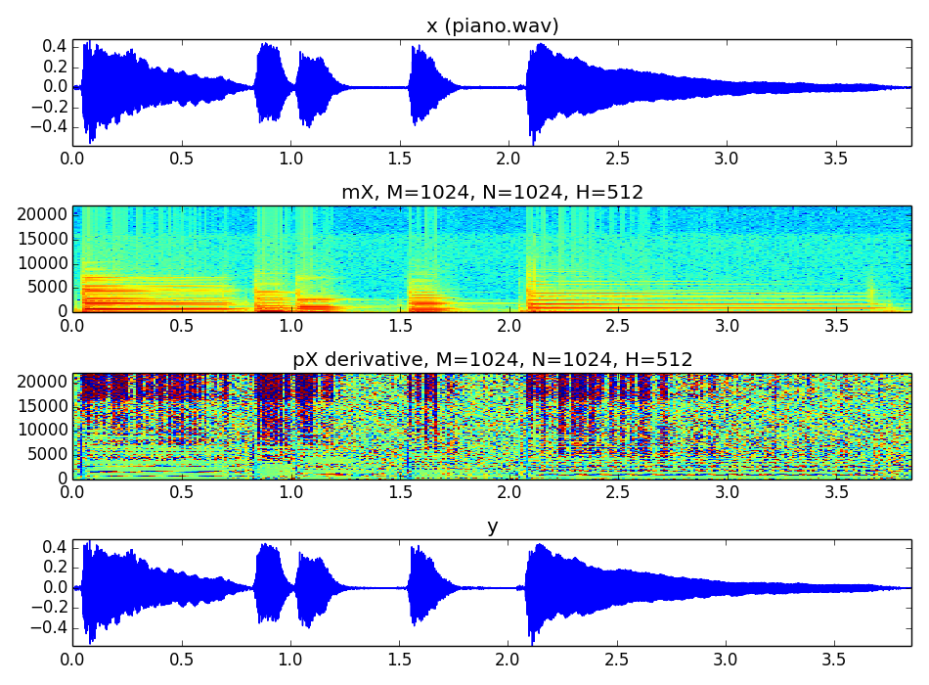
Notes:
Let's show and example.
From a complete sound, which varies in time, we can get a spectrogram, and then recover it.
...

Slide 16
Notes:
Let's show and example.
From a complete sound, which varies in time, we can get a spectrogram, and then recover it.
...

Slide 17
References and credits
More information in:
  https://en.wikipedia.org/wiki/STFT
  https://en.wikipedia.org/wiki/Window_function
  http://en.wikipedia.org/wiki/Spectrogram
Reference on the STFT by Julius O. Smith:https://ccrma.stanford.edu/~jos/sasp/
Sounds from: http://www.freesound.org/people/xserra/packs/13038/
Slides and code released using the CC Attribution-Noncommercial-Share Alike license or the Affero GPL license and available from https://github.com/MTG/sms-tools
Notes:
Again, quite a bit of references are available on this topic.
...

Slide 18
4T2: The Short-Time
Fourier Transform
(2 of 2)
Xavier Serra
Universitat Pompeu Fabra, Barcelona
&
Stanford University
Notes:
With this second part of the lecture we have completed the topic of the Short-time Fourier Transform.
We now know how to analyze and synthesize any sound.
But this is just the begining of the interesting stuff, we now will be able to do really powerfull things.
Stay with me and you will see!!

