Slide 1
5T2: Sinusoidal model
(2 of 3)
Xavier Serra
Universitat Pompeu Fabra, Barcelona
&
Stanford University
Notes:
Welcome again to the course on Audio Signal Processing for Music applications!!
This week we are talking about the sinusoidal model.
In the previous theory lecture we presented the sinusoidal model. Let's continue with that.

Slide 2
Index
Sinusoidal model
Peak detection
Time-varying sinewaves in spectrogram
Notes:
We will review again the sinusoidal model and then
...

Slide 3
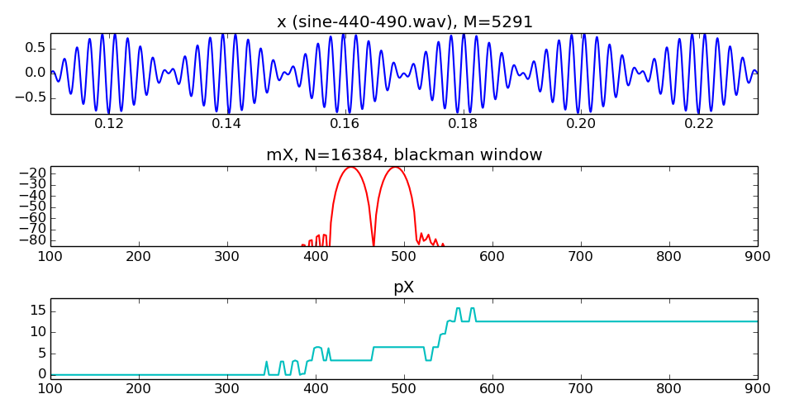
Sinusoidal model
Notes:
The sine model is is just a sum of time-varying sinusoids.
...
How do we measure the values of the sinusoids in the spectrum?

Slide 4
Sinusoidal model
Notes:
The sine model is is just a sum of time-varying sinusoids.
...
How do we measure the values of the sinusoids in the spectrum?

Slide 5
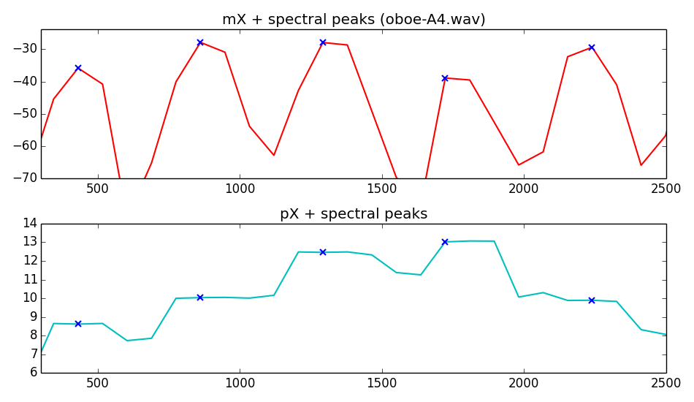
Peak detection
Notes:
If we choose the window size correctly, as we showed, we will have a peak for every sinusoid in the signal. Then to measure the frequency and amplitude of each sinusoid we have to just have to find the tip of the peak and its height.
...
To find the phase of the sinusoid in the center of the window, we just get the phase of the point we detected in the magnitude.
There is a little problem!!!, not enough resolution.

Slide 6
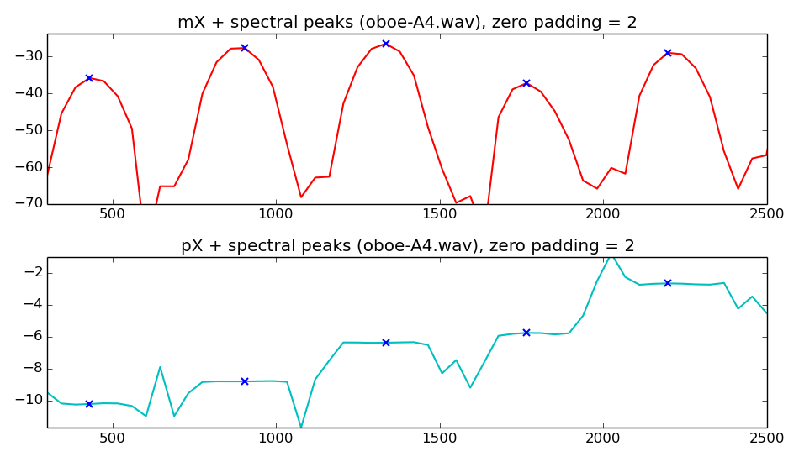
Peak detection with zero-padding
Notes:
One solution for the resolution problem is to do zero-padding. To use an FFT size much larger than the window size.
...
But if we want a good enough resolution we will need to increase the FFT size a lot, and that will be quite computationally expensive.
any other solution?

Slide 7
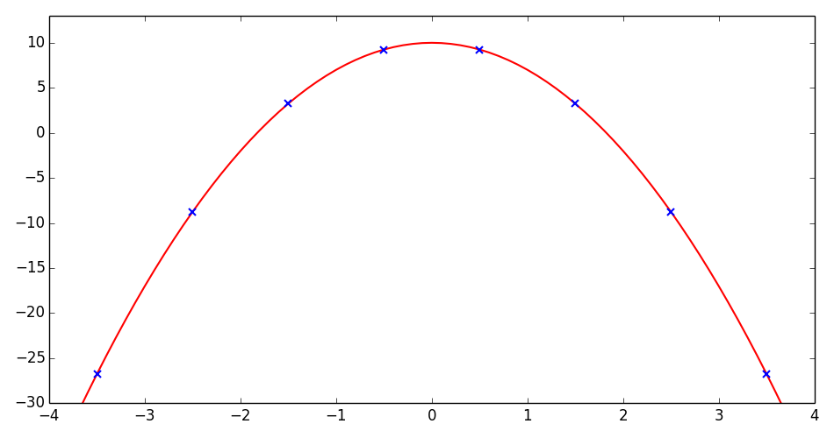
Parabola
p: center of parabola
a: concavity measure
b: offset
Notes:
Yes, we can do a cheaper interpolation by using, for example, parabolic interpolation.
The parabola is a function with a shape quite similar to the tip of the lobe of the spectrum of the analysis windows, in dB scale.
....

Slide 8
Peak interpolation
o
o
o
-1
0
+1
center of the parabola:
amplitude:
Notes:
To perform the parabolic interpolation on a spectral peak we can use the three highest values of the magnitude of the peak.
...

Slide 9
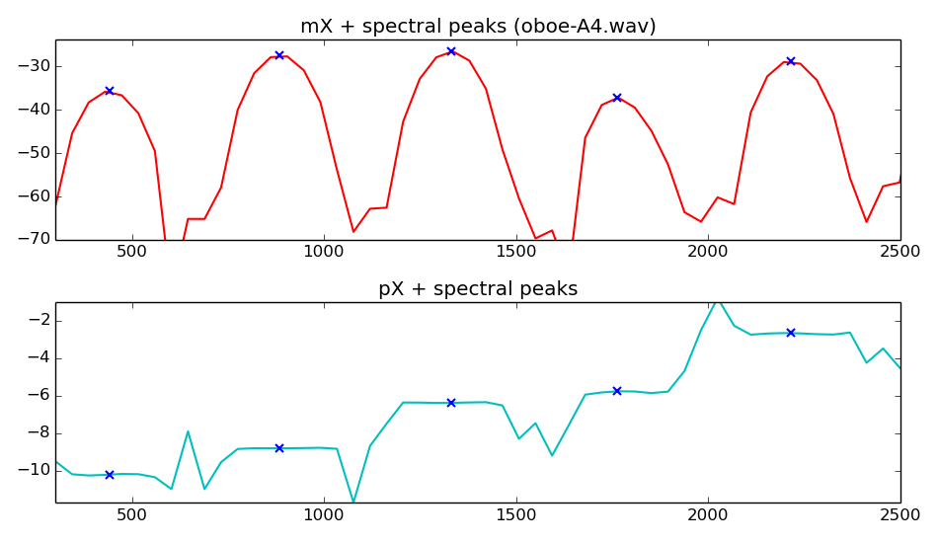
Peak detection with interpolation
Notes:
Now if we combine a bit of zero-padding and parabolic interpolation we get much better results.
...
So this will give us a quite good measure of the frequency, amplitude, and phase of all the sinusoids present in a spectrum.

Slide 10
Sinusoidal parameters from peaks
Notes:
This is what we will get for every spectral peak.
...
But these are the values for a single frame and the sinusoidal model is about time-varying sounds, thus time-varying sinusoids.

Slide 11
Sinewaves in spectrogram
Sinusoid stable peak track in spectrogram
Stability identified by
  frequency and amplitude in succesive frames
  phase derivative in time/freq
Notes:
So we have to deal with spectrograms and find time-varying sinusoids there.
...

Slide 12
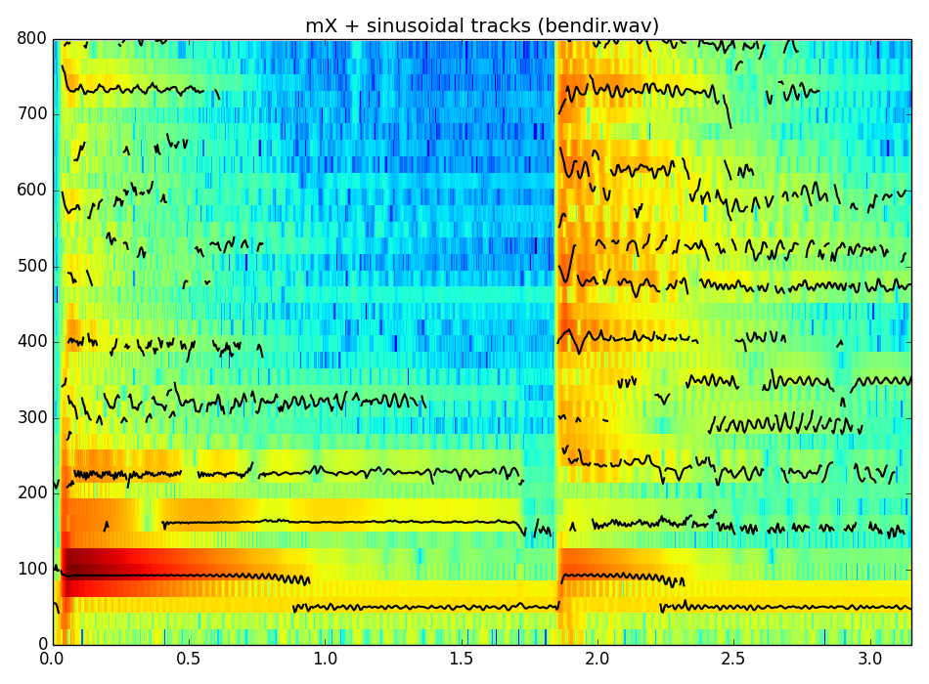
Notes:
These are the sinusoidal tracks obtained from the sound of a bendir, a drum used in Turkey and other places.
...

Slide 13
Notes:
These are the sinusoidal tracks obtained from the sound of a bendir, a drum used in Turkey and other places.
...

Slide 14
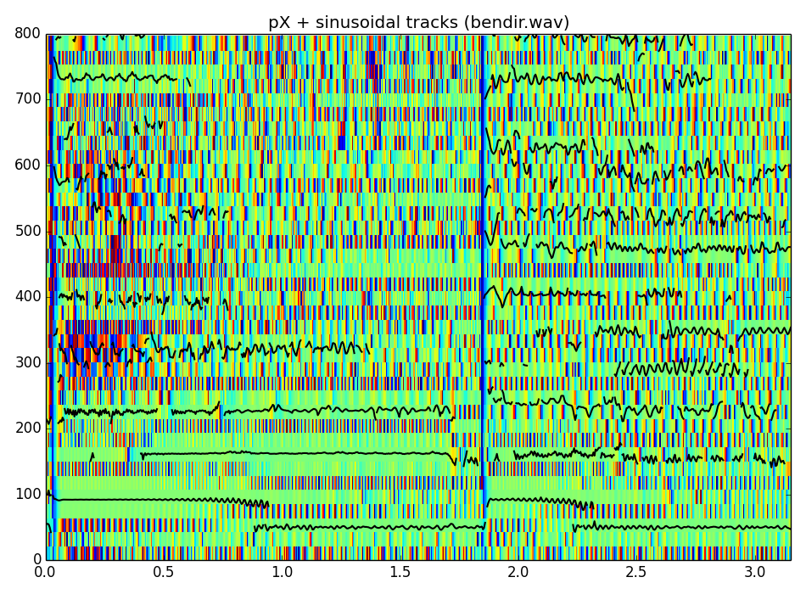
Notes:
If we plot the sinusoidal tracks on the phase spectrogram it is quite interesting.
...

Slide 15
References and credits
More information in:
  http://en.wikipedia.org/wiki/Sinusoidal_model
Reference on sinusoidal modeling by Julius O. Smith: https://ccrma.stanford.edu/~jos/sasp/Spectrum_Analysis_Sinusoids.html
Sounds from: http://www.freesound.org/people/xserra/packs/13038/
Slides and code released using the CC Attribution-Noncommercial-Share Alike license or the Affero GPL license and available from https://github.com/MTG/sms-tools
Notes:
Sorry not many references on all these topics.
...

Slide 16
5T2: Sinusoidal model
(2 of 3)
Xavier Serra
Universitat Pompeu Fabra, Barcelona
&
Stanford University
Notes:
This is all for this lecture.
We have presented the sinusoidal model, a sound representation built on top of the Short-time Fourier Transform that reduces the amount of information, geting rid of of non-relevant spectral components.
However its use to analyze sounds is not as easy as the STFT, we have to understand a bit more about spectra and about windows in order to make good use of it. Hopefully by now you are starting to get a grasp on that.
Now we have to complete the explanation of the sinusoidal model by descriving the synthesis part. This is what we will do in the next lecture.
Thanks for your attention.

