Slide 1
The Discrete Fourier Transform
(1 of 2)
Xavier Serra
Music Technology Group
Universitat Pompeu Fabra, Barcelona
http://mtg.upf.edu

Slide 2
Index
DFT equation
Complex exponentials
Inner product

Slide 3
Discrete Fourier Transform
n: discrete time index in samples (normalized time, T=1)
k: discrete frequency index in bins
frequency in radians
frequency in Hz, where fs is the sampling rate

Slide 4
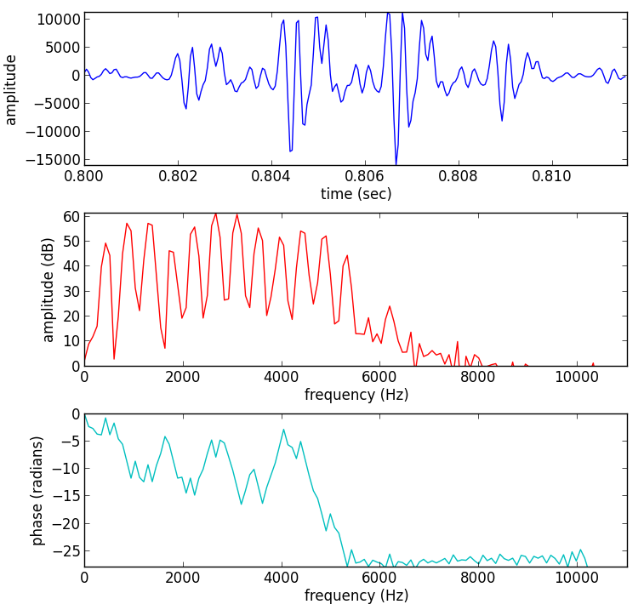
sound fragment
x[n]
magnitude
spectrum
phase
spectrum

Slide 5
Complex exponentials

Slide 6
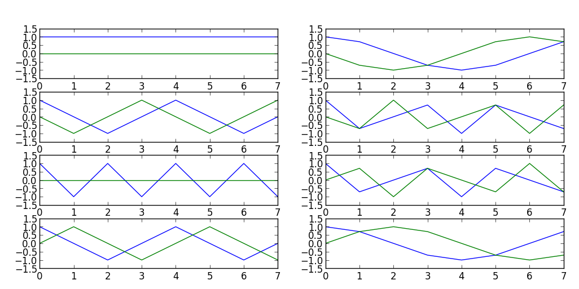
Complex exponentials

Slide 7
Inner product - DFT
Example:

Slide 8
References
https://ccrma.stanford.edu/~jos/mdft/
Full code of plots and accompanying labs available at:https://github.com/MTG/sms-tools

Slide 9
Credits
All the slides of this presentation are released under an Attribution-Noncommercial-Share Alike license.

