Slide 1
Fourier Transform theorems and properties
(2 of 2)
Xavier Serra
Music Technology Group
Universitat Pompeu Fabra, Barcelona
http://mtg.upf.edu

Slide 2
Index
Phase unwrapping
Zero padding
Power & amplitude in dB
Fast Fourier Transform (FFT)
FFT and zero-phase

Slide 3
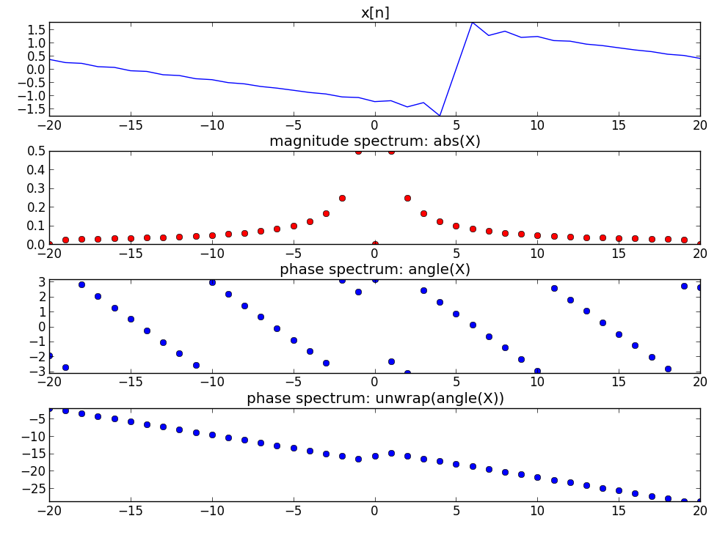
Phase unwrapping

Slide 4
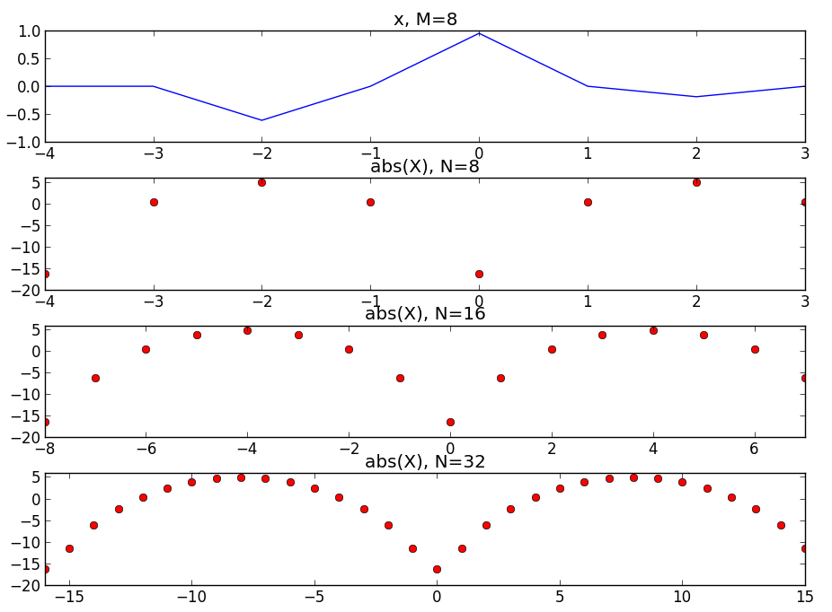
Zero-padding

Slide 5
M = 8
N1 = 8
N2 = 16
N3 = 32
x = np.cos(2*np.pi*2/M*np.arange(M)) * np.hanning(M)
plt.subplot(4,1,1)
plt.plot(x, 'b')
mX = 20 * np.log10(np.abs(fftshift(fft(x, N1))))
plt.subplot(4,1,2)
plt.plot(mX, 'ro')
mX = 20 * np.log10(np.abs(fftshift(fft(x, N2))))
plt.subplot(4,1,3)
plt.plot(mX, 'ro')
mX = 20 * np.log10(np.abs(fftshift(fft(x, N3))))
plt.subplot(4,1,4)
plt.plot(mX, 'ro')

Slide 6
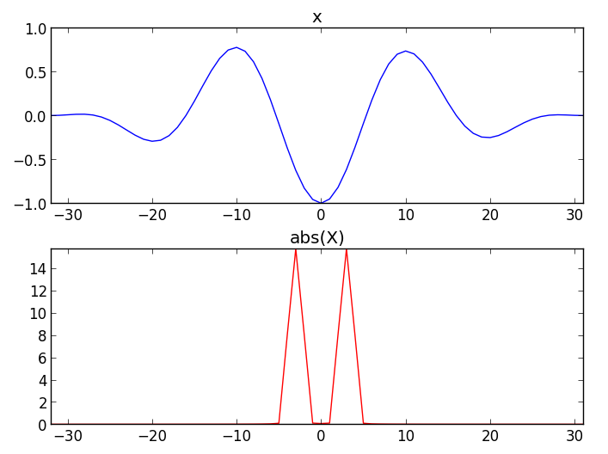
Power

Slide 7
M= 64
N = 64
x = np.cos(2*np.pi*3/M*np.arange(M)) * np.hanning(M)
plt.subplot(2,1,1)
plt.plot(x, 'b')
powerx = sum(np.abs(x)**2)
print powerx
mX = np.abs(fftshift(fft(x, N)))
plt.subplot(2,1,2)
plt.plot(mX, 'r')
powerX = sum(mX**2) / N
print powerX

Slide 8
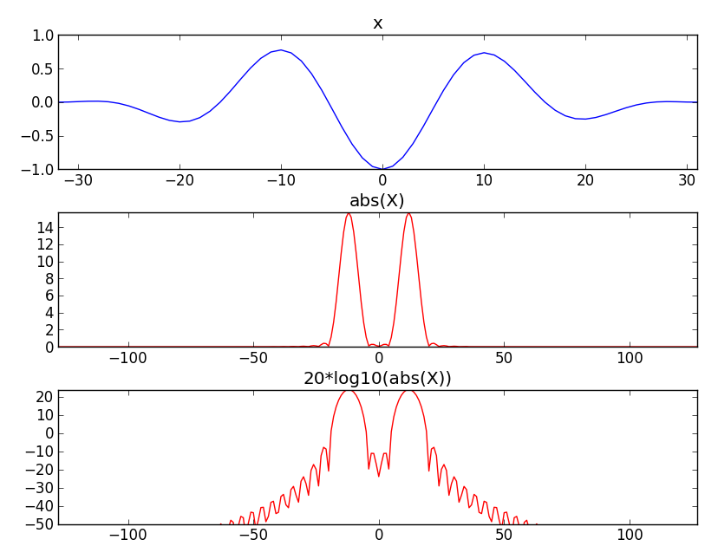
Amplitude in Decibels

Slide 9
M= 64
N = 256
x = np.cos(2*np.pi*3/M*np.arange(M)) * np.hanning(M)
plt.subplot(3,1,1)
plt.plot(x, 'b')
mX = np.abs(fftshift(fft(x, N)))
plt.subplot(3,1,2)
plt.plot(np.arange(-N/2,N/2,1), mX, 'r')
mX = 20 * np.log10(mX)
plt.subplot(3,1,3)
plt.plot(np.arange(-N/2,N/2,1), mX, 'r')

Slide 10

Fast Fourier Transform
The most common version uses the Coley-Tukey algorithm. It breaks down recursively the DFT of a power of 2 size into two pieces of size N/2.

Slide 11
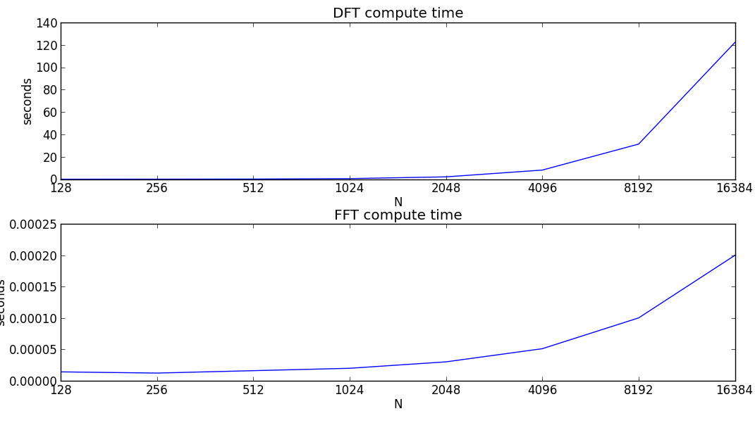
Ns = 2**np.arange(7,15)
for N in Ns:
str_time = time.time()
for k in range(N):
s = np.exp(1j*2*np.pi*k/N*np.arange(N))
X = np.append(X, sum(x*np.conjugate(s)))
timeDFT = np.append(timeDFT, time.time()-str_time)
for N in Ns:
str_time = time.time()
X = fft(x)
timeFFT = np.append(timeFFT, time.time()-str_time)

Slide 12
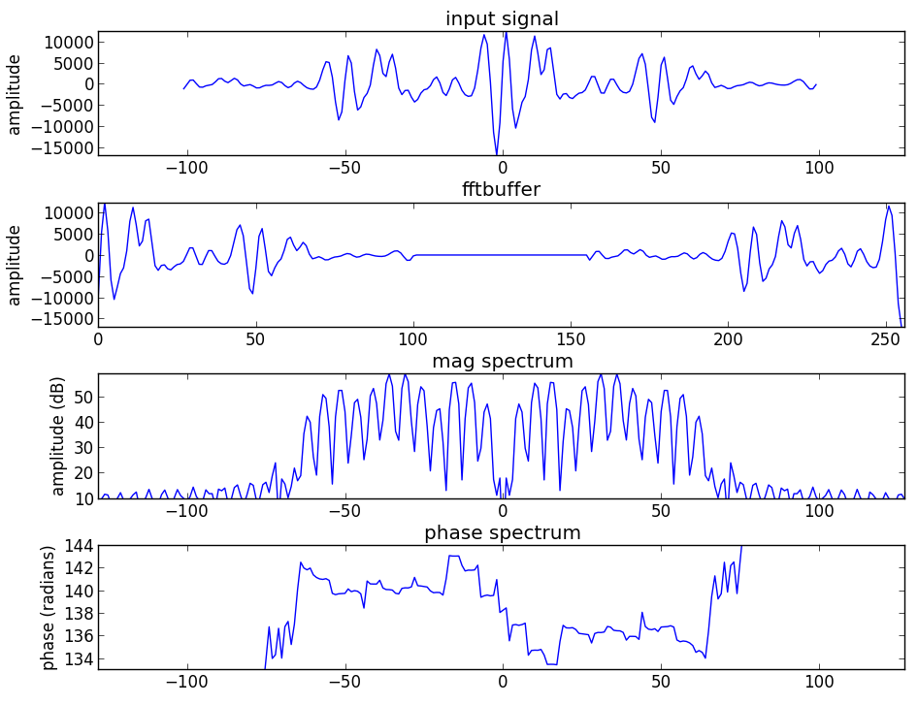
FFT and zero-phase

Slide 13
(fs, x) = read('oboe.wav')
N = 256
M = 201
hN = N/2
hM = (M+1)/2
start = .8*fs
xw = x[start-hM:start+hM-1] * np.hamming(M)
plt.plot(np.arange(-hM, hM-1), xw)
fftbuffer = np.zeros(N)
fftbuffer[:hM] = xw[hM-1:]
fftbuffer[N-hM+1:] = xw[:hM-1]
plt.plot(np.arange(0, N), fftbuffer)
X = fftshift(fft(fftbuffer))
mX = 20 * np.log10(abs(X)/N)
pX = np.unwrap(np.angle(X))
plt.plot(np.arange(-hN, hN), mX)
plt.plot(np.arange(-hN, hN), pX)

Slide 14
References
https://ccrma.stanford.edu/~jos/mdft/
https://en.wikipedia.org/wiki/Fast_Fourier_transform
Full code of plots and accompanying labs available at:https://github.com/MTG/sms-tools

Slide 15
Credits
All the slides of this presentation are released under an Attribution-Noncommercial-Share Alike license.

