Slide 1
The Short-Time Fourier Transform
(1 of 2)
Xavier Serra
Music Technology Group
Universitat Pompeu Fabra, Barcelona
http://mtg.upf.edu

Slide 2
Index
Short-time Fourier Transform equation
Window size
FFT size
Hop size
Time-frequency compromise
Inverse STFT

Slide 3
Short-time Fourier Transform
w: real window
l: number of frame
H: time advance of window (hop-size)

Slide 4
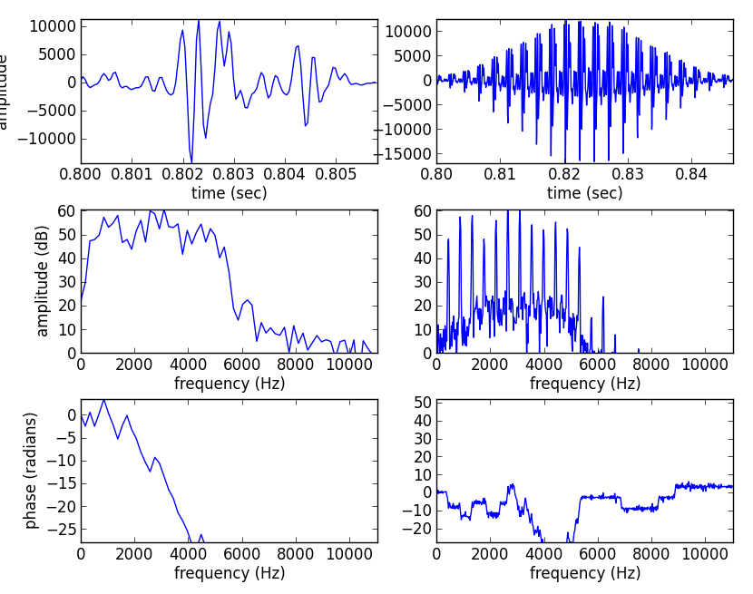
Window size
Affects the time versus frequency resolution
M = 128
M = 1024

Slide 5
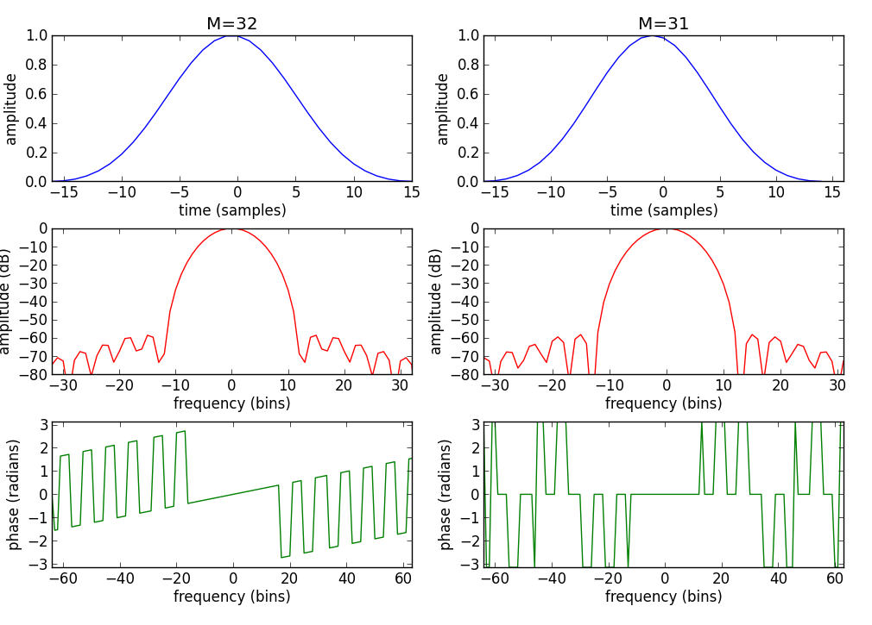
Even-Odd size Window

Slide 6
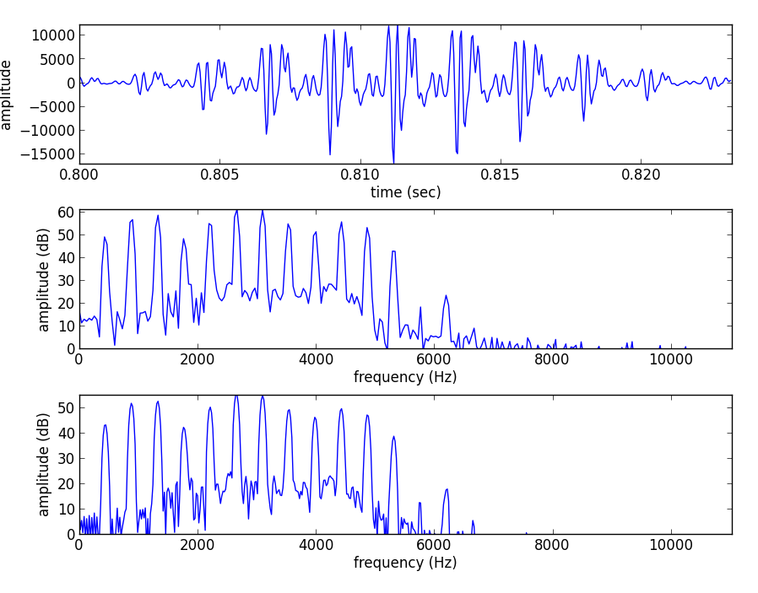
FFT size
FFT size, N, should be equal or larger than the window size, M

Slide 7
Hop size
Successive frames should overlap in time in such a
way that all the data are weighted equally.
For certain windows exists perfect overlap factors.
Rectangular: M/j, Hanning and Hamming: (M/2)/j,
where j = 0, 1, ....
The overlap factor can be expressed by:

Slide 8
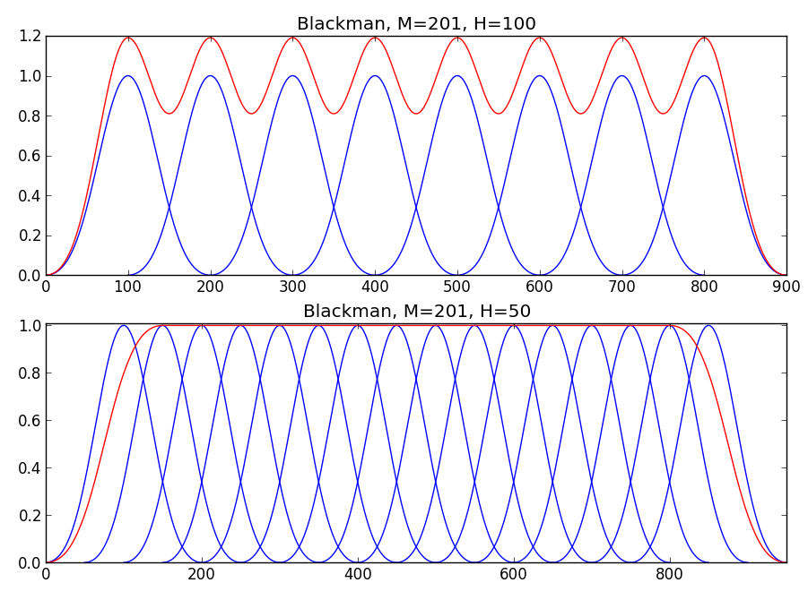

Slide 9
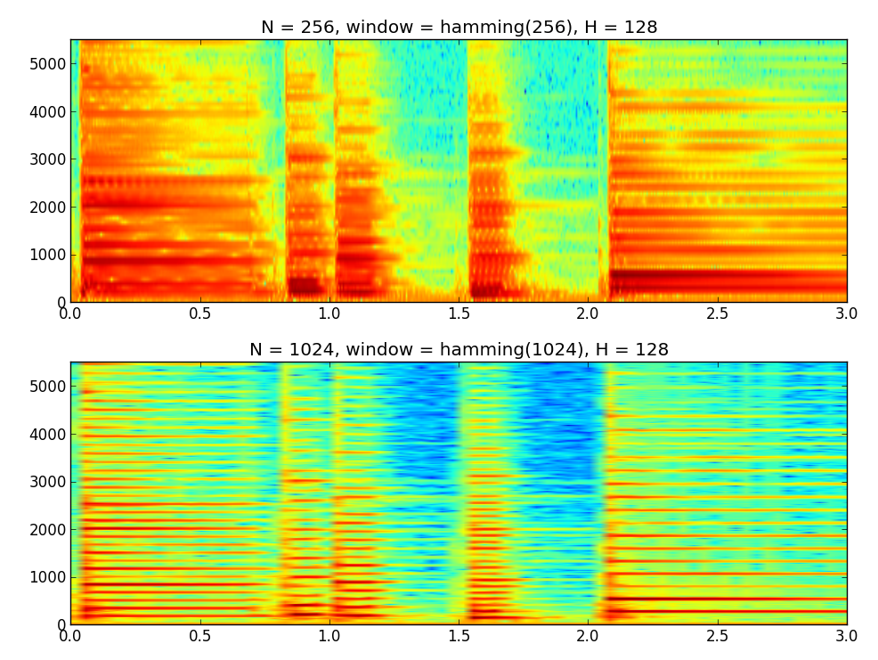
Time-frequency compromise

Slide 10
Inverse STFT
each synthesized frame is:
and the synthesized sound is:

Slide 11


Slide 12
STFT diagram
w[n]
x[n]
|X[k]|
yw[n]
y[n]
FFT
IFFT
Overlap-add
xw[n]
<X[k]

Slide 13
References
https://ccrma.stanford.edu/~jos/sasp/
https://en.wikipedia.org/wiki/STFT
https://en.wikipedia.org/wiki/Window_function
Full code of plots and accompanying labs available at: https://github.com/MTG/sms-tools

Slide 14
Credits
All the slides of this presentation are released under an Attribution-Noncommercial-Share Alike license.

