Slide 1
Harmonic Modeling
(1 of 2)
Xavier Serra
Music Technology Group
Universitat Pompeu Fabra, Barcelona
http://mtg.upf.edu

Slide 2
Index
Harmonic Model equation
Sinusoids-Partials-Harmonics
F0 detection: time domain

Slide 3
Harmonic model

Slide 4
Sinusoids-Partials-Harmonics
Any time-varying spectrum can be modeled as the sum of time-varying sinusoids.
Most of the spectral bins in a spectrum do not correspond to actual partials of the analyzed sound.
A sound partial is the result of a main mode of vibration of the generating system.
Partials can be modeled as slowly time-varying sinusoids.
A partial in the frequency domain can be identified by its spectral shape (magnitude and phase), its relation to other partials, and its time evolution.
When the partials of a sound are related harmonically we call them harmonics.

Slide 5
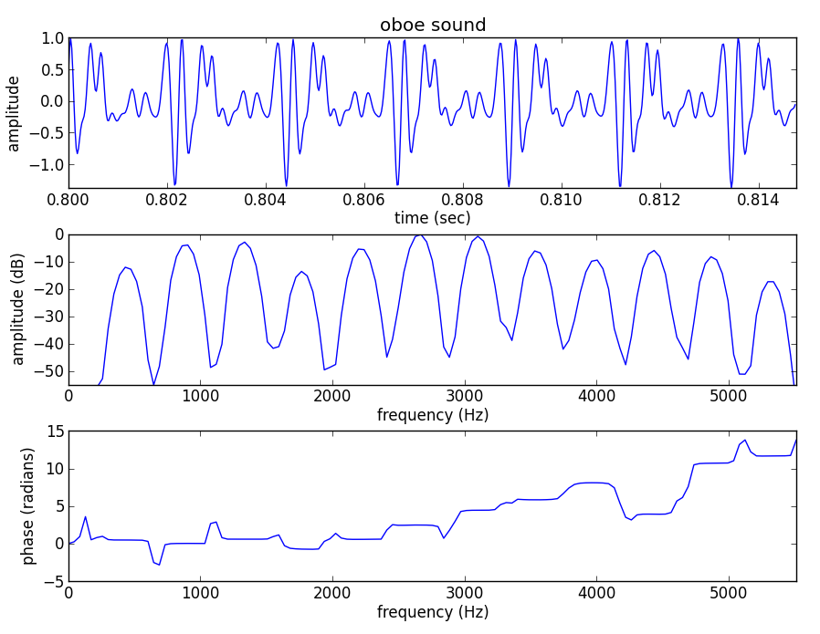

Slide 6
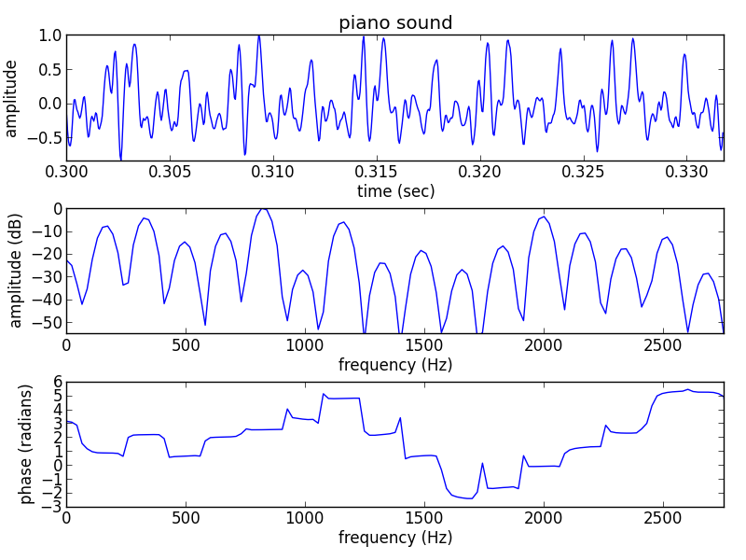

Slide 7
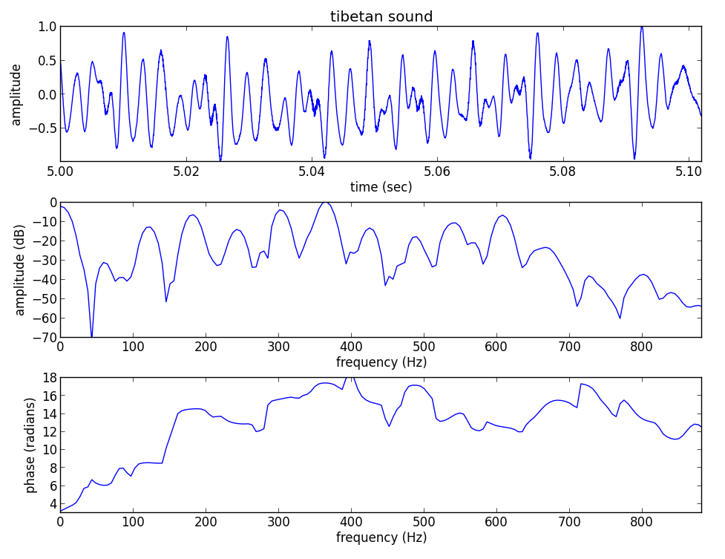

Slide 8
F0 detection in time domain
Autocorrelation

Slide 9
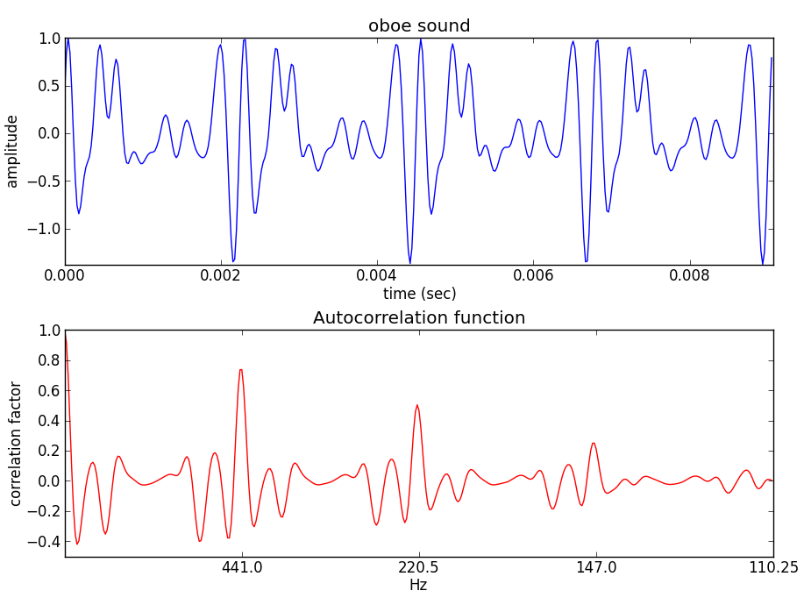

Slide 10
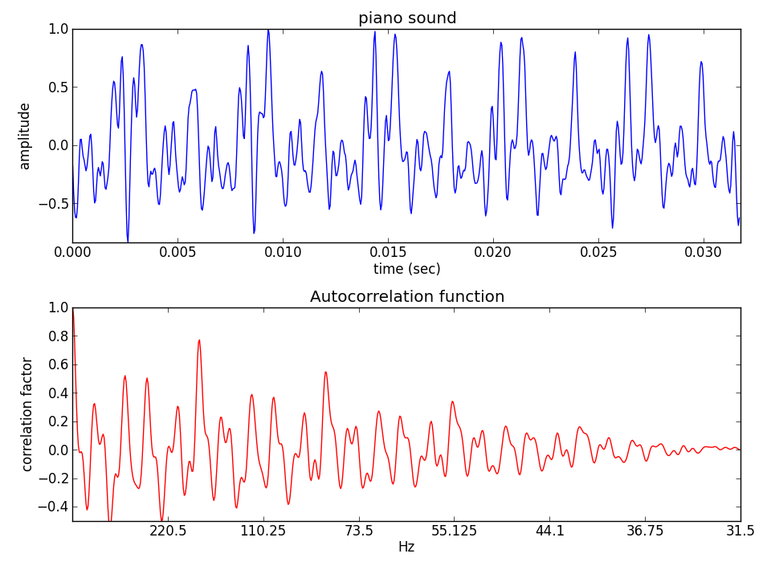

Slide 11
References
http://en.wikipedia.org/wiki/Fundamental_frequency
http://en.wikipedia.org/wiki/Pitch_detection_algorithm

Slide 12
Credits
All the slides of this presentation are released under an Attribution-Noncommercial-Share Alike license.

