Slide 1
Sinusoidal plus Residual Modeling
(1 of 2)
Xavier Serra
Music Technology Group
Universitat Pompeu Fabra, Barcelona
http://mtg.upf.edu

Slide 2
Index
Sinusoidal plus residual model
Sinusoidal subtraction
Stochastic model

Slide 3
Sinusoidal plus residual model
when yr[n] is an stochastic signal, it can be modeled as filtered white noise:
otherwise:

Slide 4
Spectral view of SpR model
when e[n] is an stochastic signal, it can be modeled as filtered white noise:
otherwise:

Slide 5
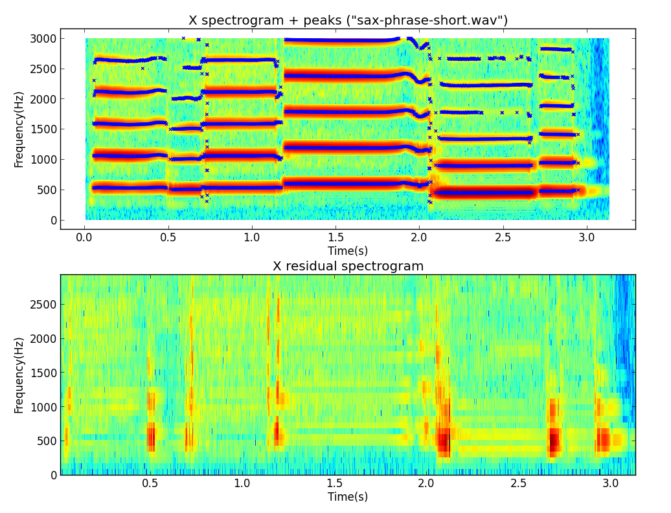

Slide 6
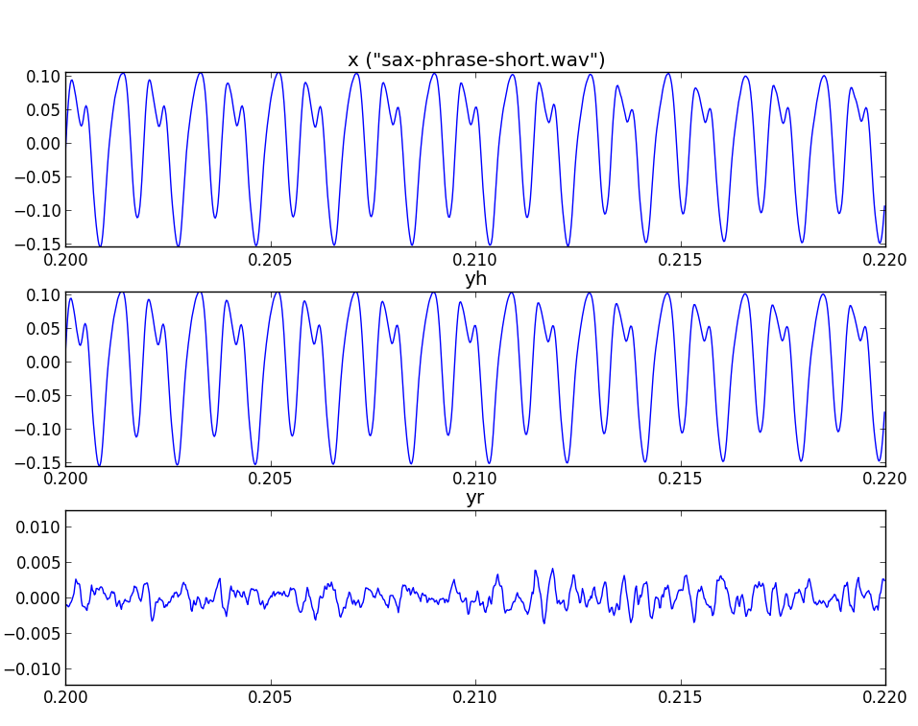

Slide 7
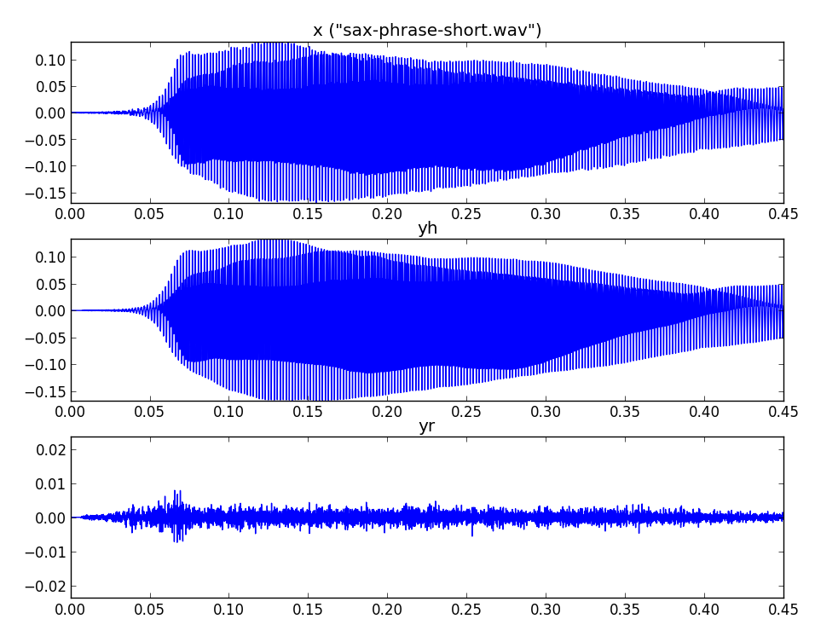

Slide 8
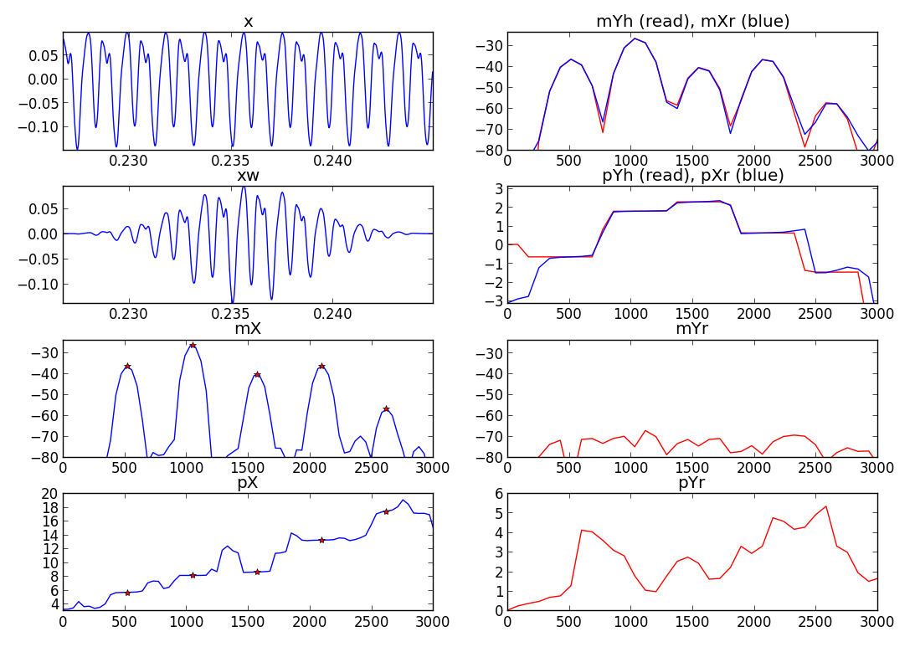

Slide 9
Stochastic signals
Stochastic processes
  described by the laws of probability, mean, variance, probability distributions
Autocorrelation
Power spectral density

Slide 10
Stochastic model
Spectral view:

Slide 11
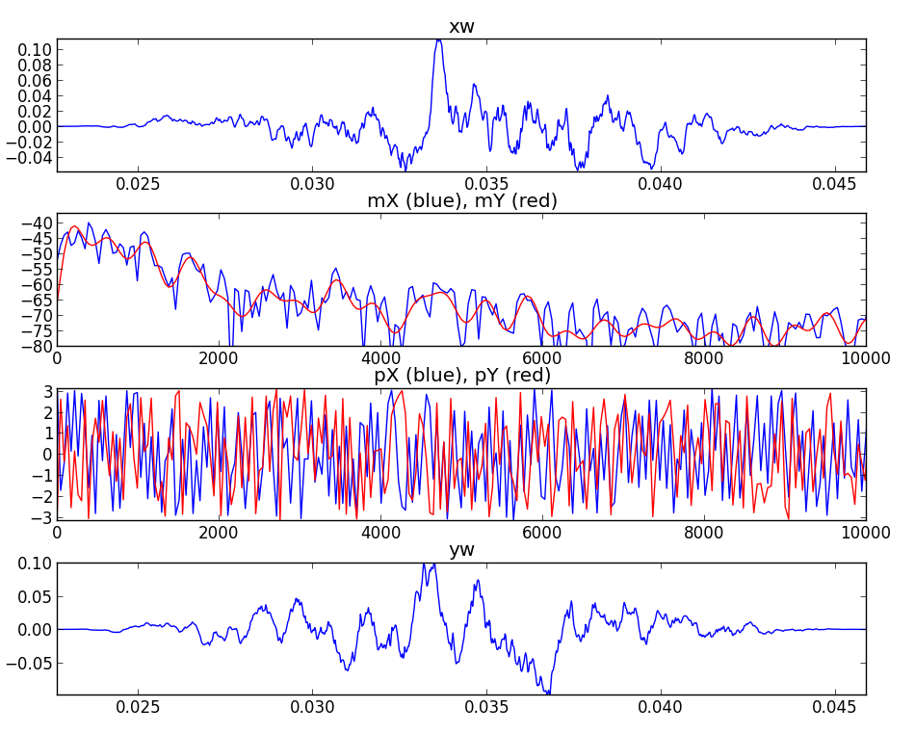

Slide 12
References
https://ccrma.stanford.edu/~jos/sasp/Spectrum_Analysis_Sinusoids.html
http://en.wikipedia.org/wiki/Stochastic_process
http://en.wikipedia.org/wiki/Linear_predictive_coding
Sounds: http://www.freesound.org/people/xserra/packs/13038/

Slide 13
Credits
All the slides of this presentation are released under an Attribution-Noncommercial-Share Alike license.

