Slide 1
Sinusoidal plus Residual Model
Xavier Serra
Universitat Pompeu Fabra, Barcelona
Notes:
Welcome again to the course on Audio Signal Processing for Music applications.
Last time we talked about stochastic signals and models. With that we are now ready to extend to sinusoidal model to the concept of sinusoidal plus residual model.
We will decompose sounds into two components, the sinusoidal part, a deterministic component, and the residual part, ideally an stochastic component.

Slide 2
Index
Sinusoidal/Harmonic plus residual model (SpR, HpR)
Residual subtraction
Harmonic plus residual system
Sinusoidal/Harmonic plus stochastic model (SpS, HpS)
Stochastic model of residual
Harmonic plus stochastic system
Notes:
In this lecture we will basically combine all the models that we have covered until now.
...

Slide 3
Sinusoidal plus residual model

Slide 4
Spectral view

Slide 5
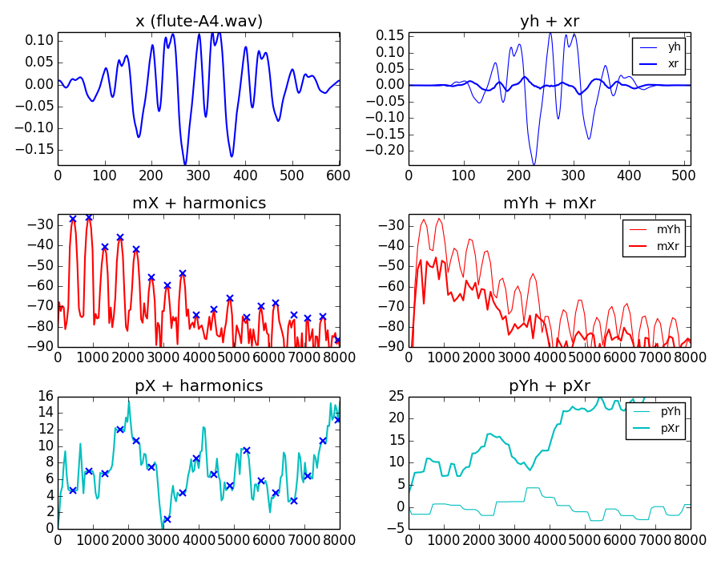

Slide 6
HpR model system
w[n]
|X[k]|
f_{p}
p_{p}
f₀
x[n]
A_{p}
F0
detection
Harmonic
detection
X
FFT
Peak detection
xw[n]
<X[k]
f_{h}
p_{h}
A_{h}
w[n]
Sine spectral
synthesis
xw[n]
X[k]
-
X
FFT
+
Xr[k]
Yh[k]
+
IFFT
yw[n]
Overlap-add
y[n]

Slide 7
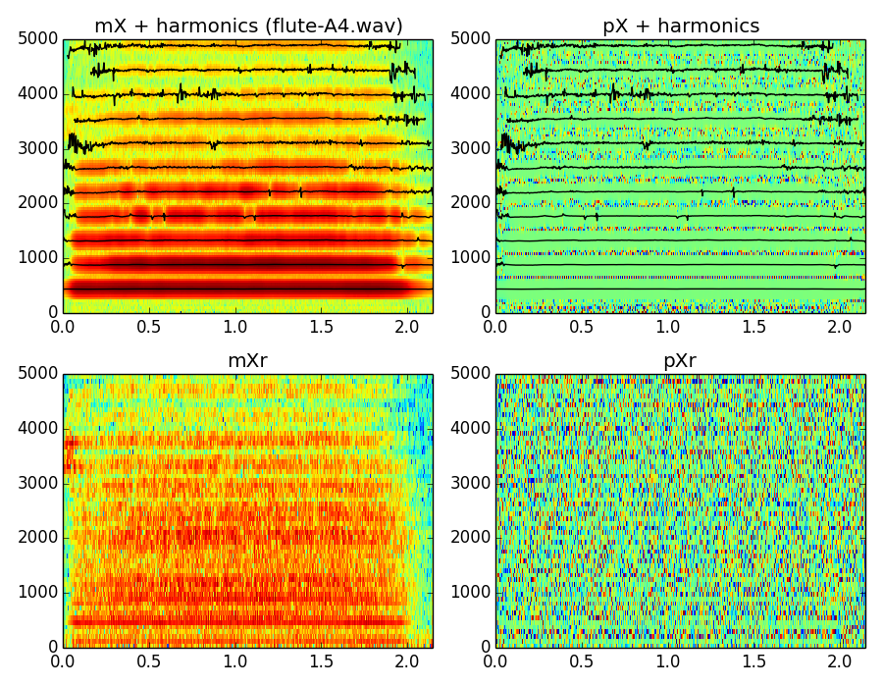

Slide 8
Sinusoidal plus stochastic model
where:

Slide 9
Spectral view
where:

Slide 10
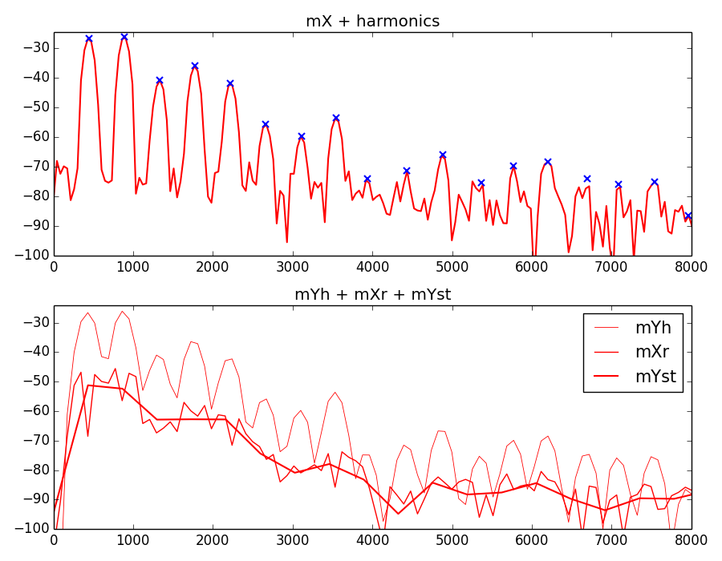

Slide 11
HpS model system
wh[n]
|X[k]|
p_{p}
f₀
f_{p}
x[n]
A_{p}
F0
detection
Harmonic
detection
X
FFT
Peak detection
xw[n]
<X[k]
f_{h}
p_{h}
A_{h}
wr[n]
Sine spectral
synthesis
X[k]
-
X
FFT
+
Yh[k]
xwr[n]
Xr[k]
Stochastic approximation
|Yst[k]|
Random phase generation
<Yst[k]
Stochastic spec. synthesis
IFFT
Yst[k]
yw[n]
Overlap-add
y[n]

Slide 12
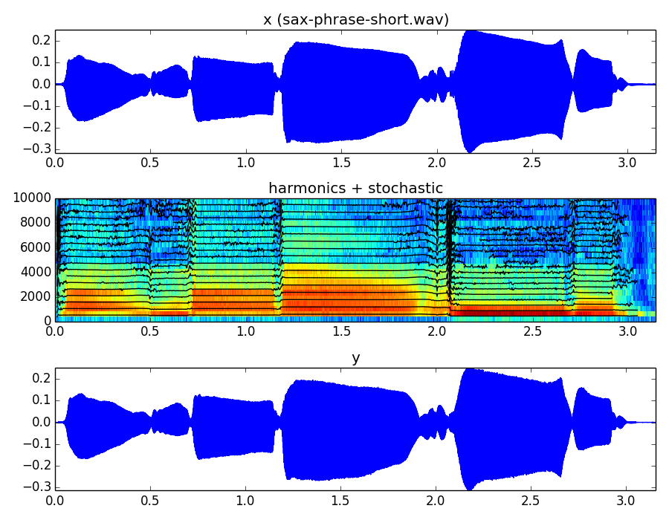

Slide 13
References and credits
Further references: http://mtg.upf.edu/technologies/sms
Sounds used taken from Freesound: http://www.freesound.org/people/xserra/packs/13038/
All slides and code are released using the CC Attribution-Noncommercial-Share Alike license or the Affero GPL license and available from https://github.com/MTG/sms-tools

Slide 14
Sinusoidal plus Residual Model
Xavier Serra
Universitat Pompeu Fabra, Barcelona
Notes:
In this lecture we have covered the most advance models that we will present and use in this course.
We basically combined all the previous models, developing a variety of analysis/synthesis techniques that can be applied to many sounds and for many applications.
In the next lecture we will focus on the use of these models for transforming sounds.
See you then!!!

