Slide 1
Harmonic Model
Xavier Serra
Universitat Pompeu Fabra, Barcelona

Slide 2
Index
Harmonic model
Sinusoids-partials-harmonics
Monophonic-polyphonic signals
Harmonic detection (after F0 detection)
Harmonic model system

Slide 3
Harmonic model

Slide 4
Spectral view

Slide 5
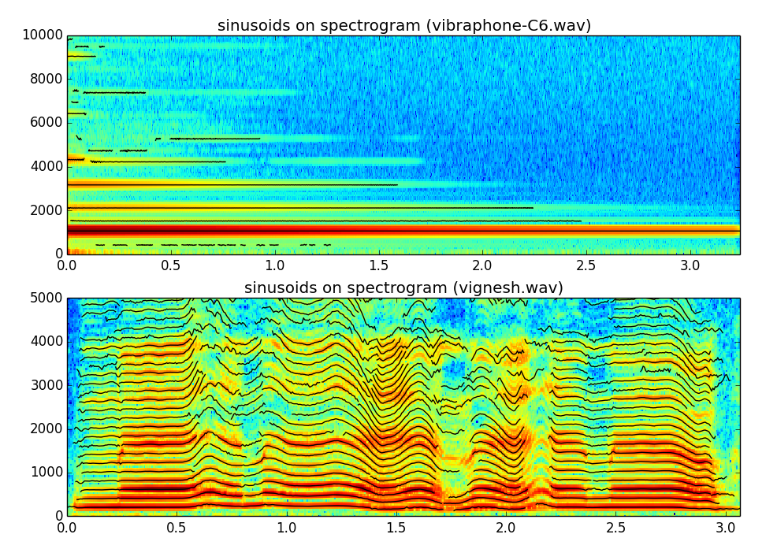

Slide 6
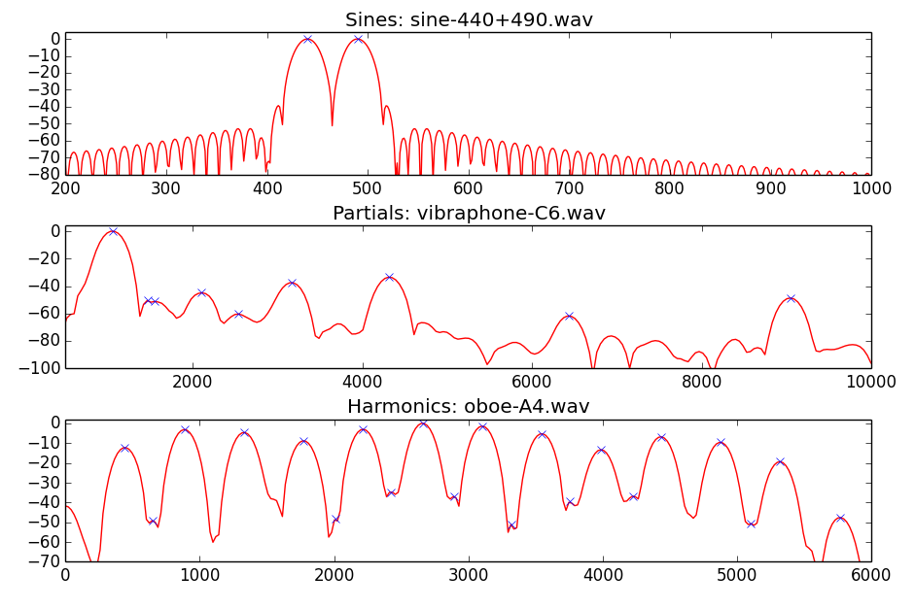
Sinusoids-Partials-Harmonics

Slide 7
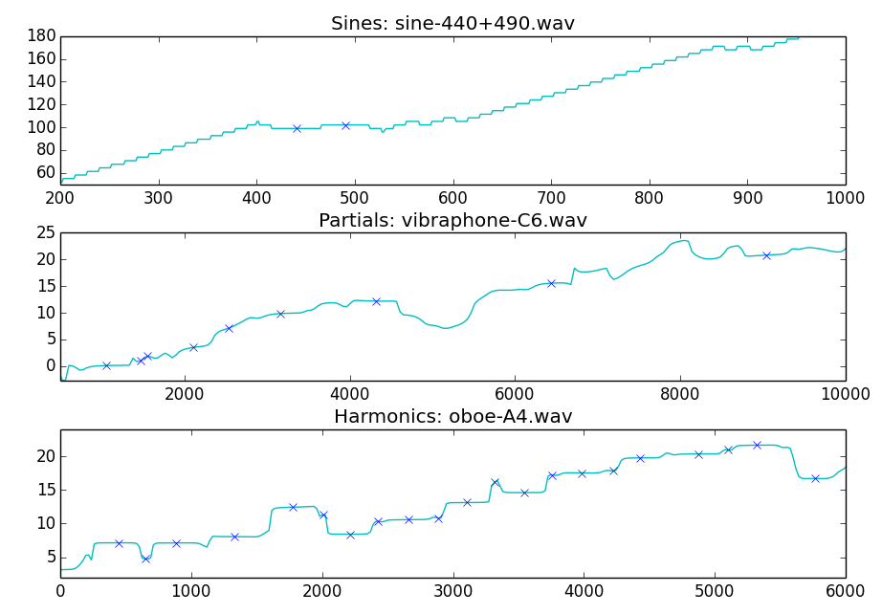
Sinusoids-Partials-Harmonics

Slide 8
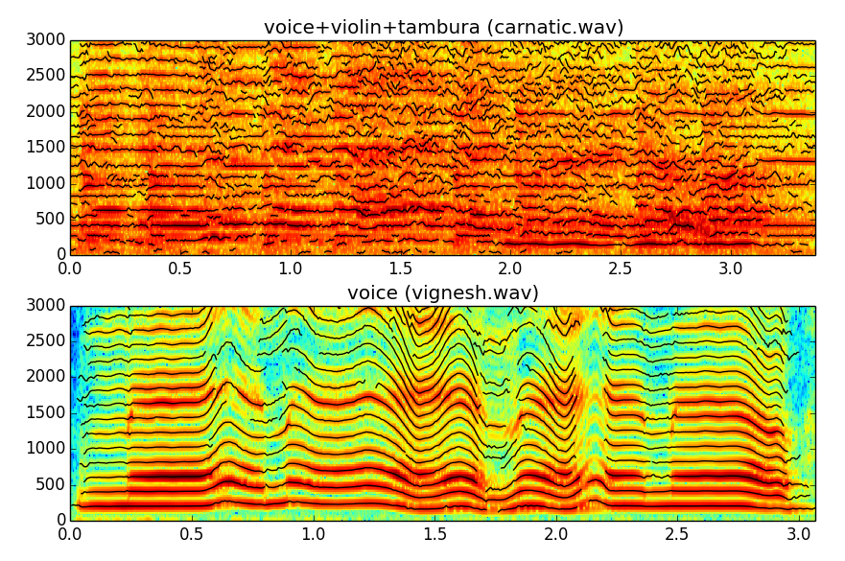
Monophonic-Polyphonic signals

Slide 9
Harmonic detection
Harmonic stable peak whose frequency is close to a multiple of the fundamental frequency.

Slide 10
Harmonic model system
w[n]
|X[k]|
f_{p}
p_{p}
f₀
x[n]
A_{p}
F0
detection
Harmonic
detection
X
FFT
Peak detection
xw[n]
<X[k]
A_{h}
f_{h}
p_{h}
Analysis
Synthesis
Sine spectral
synthesis
Yh[k]
IFFT
yhw[n]
Overlap-add
yh[n]

Slide 11
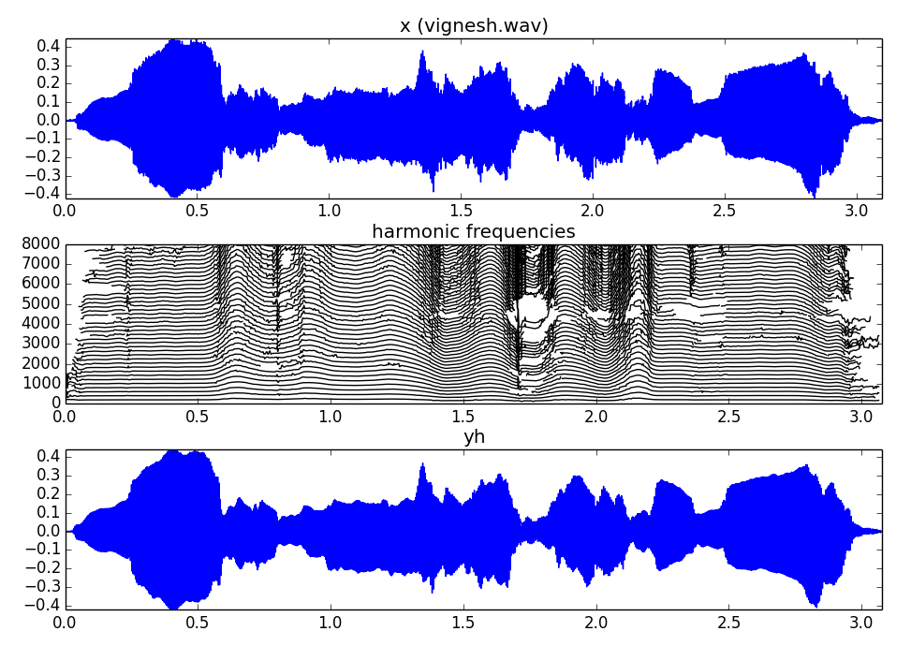

Slide 12
References and credits
More information on this topic from Wikipedia:
  https://en.wikipedia.org/wiki/Harmonic_series_(music)
  https://en.wikipedia.org/wiki/Harmonic
Sounds used taken from Freesound: http://www.freesound.org/people/xserra/packs/13038/
All slides and code produced for this course are released using the CC Attribution-Noncommercial-Share Alike license or the Affero GPL license and available from https://github.com/MTG/sms-tools

