Slide 1
Stochastic Model
Xavier Serra
Universitat Pompeu Fabra, Barcelona

Slide 2
Index
Stochastic signals
Stochastic model
Stochastic approximation of sounds
Stochastic model system

Slide 3
Stochastic signals
Stochastic processes
  described by the laws of probability, mean, variance, probability distributions
Autocorrelation
Power spectral density

Slide 4
Stochastic model
Spectral view:

Slide 5
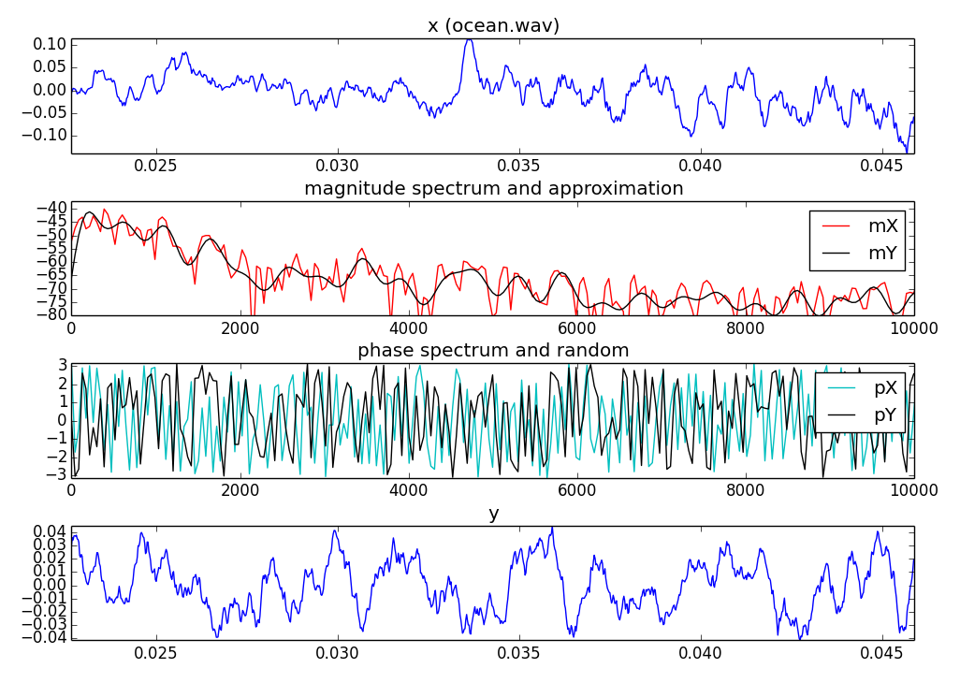

Slide 6
Filter approximation
LPC model:
The error is minimized by minimizing the mean of the total squared error with
respect to each of the parameters.

Slide 7
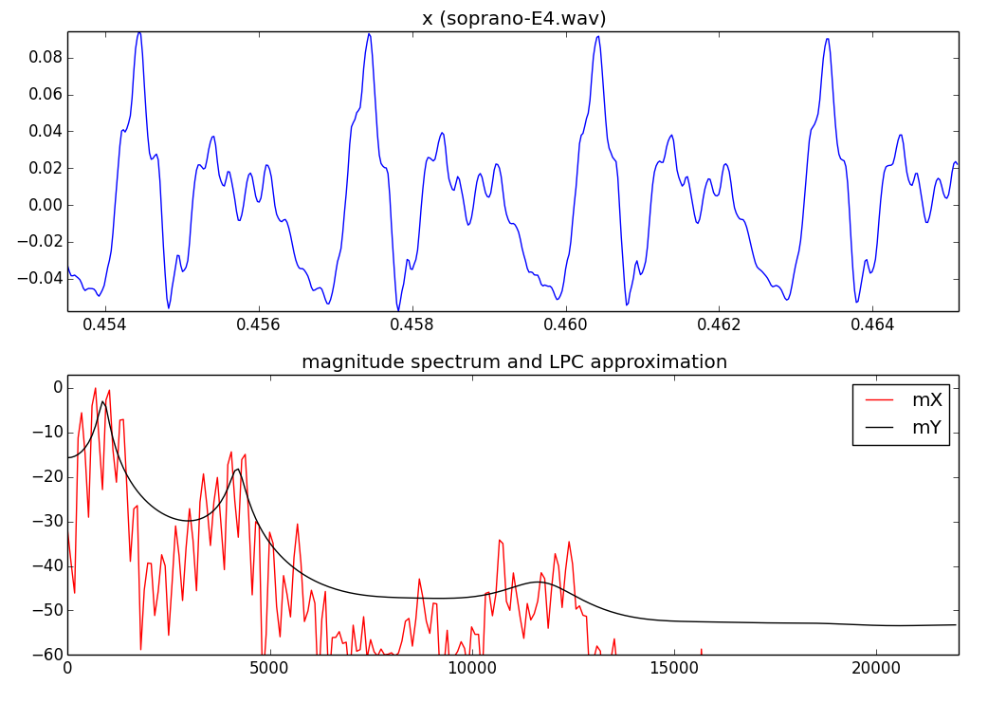

Slide 8
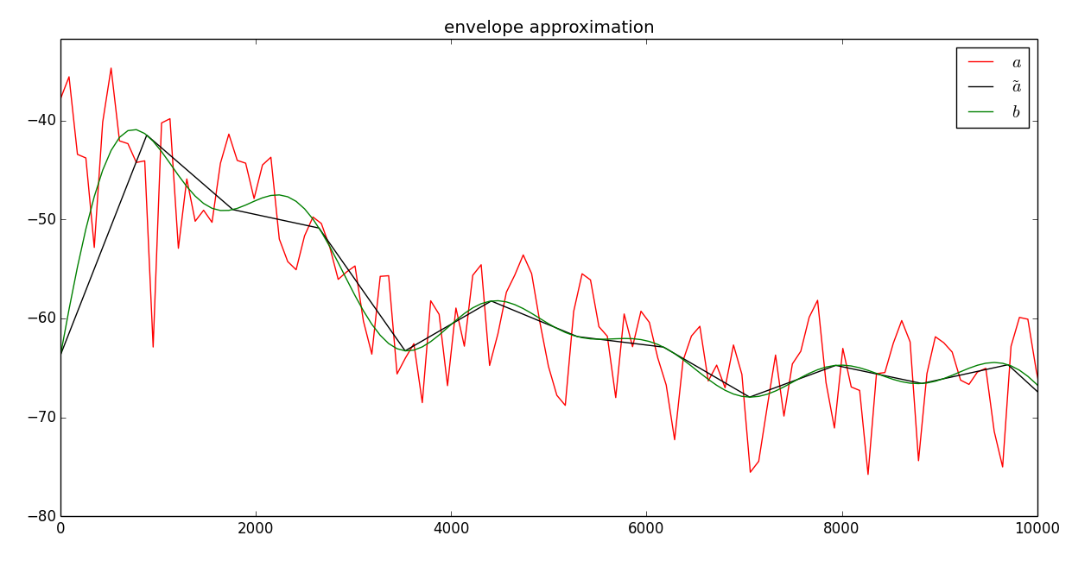
Envelope approximation

Slide 9


Stochastic synthesis using LPC
direct form
structure
lattice
structure

Slide 10
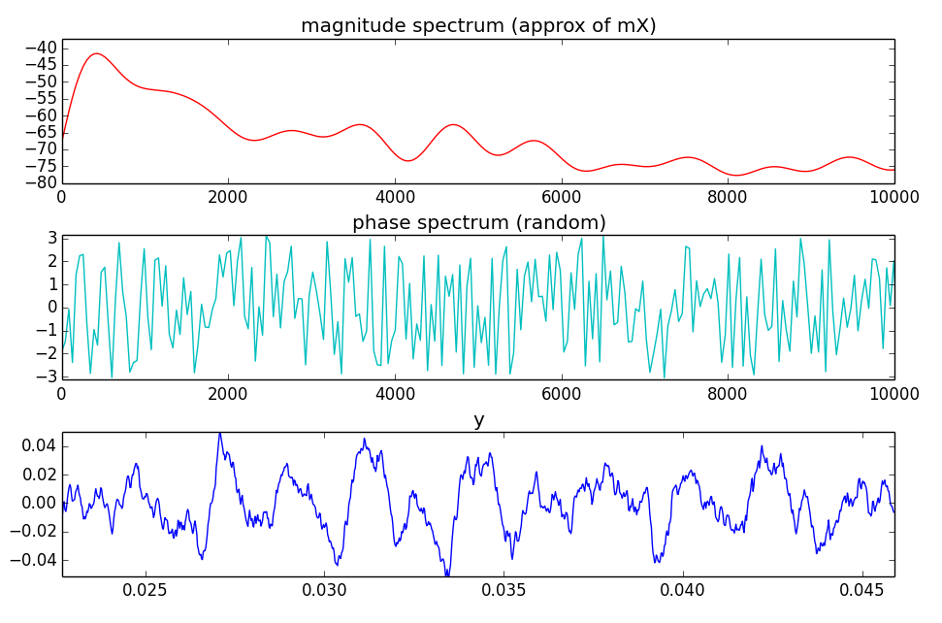
Stochastic synthesis using envelopes

Slide 11
Stochastic model system
w[n]
x[n]
xw[n]
|X[k]|
|Yst[k]|
yw[n]
yst[n]
X
FFT
Stochastic approx.
Stochastic spec. synthesis
IFFT
Overlap-add
Random phase generation
<Yst[k]

Slide 12
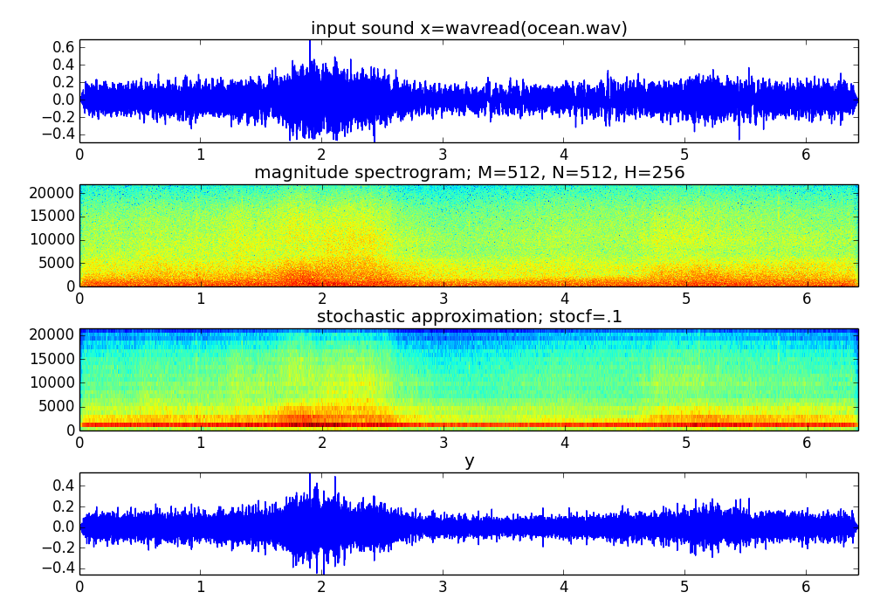

Slide 13
References and credits
More information on this topic from Wikipedia:
  http://en.wikipedia.org/wiki/Stochastic_process
  http://en.wikipedia.org/wiki/Linear_predictive_coding
Sounds used taken from Freesound: http://www.freesound.org/people/xserra/packs/13038/
All slides and code produced for this course are released using the CC Attribution-Noncommercial-Share Alike license or the Affero GPL license and available from https://github.com/MTG/sms-tools

Slide 14
Stochastic Model
Xavier Serra
Universitat Pompeu Fabra, Barcelona

