Slide 1
Sinusoidal Model
(2 of 2)
Xavier Serra
Universitat Pompeu Fabra, Barcelona

Slide 2
Index
Sinusoidal model and spectral peaks
Sinusoidal synthesis
Sinusodal model system

Slide 3
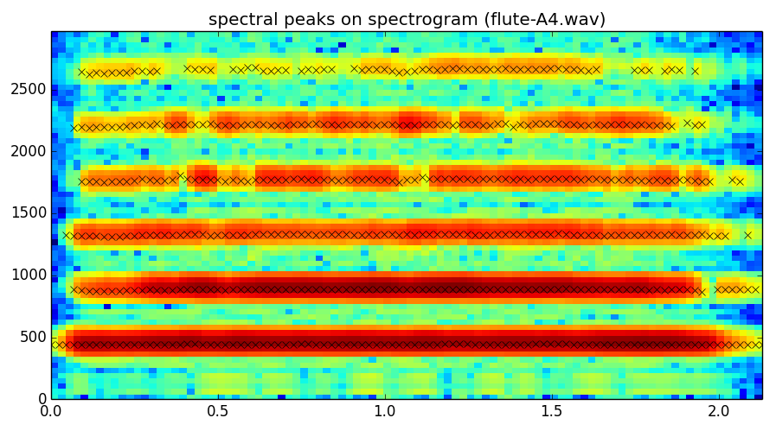
Sinusoidal model

Slide 4
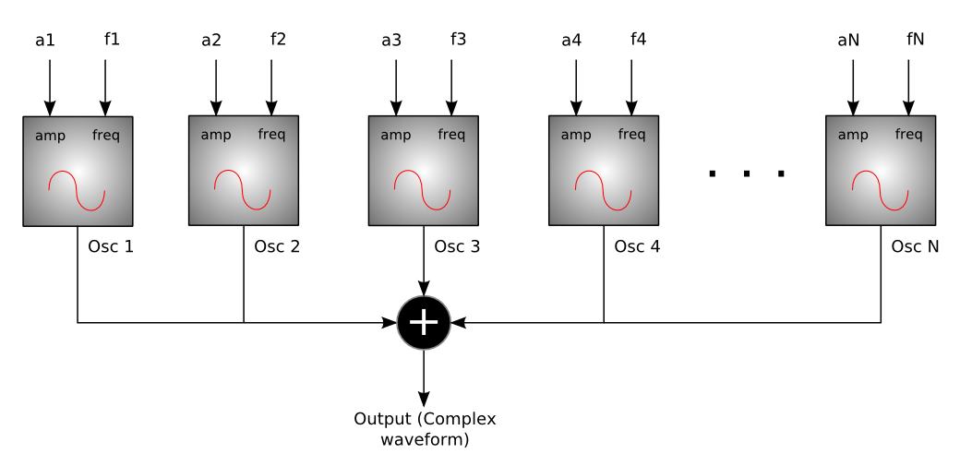
Sinusoidal synthesis
http://en.wikibooks.org/wiki/File:SSadditiveblock.png

Slide 5
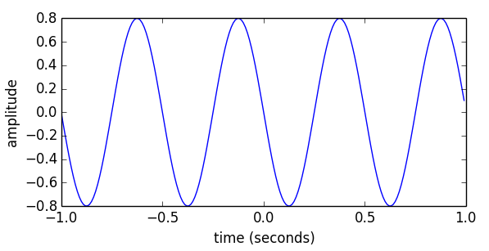
Sinusoidal synthesis
Ar = .8
fr = 2.0
phi = pi/2
fs = 100
t = arange(-1, 1, 1.0/fs)
x = Ar * cos(2*pi*fr*t+phi)

Slide 6
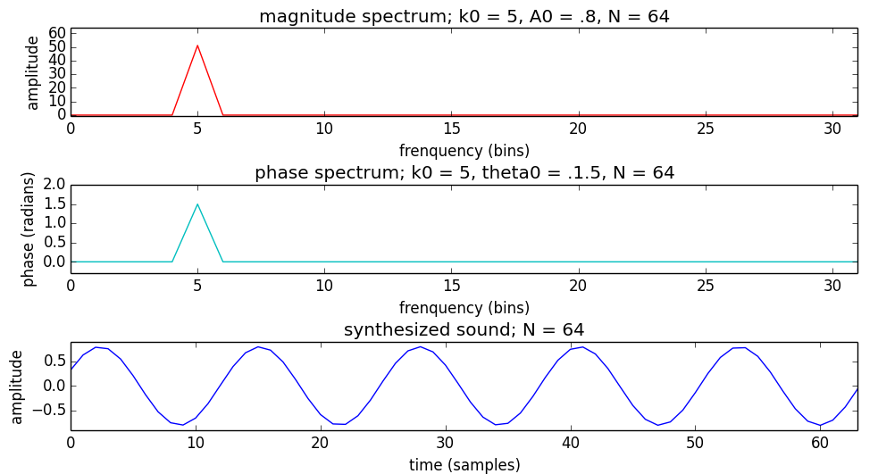
Sinusoidal synthesis: discrete frequency

Slide 7
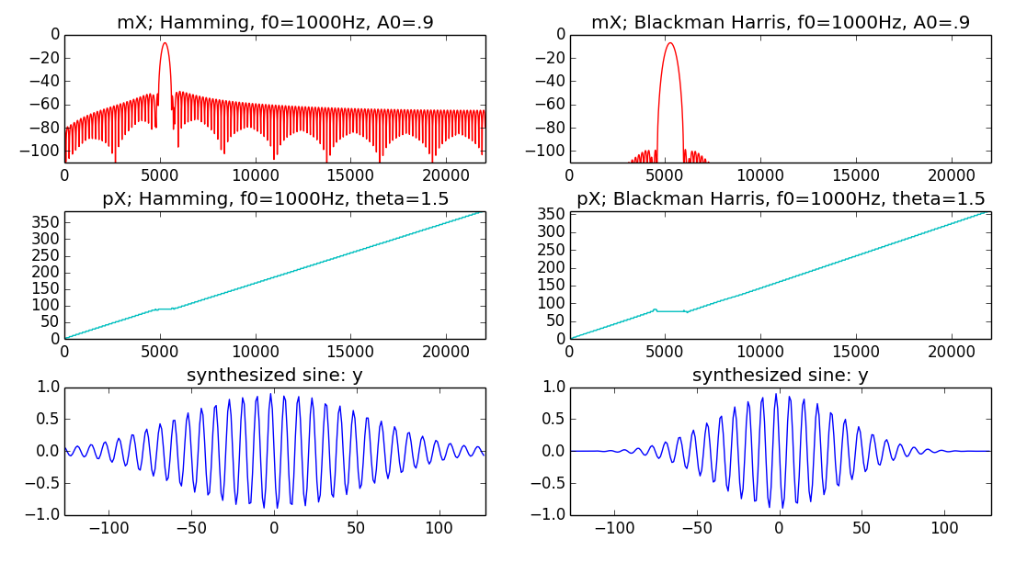
Sinusoidal synthesis: any frequency

Slide 8
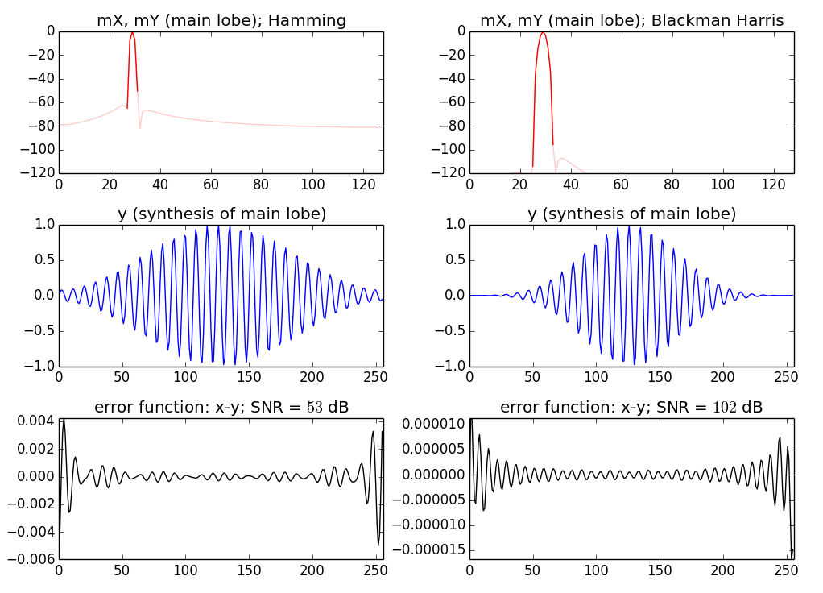
Sinusoidal synthesis: only main lobe

Slide 9
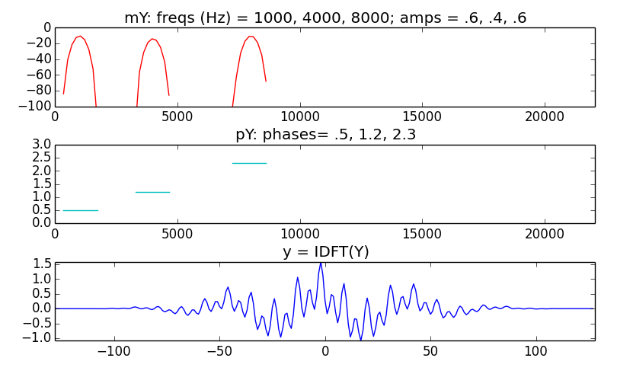
Additive synthesis

Slide 10
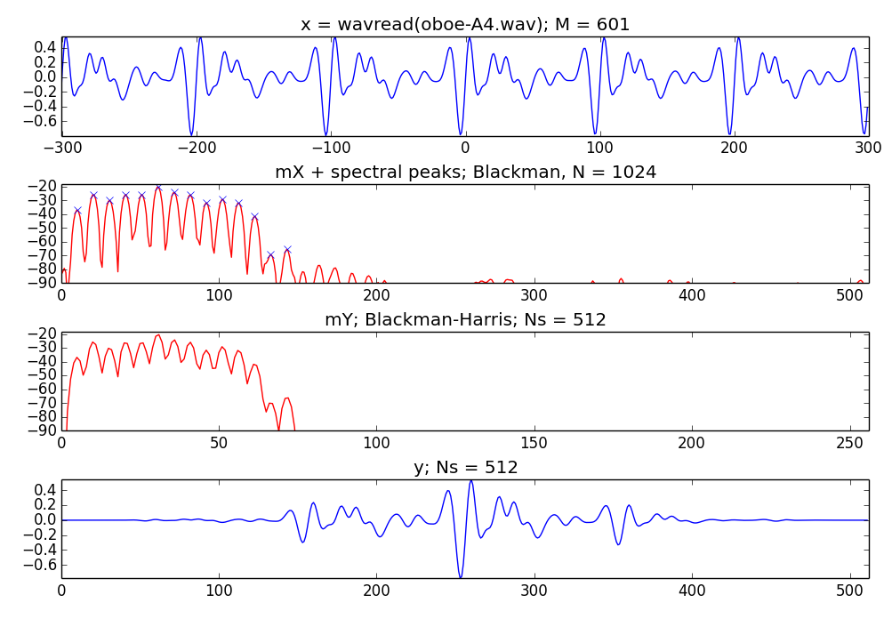
Analysis / Synthesis

Slide 11
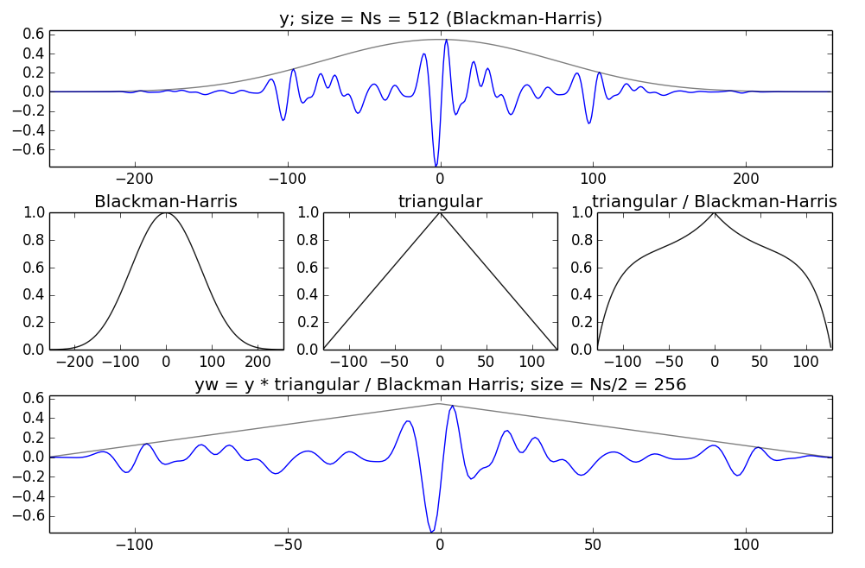
Synthesis window

Slide 12
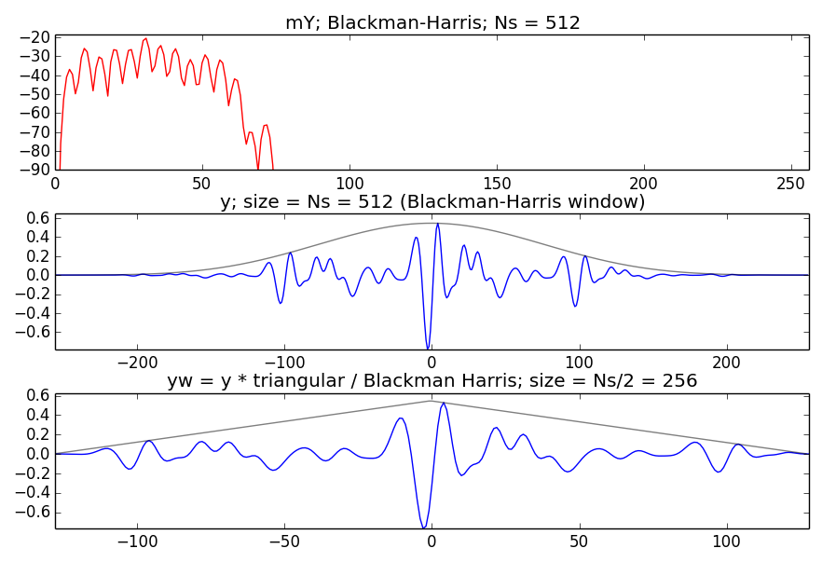
Synthesis for overlap of 50%

Slide 13
Sinusoidal model system
Analysis
Synthesis
w[n]
x[n]
|X[k]|
Peak detection
A_{r}
f_{r}
p_{r}
Sine spectral
synthesis
X
FFT
xw[n]
<X[k]
Y[k]
IFFT
yw[n]
Overlap-add
y[n]

Slide 14
References and credits
More information on this topic from Wikipedia:
  http://en.wikipedia.org/wiki/Additive_synthesis
  http://en.wikipedia.org/wiki/Sinusoidal_model
Good reference for Sinusoidal modeling by Julius O. Smith: https://ccrma.stanford.edu/~jos/sasp/Spectrum_Analysis_Sinusoids.html
Sounds used taken from Freesound: http://www.freesound.org/people/xserra/packs/13038/
All slides and code produced for this course are released using the CC Attribution-Noncommercial-Share Alike license or the Affero GPL license and available from https://github.com/MTG/sms-tools

Slide 15
