Slide 1
1T1: Audio Signal Processing for Music Applications:
Welcome
Xavier Serra
Universitat Pompeu Fabra, Barcelona
Notes:
Welcome everyone to the course on Audio Signal Processing for Music Applications.
This is the Welcome class, where I want to introduce you to the practical aspects of the course.

Slide 2
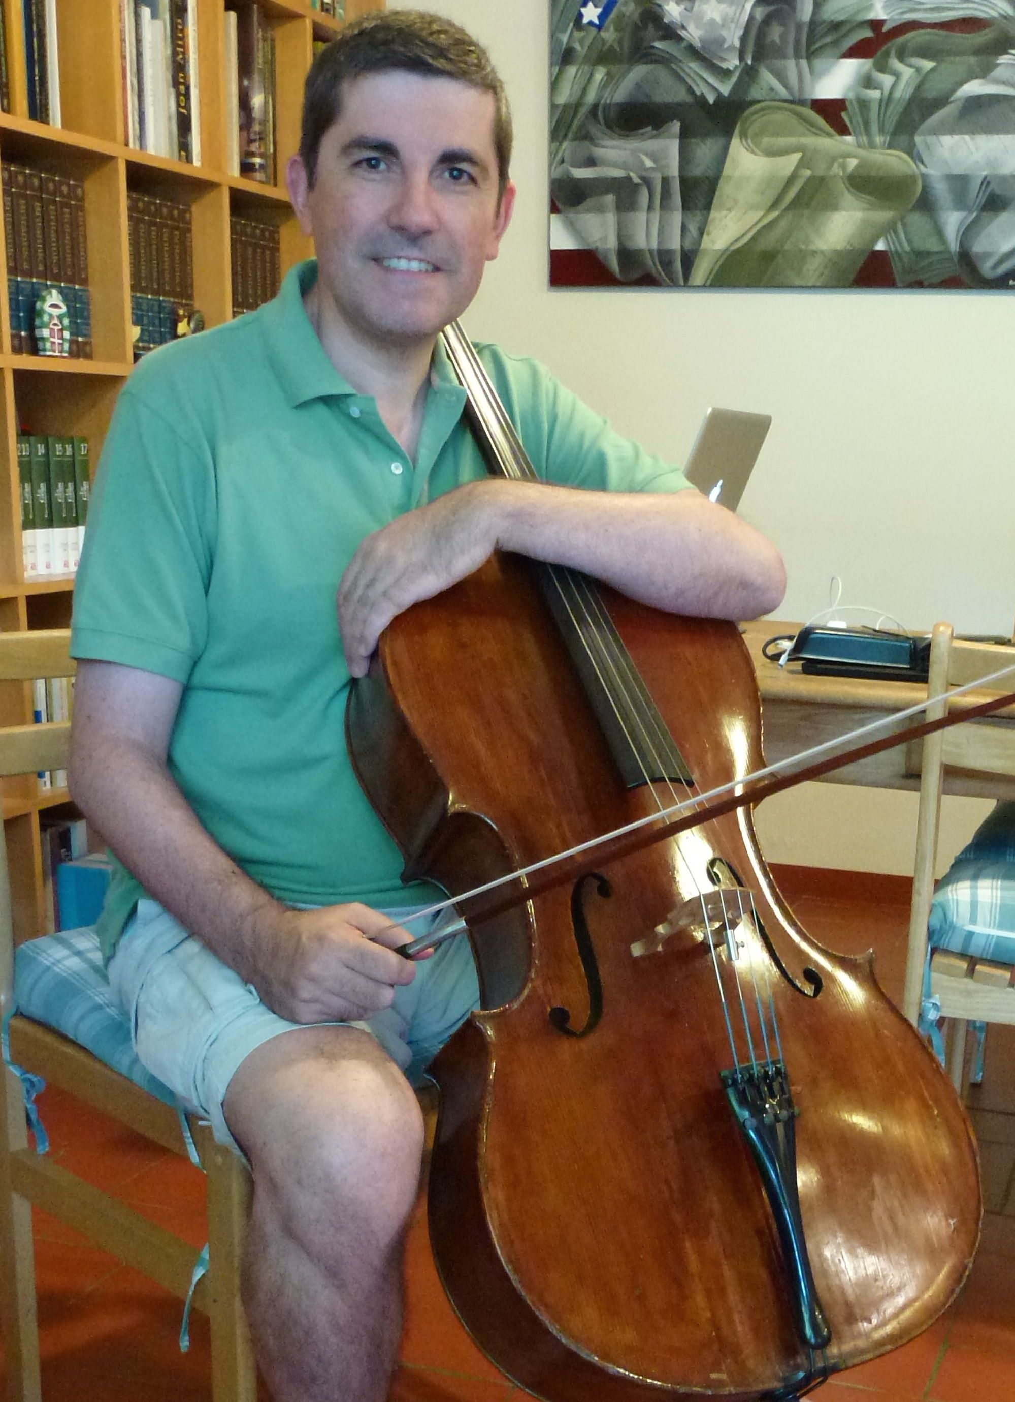
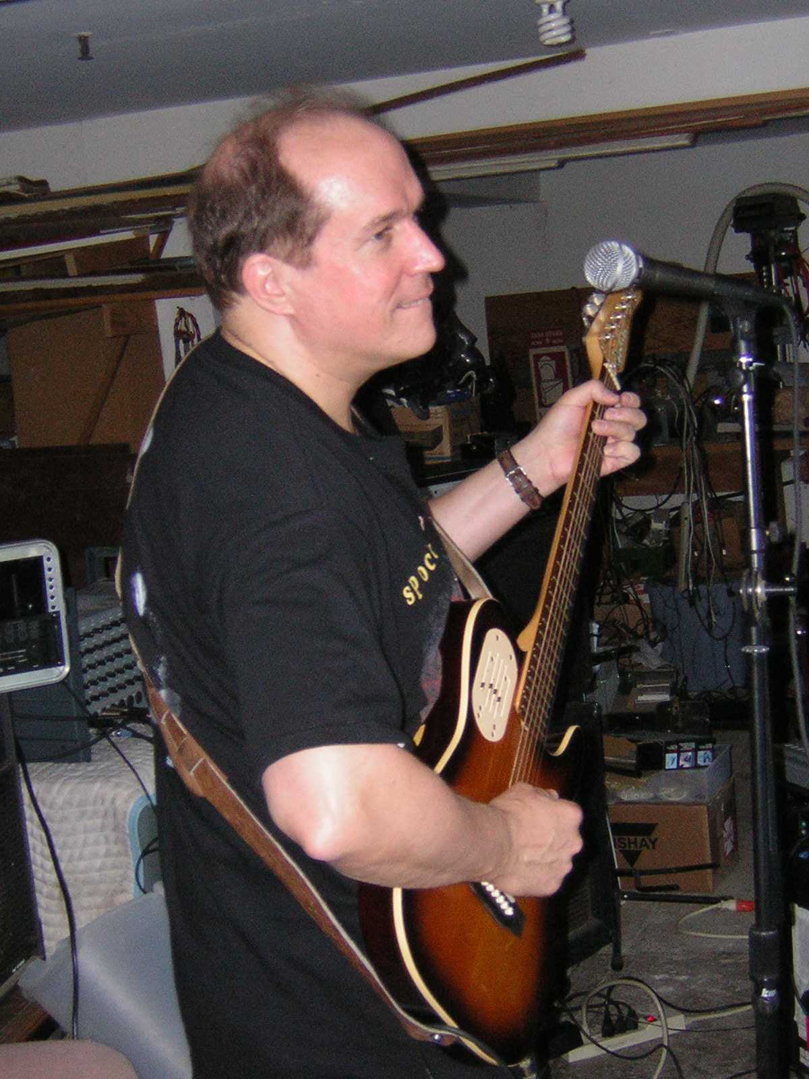
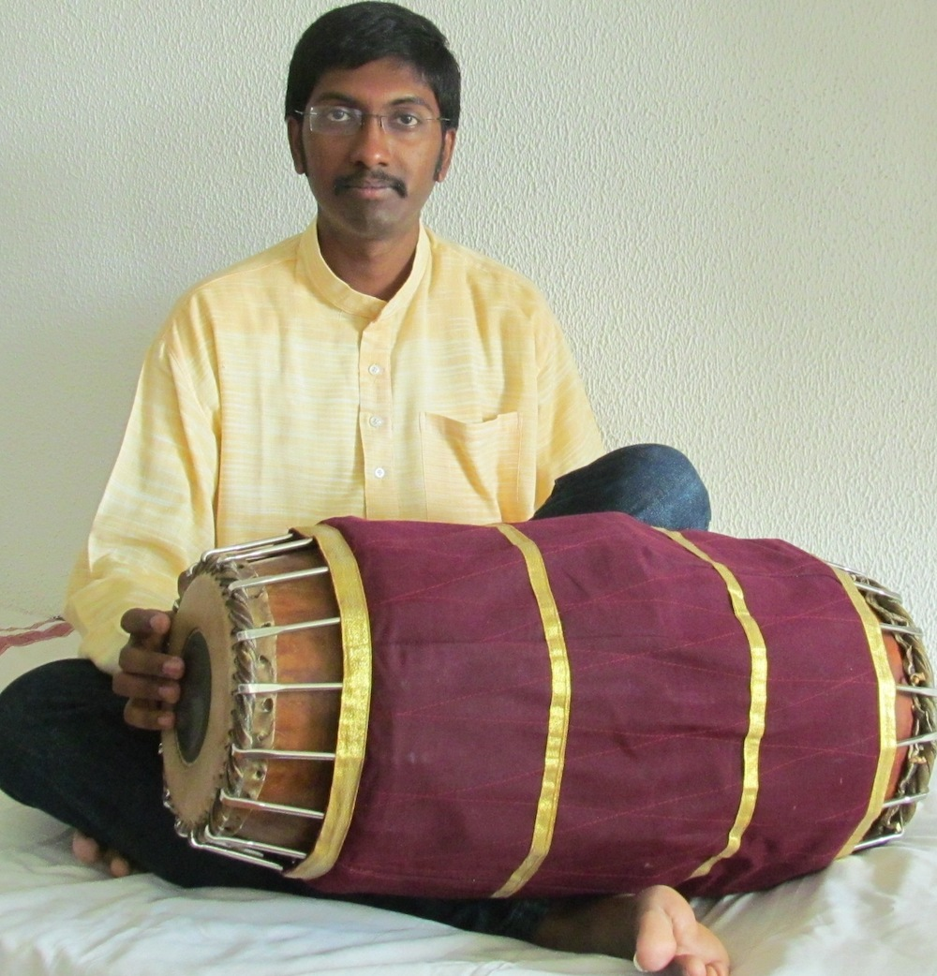
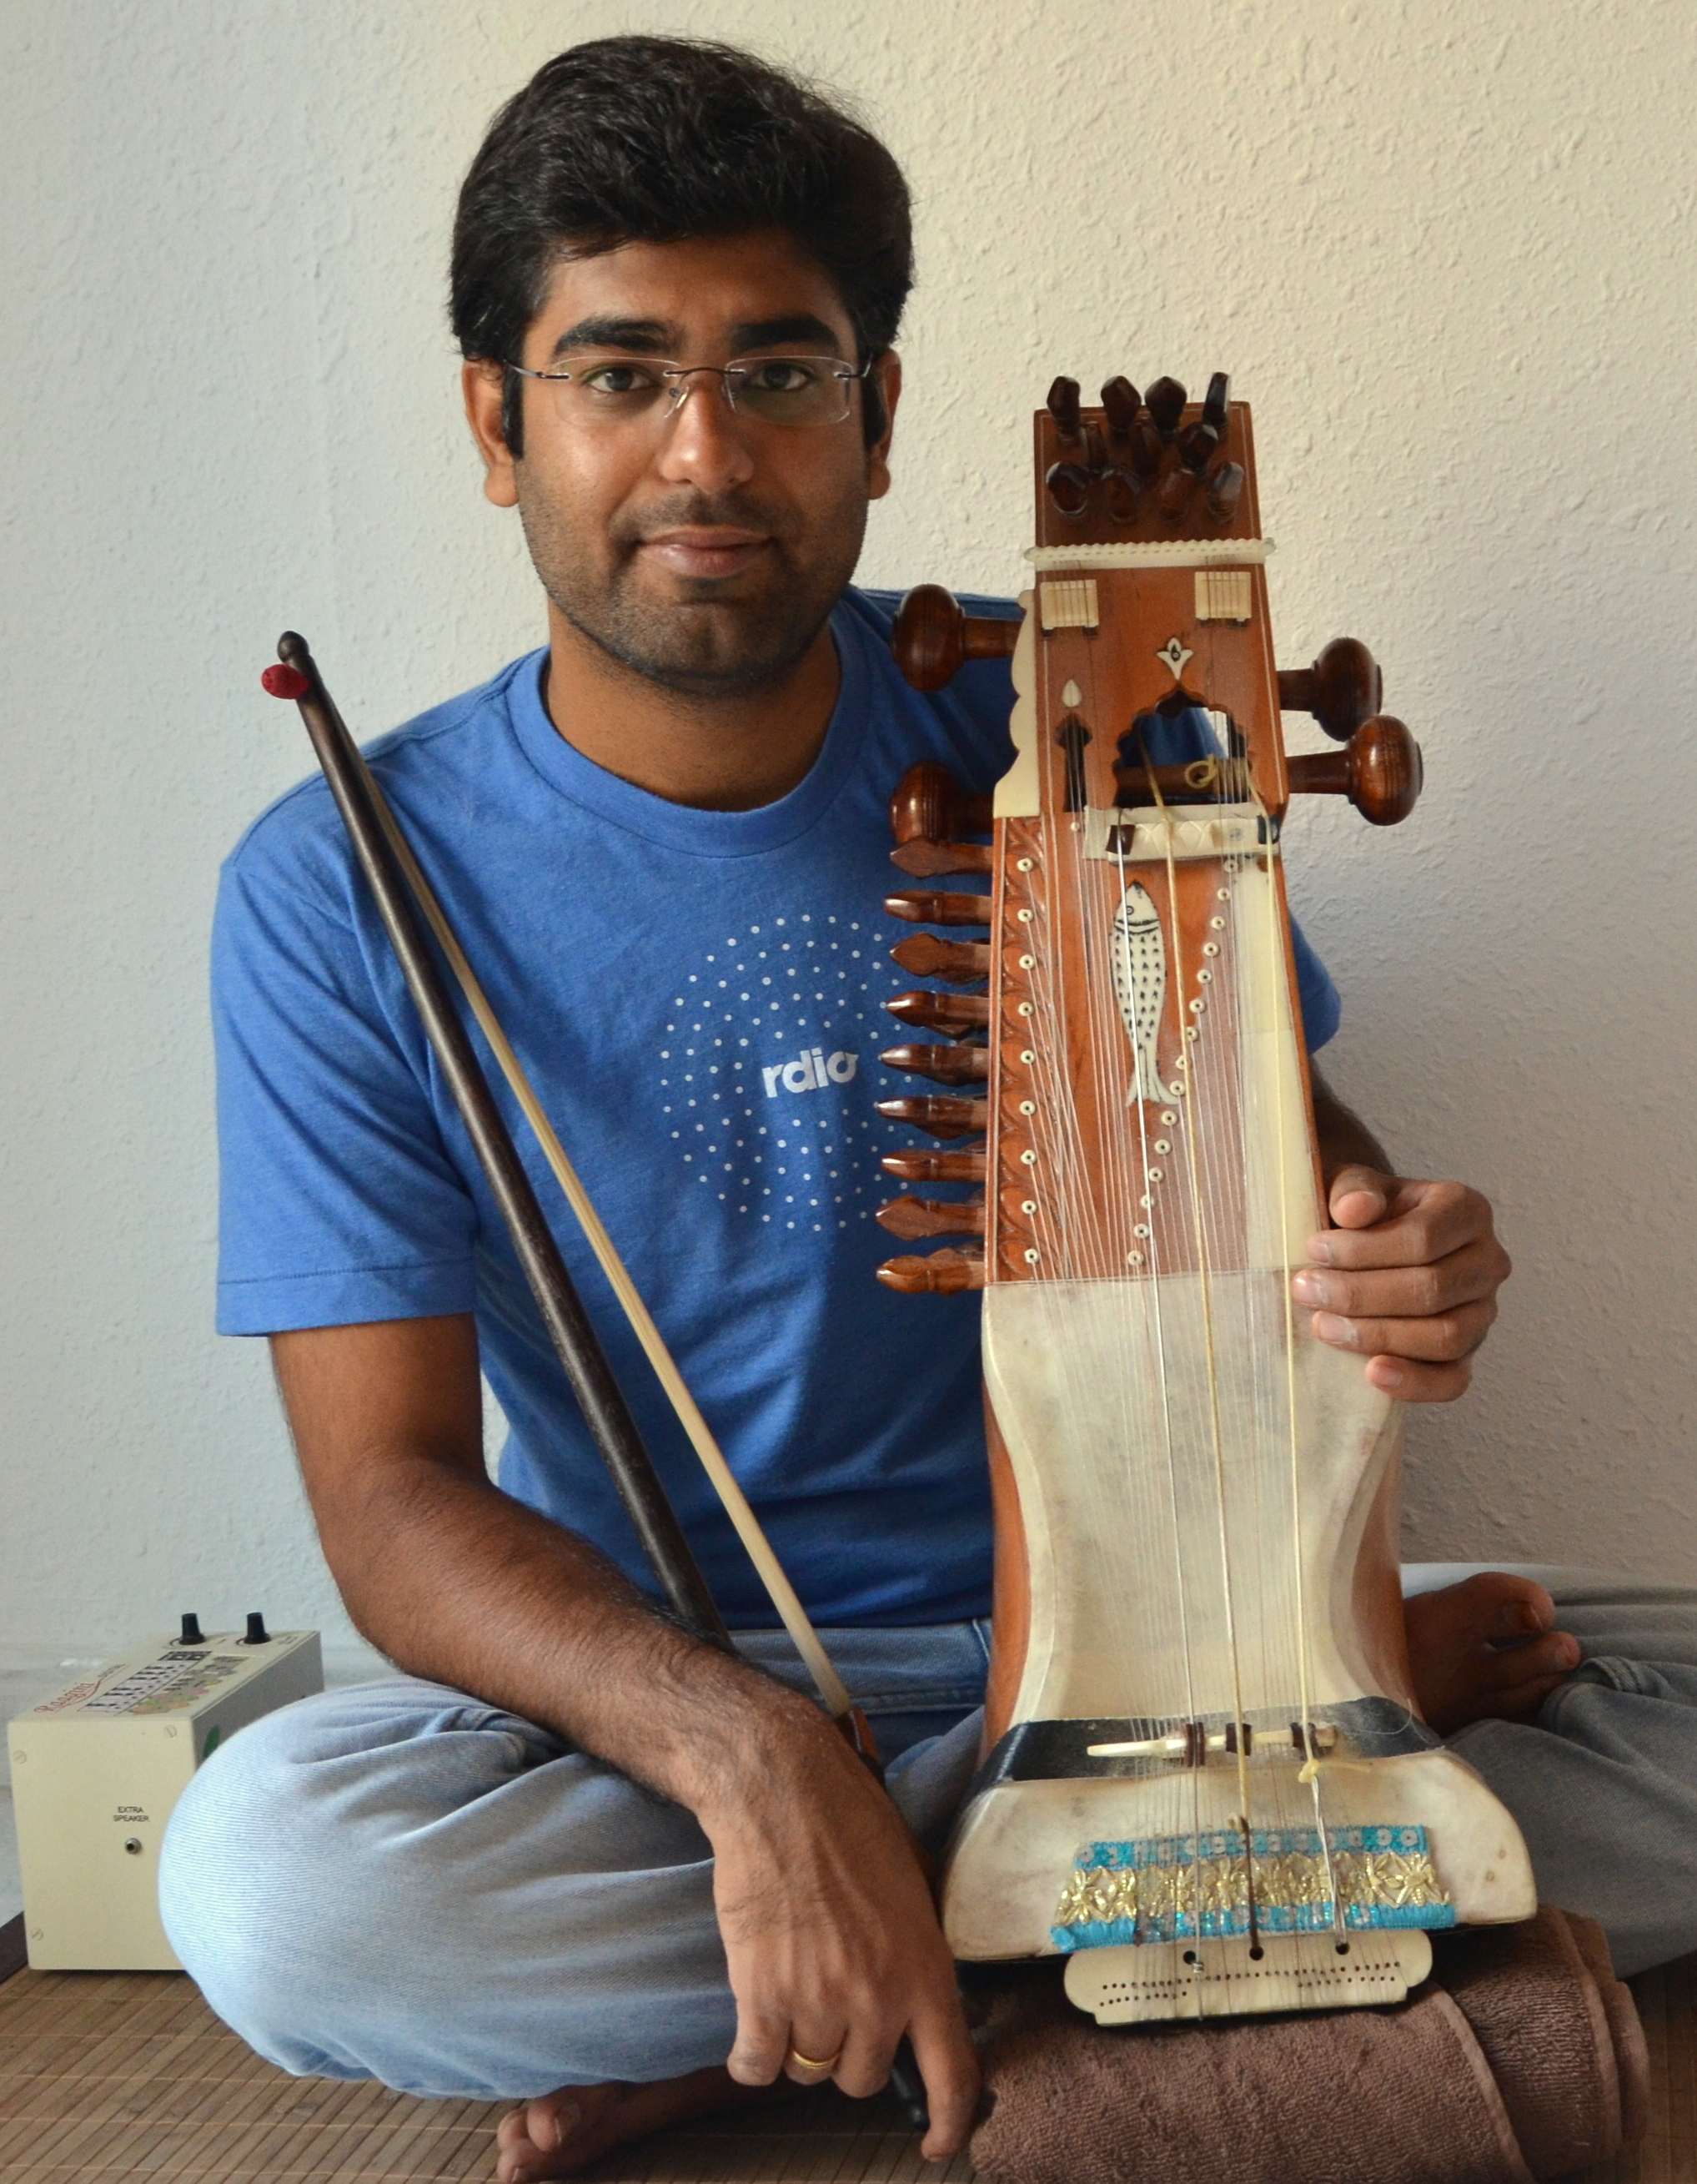
Xavier Serra
Julius O. Smith
Ajay Srinivasamurthy
Sankalp Gulati
Notes:
Who are we?

Slide 3
What is this course about?
Signal processing
Audio/Music
Programming
Analzing/making sounds
Notes:
...

Slide 4
Who is this course for?
Anyone interested in understanding how to analyze and process musical sounds
but ... able to:
  Follow mathematical formulations
  Use a programming language
  Use sound processing software
Notes:
...

Slide 5
Course organization
Duration: 10 weeks
Weekly content:
  Theory lectures (~30min)
  Programming lectures (~30min)
  Demo lectures (~30min)
  Advanced topics and references
  Assignments (programming + Quiz)
Notes:
a student will be able to take her own path

Slide 6
Course evaluation
Weekly quizzes (5 point each)
Weekly assignments (10 points each)
Pre- and Post- surveys (2 points each)

Slide 7
Open content !!
Videos and slides released under CC Attribution-Noncommercial-Share Alike license
Software released under Affero GPL license
Most references from Wikipedia.org
Sounds from Freesound.org
Notes:
I want to finish by mentioning that all the materials I will use and produce in this course are available under open licenses.
...

Slide 8
1T1: Audio Signal Processing for Music Applications:
Welcome
Xavier Serra
Universitat Pompeu Fabra, Barcelona
Notes:
Well....

