Slide 1
Audio Signal Processing for
Music Applications:
Welcome
Xavier Serra
Universitat Pompeu Fabra, Barcelona
&
Stanford University
Notes:
Welcome everyone

Slide 2
Who am I?

Slide 3
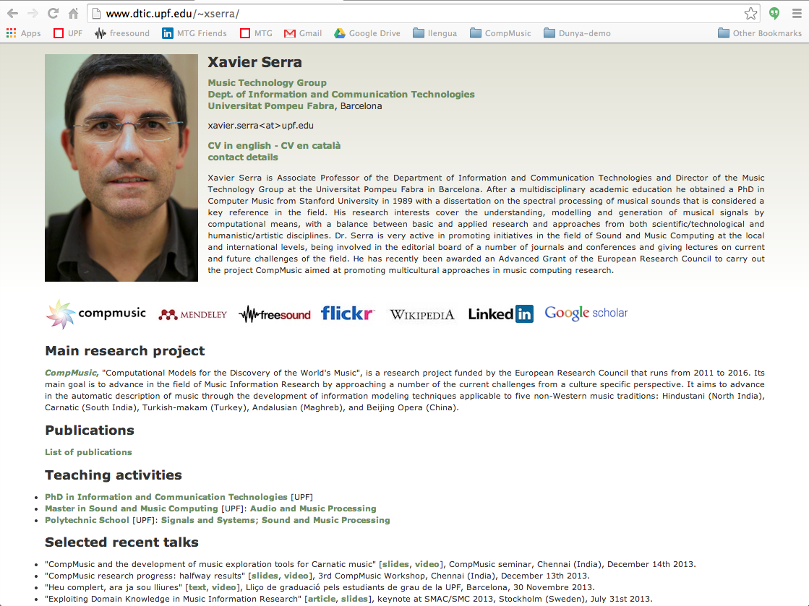

Slide 4
Who are my TA's?

Slide 6
Universitat Pompeu Fabra, Barcelona
&
Stanford University
Notes:
...

Slide 8
Music Technology Group (MTG)
&
Center for Computer Research in Music and Acoustics (CCRMA)

Slide 10
Who is this course for?
Anyone interested in understanding how to analyze and process musical sounds.
but ... able to:
  Follow mathematical formulations
  Use a programming language
  Use sound processing software
Notes:
...

Slide 11
Course organization
Duration: 10 weeks
Weekly content:
  Theory lectures (~30h/week)
  Programming lectures (~30h/week)
  Demo lectures (~30h/week)
  Programming/practical assignments
Notes:
a student will be able to take her own path

Slide 12
Course evaluation
Lecture quizzes
Programming assignments
Peer-graded assignments

Slide 13
Open content !!
Videos and slides released using the CC Attribution-Noncommercial-Share Alike license
Software released using the Affero GPL license
Most references from Wikipedia.org
Sounds from Freesound.org
Notes:
I want to finish by mentioning that all the materials I will use and produce in this course are available under open licenses.
...

Slide 14
Audio Signal Processing for
Music Applications:
Welcome
Xavier Serra
Universitat Pompeu Fabra, Barcelona
&
Stanford University
Notes:
Well....

