Slide 1
Sinusoidal plus Residual Modeling
Xavier Serra
Music Technology Group
Universitat Pompeu Fabra, Barcelona
http://mtg.upf.edu

Slide 2
Index
Sinusoidal plus residual model
Sinusoidal subtraction
Stochastic approximation of residual
Implementation

Slide 3
Sinusoidal plus Residual model
when e[n] is an stochastic signal, it can be modeled as filtered white noise:
otherwise:

Slide 4
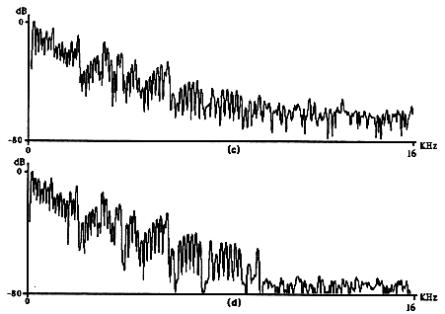
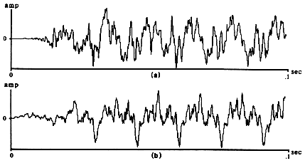
Sinusoidal subtraction
original sound
original sound
spectrum
additive synthesis
Reconstruction without
phase matching
spectrum of
synthesized sound

Slide 5
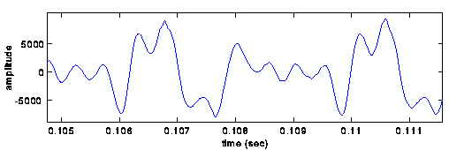
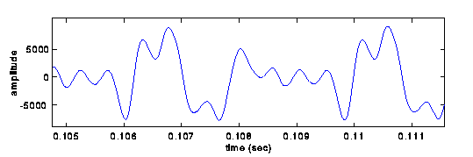
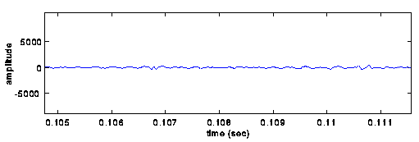
original sound
synthesized sound
with phase matching
residual sound

Slide 6
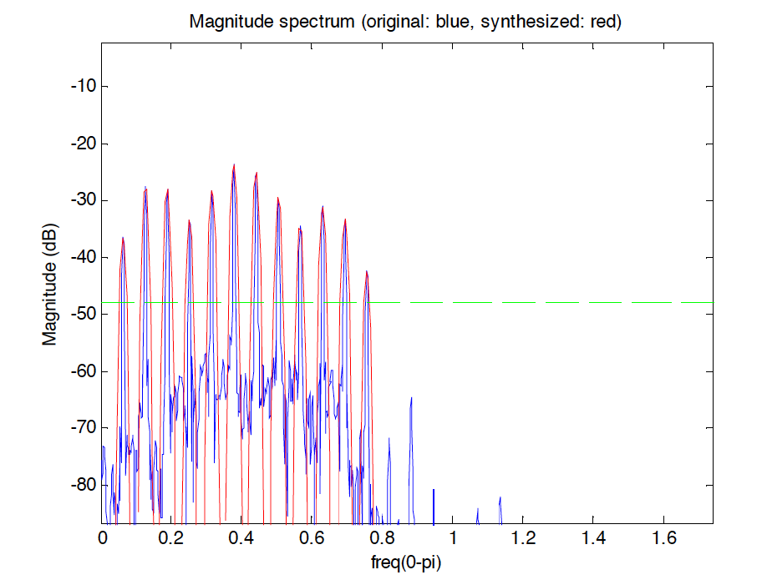
Frequency domain subtraction

Slide 7
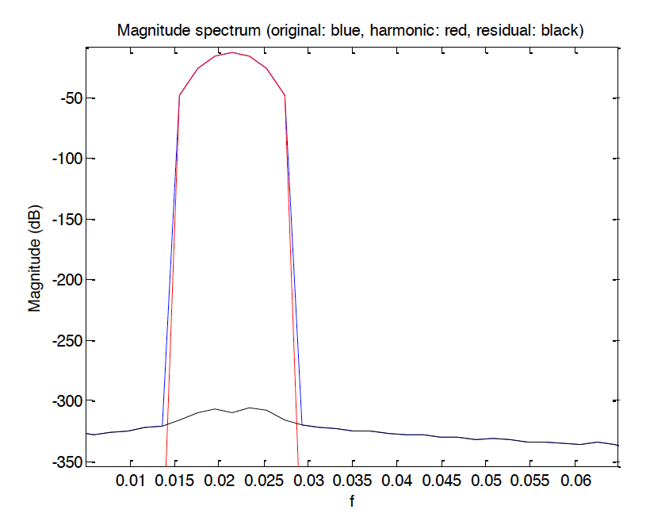

Slide 8
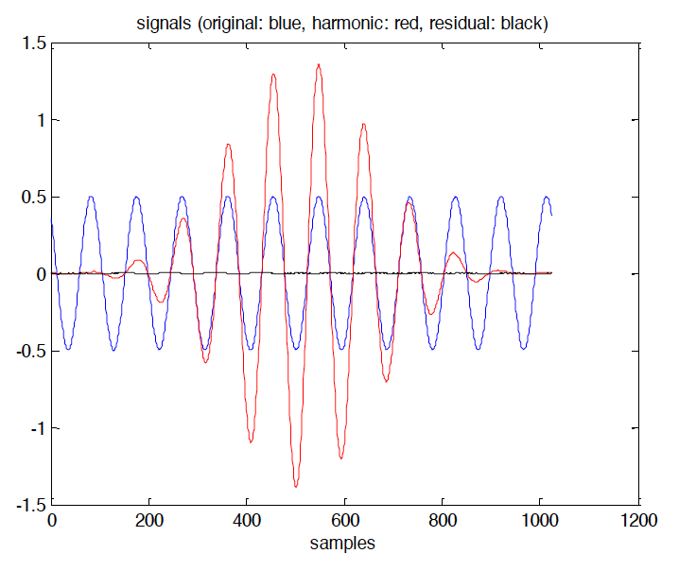

Slide 9
Residual modeling
Stochastic spectrum analysis:
Stochastic processes
  described by the laws of probability, mean, variance, probability distributions
Autocorrelation
Power spectral density

Slide 10
Stochastic model of residual
By assuming that e(t) is a stochastic signal, it can be described as filtered white noise,

Slide 11
IIR-filter approximation
LPC model:
The error is minimized by minimizing the mean of the total
squared error with respect to each of the parameters.

Slide 12
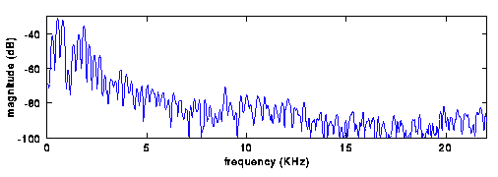
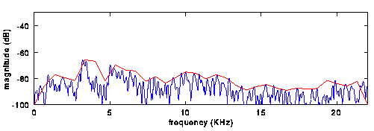
Spectral envelopes
original spectrum
residual spectrum
and its approximation

Slide 13
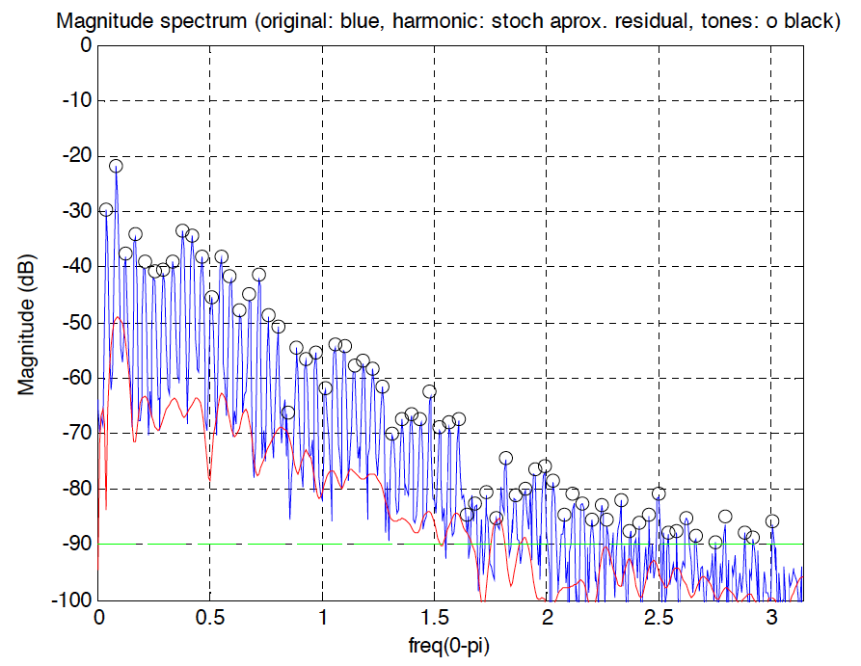

Slide 14
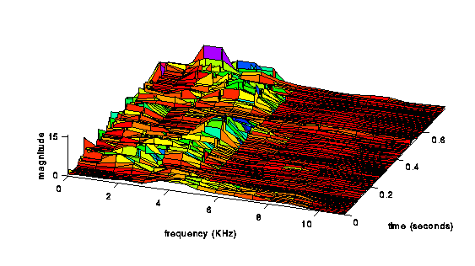
normalized spectral envelopes of a residual

Slide 15


Residual synthesis
Noise generation:
  Algorithms for random number generation
  White noise, other types of noises
  Gaussian noise
direct form
structure
lattice
structure

Slide 16
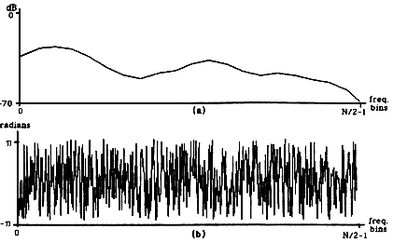
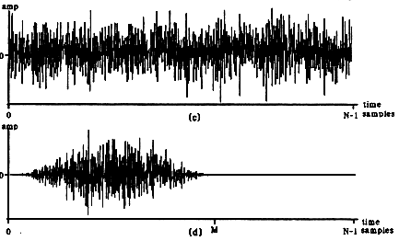
Noise synthesis using IFFT
spectral magnitude
approximation of residual
random spectral phase
synthesized sound
synthesized sound
with window

Slide 17
FFT
Peak detection
F0
detection
Sine spectral
synthesis
FFT
Stochastic approx
Random phase
generation
Stoc. spectral
synthesis
IFFT
Overlap-add

Slide 18
References
https://ccrma.stanford.edu/~jos/sasp/Spectrum_Analysis_Sinusoids.html

Slide 19
Credits
All the slides of this presentation are released under an Attribution-Noncommercial-Share Alike license.

