Slide 1
Harmonic Modeling
Xavier Serra
Music Technology Group
Universitat Pompeu Fabra, Barcelona
http://mtg.upf.edu

Slide 2
Index
Harmonic Model
Sinusoids-Partials-Harmonics
F0 detection
Harmonic tracking
Implementation

Slide 3
Harmonic model

Slide 4
Sinusoids-Partials-Harmonics
Any time-varying spectrum can be modeled as the sum of time-varying sinusoids.
Most of the spectral bins in a spectrum do not correspond to actual partials of the analyzed sound.
A sound partial is the result of a main mode of vibration of the generating system.
Partials can be modeled as slowly time-varying sinusoids.
A partial in the frequency domain can be identified by its spectral shape (magnitude and phase), its relation to other partials, and its time evolution.
When the partials of a sound are related harmonically we call them harmonics.

Slide 5
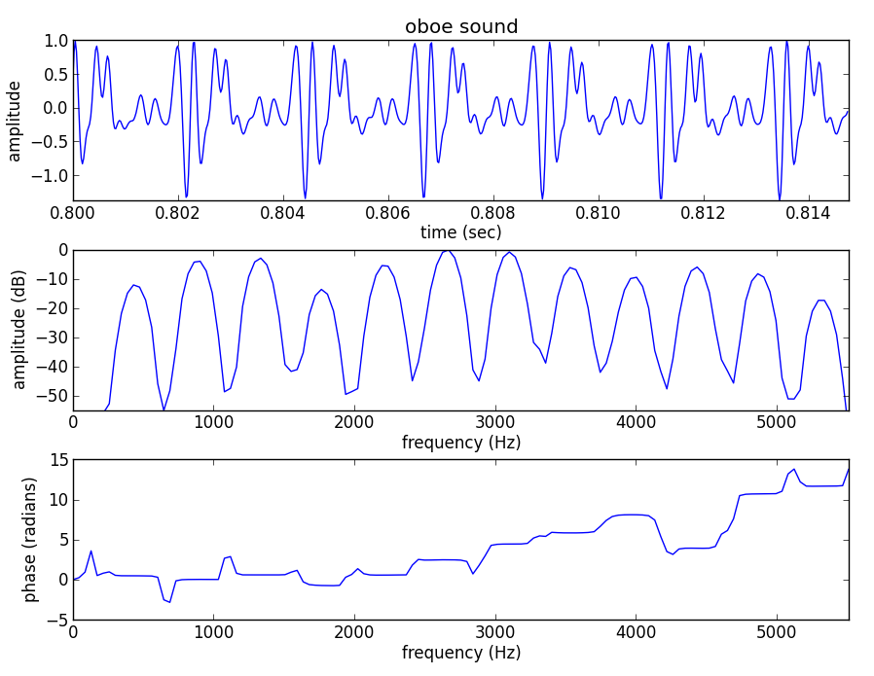

Slide 6
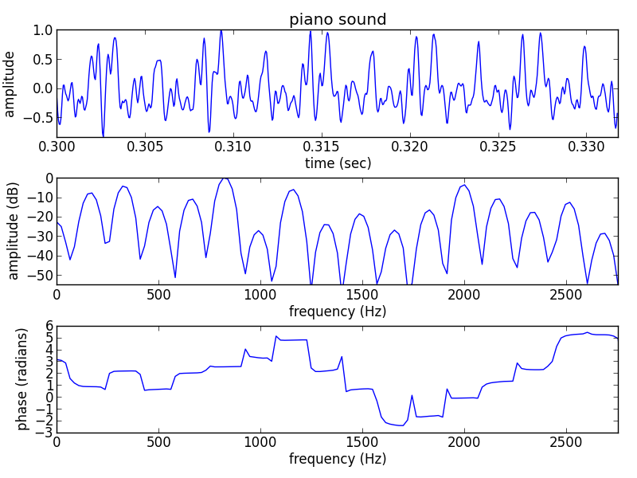

Slide 7
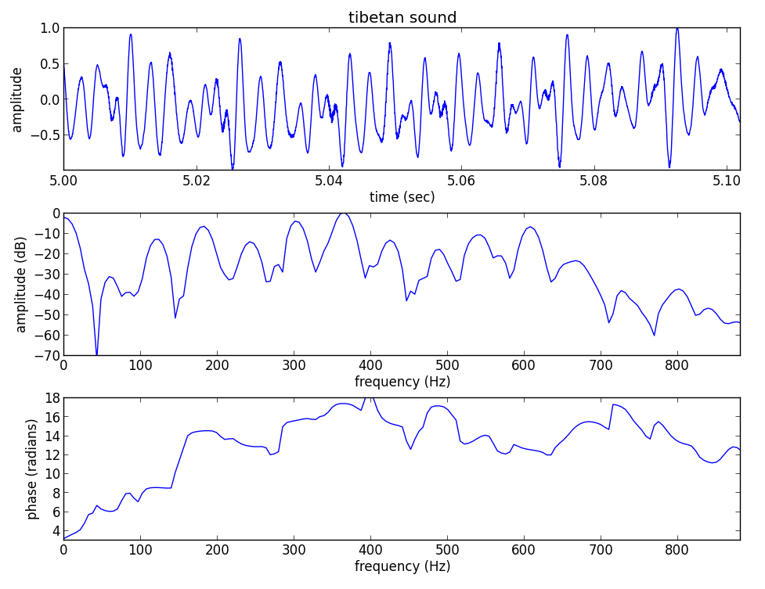

Slide 8
F0 detection in time domain
Autocorrelation

Slide 9
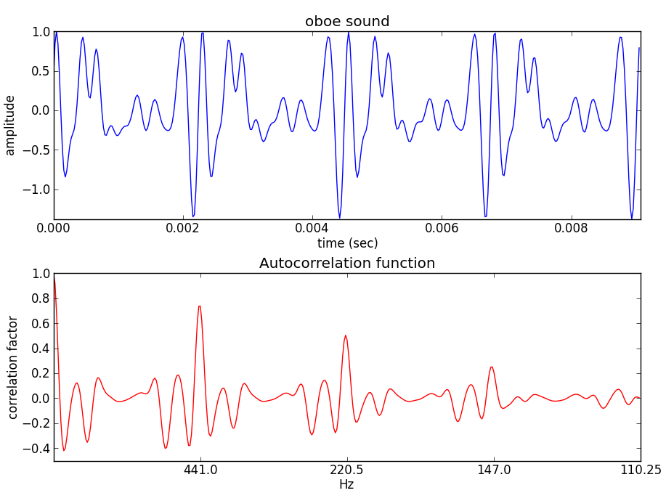

Slide 10
(fs, x) = read('oboe.wav')
M = 400
str = .8*fs
xp = x[str:str+M]/float(max(x[str:str+M]))
z = np.correlate(xp,xp,'full')
plt.subplot(211)
plt.plot(np.arange(M)/float(fs), xp)
plt.subplot(212)
plt.plot(z[M-1:]/max(z),'r')

Slide 11
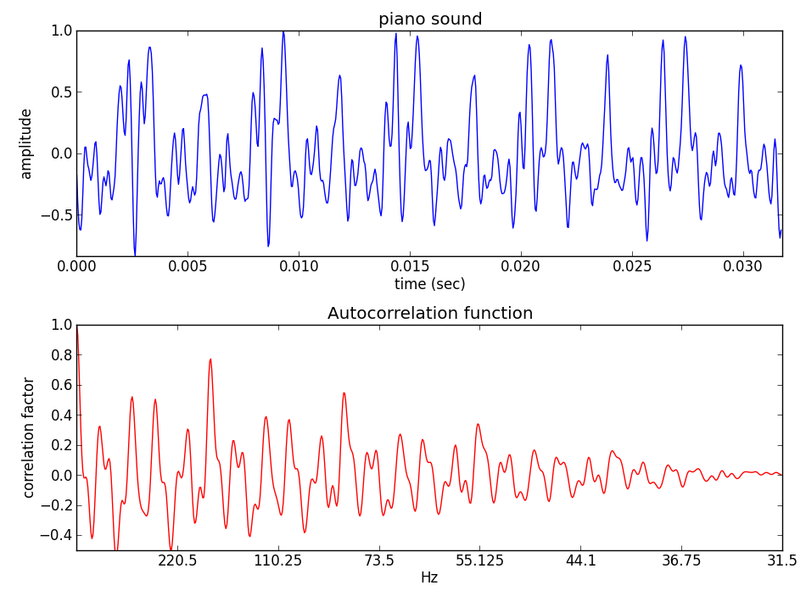

Slide 12
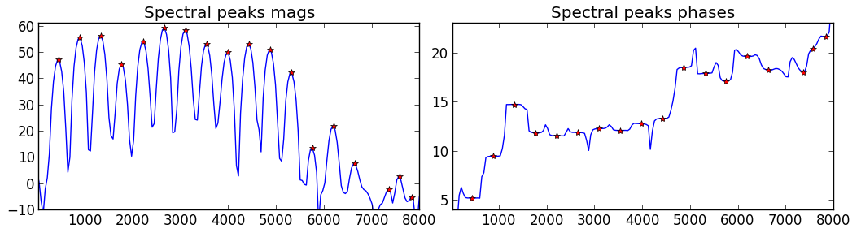
F0 detection from spectral peaks
The fundamental frequency can be defined as the common divisor of the harmonic series that best explains the spectral peaks.
Steps:
  Choose possible fundamental candidates.
  Measure the “goodness” of the resulting harmonic series
  compared with the spectral peaks.
  Get the best candidate.

Slide 13
Two-way mismatch
error calculation
(Maher and Beauchamp, 94)
7F
6F
5F
4F
3F
2F
F

Slide 14
Total error:
Maher and Beauchamp propose:

Slide 15
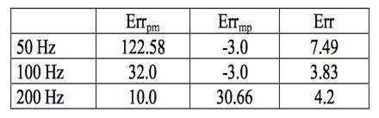
TWM calculation from a harmonic series that includes the frequencies: 200, 300, 500, 600, 700, 800.

Slide 16
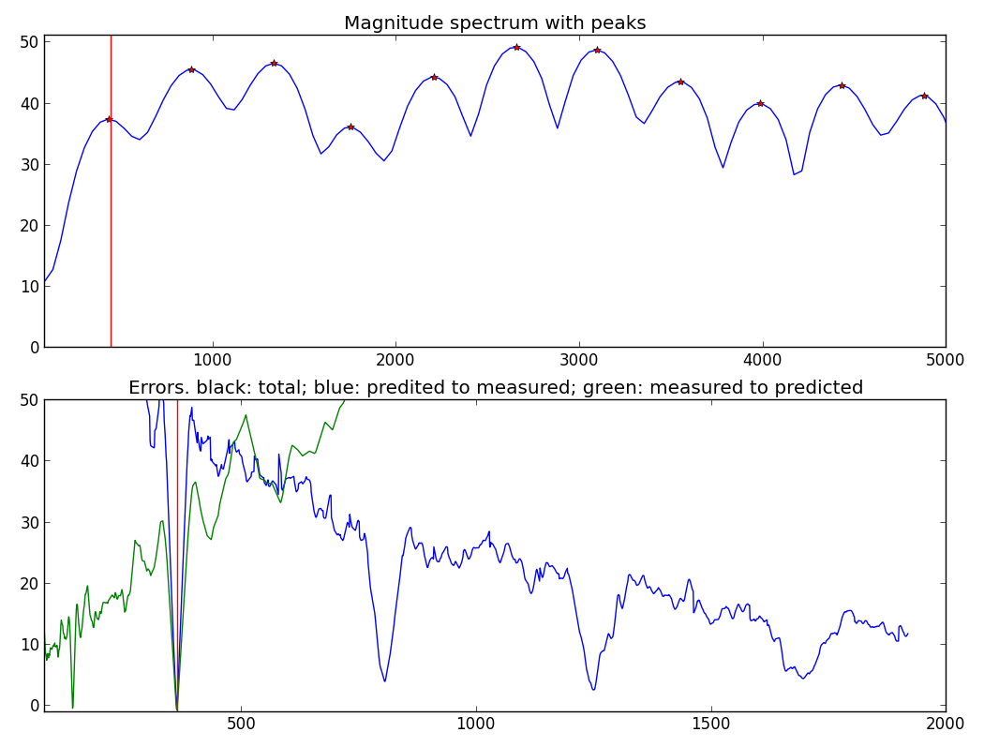

Slide 17
p = 0.5
q = 1.4
r = 0.5
rho = 0.33
Amax = max(pmag)
harmonic = np.matrix(f0cand)
MaxNPM = min(maxnpeaks, pfreq.size)
for i in range(0, MaxNPM) :
difmatrixPM = harmonic.T * np.ones(pfreq.size)
difmatrixPM = abs(difmatrixPM - np.ones((harmonic.size, 1))*pfreq)
FreqDistance = np.amin(difmatrixPM, axis=1)
peakloc = np.argmin(difmatrixPM, axis=1)
Ponddif = np.array(FreqDistance) * (np.array(harmonic.T)**(-p))
PeakMag = pmag[peakloc]
MagFactor = 10**((PeakMag-Amax)/20)
ErrorPM = ErrorPM + (Ponddif + MagFactor*(q*Ponddif-r)).T
harmonic = harmonic+f0cand
MaxNMP = min(maxnpeaks, pfreq.size)
for i in range(0, f0cand.size) :
nharm = np.round(pfreq[:MaxNMP]/f0cand[i])
nharm = (nharm>=1)*nharm + (nharm<1)
FreqDistance = abs(pfreq[:MaxNMP] - nharm*f0cand[i])
Ponddif = FreqDistance * (pfreq[:MaxNMP]**(-p))
PeakMag = pmag[:MaxNMP]
MagFactor = 10**((PeakMag-Amax)/20)
ErrorMP[i] = sum(MagFactor * (Ponddif + MagFactor*(q*Ponddif-r)))
Error = (ErrorPM/MaxNPM) + (rho*ErrorMP/MaxNMP)
f0index = np.argmin(Error)
f0 = f0cand[f0index]

Slide 18
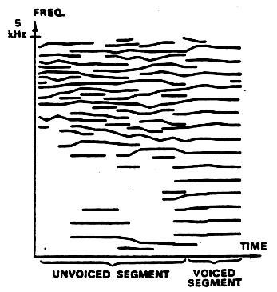
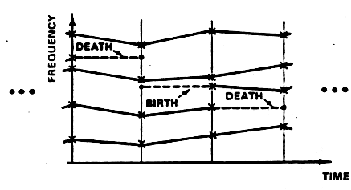
Peak continuation
McAulay and Quatieri approach:
frequency tracker
frequency tracks of speech

Slide 19
Harmonic tracking
f0 = fd.f0DetectionTwm(iploc, ipmag, N, fs, f0et, minf0, maxf0)
hf = (f0>0)*(f0*np.arange(1, nH+1))
hi = 0
npeaks = ploc.size
while f0>0 and hi<nH and hf[hi]<fs/2 :
dev = min(abs(iploc/N*fs - hf[hi]))
pei = np.argmin(abs(iploc/N*fs - hf[hi]))
if (hi==0 or not any(hloc[:hi]==iploc[pei])) and dev<maxhd*hf[hi]:
hloc[hi] = iploc[pei]
hmag[hi] = ipmag[pei]
hphase[hi] = ipphase[pei]
hi += 1
hloc = (hloc!=0) * (hloc*Ns/N)

Slide 20
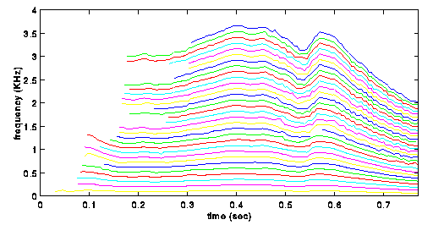
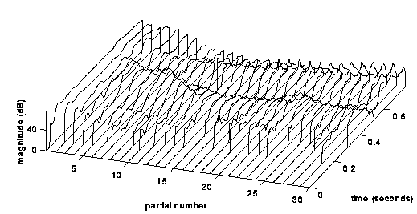
frequency trajectories
magnitude trajectories

Slide 21
Implementation: Harmonic model
w[n]
|X[k]|
x[n]
Peak detection
A_{r}
f_{r}
p_{r}
F0
detection
FFT
xw[n]
<X[k]
f₀
A_{h}
f_{h}
p_{h}
Analysis
Synthesis
Sine spectral
synthesis
Yh[k]
IFFT
yhw[n]
Overlap-add
yh[n]

Slide 22
def harmonicModel(x, fs, w, N, t, nH, minf0, maxf0, f0et, maxhd):
Ns = 512
w = w / sum(w)
ow = triang(2*H)
sw[hNs-H:hNs+H] = ow
bh = blackmanharris(Ns) / sum(bh)
sw[hNs-H:hNs+H] = sw[hNs-H:hNs+H] / bh[hNs-H:hNs+H]
while pin<pend:
#-----analysis-----
xw = x[pin-hM1:pin+hM2] * w
fftbuffer[:hM1] = xw[hM2:]
fftbuffer[N-hM2:] = xw[:hM2]
X = fft(fftbuffer)
mX = 20 * np.log10( abs(X[:hN]) )
ploc = PP.peakDetection(mX, hN, t)
pX = np.unwrap( np.angle(X[:hN]) )
iploc, ipmag, ipphase = PP.peakInterp(mX, pX, ploc)
f0 = fd.f0DetectionTwm(iploc, ipmag, N, fs, f0et, minf0, maxf0)
hf = (f0>0)*(f0*np.arange(1, nH+1))
while f0>0 and hi<nH and hf[hi]<fs/2 :
dev = min(abs(iploc/N*fs - hf[hi]))
pei = np.argmin(abs(iploc/N*fs - hf[hi]))
if ( hi==0 or not any(hloc[:hi]==iploc[pei]) ) and dev<maxhd*hf[hi] :
hloc[hi] = iploc[pei]
hmag[hi] = ipmag[pei]
hphase[hi] = ipphase[pei]
hi += 1
hloc = (hloc!=0) * (hloc*Ns/N)
#-----synthesis-----
Yh = GS.genSpecSines(hloc, hmag, hphase, Ns)
fftbuffer = np.real( ifft(Yh) )
yh[:hNs-1] = fftbuffer[hNs+1:]
yh[hNs-1:] = fftbuffer[:hNs+1]
y[pin-hNs:pin+hNs] += sw*yh
pin += H
return y

Slide 23
References
http://en.wikipedia.org/wiki/Fundamental_frequency
http://en.wikipedia.org/wiki/Pitch_detection_algorithm

Slide 24
Credits
All the slides of this presentation are released under an Attribution-Noncommercial-Share Alike license.

