Slide 1
2T1: The Discrete Fourier Transform (1 of 2)
Xavier Serra
Universitat Pompeu Fabra, Barcelona
Notes:
Welcome again to the course on Audio Signal Processing for Music Applications!!
In this lecture I start with our most fundamental topic, the Discrete Fourier Transform. If you can follow and understand this topic you should have no problem in following the whole course.
I divided this topic in two lectures, this is the first one.

Slide 2
Index
DFT equation
Complex exponentials in the DFT
Scalar product in the DFT
Notes:
We will start with the Discrete Fourier Transform equation and then explain its two basic components.
...

Slide 3
Discrete Fourier Transform
Notes:
This is it!!! This is the most important equation to be shown in the whole course. So, pay attention!!
...
This equation can be decomposed into two parts: the complex exponential and the dot product.

Slide 4
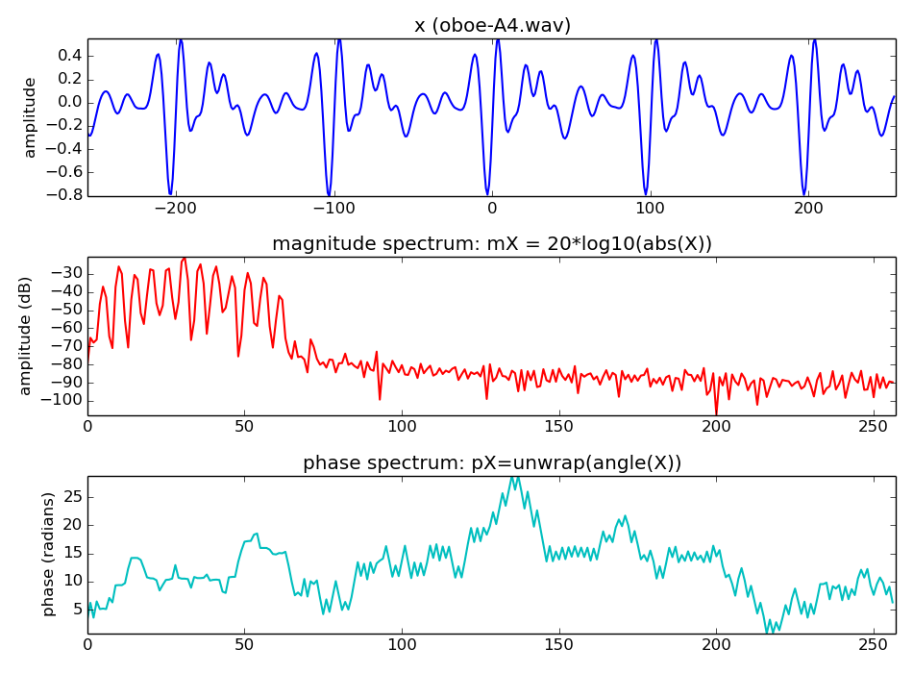
Notes:
Here we show an input signal, x[n], and the output of the DFT, X[k], the spectrum. it is a real sound, a fragment of an oboe sound.
...

Slide 5
DFT: complex exponentials
Notes:
As we said, in the DFT equation the input signal x[n] is multiplied by a series of complex exponentials, complex sinewaves.
These sinewaves are the basis functions of the DFT, the components that we will identify and measure in the input signal.
...
A signal of size N=4 will be projected into 4 sinewaves of size 4.

Slide 6
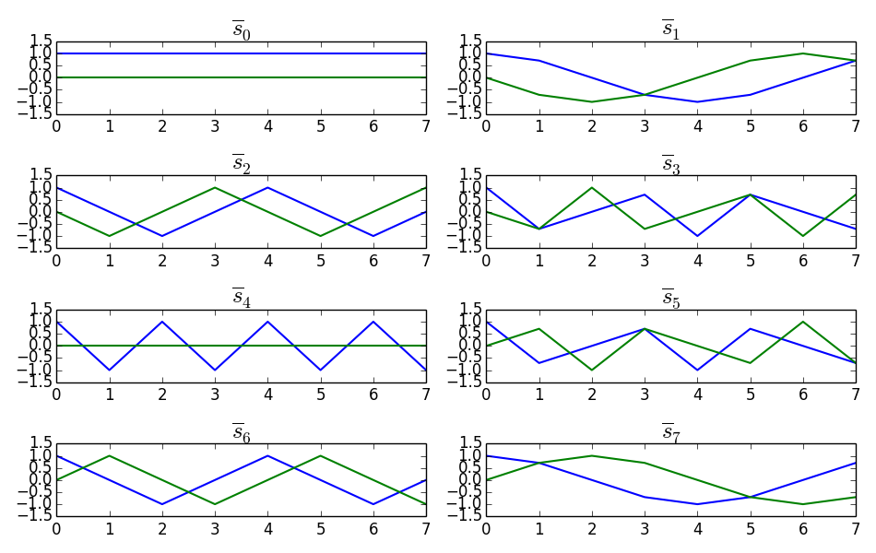
DFT: complex exponentials
Notes:
If the signal has a size N=8 we will need 8 complex sinewaves, like these ones.
...

Slide 7
DFT: scalar product
Example:
Notes:
The DFT equation can also be expressed by this equation, which emphasizes the scalar product operation of the input signal x[n] by the N complex sinewaves.
...

Slide 8
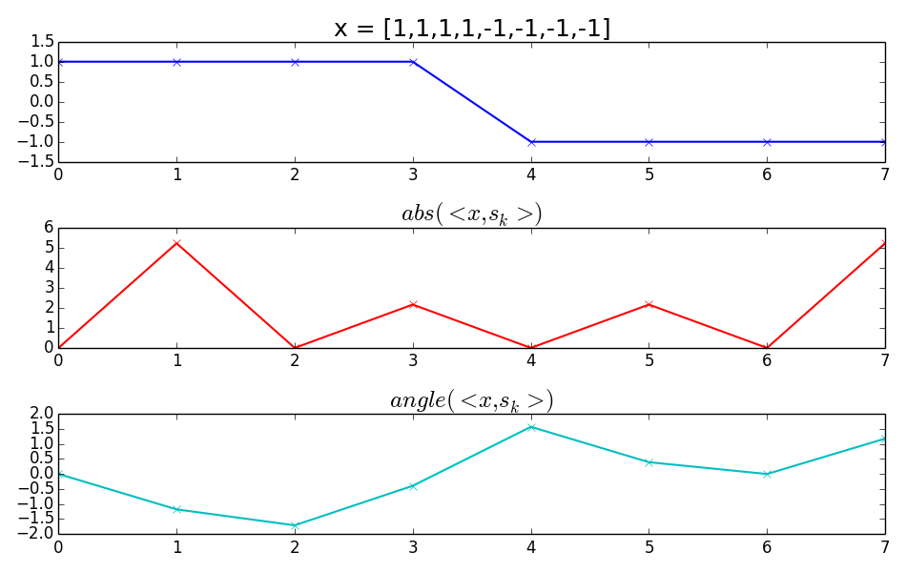
DFT: scalar product
Notes:
This is an example of the scalar product operation, of the DFT of a simple sequence.
...
This is the DFT operation.

Slide 9
References and credits
More information in:
https://en.wikipedia.org/wiki/Discrete_Fourier_transform
Reference on the mathematics of the DFT from Julius O. Smith: https://ccrma.stanford.edu/~jos/mdft/
Sounds from: http://www.freesound.org/people/xserra/packs/13038
Slides and code released using the CC Attribution-Noncommercial-Share Alike license or the Affero GPL license and available from https://github.com/MTG/sms-tools
Notes:
You can find more information on the DFT in Wikipedia and in the website of Julius Smith.
From now on all lectures will use sounds. All of them come from freesound and they can be obtained from this link.
...

Slide 10
2T1: The Discrete Fourier Transform (1 of 2)
Xavier Serra
Universitat Pompeu Fabra, Barcelona
Notes:
We have shown and explained the DFT equation, I hope you realized that is not such a complex thing.
But even if you feel it is complex, its use in audio signal processing is huge, so it is worth speding some time with it.
We will continue with the DFT in the second part of this lecture.
Thanks for your attention!!!

