Slide 1
5T3: Sinusoidal Model
(3 of 3)
Xavier Serra
Universitat Pompeu Fabra, Barcelona
Notes:
Welcome back to the course on Audio Signal Processing for Music Applications.
In the previous two lectures we presented the sinusoidal model, the analysis part. In this lecture we will finish the topic by talking about the synthesis part of the model.

Slide 2
Index
Sinusoidal model and spectral peak tracks
Sinusoidal (additive) synthesis
Sinusodal model system
Notes:
After a quick review of the sinusoidal model
....

Slide 3
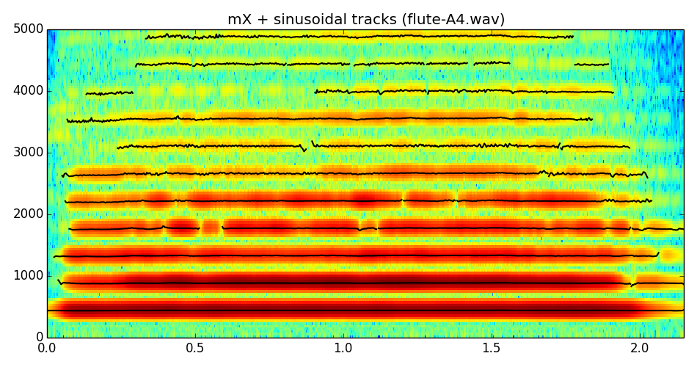
Sinusoidal model
Notes:
As we showed in the last lecture the sinusoidal model considers that a sound is the sum of time varying sinusoids.
...
A good way to show the results of the analysis is to plot the frequency of every time-varying sinusoid on top of the magnitude spectrogram of the sound. Of course each sinusoid, a part from the frequency, it also has a magnitude and a phase that are not shown.
Now we want to generate a sound from these values.

Slide 4
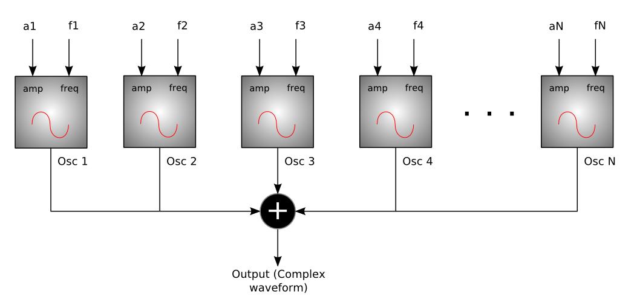
Sinusoidal (additive) synthesis
http://en.wikibooks.org/wiki/File:SSadditiveblock.png
Notes:
The standard way to synthesize sinusoids is to use additive synthesis.
This is a standard block diagram of an additive synthesizer.
....
How do we generate one of these time varying sinusoids?

Slide 5
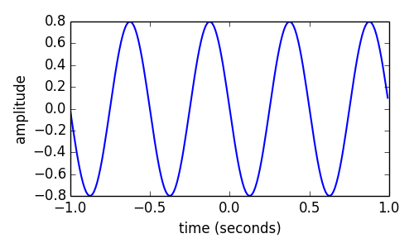
Sinusoidal synthesis
Ar = .8
fr = 2.0
phi = pi/2
fs = 100
t = arange(-1, 1, 1.0/fs)
x = Ar * cos(2*pi*fr*t+phi)
Notes:
The most straightforward way to generate a sinusoid is to use the sinusoidal function directly.
...
But this is quite expensive if, for complex signals, we have to call this function hundreds of times at every time sample.
Let's propose another way.

Slide 6
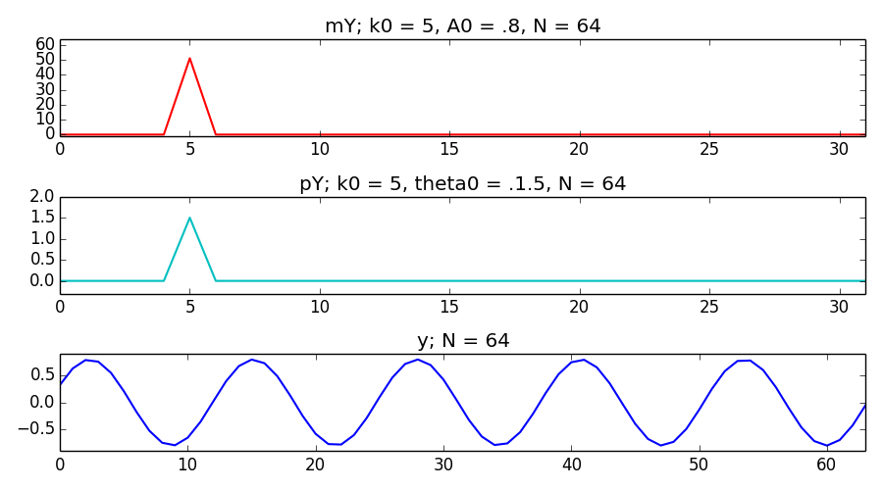
Sinusoidal synthesis: discrete frequency
Notes:
We can do it using the spectrum of a sinusoid and taking its inverse Fourier transform.
A sinusoid in the frequency domain is a single sample, and once we take the inverse-DFT of that sample we get a sinusoid in the time domain as long as the DFT size.
...
Too bad it is not that simple, this only works for sinusoids with frequencies corresponding to the discrete value of the spectral location.

Slide 7
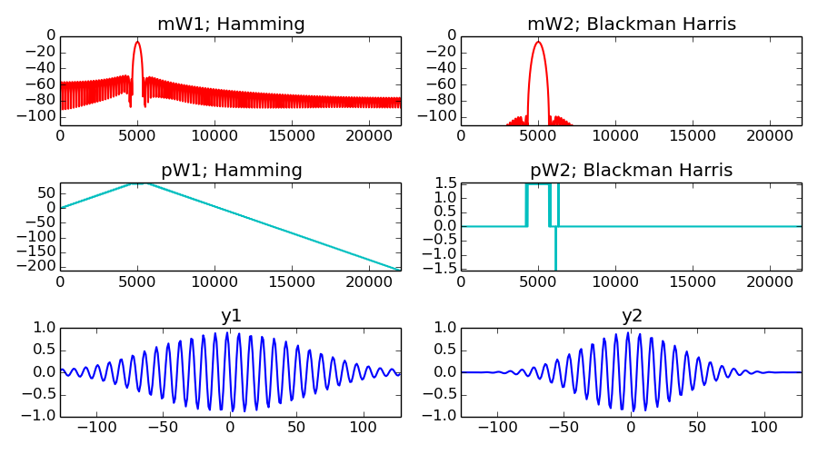
Sinusoidal synthesis: any frequency
Notes:
But we also know how to have a sinusoid in the frequency domain with any frequency.
Such a sinusoid does not have a single spectral value, it has values in all frequencies, values that depend on the window that we consider.
To generate a sinusoid in the frequency domain we have to generate the transform of a window and place it at the right frequency, amplitude and phase.
...
In the time domain all samples of a sinusoid have the same relevance, but not in the frequency domain. The window considered is a weighting factor of that relevance.

Slide 8
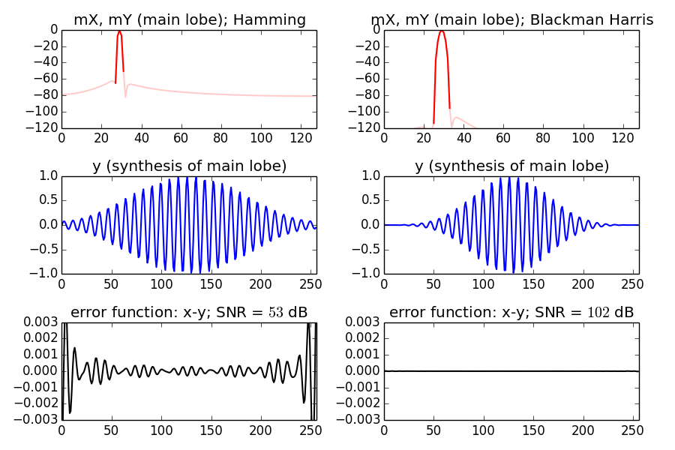
Sinusoidal synthesis: only main lobe
Notes:
The samples of the main-lobe are the ones that have the most weight, the most amplitude.
Hamming window: -42dB, 4 samples
Blackman-Harris: -92dB, 8 samples
....
So it is clear that the Blackman-Harris window is a good choice for generating sinusoids in the frequency domain.

Slide 9
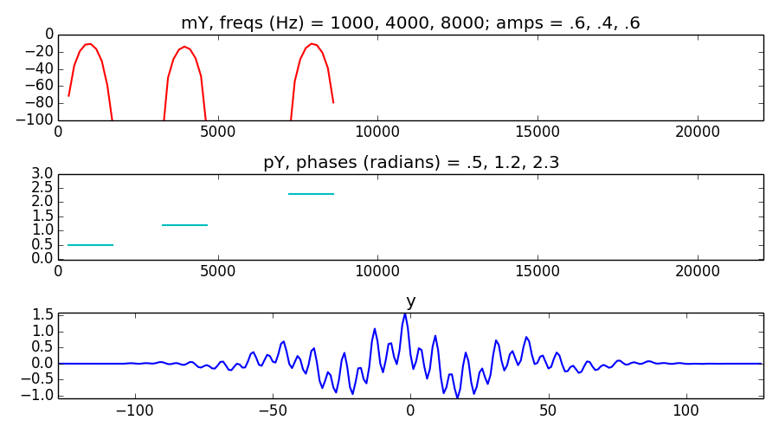
Additive synthesis
Notes:
If we want to generate several sinusoids in the spectrum we have to generate several main-lobes.
...
The result is a waveform, windowed by a Blackman-Harris window with the sinusoids we specified.

Slide 10
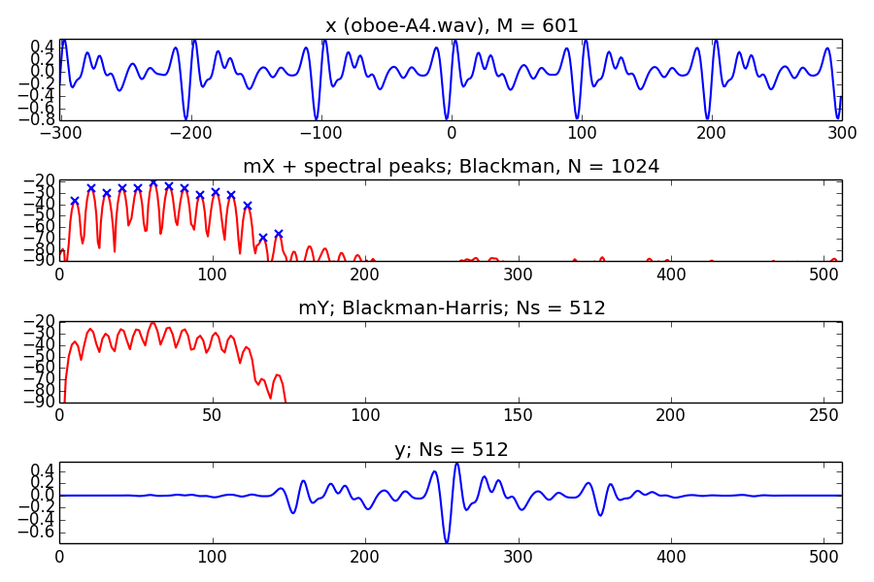
Analysis / Synthesis
Notes:
If we put this synthesis approach in an analysis/synthesis context we get this.
...
But we have one problem, we have to use the overlap-add process to get the time-varying sound, and the Blackman-Harris requires a very big overlap factor to have good reconstruction.

Slide 11
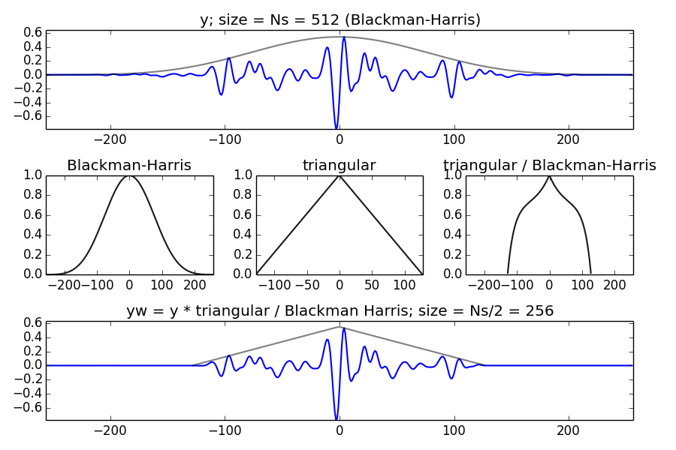
Synthesis window
Notes:
The solution is to undo the Blackman-Harris windowing and apply a window whose overlap factor can be smaller, like the triangular window.
...

Slide 12
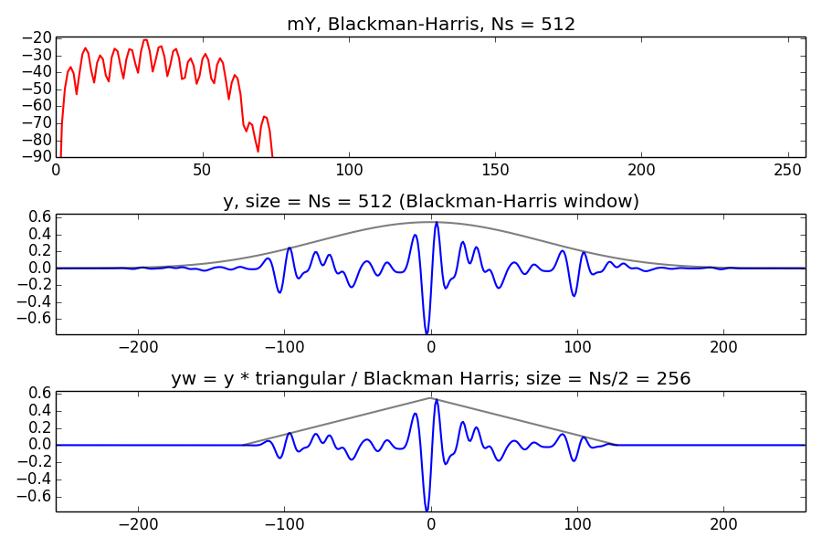
Synthesis for overlap of 25%
Notes:
With this approach we can get away with an overlap factor of 25%.
...
and we are done with the analysis/synthesis issues of the sinusoidal model.

Slide 13
Sinusoidal model system
w[n]
|X[k]|
A_{p}
f_{p}
p_{p}
x[n]
Peak detection
Sinusoidal
tracking
X
FFT
xw[n]
<X[k]
A_{t}
f_{t}
p_{t}
Analysis
Synthesis
Sine spectral
synthesis
Ys[k]
IFFT
ysw[n]
Overlap-add
ys[n]
Notes:
Like we did with the STFT, we can put it all together into an analysis/synthesis system.
...

Slide 14
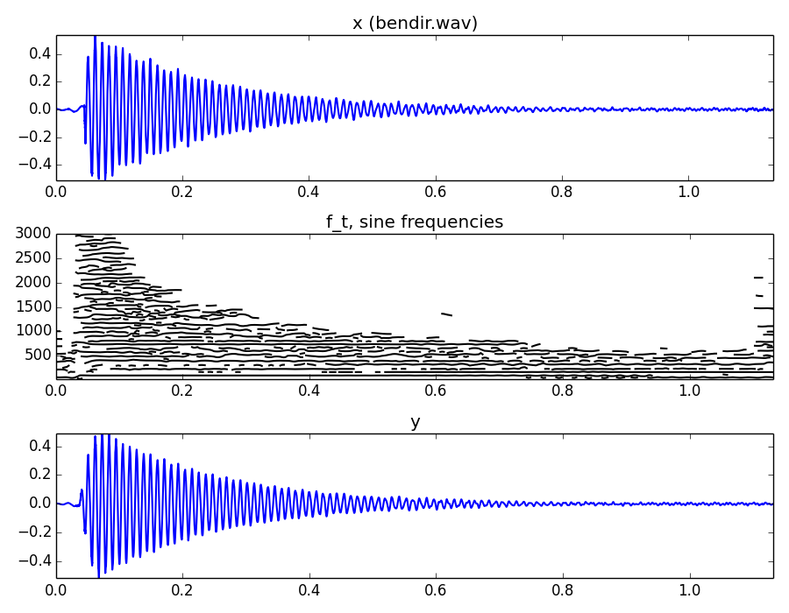
Notes:
and this is an example of analysis/synthesis using that sinusoidal model system.
...

Slide 15
References and credits
More information in:http://en.wikipedia.org/wiki/Additive_synthesishttp://en.wikipedia.org/wiki/Sinusoidal_model
Reference on sine modeling by Julius O. Smith: https://ccrma.stanford.edu/~jos/sasp/Spectrum_Analysis_Sinusoids.html
Sounds from: http://www.freesound.org/people/xserra/packs/13038/
Slides released using the CC Attribution-Noncommercial-Share Alike license and code released under the Affero GPL license. All available from https://github.com/MTG/sms-tools
Notes:
Here you have the references that I used in this class.
...

Slide 16
5T3: Sinusoidal Model
(3 of 3)
Xavier Serra
Universitat Pompeu Fabra, Barcelona
Notes:
This is all for the Sinusoidal model topic. We have seen how we can start from the Short-time Fourier Transform and obtain a sinusoidal representation of it that simplyfies the spectrum.
This is a very useful representation for coding and for being able to transform sounds. We will see that further on.
But we can continue in this direction towards more useful representationsspecially if we can work with particular types of sounds and specific applications.
We will see that in the next lecture.
Thanks for your attention!

