Slide 1
6T1: Harmonic Model
Xavier Serra
Universitat Pompeu Fabra, Barcelona
Notes:
If you are watching this hopefully means that you have followed the course on Audio Signal Processing for Music Applications until here.
You just reached the half point, congratulations!!! So no reason in giving up now, very interesting topics are coming.
Last week we talked about the sinussoidal model.
This week, following in the path towards more flexible and higher level representations of sounds we present the harmonic model.

Slide 2
Index
Harmonic model
Sinusoids-partials-harmonics
Polyphonic-monophonic signals
Harmonic detection (after F0 detection)
Harmonic model system
Notes:
We will first introduce the harmonic model.
...

Slide 3
Harmonic model
Notes:
The equation of the harmonic model is very close to the one of the sinusoidal model that we already explained.
There is a single but very significant difference, the frequencies of the sinusoids are all multiples of a fundamental frequency.
Thus it is only valid for single source sounds produced by periodic or pseudo-periodic oscillations, like the sounds produced by many musical instruments.
...

Slide 4
Spectral view
Notes:
We can also express the model in the frequency domain.
The time varying spectrum of a harmonic sound is the sum of all the time-vaying spectra of the harmonics.
...

Slide 5
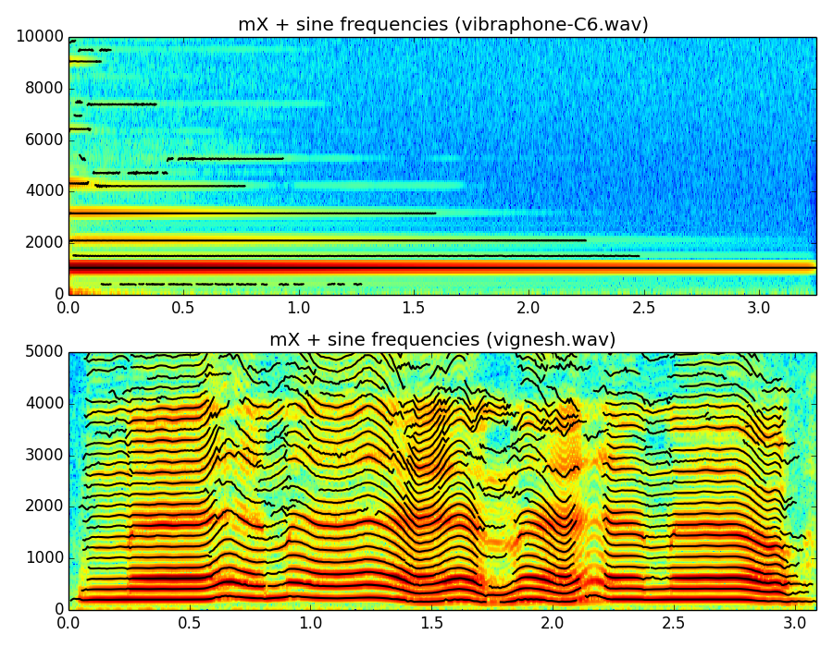
Notes:
Here we show spectrograms and the sinusoidal tracks of two sounds that have different characteristics.
The first is an inharmonic sound, a note of a vibraphone.
The second is a harmonic sound, a voice singing mainly a vowel.
..

Slide 6
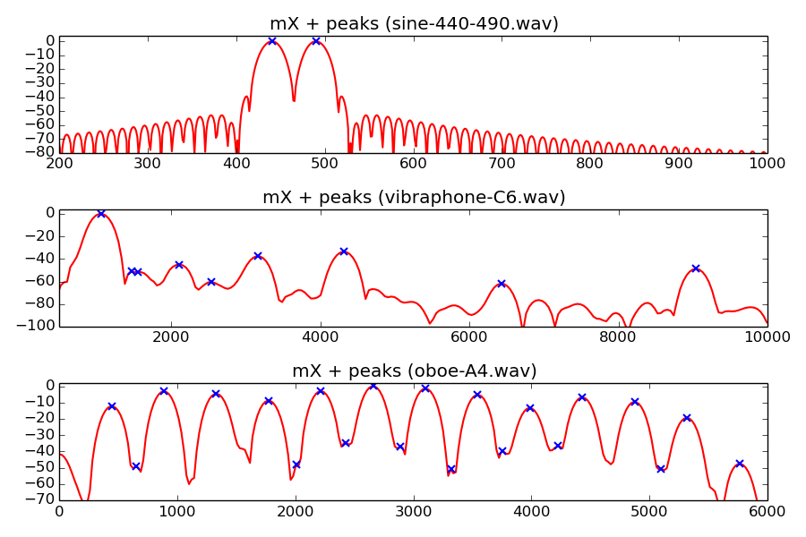
Sinusoids-partials-harmonics
Notes:
In order to better understand the concept of harmonics is important to understand the difference between sinusoids, partials and harmonics. Many people get confused with that.
A sinusoid is a mathematical function....
A partial is a component of a signal that is periodic and stable and that can be modeled as a slowly time-varying sinusoid....
A harmonic is a partial of a sound that is multiple of the fundamental frequency. It can also be modeled by a slowly time-varying sinusoid.....
...

Slide 7
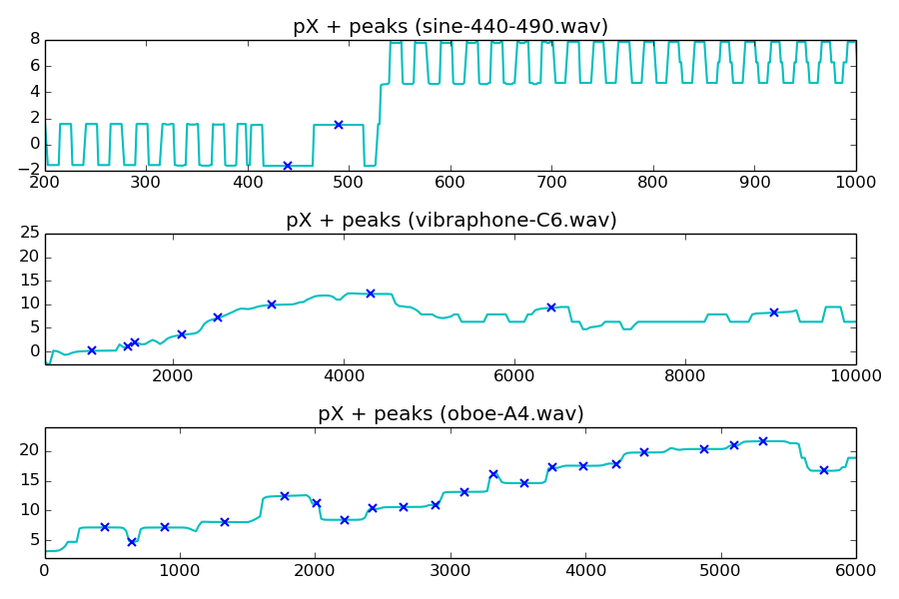
Sinusoids-partials-harmonics
Notes:
Looking at the phase spectra of the same signals also helps to understand these concepts.
...

Slide 8
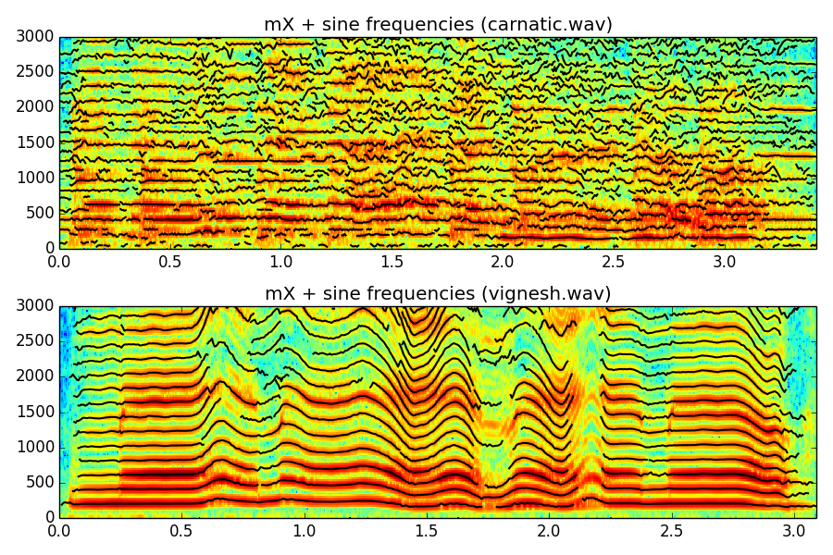
Polyphonic-monophonic signals
Notes:
In order to use the harmonic model we need to identify sound sources that are harmonic.
A polyphonic signal includes more than one sound source, for example several instruments playing at the same time.
A monophonic signal includes a single sound source, like one singing voice.
...
So how do we identify the harmonics of a sound source?

Slide 9
Harmonic detection
Harmonic stable spectral peak whose frequency is close to a multiple of the fundamental frequency.
Notes:
We are just focusing on harmonic sounds, so we would like to find the harmonics in a monophonic signal or in one of the sound sources of a polyphonic signal.
The major problem is the identification of the fundamental frequency of a sound source. This we will cover in the next lecture. Here let's assume that we know the fundamental frequency of the sound.
...

Slide 10
Harmonic model system
w[n]
|X[k]|
f_{p}
p_{p}
f₀
x[n]
A_{p}
F0
detection
Harmonic
detection
X
FFT
Peak detection
xw[n]
<X[k]
A_{h}
f_{h}
p_{h}
Analysis
Synthesis
Sine spectral
synthesis
Yh[k]
IFFT
yhw[n]
Overlap-add
yh[n]
Notes:
The implementation of the harmonic model is a modification of the sinusoidal model.
...
The F0 detection block requires to be treated separately and we will cover it in the next lecture.
....

Slide 11
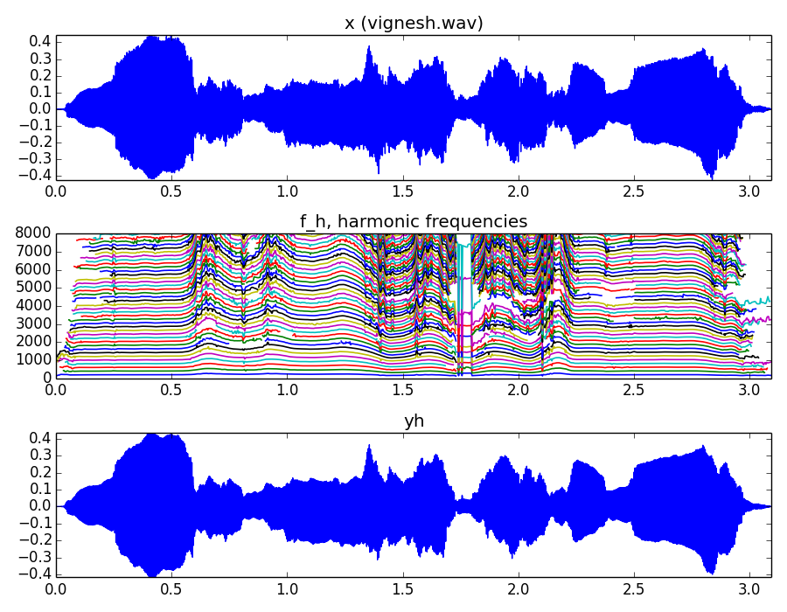
Notes:
Here is the analysis and synthesis of a sound using the harmonic model.
...

Slide 12
References and credits
More information in:https://en.wikipedia.org/wiki/Harmonic_series_(music)
https://en.wikipedia.org/wiki/Harmonic
Sounds from: http://www.freesound.org/people/xserra/packs/13038/
Slides released using the CC Attribution-Noncommercial-Share Alike license and code released under the Affero GPL license. All available from https://github.com/MTG/sms-tools
Notes:
The concept of harmonic oscillations in the study of many natural phenomena and thus you will be able to find many references. Not so much on the applications on music signals.
...

Slide 13
6T1: Harmonic Model
Xavier Serra
Universitat Pompeu Fabra, Barcelona
Notes:
We have covered the harmonic model. If we can use it to analyze and synthesize signals the applications possibilties are much larger than with the sinusoidal model. We will show examples.
The difficult step is the detection of the fundamental frequency which is what we will cover in the next theory lecture.
See you in the next class!!

