Slide 1
Fourier Transform theorems and properties
(2 of 2)
Xavier Serra
Universitat Pompeu Fabra, Barcelona

Slide 2
Index
Phase unwrapping
Zero padding
Power & amplitude in dB
Fast Fourier Transform (FFT)
FFT and zero-phase
Analysis/synthesis

Slide 3
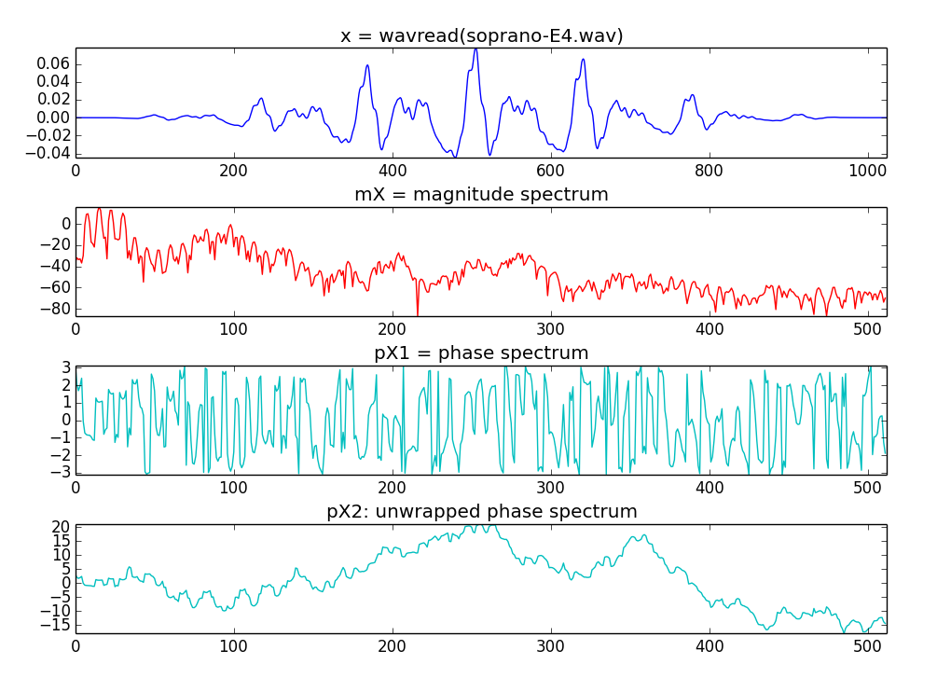
Phase unwrapping

Slide 4
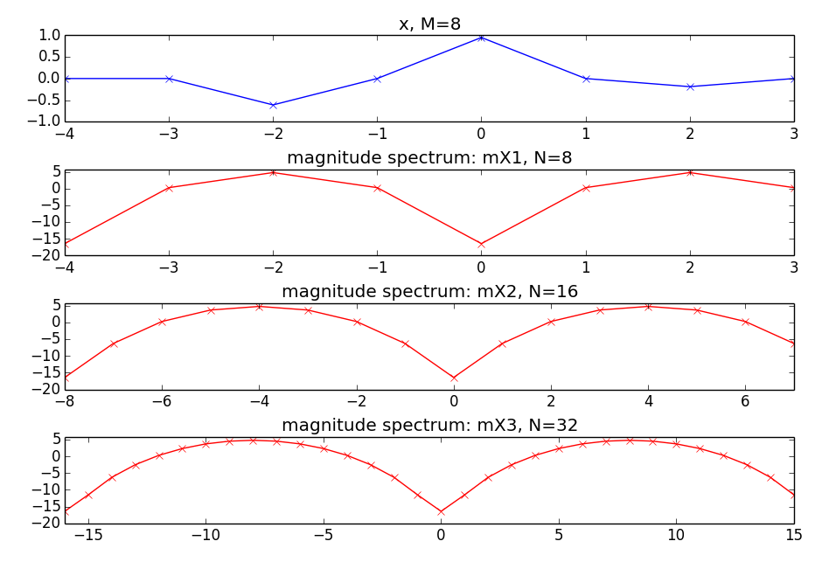
Zero-padding

Slide 5
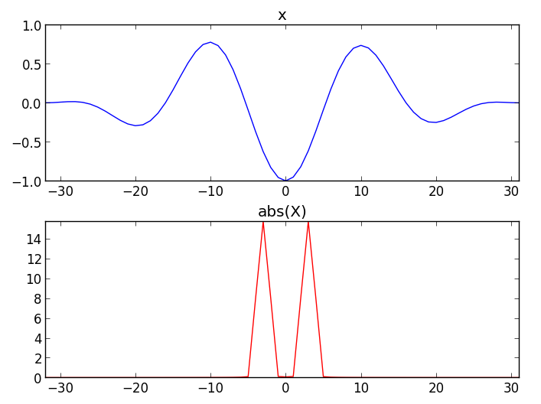
Power

Slide 6
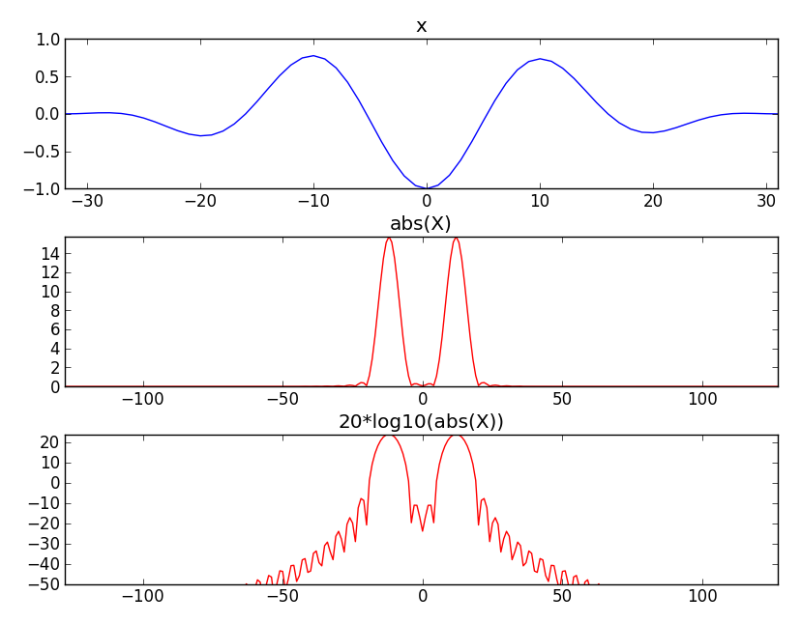
Amplitude in Decibels

Slide 7

Fast Fourier Transform
The most common version uses the Coley-Tukey algorithm. It breaks down recursively the DFT of a power of 2 size into two pieces of size N/2.

Slide 8
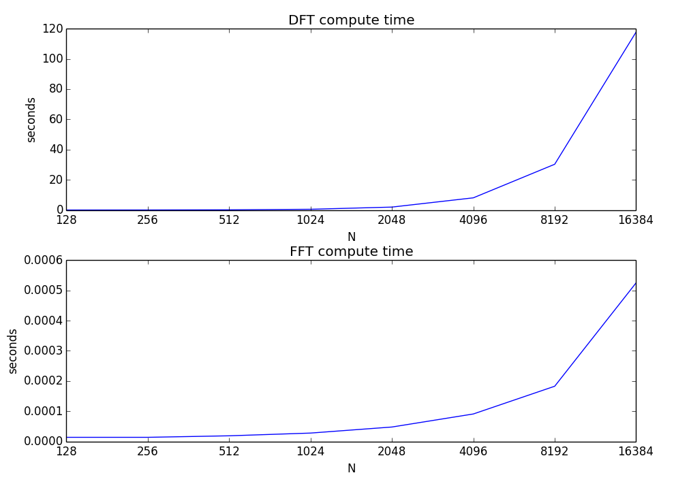

Slide 9
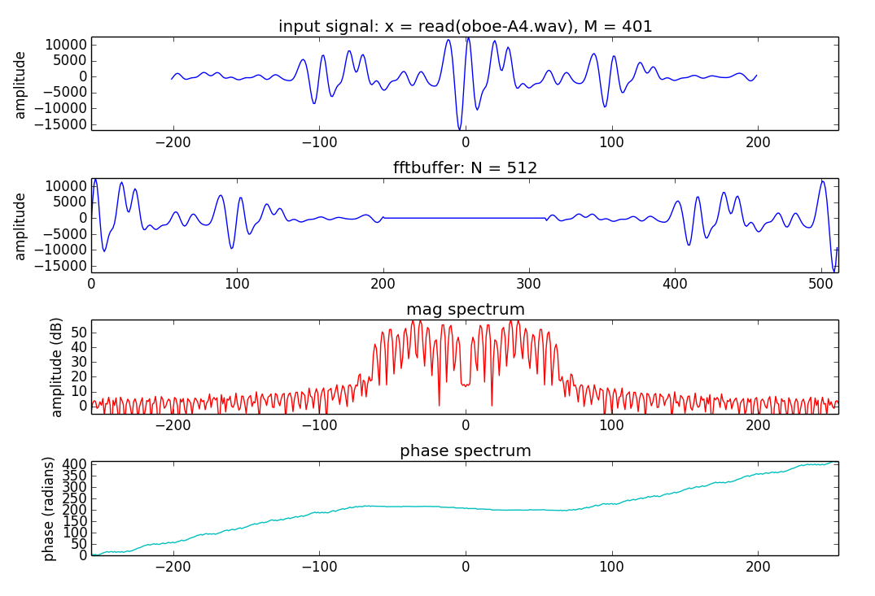
FFT and zero-phase

Slide 10
Analysis/synthesis
x[n]
|X[k]|
y[n]
FFT
IFFT
<X[k]

Slide 11
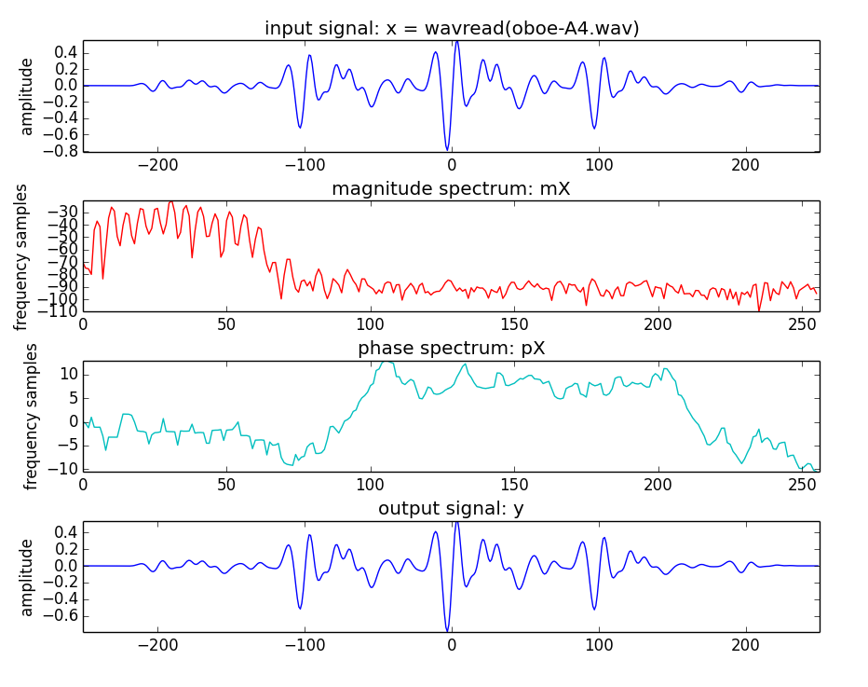

Slide 12
References and credits
More information on this topic:https://en.wikipedia.org/wiki/Fast_Fourier_transform
Sounds used taken from Freesound: http://www.freesound.org/people/xserra/packs/13038/
Good reference for the DFT by Julius O. Smith: https://ccrma.stanford.edu/~jos/mdft/
All slides and code produced for this course are released using the CC Attribution-Noncommercial-Share Alike license or the Affero GPL license and available from https://github.com/MTG/sms-tools

