Slide 1
The Discrete Fourier Transform
Xavier Serra
Music Technology Group
Universitat Pompeu Fabra, Barcelona
http://mtg.upf.edu

Slide 2
Index
DFT equation
Complex exponentials
Inner product
DFT of complex sinusoids
DFT of real sinusoids
Inverse-DFT

Slide 3
Discrete Fourier Transform
n: discrete time index in samples (normalized time, T=1)
k: discrete frequency index in bins
frequency in radians
frequency in Hz, where fs is the sampling rate

Slide 4
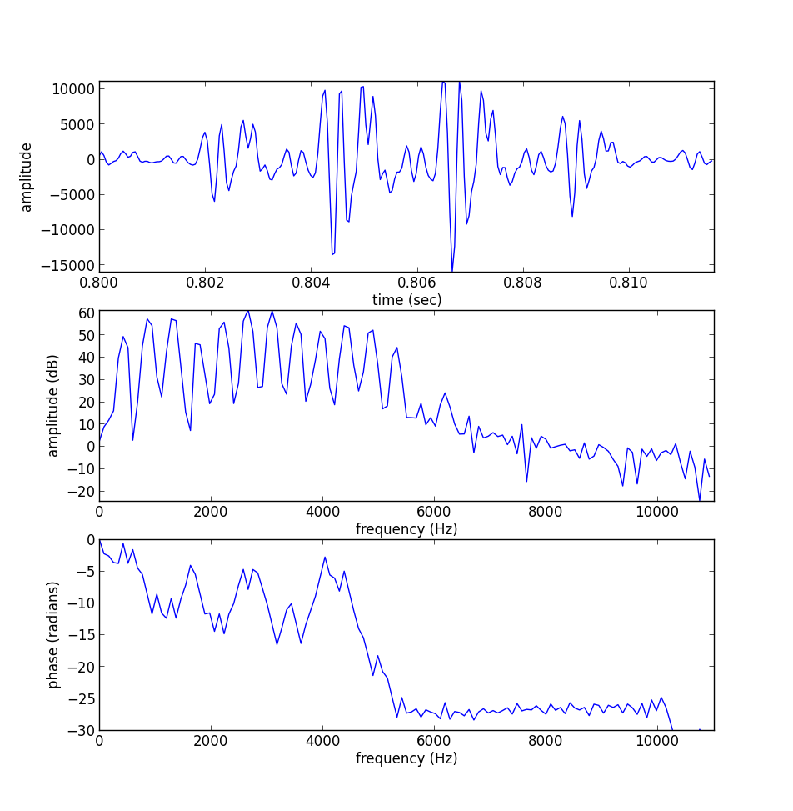
fragment of a sound, x[n]
magnitude
spectrum
phase
spectrum

Slide 5
import matplotlib.pyplot as plt
import numpy as np
from scipy.io.wavfile import read
from scipy.fftpack import fft
(fs, x) = read('oboe.wav')
size = 256
start = .8*fs
xw = x[start:start+size] * np.hamming(size)
plt.subplot(311)
plt.plot(np.arange(start, (start+size), 1.0)/fs, xw)
X = fft(xw)
mX = 20 * np.log10(abs(X)/size)
pX = np.unwrap(np.angle(X))
plt.subplot(312)
plt.plot(np.arange(0, fs/2.0, float(fs)/size), mX[0:size/2])
plt.subplot(313)
plt.plot(np.arange(0, fs/2.0, float(fs)/size), pX[:size/2])

Slide 6
Complex exponentials

Slide 7
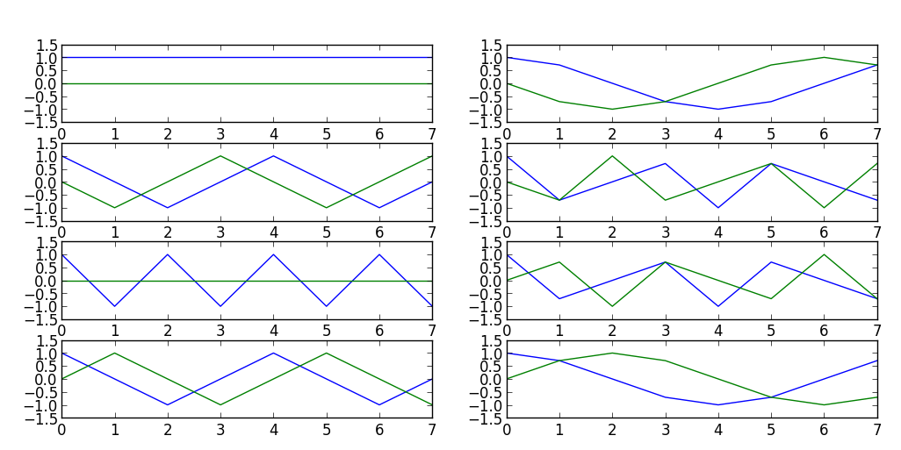
Complex exponentials
import matplotlib.pyplot as plt
import numpy as np
N = 8
for k in range(N):
s = np.exp(-1j*2*np.pi*k/N*np.arange(N))
plt.subplot(N/2, 2, k+1)
plt.plot(np.real(s))
plt.subplot(N/2, 2, k+1)
plt.plot(np.imag(s))

Slide 8
Inner product - DFT
Example:

Slide 9
Inner product - DFT
import numpy as np
x = np.array([1,-1,1,-1])
print 'x = {}'.format(x)
N = 4
for k in range(N):
s = np.exp(1j*2*np.pi*k/N*np.arange(N))
print 's{0} = {1}'.format(k, s)
X = sum(x*np.conjugate(s))
print '<x,s{0}> = {1}'.format(k,X)
Output:
x = [ 1 -1 1 -1]
s0 = [ 1.+0.j 1.+0.j 1.+0.j 1.+0.j]
<x,s0> = 0.0
s1 = [ 1.+0.j 0.+1.j -1.+0.j -0.-1.j]
<x,s1> = 1.32693504719e-16
s2 = [ 1.+0.j -1.+0.j 1.-0.j -1.+0.j]
<x,s2> = 4.0
s3 = [ 1.+0.j -0.-1.j -1.+0.j 0.+1.j]
<x,s3> = 5.52708599219e-16

Slide 10
DFT of complex sinusoid

Slide 11
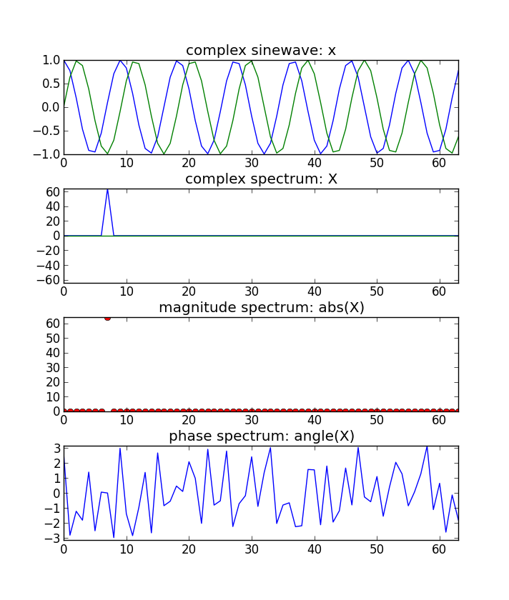
import numpy as np
import matplotlib.pyplot as plt
N = 64
k0 = 7
X = np.array([])
x = np.exp(1j*2*np.pi*k0/N*np.arange(N))
plt.subplot(411)
plt.plot(np.arange(N), np.real(x))
plt.plot(np.arange(N), np.imag(x))
for k in range(N):
s = np.exp(1j*2*np.pi*k/N*np.arange(N))
X = np.append(X, sum(x*np.conjugate(s)))
plt.subplot(412)
plt.plot(np.arange(N), np.real(X))
plt.plot(np.arange(N), np.imag(X))
plt.subplot(413)
plt.plot(np.arange(N), abs(X), 'ro')
plt.subplot(414)
plt.plot(np.arange(N), np.angle(X))

Slide 12
DFT of complex sinusoid

Slide 13
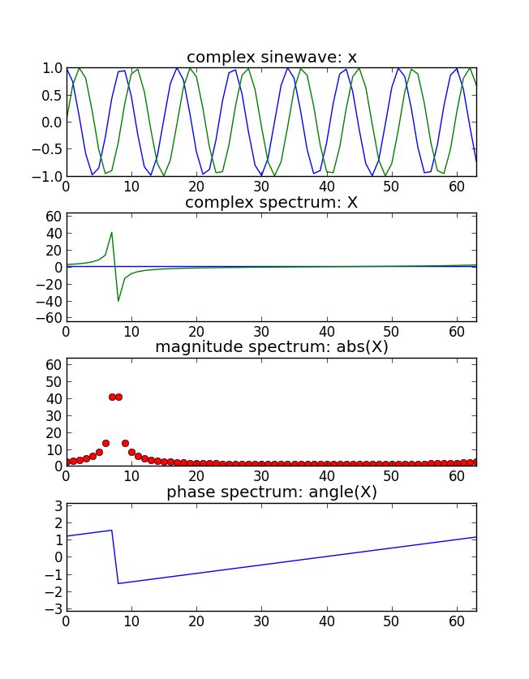
N = 64
f0 = 7.5/N
X = np.array([])
x = np.exp(1j*2*np.pi*f0/N*np.arange(N))
plt.subplot(411)
plt.plot(np.arange(N), np.real(x))
plt.plot(np.arange(N), np.imag(x))
for k in range(N):
s = np.exp(1j*2*np.pi*k/N*np.arange(N))
X = np.append(X, sum(x*np.conjugate(s)))
plt.subplot(412)
plt.plot(np.arange(N), np.real(X))
plt.plot(np.arange(N), np.imag(X))
plt.subplot(413)
plt.plot(np.arange(N), abs(X), 'ro')
plt.subplot(414)
plt.plot(np.arange(N), np.angle(X))

Slide 14
DFT of real sinusoids

Slide 15
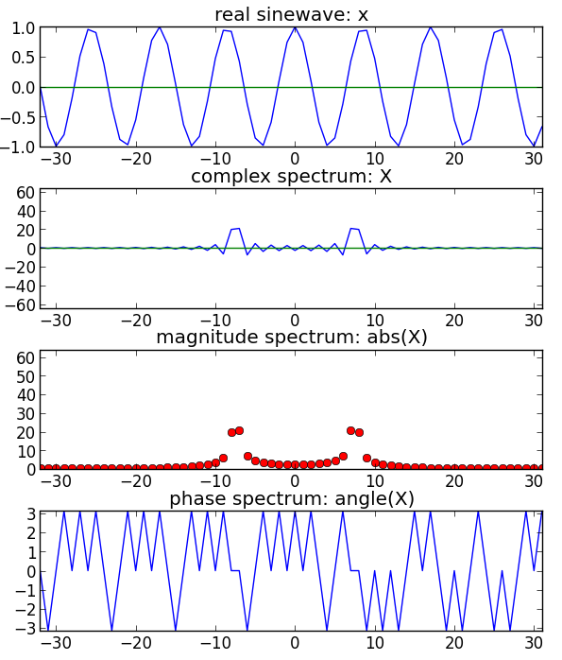
import numpy as np
import matplotlib.pyplot as plt
N = 64
k0 = 7.5
X = np.array([])
nv = np.arange(-N/2, N/2)
kv = np.arange(-N/2, N/2)
x = np.cos(2*np.pi*k0/N*nv)
plt.subplot(411)
plt.plot(nv, np.real(x))
plt.plot(nv, np.imag(x))
for k in kv:
s=np.exp(1j*2*np.pi*k/N*nv)
X=np.append(X,sum(x*np.conj(s)))
plt.subplot(412)
plt.plot(kv, np.real(X))
plt.plot(kv, np.imag(X))
plt.subplot(413)
plt.plot(kv, abs(X), 'ro')
plt.subplot(414)
plt.plot(kv, np.angle(X))

Slide 16
Inverse DFT
Example:

Slide 17
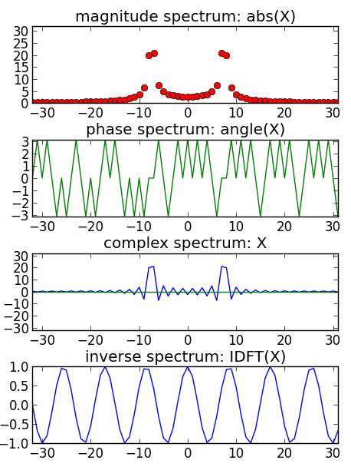
Inverse DFT example
N = 64
k0 = 7.5
x = np.cos(2*np.pi*k0/N*np.arange(-N/2, N/2))
for k in np.arange(-N/2, N/2):
s=np.exp((-1j*2*np.pi*k/N)*np.arange(-N/2,N/2))
X=np.append(X, sum(x*np.conjugate(s)))
plt.subplot(411)
plt.plot(np.arange(-N/2,N/2), abs(X), 'ro')
plt.subplot(412)
plt.plot(np.arange(-N/2,N/2), np.angle(X))
plt.subplot(413)
plt.plot(np.arange(-N/2,N/2), np.real(X))
plt.plot(np.arange(-N/2,N/2), np.imag(X))
for k in np.arange(-N/2,N/2):
s=np.exp((1j*2*np.pi*k/N)*np.arange(-N/2,N/2))
y=np.append(y, sum(X*s)/N)
plt.subplot(414)
plt.plot(np.arange(-N/2,N/2), y)

Slide 18
References
https://ccrma.stanford.edu/~jos/mdft/
Full code of plots and accompanying labs available at:https://github.com/MTG/sms-tools

Slide 19
Credits
All the slides of this presentation are released under an Attribution-Noncommercial-Share Alike license.

