Slide 1
4T1: The Short-Time
Fourier Transform
(1 of 2)
Xavier Serra
Universitat Pompeu Fabra, Barcelona
Notes:
Welcome back to the course on Audio Signal Processing for Music Applications.
Until now we have seen how to compute the spectrum a signal, its DFT, but real sound cannot be represented by a single spectrum. Sounds change in time and we need to capture this time variation.
The short-time Fourier transform is our solution.
Again, this lecture is divided in two parts, this is the first one.

Slide 2
Index
Short-time Fourier Transform equation
Analysis window
Notes:
We will first present and explain the short-time Fourier transform equation and then discuss what we call the analysis window.

Slide 3
Short-time Fourier Transform
w: analysis window
l: frame number
H: hop-size
Notes:
This is the Short-time Fourier transform equation, basically a modified version of the DFT, with few but important differences.
...
To emphasize the idea of zero-phase windowing we specify the time index n to go from -N/2 to N/2-1.

Slide 4

Notes:
The windowing process is a way to step through a sound.
If we use the analogy of image and video we could relate a spectrum with a photograph, a static image, and the STFT with a video, a time varying image.
...

Slide 5
Transform of a windowed sinewave
Notes:
To better understand the effect of windowing a sound, lets put an example of what happends when we window a real sinusoid and then compute its spectrum.
...

Slide 6
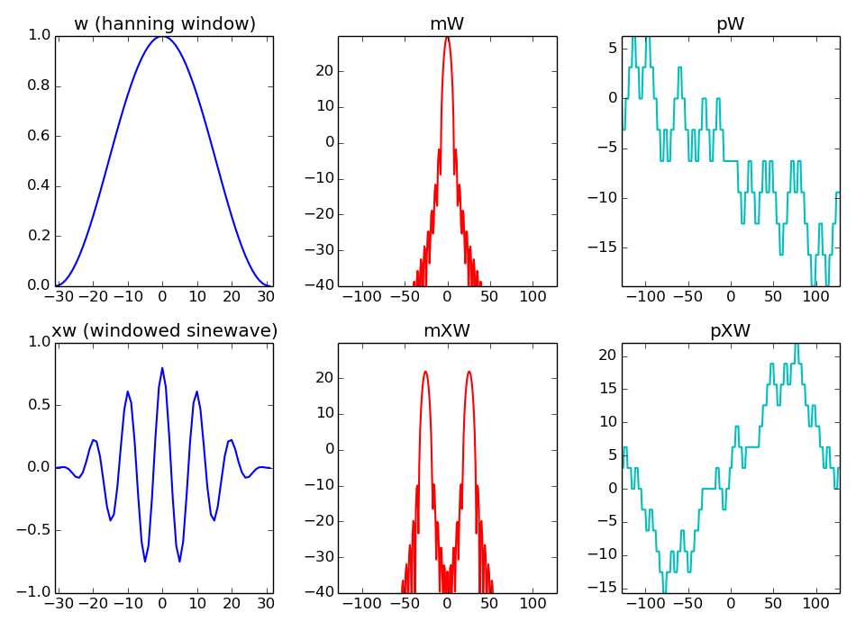
Notes:
With these plots we can understand the windowing process better.
...
From this discussion we can realize the importance of the analysis window in the spectrum of a sinusoid and thus of any sound.
It is clear that we have to spend some time explaining the windows.

Slide 7
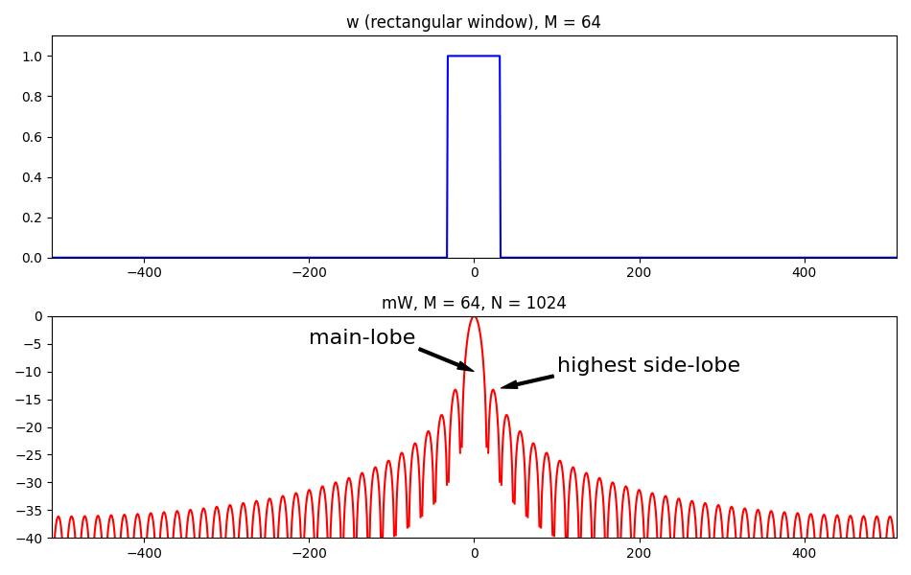
Analysis window
Notes:
An analysis window is generally a real function, symmetric around the origen.
This is the simplest window, the rectangular window.
In the time domain is nothing too particular, but its magnitude spectrum is much more interesting.
...

Slide 8
Window functions in Scipy
Window functions
barthann (M[, sym]) | Return a modified Bartlett-Hann window.
bartlett (M[, sym]) | Return a Bartlett window.
blackman (M[, sym]) | Return a Blackman window.
blackmanharris (M[, sym]) | Return a minimum 4-term Blackman-Harris window.
bohman (M[, sym]) | Return a Bohman window.
boxcar (M[, sym]) | Return a boxcar or rectangular window.
chebwin (M, at[, sym]) | Return a Dolph-Chebyshev window.
flattop (M[, sym]) | Return a flat top window.
gaussian (M, std[, sym]) | Return a Gaussian window.
general-gaussian (M, p, sig[, sym]) | Return a window with a generalized Gaussian shape.
hamming (M[, sym]) | Return a Hamming window.
hann (M[, sym]) | Return a Hann window.
kaiser (M, beta[, sym]) | Return a Kaiser window.
nuttall (M[, sym]) | Return a minimum 4-term Blackman-Harris window according to Nuttall.
parzen (M[, sym]) | Return a Parzen window.
slepian (M, width[, sym]) | Return a digital Slepian window.
triang (M[, sym]) | Return a triangular window.
Notes:
There are many windows used in audio signal processing. This is the list of windows available in the Scipy module of Python.
...
Each window can be distingushed from the others by measuring the main-lobe width and the side-lobe level.
Each window offers a different compromise with respect to these two values.
Let's show some of them.

Slide 9
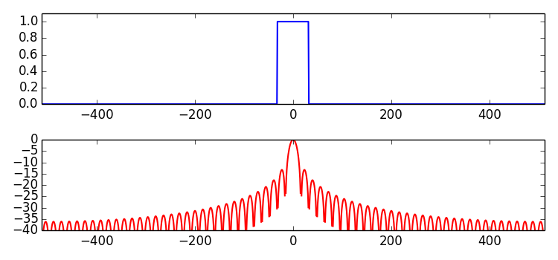
Rectangular window
main-lobe width: 2 bins
side-lobe level: -13.3 dB
Notes:
We start by showing, again, the rectangular window.
...

Slide 10
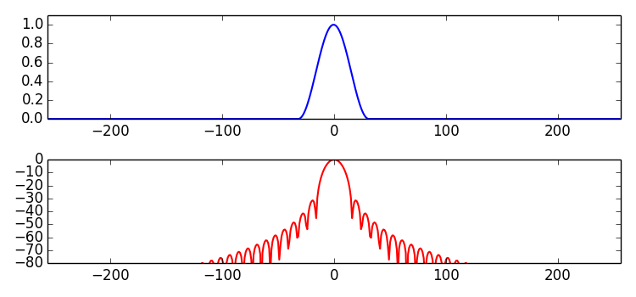
Hanning window
main-lobe width: 4 bins
side-lobe level: -31.5 dB
Notes:
Maybe the most popular window is the hanning window, which is a raised cosine.
...

Slide 11
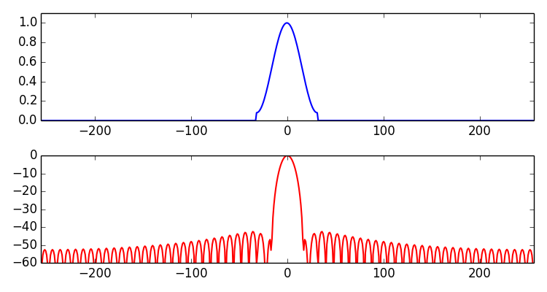
Hamming window
main-lobe width: 4 bins
side-lobe level: -42.7 dB
Notes:
The hamming window is very similar to the hanning window. With a small but significant difference.
...

Slide 12
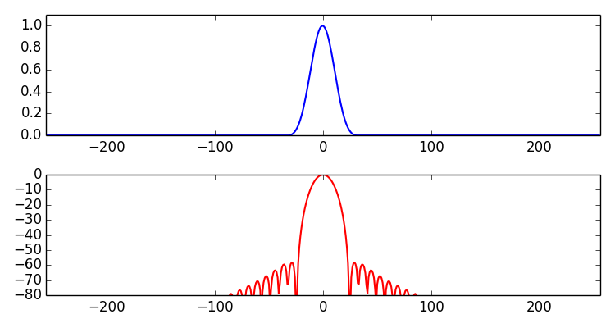
Blackman window
main-lobe width: 6 bins
side-lobe level: -58 dB
Notes:
The Blackman window is the sum of two sinusoids and with that we acomplish a significant improvement in terms of the side-lobe level measure.
...

Slide 13
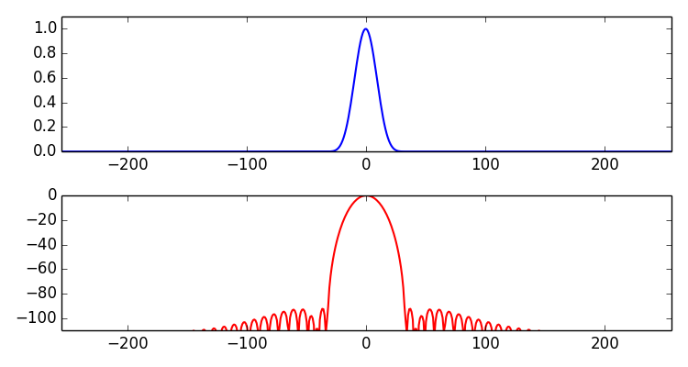
Blackman-Harris window
Notes:
The Blackman-Harris is a very special window, because we could basically say that it does not have side lobes.
...

Slide 14
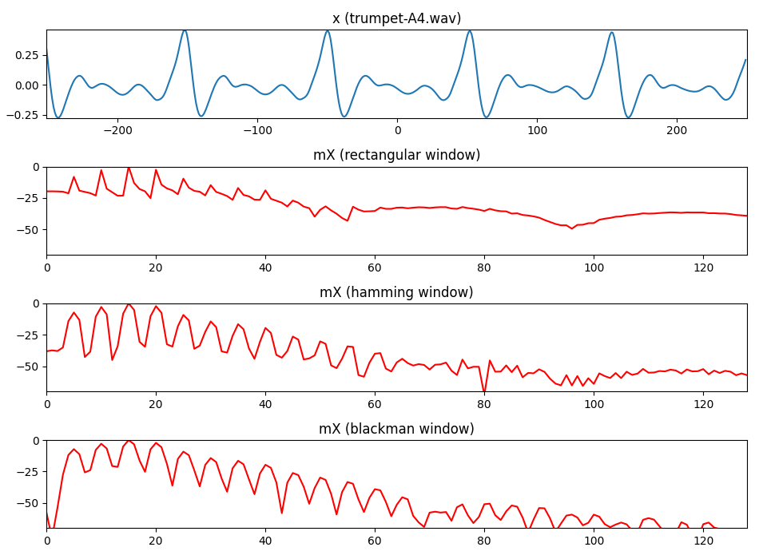
Notes:
This is an example of applying different windows to the same sound fragment.
...

Slide 15
References and credits
More information in:
https://en.wikipedia.org/wiki/STFThttps://en.wikipedia.org/wiki/Window_function
Reference on the STFT by Julius O. Smith:https://ccrma.stanford.edu/~jos/sasp/
Sounds from: http://www.freesound.org/people/xserra/packs/13038/
Slides and code released using the CC Attribution-Noncommercial-Share Alike license or the Affero GPL license and available from https://github.com/MTG/sms-tools
Notes:
There is a lot of signal processing literature on windows.
...

Slide 16
4T1: The Short-Time
Fourier Transform
(1 of 2)
Xavier Serra
Universitat Pompeu Fabra, Barcelona
Notes:
This is all for this first part of this lecture.
We have explained the basic equation of the Short-time Fourier Transform and we have focused on the analysis window.
In the second part we will continue with this topic.
See you next time!!

