Slide 1
3T2: Fourier Transform properties (2 of 2)
Xavier Serra
Universitat Pompeu Fabra, Barcelona
&
Stanford University
Notes:
In the first part of this lecture we presented some properties of the Discrete Fourier Transform.
We now continue with some more properties that will be useful when using the DFT.

Slide 2
Index
Energy conservation & decibels
Phase unwrapping
Zero padding
Fast Fourier Transform (FFT)
FFT and zero-phase windowing
Analysis/synthesis
Notes:
We will talk about
...

Slide 3
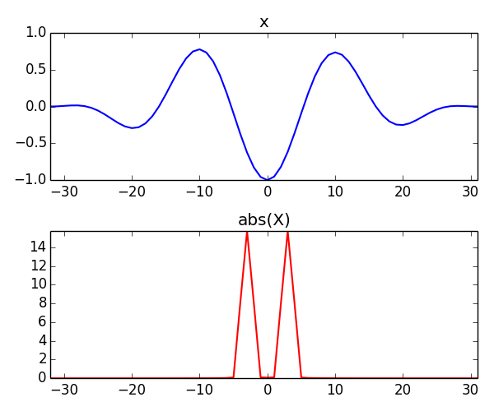
Energy conservation
Notes:
This property relates with the conservation of the signal energy when going from the time domain to the frequency domain.
The energy of a signal can either be computed in one domain or in the other, the result is the same.
....

Slide 4
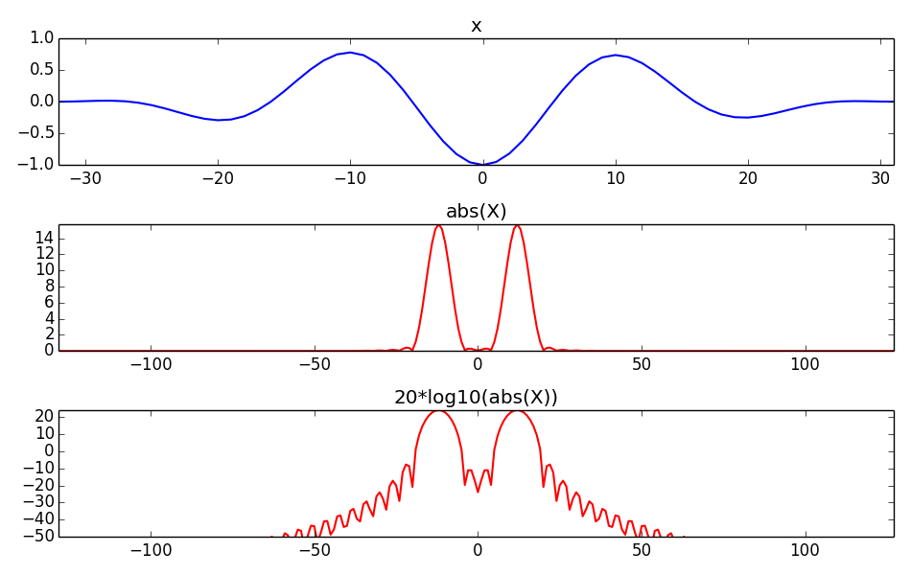
Amplitude in decibels (dB)
Notes:
A concept related to energy is amplitude, which is what we normally use, either in the time domain or in the frequency domain. When we obtain the polar representation of the spectrum of the signal, its DFT, the amplitude is obtained by computing the absolute value, a linear measure.
However for the case of sounds, a more intuitive representation of the amplitude can be obtained by converting it to decibels, a log value.
....

Slide 5
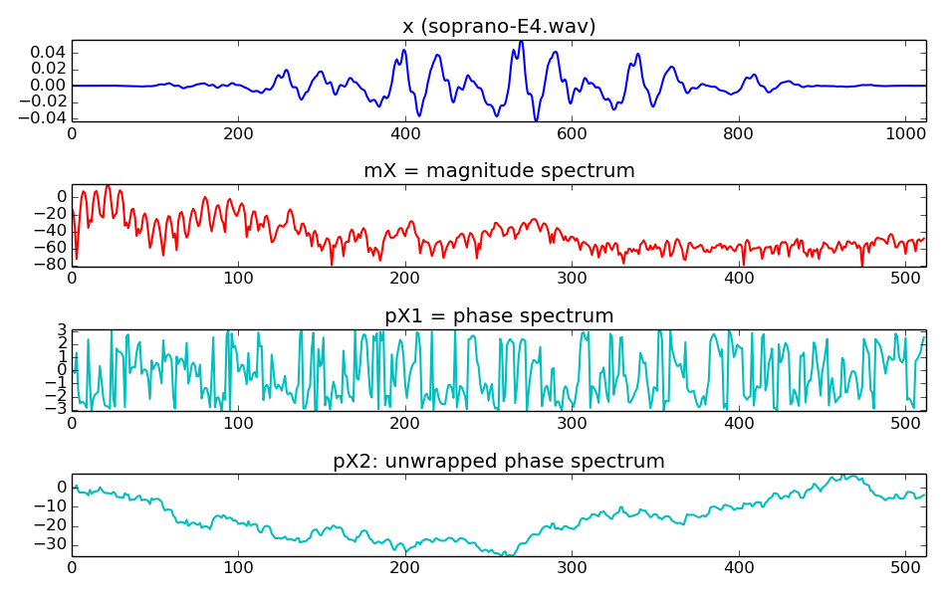
Phase unwrapping
Notes:
The spectrum of a signal includes the amplitude, now computed in decibels, and the phase.
Phase unwrapping is a way to represent the phase spectrum computed by the DFT in a way that is easier to visualize and understand.
...

Slide 6
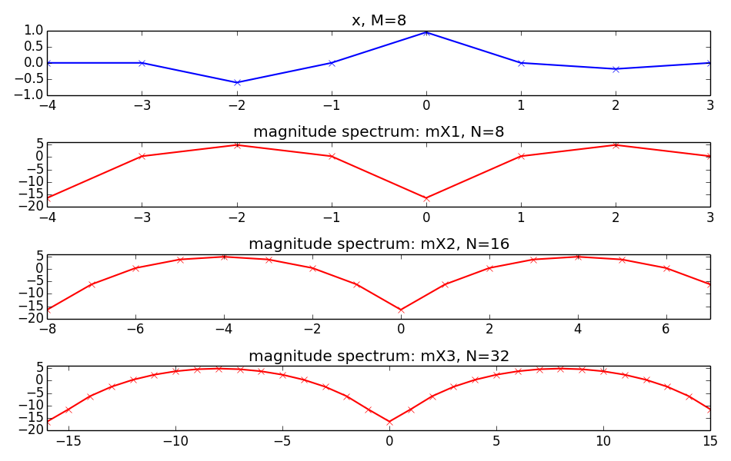
Zero-padding
Notes:
Zero-padding means to add zeros at the end of a signal.
In the context of the DFT if we zero-pad in one domain it produces an interpolated signal in the other domain.
...

Slide 7

Fast Fourier Transform
Cooley-Tukey algorithm: breaks down recursively the DFT of a power of 2 size into two pieces of size N/2.
Notes:
When we have to compute the DFT many times, which will be quite often, it is very convenient to use an efficient implementation of the equation. This is the FFT.
....

Slide 8
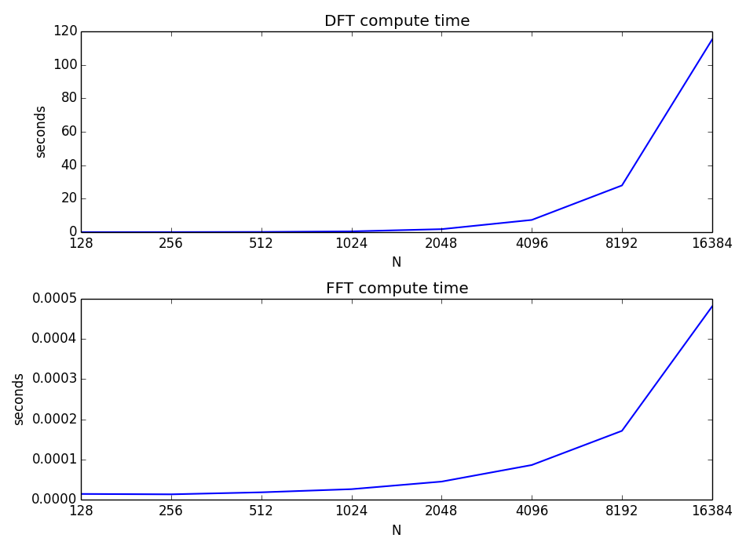
Notes:
Here we show the difference in computational cost between the direct implementation of the DFT equation and of the FFT implementation.
...

Slide 9
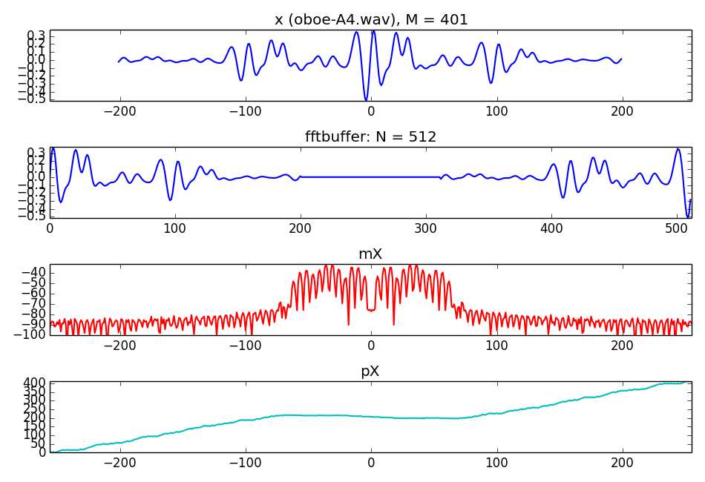
FFT and zero-phase windowing
Notes:
In order to use the FFT we need to have the input signal to have a power of two length. But we want to compute the spectrum of any length signal.
This is the way that we propose to compute the spectrum of a signal, zero-padding and using what is called zero-phase windowing.
...

Slide 10
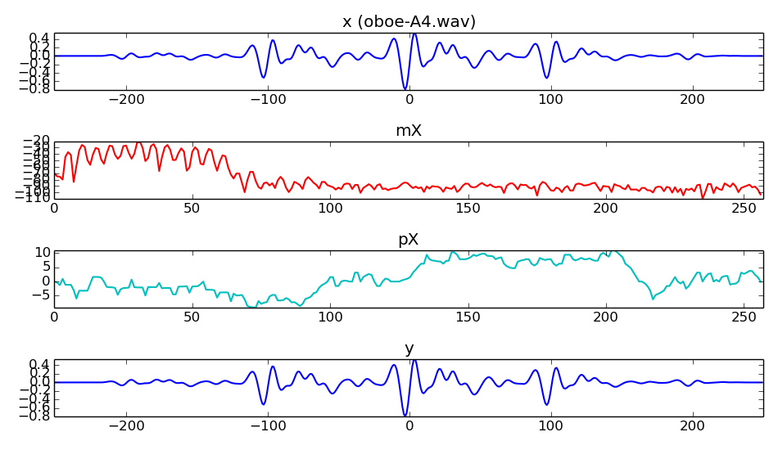
Analysis/synthesis
x[n]
|X[k]|
y[n]
FFT
IFFT
<X[k]
Notes:
We saw that the DFT was an invertible operation; after computing the spectrum we can compute its inverse DFT and get back the original spectrum.
This allows to perform analysis and synthesis of a sound.
...

Slide 11
References and credits
More information on:
  https://en.wikipedia.org/wiki/Discrete_Fourier_transform
  https://en.wikipedia.org/wiki/Fast_Fourier_transform
Sounds from: http://www.freesound.org/people/xserra/packs/13038/
Reference for the DFT by Julius O. Smith: https://ccrma.stanford.edu/~jos/mdft/
Slides and code released using the CC Attribution-Non Commercial-Share Alike license or the Affero GPL license and available from https://github.com/MTG/sms-tools
Notes:
We have seen this slide before, sorry, but it has to be here!!!

Slide 12
3T2: Fourier Transform properties (2 of 2)
Xavier Serra
Universitat Pompeu Fabra, Barcelona
&
Stanford University
Notes:
With this lecture we complete the presentation of the relevant Fourier transform properties that are of relevance to our audio processing work.
In the next lecture we will take this further and start working with more complex sounds.
See you in the next class.

