Slide 1
Spectral-based audio features
Xavier Serra
Universitat Pompeu Fabra, Barcelona

Slide 2
Index
Introduction: audio features
Single-frame spectral features
Multiple-frames spectral features

Slide 3
Audio features
w[n]
x[n]
|X[k]|
FFT
Feature analysis
Audio
features
xw[n]
<X[k]
Types of features:
  Timbre
  Dynamics
  Pitch/tonality

Slide 4
Single-frame spectral features
Spectral centroid
Mel-frequency cepstral coefficients (MFCC)
Loudness
Pitch, pitch salience
Harmonic pitch class profile (HPCP)

Slide 5
Spectral centroid

Slide 6
Mel Frequency Cepstral Coefficients
w[n]
x[n]
xw[n]
|X[k]|
FFT
Mel-band
Log
DCT
MFCC
<X[k]

Slide 7
Loudness

Slide 8
HPCP

Slide 9
Multiple-frames spectral features
Event segmentation
Statistics of single-frame features
Pitch contour
Onsets
Attack time

Slide 10
Event segmentation

Slide 11
Statistics of single frame features
Moments (mean, variance, ...)
Modulations

Slide 12
Pitch contour

Slide 13
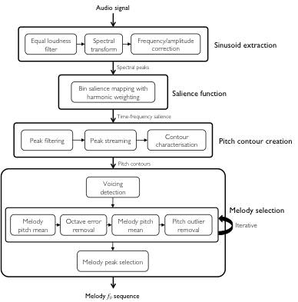
Prominent pitch detection
(Salamon, 2013)

Slide 14
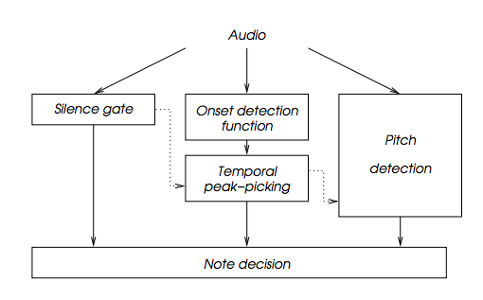
Onset detection

Slide 15
References
http://en.wikipedia.org/wiki/Spectral_centroid
http://en.wikipedia.org/wiki/Mel-frequency_cepstrum
http://en.wikipedia.org/wiki/Loudness
http://en.wikipedia.org/wiki/Harmonic_pitch_class_profiles
http://en.wikipedia.org/wiki/Moment_(mathematics)
http://en.wikipedia.org/wiki/Onset_(audio)
All slides and code produced for this course are released using the CC Attribution-Noncommercial-Share Alike license or the Affero GPL license and available from https://github.com/MTG/sms-tools

