Slide 1
1T4: Some basic mathematics
Xavier Serra
Universitat Pompeu Fabra, Barcelona
Notes:
Welcome again to the course on Audio Signal Processing for Music Applications!!
In this class I want to highlight the basic mathematic concepts that are required to understand what we will cover in the course.
I will not explain them in depth, so if you have not seen them before, or you already forgot them, I strongly encourage you to go over them by yourself as soon as posible.

Slide 2
Index
Sinusoidal functions
Complex numbers
Euler’s formula
Complex sinusoids
Scalar product of sequences
Even and odd functions
Convolution
Notes:
In the context of this course, sounds are discrete signals and the processes we will develop are discrete systems, thus we will require some background on discrete mathematics.
The good news is that no calculus is required to follow this course. You just have to know a bit about
...
Not much more. The rest we will cover and explain in the course.
Let me now present these concepts so you can identify what you should review before we really start into our core topics.

Slide 3
Sinusoidal functions (sinewaves)
Notes:
Our first basic concept is the sinewave.
A sinusoidal function, or sinewave, is a mathematical curve that describes a smooth repetitive oscillation. It occurs often in physics, engineering and many other fields.
...
For us the sinewave is the basic building block that makes up all sounds and it is of fundamental importance for Fourier analysis, which is at the core of this course.

Slide 4
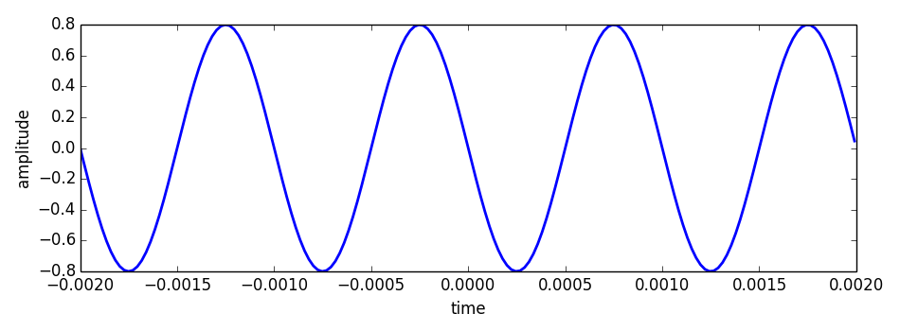
Sinewave plot
A = .8
f0 = 1000
phi = np.pi/2
fs = 44100
t = np.arange(-.002, .002, 1.0/fs)
x = A * np.cos(2*np.pi*f0*t+phi)
Notes:
The most common visual representation of a sinewave is this one.
...
For all our example calculations and plots done during the course, also for the assignments, we will be using the programing language Python.
...

Slide 5
Complex numbers
a, b: real numbers
: imaginary unit
Im
Complex plane:
Re (real axis)
Im (imaginary axis)
Re
Notes:
Another needed basic concept is the one of complex numbers, which are numbers that are built of two parts.
One part is what we call the real part and the other is the imaginary part.
...

Slide 6
Rectangular form:
Im
b
x
Polar form:
a
Re
Im
where:
x
A
φ
Re
Notes:
A complex number can be expressed in two ways, in what we call rectangular form or in polar form.
...
The polar form representation makes the sum and multiplications operations of complex numbers more intuitive. For us that will be a great advantage and we will use the polar form representation of complex numbers and functions whenever possible.

Slide 7
Euler's formula
Im
x
Re
Notes:
Now lets combine sines and complex numbers.
Euler's equation establishes a very useful relationship between rectangular and polar coordinates of a complex number.
....
It is a really nice looking formula. The physicist Richard Feynman called the equation "the most remarkable formula in mathematics”.
....
This formula will be fundamental to understand the Discrete Fourier Transform.

Slide 8
Complex sinewave
Real sinewave:
Notes:
By using sinusoids, complex numbers and Euler's formula, we can introduce complex sinusoids.
...
We will normally be working with real signals, thus real sinusoids, and we will have to go from the complex sinusoids, the ones that the Fourier transform works with, to real sinusoids.
...
This basically says that by summing two complex sinusoids we can cancel the imaginary components of the sinusoids and keep only their real part.

Slide 9
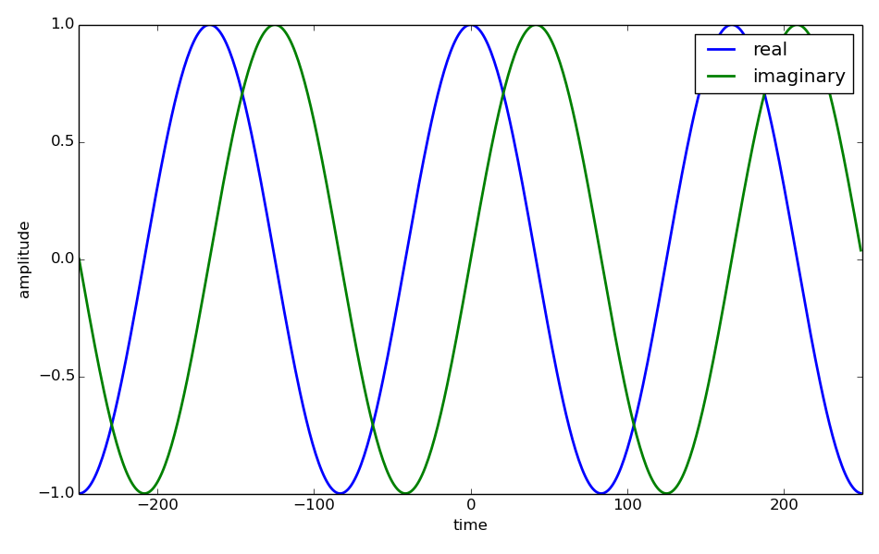
Notes:
To plot a complex sinusoid is not easy, we would need to show it in a 3D space. A common alternative is to plot the real and imaginary components as two separate functions.
...

Slide 10
Scalar (dot) product of sequences
Example:
Notes:
Another concept to be familiar with is the scalar, or dot, product, a common algebraic operation between sequences.
This is an operation that takes two equal-length sequences of numbers and returns a single value.
This operation can be defined either geometricaly or algebraically.
Algebraically, it is the sum of the products of the corresponding entries of the two sequences of numbers.
...

Slide 11
Orthogonality of sequences
x=(2,2)
2
Example:
1
1
2
3
4
-1
-2
y=(2,-2)
Notes:
An important property of the scalar product is that when two sequences are orthogonal their scalar product is equal to 0.
...
Geometrically, the dot product can be understood as the projection of one sequence into the other.
...
This is the basic operation that is performed by the Discrete Fourier Transform.

Slide 12
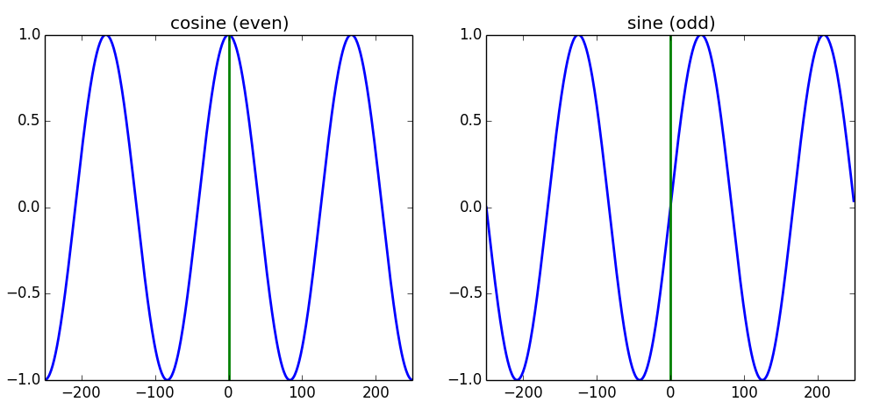
Even and odd functions
f [n] is even if f [-n] = f [n] [symmetric]
f [n] is odd if f [-n] = -f [n] [antisymmetric]
Notes:
Another mathematical concept that will appear in our signal analysis operations is the one of even and odd functions.
..
The cosine function is even and the sine function is odd. This can be shown in these plots.

Slide 13
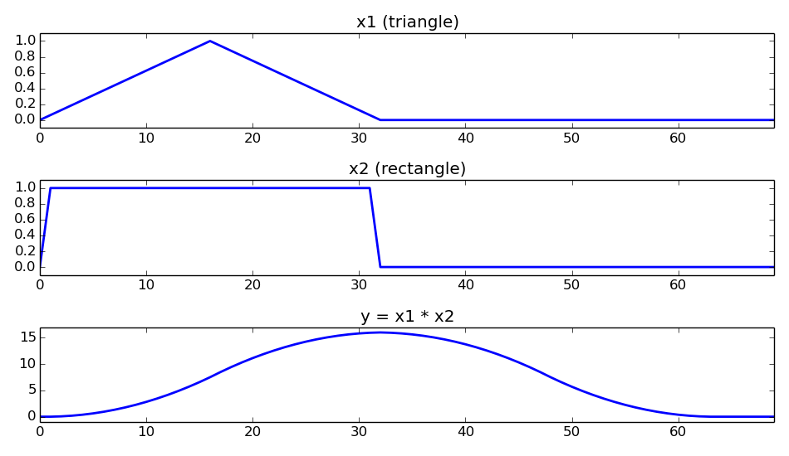
Convolution
Notes:
The last concept I want to mention is the one of convolution of sequences.
This is a mathematical operation on two sequences, producing a third sequence that can be viewed as a modified version of one of the original sequences.
...
Convolution is similar to cross-correlation.
It is a common operation used to implement filtering of sounds and it is also very useful to understand several of the properties of the Fourier transform.

Slide 14
References and credits
More information in:
  https://en.wikipedia.org/wiki/Sinusoid
  https://en.wikipedia.org/wiki/Complex_numbers
  https://en.wikipedia.org/wiki/Euler_formula
  http://en.wikipedia.org/wiki/Dot_product
  https://en.wikipedia.org/wiki/Convolution
Reference for the mathematics of the DFT by Julius O. Smith: https://ccrma.stanford.edu/~jos/mdft/
Slides released under CC Attribution-Noncommercial-Share Alike license and code under Affero GPL license; available from https://github.com/MTG/sms-tools
Notes:
The concepts I highlighted in this lecture are extensively covered in many text books.
Most of the references I used come from Wikipedia and from the website of Julius Smith on the Mathematics of the Discrete Fourier Transform, reference that I very much recommend for this course.
...

Slide 15
1T4: Some basic mathematics
Xavier Serra
Universitat Pompeu Fabra, Barcelona
Notes:
This is all for this lecture.
We have identifyed the basic math concepts that will be very much needed throughout the course.
Please make sure that you get a grasp of them before we start the Fourier topics.
Thanks for your attention!!

