Slide 1
7T1: Stochastic Model
Xavier Serra
Universitat Pompeu Fabra, Barcelona
&
Stanford University
Notes:
Welcome again to a lecture of the course on Audio Signal Processing for Music applications.
Until now we have been analyzing sounds using sinusoidal representations, they work!! but there are many types of sounds that are best described by what are called stochastic models.
Signals like the sound of the ocean, or the bowed noise of a violin fit into this category of stochastic signals.
We will talk about this today.

Slide 2
Index
Stochastic signals
Stochastic model
Stochastic approximation of sounds
Stochastic model system
Notes:
In this lecture I will cover
...
The stochastic model is complementary to the models covered until now. In fact in the following lecture we will combine the stochastic model with the sinusoidal-based models, being able to take advantage of the best of both types of models.

Slide 3
Stochastic signals
Described by the laws of probability; mean, variance, probability distributions
Autocorrelation
Power spectral density
Notes:
What is an stochastic signal?
An stochastic signal cannot be described in a deterministic way, only probabilistically.
The field of statistical signal processing deals with this type of signals and is a quite advance topic. Here we will give a very broad approach, which is suficient for our needs.
...

Slide 4
Stochastic model
Spectral view:
Notes:
There are many models that have been proposed for modeling stochastic signals.
We will use a very general model. This equation is the convolution of two signals.
...

Slide 5
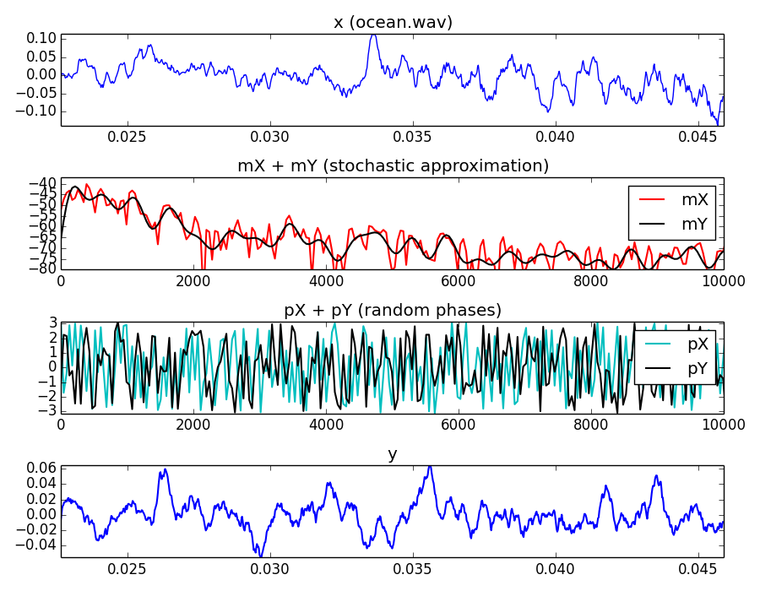
Notes:
Let's show an example.
If we start with a fragment of the sound of the ocean...
...
So the main analysis issue for this stochastic model is the approximation of the time-varying magnitude spectrum of the input signal.

Slide 6
Notes:
Let's show an example.
If we start with a fragment of the sound of the ocean...
...
So the main analysis issue for this stochastic model is the approximation of the time-varying magnitude spectrum of the input signal.

Slide 7
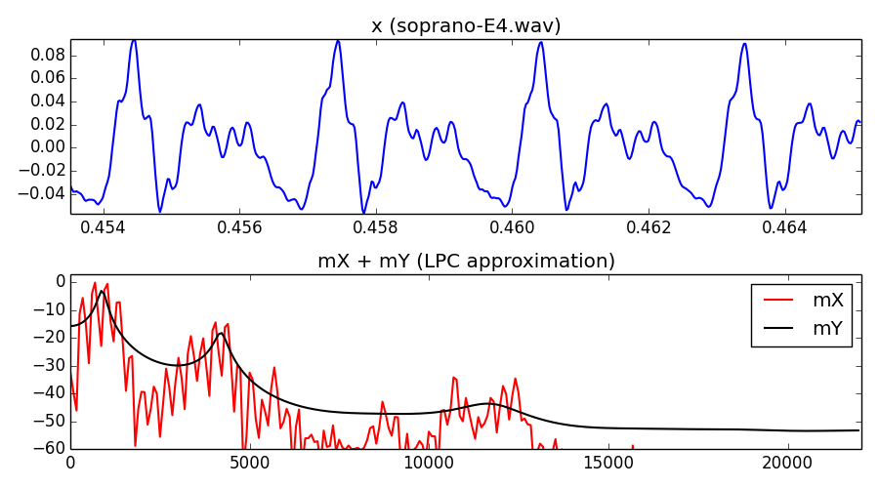
LPC approximation
Notes:
A common approach for obtaining a filter that approximates the spectral characteristics of a sound is to use Linear Predictive Coding.
With LPC we can obtain a set of filter coefficients a_k, and the frequency response of the resulting filter approximates the spectrum of the input sound.
...
LPC works good with voice signals, but not so good with other types of signals.

Slide 8
LPC approximation
Notes:
A common approach for obtaining a filter that approximates the spectral characteristics of a sound is to use Linear Predictive Coding.
With LPC we can obtain a set of filter coefficients a_k, and the frequency response of the resulting filter approximates the spectrum of the input sound.
...
LPC works good with voice signals, but not so good with other types of signals.

Slide 9
LPC approximation
Notes:
A common approach for obtaining a filter that approximates the spectral characteristics of a sound is to use Linear Predictive Coding.
With LPC we can obtain a set of filter coefficients a_k, and the frequency response of the resulting filter approximates the spectrum of the input sound.
...
LPC works good with voice signals, but not so good with other types of signals.

Slide 10
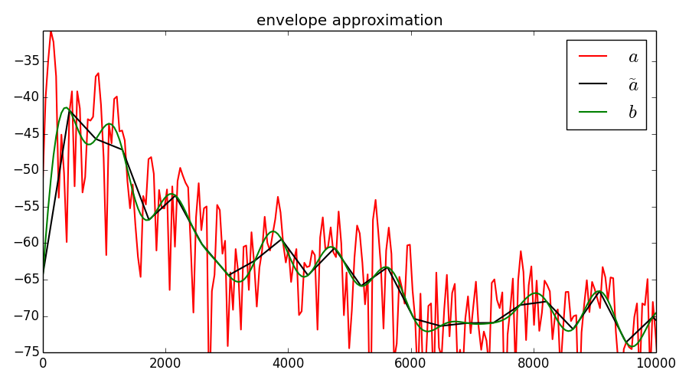
Envelope approximation
Notes:
A simpler and more general approximation approach can be done by applying a low-pass filter to the spectrum of the input signal.
We can easily implement a low-pass filter of a sequence using the DFT.
A smooth version of the approximation can be obtained by zero-padding. This is an interpolation process.
...
This is the approach we use in our implementations.

Slide 11


Stochastic synthesis using LPC
direct form
structure
lattice
structure
Notes:
Now let's talk about the synthesis part of the stochastic model.
If we approximate a sound using LPC or with any other type of filter design approach, we can synthesize a signal from the obtained filter coefficients by filtering white noise.
...

Slide 12
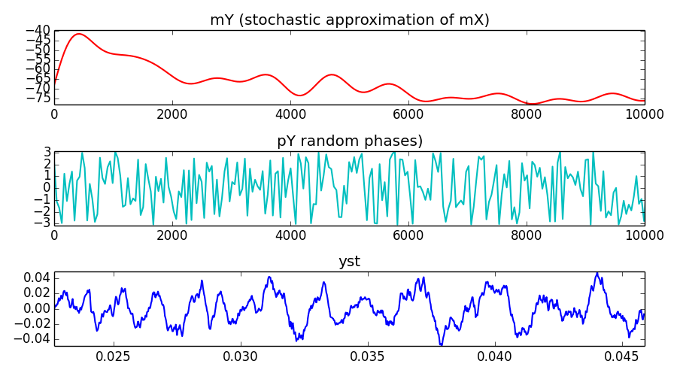
Stochastic synthesis using envelopes
Notes:
If we obtain the approximation using the low-pass filtering approach we can synthesize the sound directly by computing the inverse DFT.
...
This will be the method that we will use in our examples.

Slide 13
Stochastic model system
w[n]
x[n]
xw[n]
|X[k]|
|Yst[k]|
yw[n]
yst[n]
X
FFT
Stochastic approx.
Stochastic spec. synthesis
IFFT
Overlap-add
Random phase generation
<Yst[k]
Notes:
The complete analysis/synthesis method using the stochastic model can be implemented with this system.
...

Slide 14
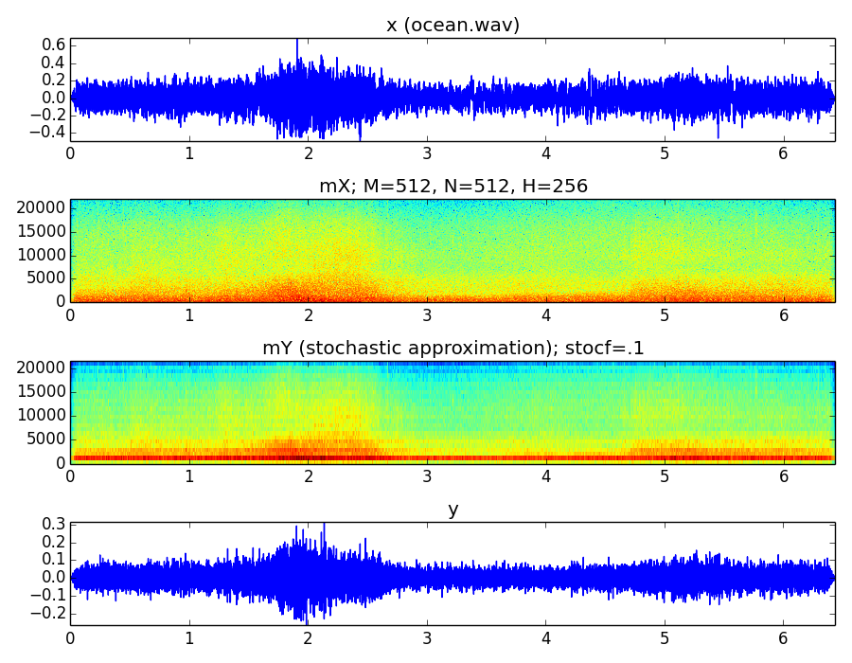
Notes:
This is an example analyzing and synthesizing a sound using the stochastic model system.
...

Slide 15
Notes:
This is an example analyzing and synthesizing a sound using the stochastic model system.
...

Slide 16
References and credits
More information in:
  http://en.wikipedia.org/wiki/Statistical_signal_processing
  http://en.wikipedia.org/wiki/Stochastic_process
  http://en.wikipedia.org/wiki/Linear_predictive_coding
Sounds from: http://www.freesound.org/people/xserra/packs/13038/
Slides and code released using the CC Attribution-Noncommercial-Share Alike license or the Affero GPL license and available from https://github.com/MTG/sms-tools
Notes:
The field of statistical signal processing is quite an advance one, so most references can be quite complicated.
...

Slide 17
7T1: Stochastic Model
Xavier Serra
Universitat Pompeu Fabra, Barcelona
&
Stanford University
Notes:
In this lecture we talked about stochastic models. The goal was to introduce an strategy with which to model some sounds, or parts of sounds, that cannot be well represented with sinusoids.
In the next lecture we will see how we can combine these stochastic models with the other models we have been discussing.
See you in the next class.

