Slide 1
Spectral-based sound transformations
(1 of 2)
Xavier Serra
Universitat Pompeu Fabra, Barcelona

Slide 2
Index
Short-time Fourier transform
  Filtering
  Morphing
Sinusoidal model
  Frequency scaling
  Time scaling

Slide 3
Short-time Fourier transform
w[n]
x[n]
|X[k]|
|Y[k]|
yw[n]
FFT
y[n]
Transf
IFFT
Overlap-add
xw[n]
<X[k]
<Y[k]

Slide 4
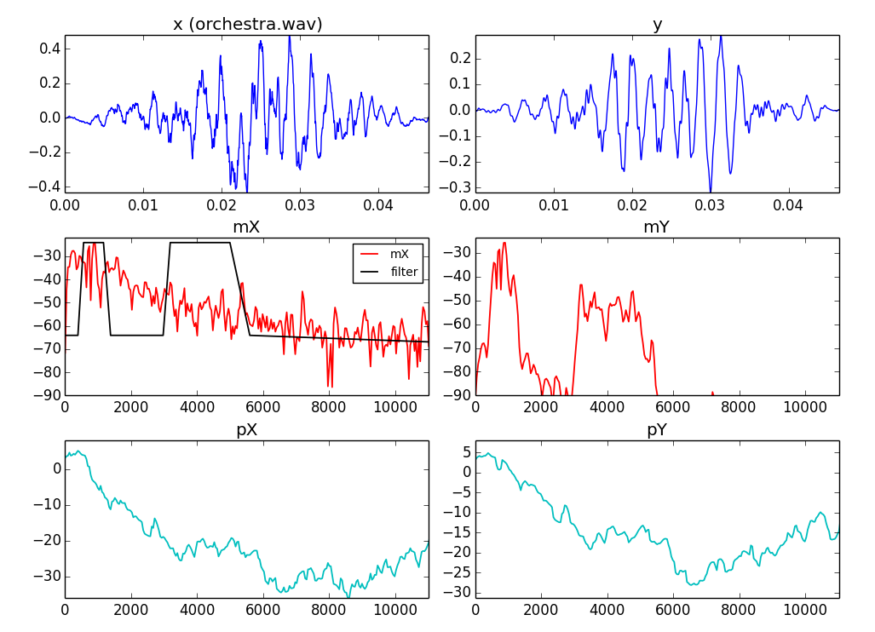

Slide 5
Sinusoidal model
w[n]
|X[k]|
p_{p}
x[n]
Peak detection
A_{p}
f_{p}
Sinusoidal
tracking
X
FFT
xw[n]
<X[k]
A_{t}
f_{t}
p_{t}
Transformations
A_{t'}
f_{t'}
p_{t'}
Sine spectral
synthesis
Ys[k]
IFFT
ysw[n]
Overlap-add
ys[n]

Slide 6
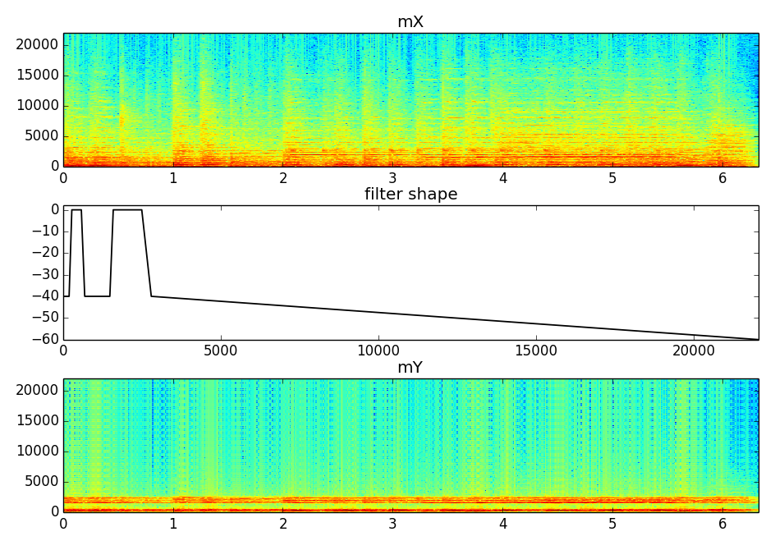

Slide 7
Morphing with STFT
w1[n]
x1[n]
|X1[k]|
X
FFT
x1w[n]
smoothing
w[n]
x[n]
|X[k]|
|Y[k]|
FFT
X
yw[n]
y[n]
X
IFFT
Overlap-add
xw[n]
<X[k]

Slide 8
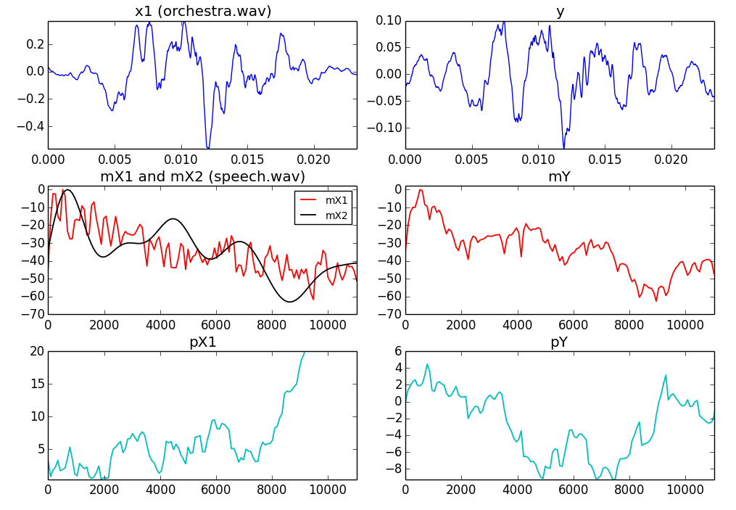

Slide 9
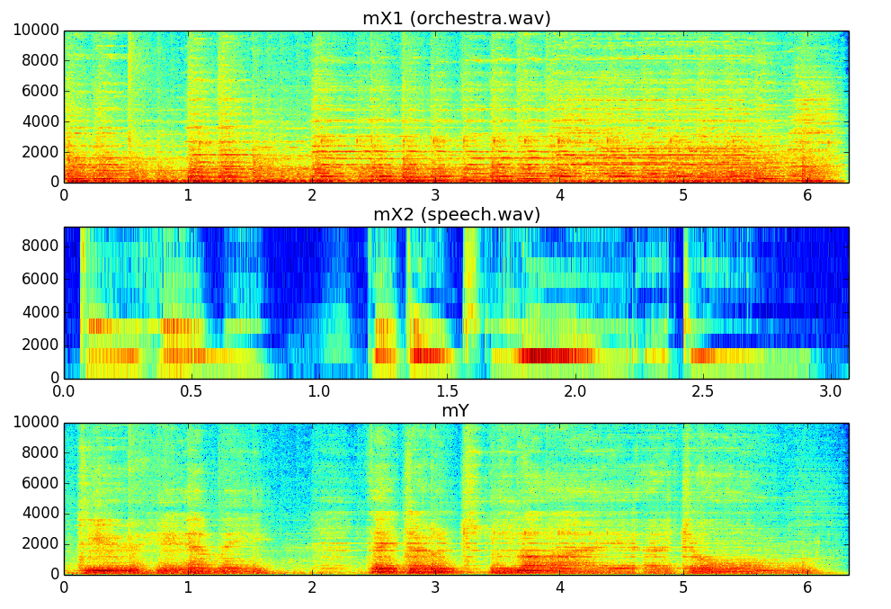

Slide 10
Time-scaling

Slide 11
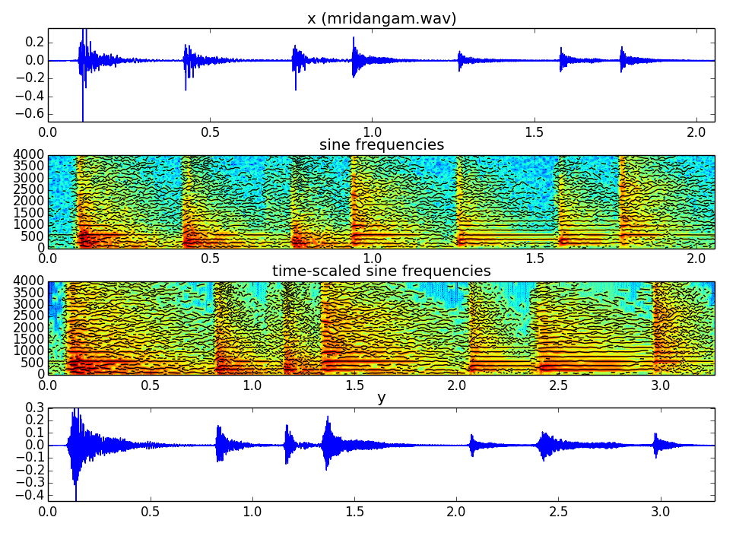

Slide 12
Frequency scaling

Slide 13
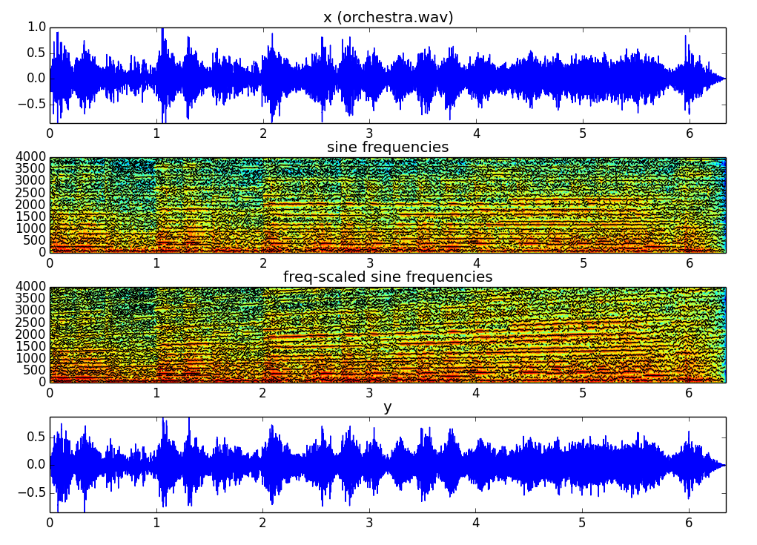

Slide 14
References
More information on this topic from Wikipedia:
  http://en.wikipedia.org/wiki/Sound_effects
  http://en.wikipedia.org/wiki/Equalization_filter
  http://en.wikipedia.org/wiki/Audio_timescale-pitch_modification
Sounds taken from Freesound: http://www.freesound.org/people/xserra/packs/13038/
The slides and code are released using the CC Attribution-Noncommercial-Share Alike license or the Affero GPL license and available from https://github.com/MTG/sms-tools

Slide 15
Spectral-based sound transformations
(1 of 2)
Xavier Serra
Universitat Pompeu Fabra, Barcelona

