Slide 1
7T2: Sinusoidal plus Residual Modeling
Xavier Serra
Universitat Pompeu Fabra, Barcelona
Notes:
Welcome again to the course on Audio Signal Processing for Music applications.
In the last lecture we talked about stochastic signals and how to model them. With that we can now extend the sinusoidal model that we had presented before to the concept of sinusoidal plus stochastic model.
We will decompose sounds into two components, the sinusoidal part, which can be called a deterministic component, and the residual part, ideally an stochastic component.

Slide 2
Index
Sinusoidal/Harmonic plus residual model (SpR, HpR)
Residual subtraction
Harmonic plus residual system
Sinusoidal/Harmonic plus stochastic model (SpS, HpS)
Stochastic model of residual
Harmonic plus stochastic system
Notes:
In this class we will combine all the models that we have covered until now.
...

Slide 3
Sinusoidal plus residual model
Notes:
The sinusoidal plus residual model is an extension of the sinusoidal model.
We assume that a sinusoidal model is not able to represent the whole sound, that there is a residual component that is perceptually relevant.
...

Slide 4
Spectral view
Notes:
We can also show the same model in the frequency domain.
...

Slide 5
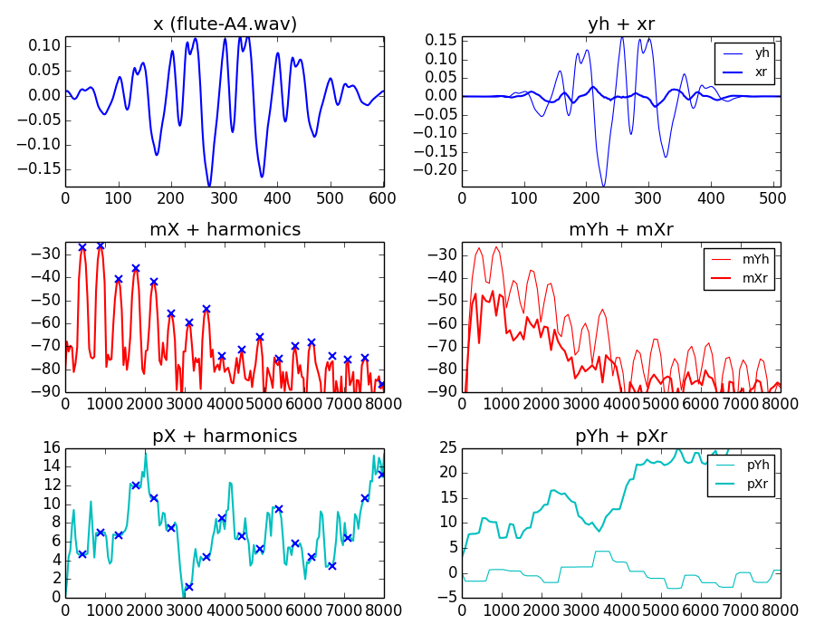
Notes:
Let's show all the steps involved in modeling a frame of a sound using the sinusoidal plus residual model.
...

Slide 6
HpR model system
wh[n]
|X[k]|
f_{p}
p_{p}
f₀
x[n]
A_{p}
F0
detection
Harmonic
detection
X
FFT
Peak detection
xwh[n]
<X[k]
f_{h}
p_{h}
A_{h}
wr[n]
Sine spectral
synthesis
xwr[n]
X[k]
-
X
FFT
+
Xr[k]
Yh[k]
+
IFFT
yw[n]
Overlap-add
y[n]
Notes:
If we put all the parts of the harmonic plus residual model together in an analysis/synthesis system we get this.
...

Slide 7
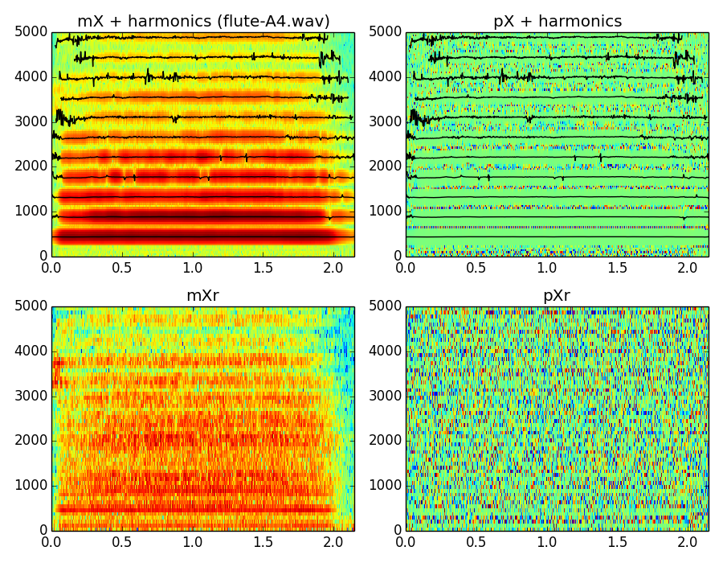
Notes:
We can see here an example of the analysis of a particular sound using the harmonic plus residual model.
...
But the residual component is a complete sound, thus dificult to process. We need a model for it. What model? the stochastic model.

Slide 8
Sinusoidal plus stochastic model
where:
Notes:
Let's introduce the stochastic approximation of the residual component. With that we present the sinusoidal plus stochastic model.
...

Slide 9
Spectral view
where:
Notes:
The spectral view of the sinusoidal plus stochastic model should be quite clear from what we have seen until now.
...

Slide 10
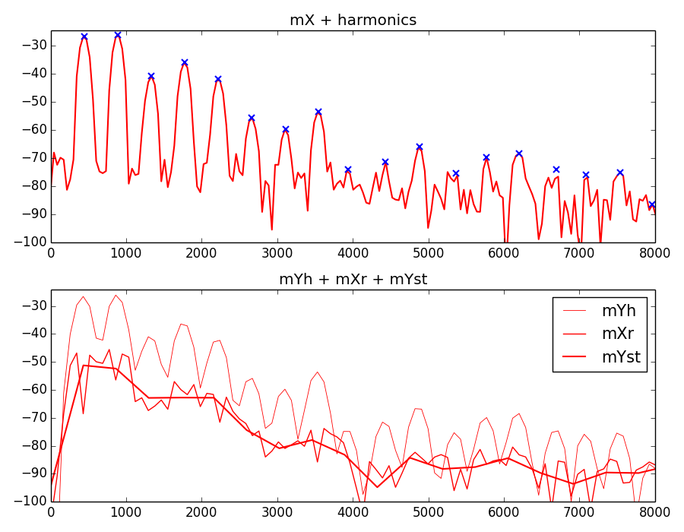
Notes:
Let's focus on the magnitude spectrum of a single frame to show some of the analysis process that takes places to obtain the sinusoidal plus stochastic representation.
...

Slide 11
HpS model system
wh[n]
|X[k]|
p_{p}
f₀
f_{p}
x[n]
A_{p}
F0
detection
Harmonic
detection
X
FFT
Peak detection
xwh[n]
<X[k]
f_{h}
p_{h}
A_{h}
wr[n]
Sine spectral
synthesis
X[k]
-
X
FFT
+
Yh[k]
xwr[n]
Xr[k]
Stochastic approximation
|Yst[k]|
+
Random phase generation
<Yst[k]
Stochastic spec. synthesis
Yst[k]
IFFT
yw[n]
Overlap-add
y[n]
Notes:
We can show the complete diagram of the harmonic plus stochastic system.
...

Slide 12
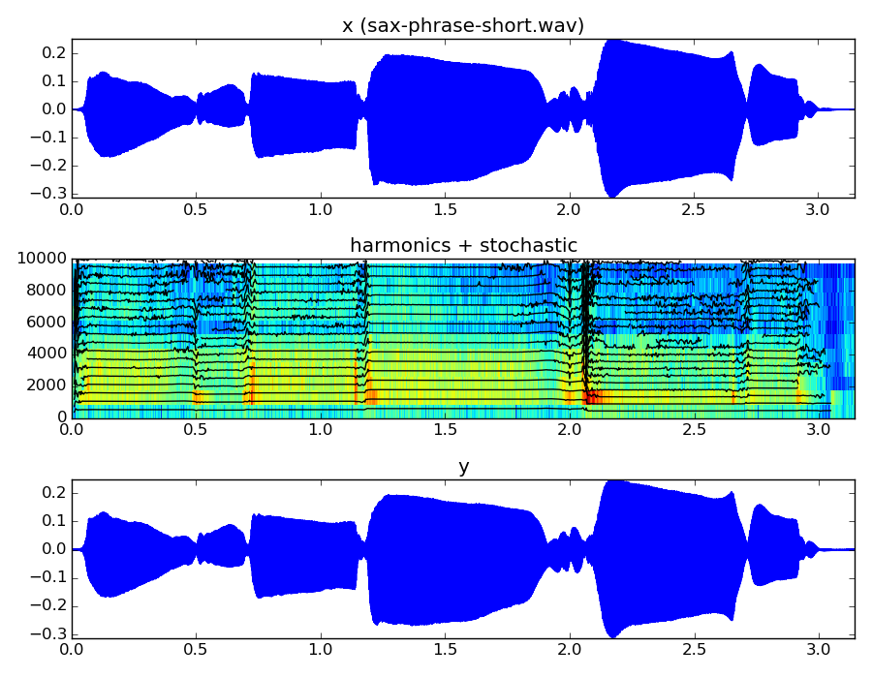
Notes:
This is an example of the analysis/synthesis process of a sound using the HpS model.
...

Slide 13
References and credits
Further references: http://mtg.upf.edu/technologies/sms
Sounds from: http://www.freesound.org/people/xserra/packs/13038/
Slides released under CC Attribution-Noncommercial-Share Alike license and code under Affero GPL license; available from https://github.com/MTG/sms-tools
Notes:
Not many references are available on this topic.
In this page that I maintain you can find some references related to this topic.
...

Slide 14
7T2: Sinusoidal plus Residual Modeling
Xavier Serra
Universitat Pompeu Fabra, Barcelona
Notes:
In this lecture we have covered the most advance models that we will present and use in this course.
We basically combined all the previous models, developing a variety of analysis/synthesis techniques that can be applied to many sounds and for many applications.
In the next lecture we will focus on the use of these models for transforming sounds.
See you then!!!

Slide 15
7T2: Sinusoidal plus Residual Modeling
Xavier Serra
Universitat Pompeu Fabra, Barcelona
&
Stanford University
Notes:
In this lecture we have covered the most advance models that we will present and use in this course.
We basically combined all the previous models, developing a variety of analysis/synthesis techniques that can be applied to many sounds and for many applications.
In the next lecture we will focus on the use of these models for transforming sounds.
See you then!!!

