Slide 1
Current Transformer Calculation Report Generator
Object-Oriented Analysis and Diagrams

Slide 2

Abstract
This document outlines the calculation and selection criteria for Current Transformers (CT) used in a high-voltage substation environment. The focus is on determining the knee-point voltage (Vk) for protection and distance relay applications. The software ensures accurate CT calculations using key parameters like short-circuit current factors, reactance/resistance ratios, and transformer resistances.

Slide 3
Class Diagram (Entities and Methods)
Classes:
- Client
- Consultant
- Contractor/Subcontractor
- Current Transformer
- Relay
- System Information
- Document
Methods: PerformCalculation(), ValidateVk(), GeneratePDFReport(), etc.

Slide 4
Object-Oriented Entities
1. Client
2. Consultant
3. Contractor/Subcontractor
4. Current Transformer (CT)
5. Relay
6. System Information
7. CT Report
8. Project

Slide 5



SoftWare Process
1. Initialize project
- Consultant/Client/Contractor inputs data, calculations Take place.
2. Validate CT Specifications:
- Consultant/Client/Contractor inputs CT parameters, and the system validates them (According To Calculations.
3. CT Calculation Report Generation:
- A PDF report is generated from that JSX.
Consultant/Client/Contractor creates a new project.
Consultant/Client/Contractor adds project details.
- All the data is aligned in a proper JSX format

Slide 6













In the second slide, according to the <SoftWare Process> slide, we’ll begin to perform an analysis on each of these classes:
Class:
Attributes . . .
Methods . . .
.
.
But in a diagram form!

Slide 7

Project

Slide 8


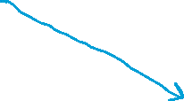

Consultant/Client/Contractor

Slide 9



The CT !
from django.db import models
class CT(models.Model):
ct_id = models.CharField(max_length=100)
primary_current = models.FloatField()
secondary_current = models.FloatField()
resistance = models.FloatField()
burden = models.FloatField()
Vk_required = models.FloatField()
Vk_calculated = models.FloatField()
system_info = models.ForeignKey(SystemInformation, on_delete=models.CASCADE)
def acceptRelay(self, relay):
# Check if the relay is a fit
if relay.burden <= self.burden:
return True
return False
def calculateVk(self):
# Logic to calculate Vk based on CT properties
pass
def validateVk(self):
# Validation of calculated Vk against required Vk
return self.Vk_calculated >= self.Vk_required

Slide 10
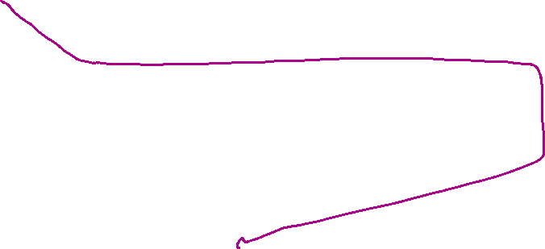
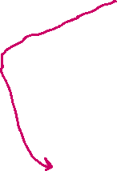
The Relay !
class Relay(models.Model):
relay_id = models.CharField(max_length=100)
type = models.CharField(max_length=100)
manufacturer = models.CharField(max_length=100)
burden = models.FloatField()
ct = models.ForeignKey(CT, on_delete=models.CASCADE)
def connectToCT(self, ct):
if ct.acceptRelay(self):
self.ct = ct
self.save()
return True
return False

