Slide 1
Reviving Lira Spinning & Strengthening the TEXDA Training Facility - Uganda
Gatsby East Africa
Textiles and Apparel
June 2022

Slide 2
Disclaimer
Gatsby Africa is an organization supporting competitiveness – enabling growth and long-term viability of industry in East Africa by maintaining and improving the region’s position in the global market; relative productivity and ability to create value-added industries , driving significant structural transformation and growth that benefits low-income sections of society within Eastern African countries: Kenya, Rwanda, Tanzania and Uganda.
Gatsby Africa provides trade and investment related information and may from time to time facilitates business linkages. Gatsby Africa is not an engineering or project management company, facility or organization neither does it specialize in providing manufacturing advisory services and commercial advice. Parties receiving Gatsby Africa information related to engineering, project execution or financing, should consult a specialist or an organization specializing in the engineering or manufacturing related services prior to making any decision based on the information provided by Gatsby Africa.
Parties receiving Gatsby Africa facilitation and information should not make any investment decision without first consulting their own financial advisor and conducting their own research and due diligence, even when using Gatsby Africa -provided linkages and information.
To the maximum extent permitted by law, Gatsby Africa disclaims any and all liability in the event any information, commentary, analysis, opinions, advice and/or recommendations prove to be inaccurate, incomplete or unreliable, or result in any investment or other losses.

Slide 3
Introduction
Gatsby East Africa were approached in April 2022 by The Ministry of Trade, Industry and Cooperatives of Uganda, to visit the Lira Spinning facility in Lira.
The objective was to assess the existing mill, with a view to assess the possibility to revive the facility to add value to Ugandan cotton, and what needs to be done to bring about this value add. Accompanying the members of Gatsby Africa was Anandhakumar Shanmugan of Lakshmi Machine Works Ltd, a specialist with experience on establishing textile mills.
During the trip, the team also visited the TEXDA site in Namamve Kampala to suggest what could be the best use for this new facility.
The below report gives a summary of findings and proposed investment options for consideration of the Ministry and stakeholders in Uganda.
The report does not cover fabric production in detail, this information will be provided in due course once a detailed analysis of requirements is finalized.

Slide 4
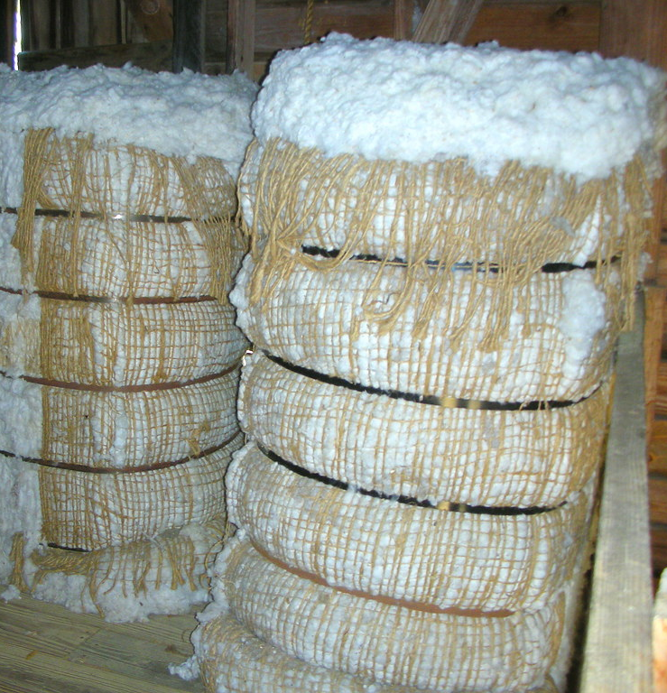
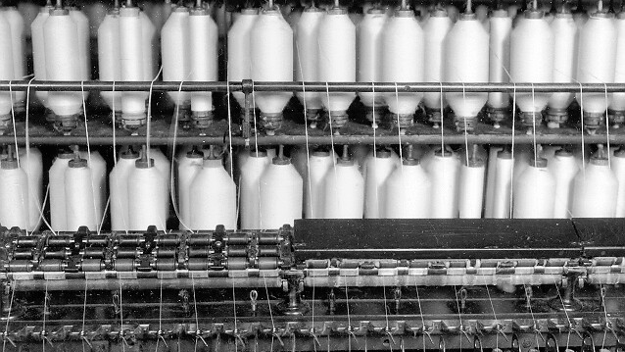
Lira Spinning Mill “How can this facility (Lira Spinning Mill) add value to our cotton, and what needs to be done”
The initial thought was to re-establish a minimum of 25k spindles to produce greige yarn. Having had the site remeasured, we can plan for 36480 spindles to fit in the existing space. To feed this quantity of spindles would require approximately 61000 bales of cotton/year.
61000 bales @185kg/bale = 11.285k tonnes/year.
11.285k tonnes cotton = 8.125k tonnes of yarn/year (28% wastage)

Slide 5
Value Addition
 | Cotton | Yarn (greige) | Fabric | Apparel | Total
Product | 11.285k tonnes/yr (Using $1.56/kg) | 8.125k tonnes/yr (considering 28% wastage) | Mix of woven and knits (1 kg of yarn = 2.1m of fabric approx.) | 32M pieces | Combined cost/ value at integrated value chain based on investment
Cost | tbd | $36.4M | $23.5M | $13M | $ 49.4 M
Working capital |  | $18M | $13M | $7M | $38 M
Jobs created | N/A | 290 | 230 | 7000 | 7520
Value: | $17.6M | $25.168M | $38.26M | $75.37M | $156.40 M
% value add |  | 43% | 52% | 97%
% value cotton to fashion |  |  |  | 428%

Slide 6
Capex Required for Cotton to Yarn - Greige
According to Lakshmi Machine Works Ltd:
36,480 spindles can be installed in the spinning mill, providing production capacity for cotton ring yarn of 21 tonnes/day – 50% carded and 50% combed.
720 rotors open end mill can also be installed to consume the process waste from the ring spinning mill, approx. 4 tonnes/day.
Capex required: USD $32/34M, this would include capital machinery, accessories, utilities, testing equipment, logistics, training, and skill development.
Working Capital: USD $16/18M per annum (70% to purchase cotton lint and chemicals and 30% for operating costs)
Revenue: The project is expected to generate around USD $32M per year – at current yarn prices.

Slide 7
Additional Capex to enhance the value add
Yarn Dyeing: Machinery Required for 1 tonne of yarn per day
60 drums soft package winder
60 drums rewinder
Dyeing vessels: 1x 250kgs, 1x 100kgs, 1x 50kgs
Hydro extractor
RF drier
Cost: $400k
Additional Cost to add stretch capabilities into woven fabrics.
600kgs of yarn/day
Cost - $100k
Yarn to fabric:
Cost - $75M (Including civil works - more details to follow)

Slide 8
Project Timelines
Building Renovation – 10 months
Utility (Humidification, electrical, water pipeline) – 6 months
Open End Mill commissioning - 4 months
Ring Spinning Mill commissioning - 6 months
Training & Skill Development - 4 months
Total – 30 months

Slide 9
Utilities
ZLD ( Zero Liquid Discharge water management system):
800 cubic m/day, including weaving and dyeing
Usual water consumption is 80/100 litres per kg of finished fabric.
Cost for 800 cum/day:
$745k for equipment
$100k for electrics and logistics
$450k for civil works
Total = $1.3M
Solar Power:
1MW of Solar Power = $1M
Power required:
5500 KVA

Slide 10
Staffing (per shift)
Spinning
4 Management
230 Operators
35 Maintenance
20 Supervisor roles
Dyeing
4 operators per tonne
1 supervisor
Weaving/Knitting/Finishing
4 Management
150 Operators
20 Maintenance
12 Supervisor roles
Total Cotton to fabric: 478 employees

Slide 11
Opportunities – Apparel Manufacturing
Garment Manufacturing
The Lira site has a total of 35acres – with some yet to be developed.
This undeveloped land could have apparel manufacturing sheds built that outside investors could take advantage of, using the vertical mill as a Supply Chain.
A 10k sqm shed, could employ +4k people over 2 shifts
Cost to build 10k sqm shed – US $2/3M
Rental of shed to investor -US$3/3.5 per sqm per month
Rental per year – US $360/420k per annum.
Multiple sheds could be built.
Machines to set up facility- US $ 5-10Mio
Working Capital- US $ 7mio per year

Slide 12
TEXDA (Textile Development Agency)
Gatsby East Afica
May 2022

Slide 13


Opportunities Sewing Operators
Prescreening of operators is always a welcome service. This should include:
Dexterity/ Eyesight/color blindness/
Birth certs/ ID cards/ police record/ vaccinations etc. etc.
Industry best practice shows that training programs works best when training is conducted within or alongside a best-in-class factory. Considering the diversity of apparel products, teaching operators to stitch and construct a garment is best left to the factories. In the factories, the operators can be taught to sew, stitching the correct products, with the correct fabrics, using the correct machinery

Slide 14
Opportunities – Based on observed skill gaps
Maintenance
Sewing machines – various
Cutting equipment
Pressing equipment
Compressors
Electronics
Electrical work
Production Skills
Line balancing
Production Forecasting
Efficiency
Utilisation
Problem Solving
People Management
Cost Controls

Slide 15
Opportunities - Best In Class Laboratory
Equipment Required:
Fibre (HVI, AFIS, transh analyser, Medan stickiness tester, moisture)
Cost - $0.8M
Yarn (Uster evenness tester, single yarn tenacity, twist tester, CSP strength)
Cost: $0.7M
Processing Lab (Spectophotometer, pilling test, tearing strength, color matching cabinet, pH, TDS test, Sample Dyeing machine, water bath, padding mangle, rubbing fastness, GSM cutter, microscope etc.)
Cost: $0.5M
Total Cost: $2M
Possible JV with SGS, Intertek etc.

