Slide 1
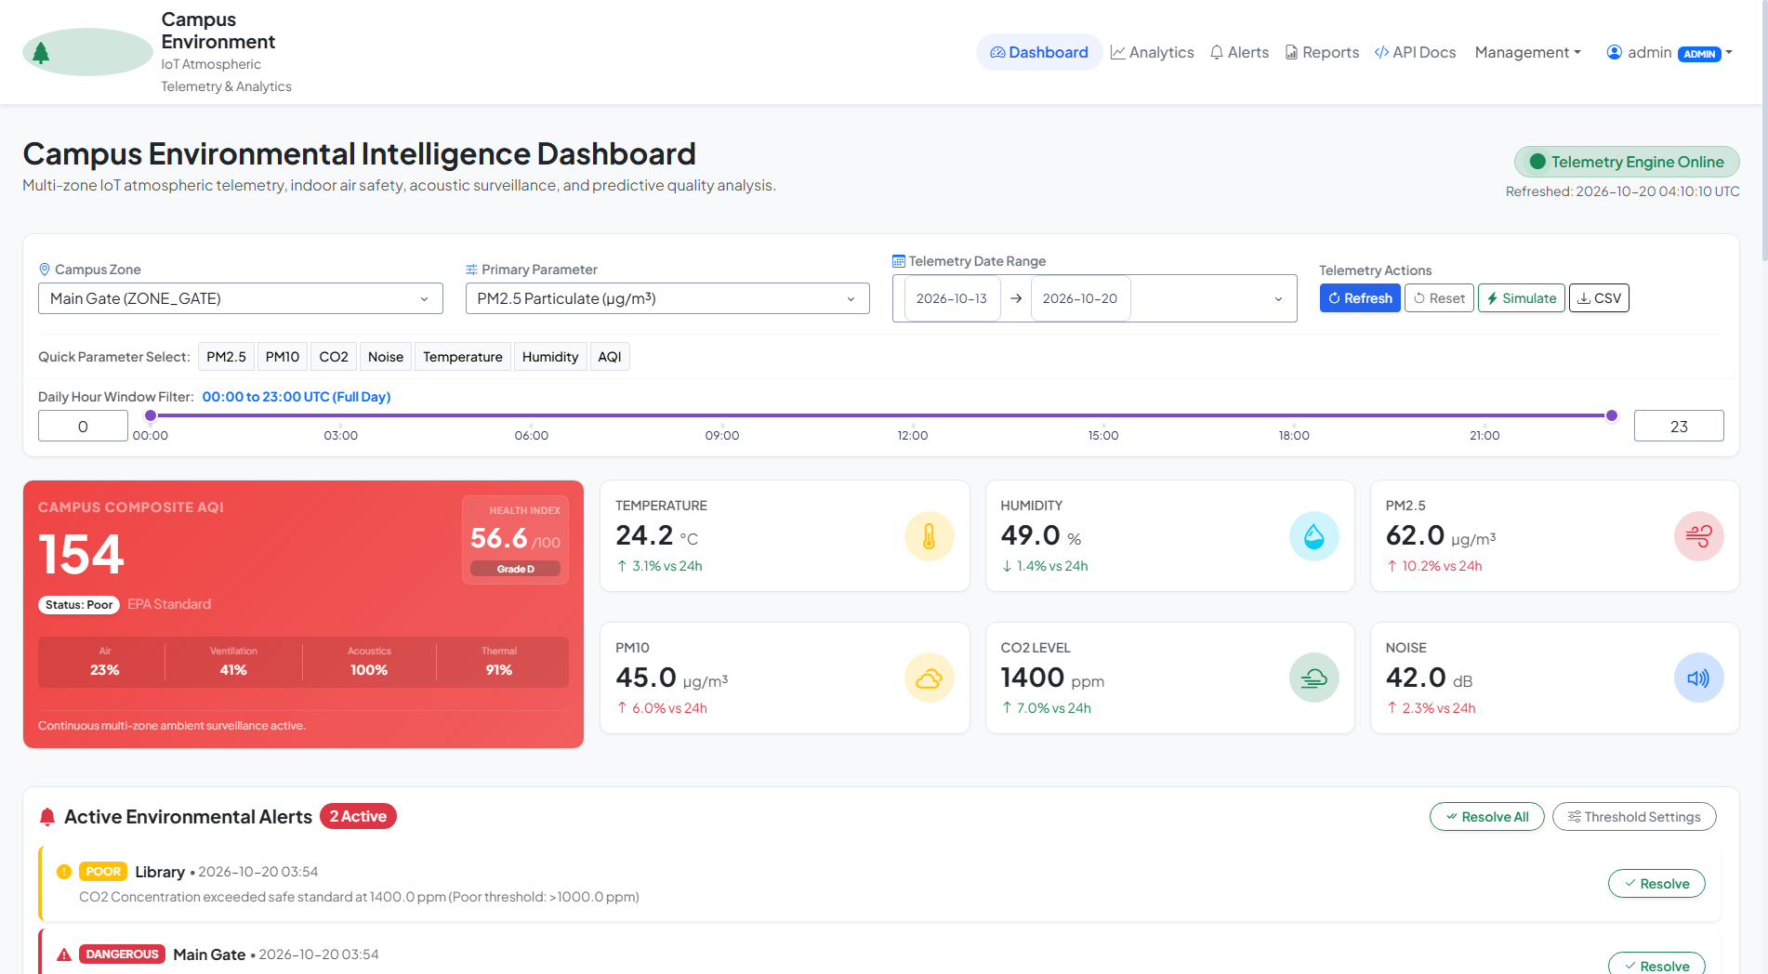
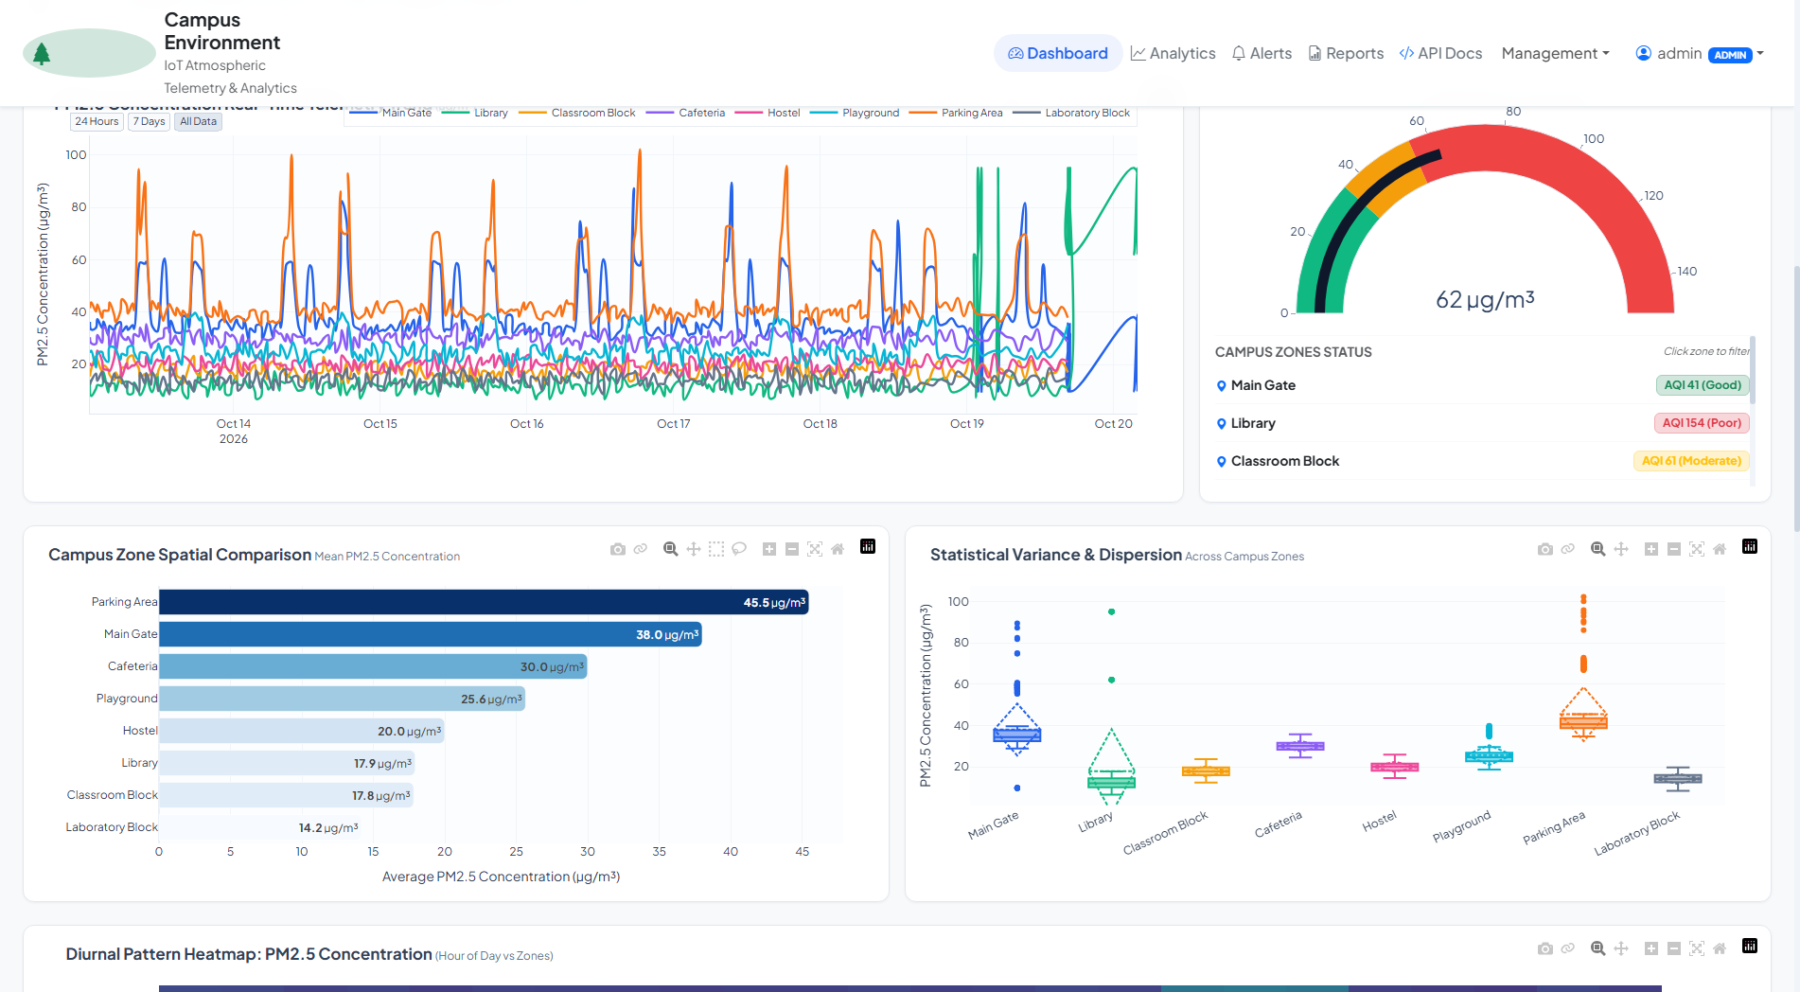
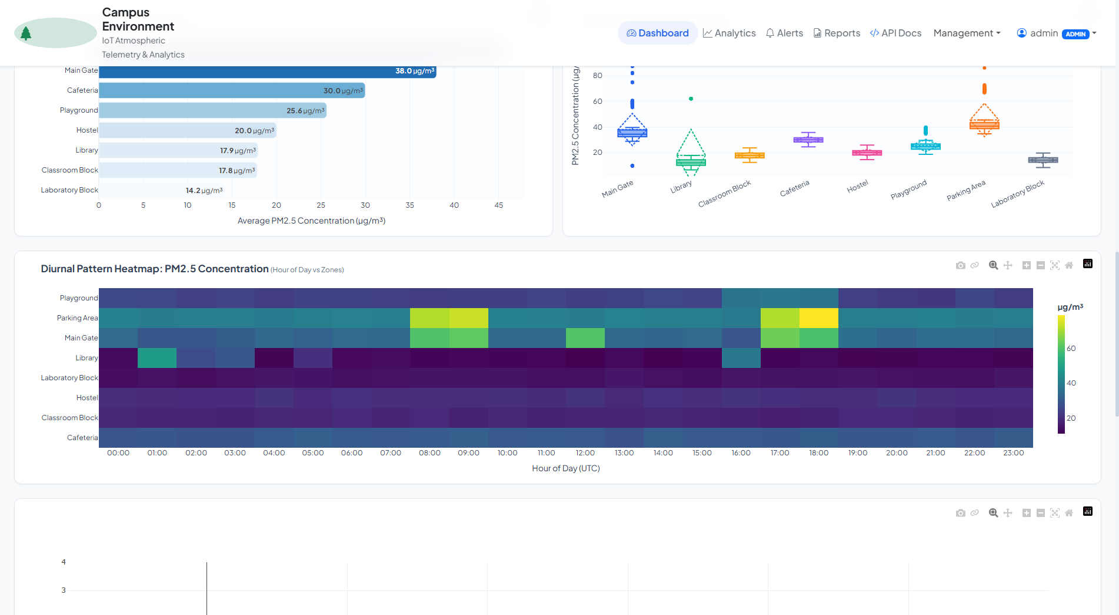
SMART CAMPUS / ENVIRONMENTAL INTELLIGENCE
Campus Environment
Data Visualization System
A Python-based platform for hyper-local telemetry,
health scoring, and evidence-led campus decisions.
UNIVERSITY APPROVAL PRESENTATION
Department of Information Engineering
Computer Application Technology
Wuhu Vocational And Technical University
Prepared for academic review · 2026

Slide 2
01 / EXECUTIVE SNAPSHOT
From scattered readings to campus-wide environmental intelligence
The project turns raw environmental telemetry into an operational view that people can understand and act on.
8
6
100
27/27
CAMPUS ZONES MODELED
CORE PHYSICAL PARAMETERS
POINT CEHI SCALE
AUTOMATED TESTS PASSED
The approval case
A compact technical thesis
Useful
Can a unified Python stack deliver a responsive, testable, and visually rich smart-campus monitoring system?
A single dashboard connects air quality, thermal comfort, ventilation, and noise.
Defensible
AQI follows US EPA breakpoint interpolation; CEHI exposes a transparent weighted score.
This project demonstrates that it can.
CAMPUS ENVIRONMENT DATA VISUALIZATION SYSTEM
02

Slide 3
02 / THE PROBLEM
Campus conditions change by zone, hour, and activity
Traditional inspection and isolated logs do not provide the context needed for timely action.
What is missing today
The campus is a living dataset
Hyper-local visibility
TRAFFIC
OCCUPANCY
VENTILATION
WEATHER
Municipal or single-point weather data misses the library, gate, cafeteria, and lab as distinct environments.
Early warning
Manual checks are periodic; CO2, particulate, or noise spikes can happen between inspections.
Morning commute
→
PM spike at gate
→
Actionable alert
Shared understanding
Raw logs and vendor silos make it difficult for facilities, faculty, and students to see the same evidence.
The system makes those relationships visible in one place, with a history that can be inspected later.
CAMPUS ENVIRONMENT DATA VISUALIZATION SYSTEM
03

Slide 4
03 / THE SOLUTION
One platform, four decision layers
The system is designed as a continuous loop: collect, calculate, interpret, respond.
01
02
03
04
COLLECT
CALCULATE
INTERPRET
RESPOND
Sensor or manual telemetry enters through validated REST endpoints.
AQI and CEHI are computed from transparent, reusable services.
Dash visuals reveal trends, zone differences, distributions, and time patterns.
Threshold alerts, admin workflows, and reports support campus action.
Sensor node → Flask API → AQI / CEHI → SQLite + Pandas → Dash dashboard
CAMPUS ENVIRONMENT DATA VISUALIZATION SYSTEM
04

Slide 5
04 / ARCHITECTURE
A unified Python stack keeps the system understandable
The design separates presentation, routing, analytics, and persistence while keeping deployment compact.
PRESENTATION
Flask views · Plotly Dash · Bootstrap 5
↓
ROUTING
Auth · Zones · Sensors · Readings · Alerts · Reports
↓
ANALYTICS
Telemetry generator · EPA AQI · CEHI · Pandas statistics · Alert engine
↓
PERSISTENCE
SQLAlchemy ORM · Users · Zones · Sensors · Readings · Alerts · SQLite
Why this matters academically: the same language handles web routing, visualization, statistics, and persistence, reducing integration friction and improving reproducibility.
CAMPUS ENVIRONMENT DATA VISUALIZATION SYSTEM
05

Slide 6
05 / DATA AND INTELLIGENCE
The platform turns telemetry into a common language for campus health
Each reading becomes both a record for analysis and a signal for immediate operational response.
Eight modeled zones
Six physical signals
Transparent scoring
Main Gate
Hostel
Temperature
°C
AQI
US EPA breakpoint interpolation
Composite value = max(PM2.5, PM10)
Library
Playground
Humidity
%
PM2.5 / PM10
µg/m³
Classroom Block
Parking Area
CEHI
Air 35% · CO₂ 25%
Noise 20% · Thermal 20%
CO₂
ppm
Cafeteria
Laboratory Block
Noise
dB
AQI
index
Every score can be explained, audited, and compared across zones.
CAMPUS ENVIRONMENT DATA VISUALIZATION SYSTEM
06

Slide 7
06 / PRODUCT EXPERIENCE
The dashboard is built for scanning first, exploring second
Executive KPIs answer “how are we doing?”; interactive charts answer “where, when, and why?”
At a glance
KPI hierarchy
CEHI, AQI, temperature, humidity, particulates, CO₂, and noise are surfaced together.
Filterable context
Zone, parameter, date range, and hour window support focused investigation.
Operational signal
Alerts and status colors keep attention on conditions that need a response.
CAMPUS ENVIRONMENT DATA VISUALIZATION SYSTEM
07

Slide 8
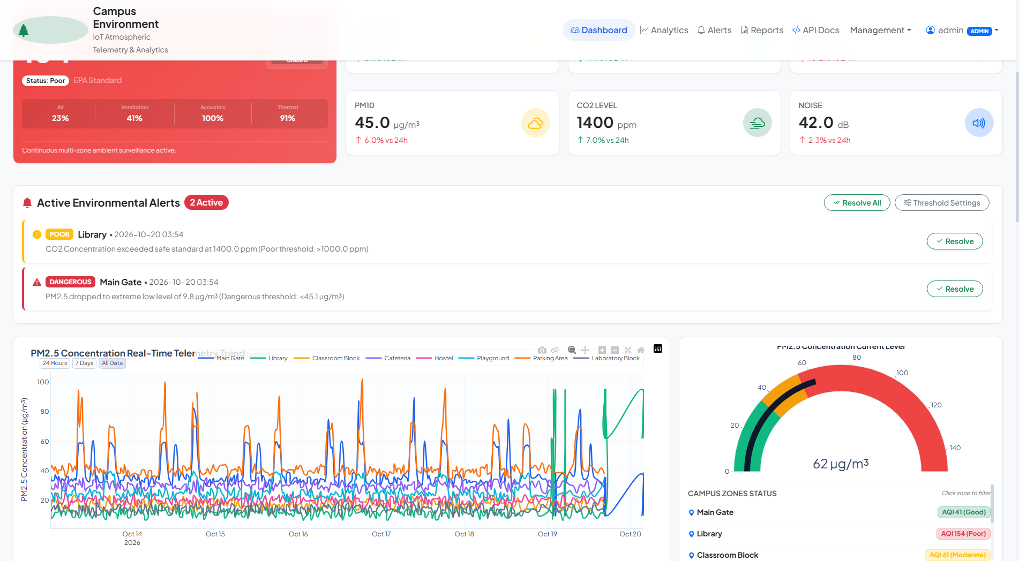
07 / VISUAL ANALYTICS
Three views reveal three different kinds of truth
The project does not rely on one chart: it combines trend, spatial comparison, and diurnal pattern recognition.
TREND
SPACE
TIME OF DAY
What changed over time?
Which zones differ?
When do risks cluster?
Time-series curves expose spikes, recovery, and long-running drift.
Radar and comparison views make cross-zone health profiles legible.
The heatmap turns recurring daily patterns into a planning signal.
CAMPUS ENVIRONMENT DATA VISUALIZATION SYSTEM
08

Slide 9
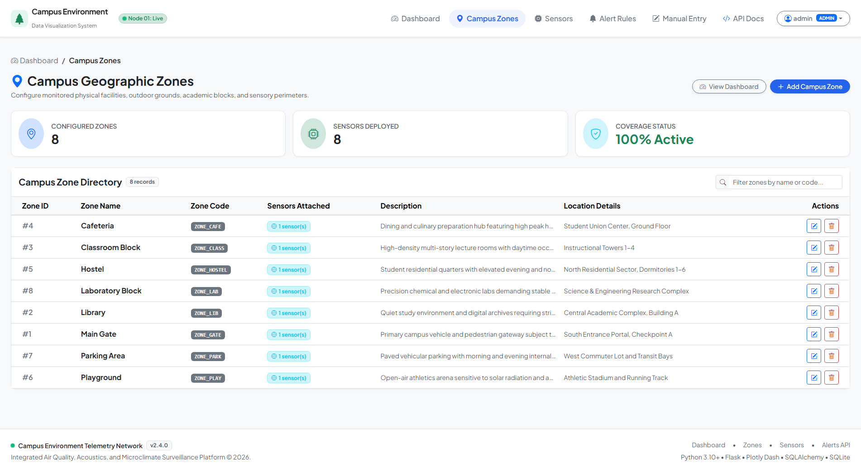
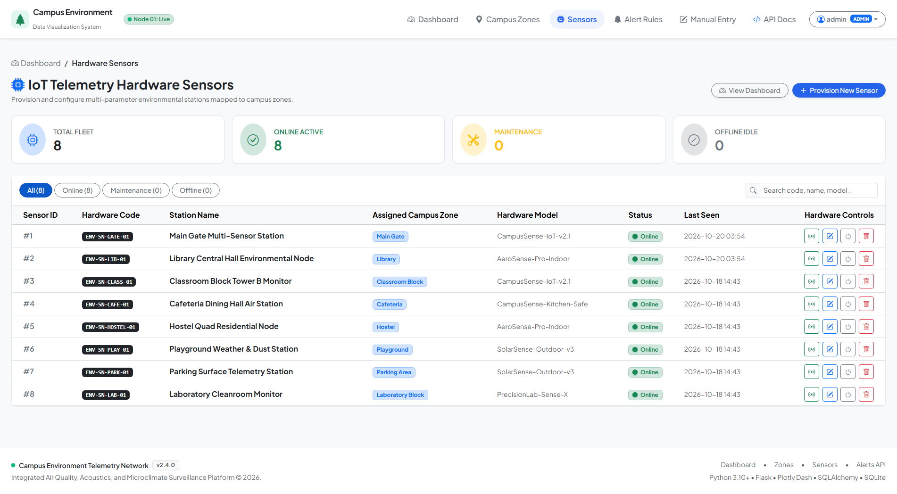
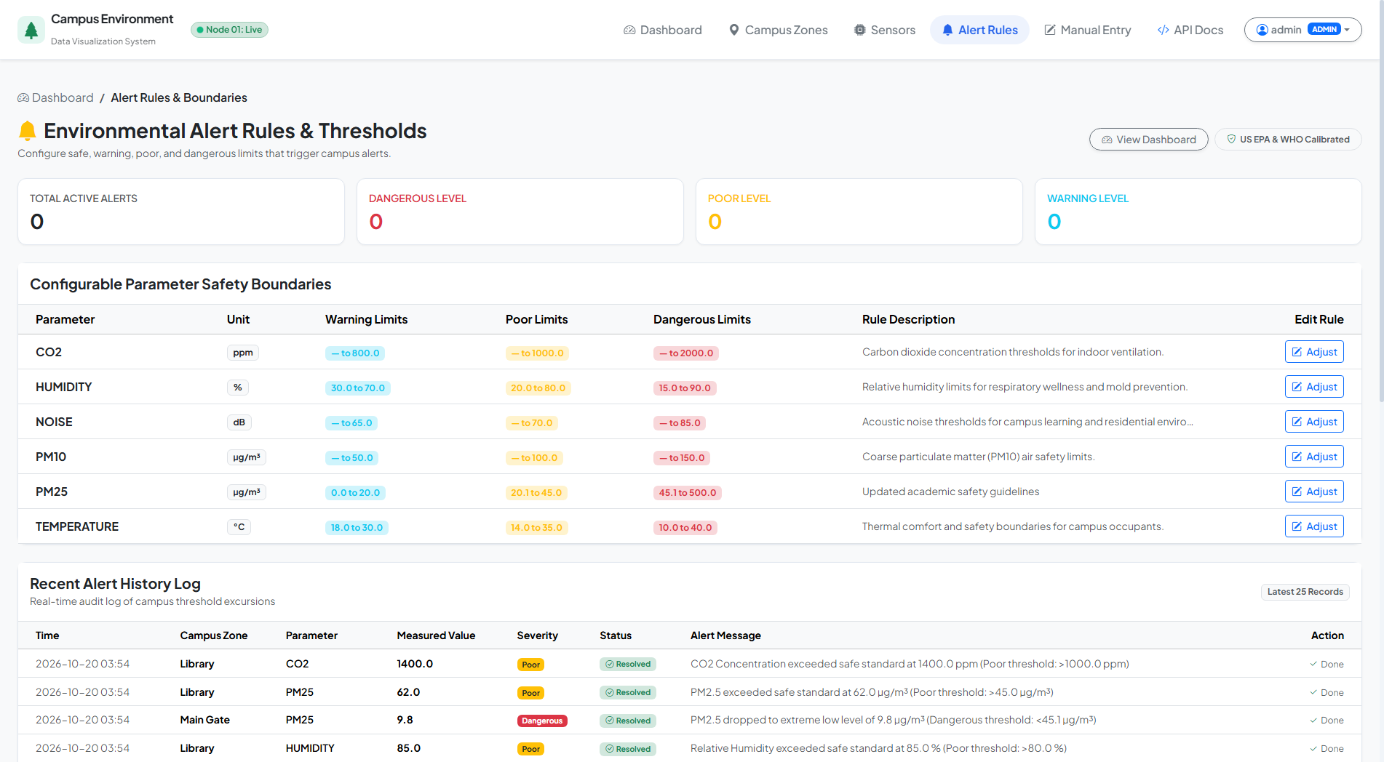
08 / GOVERNANCE AND CONTROL
The system supports both analysis and administration
A usable monitoring platform needs a controlled path from insight to configuration.
ZONE MANAGEMENT
SENSOR FLEET
THRESHOLD ENGINE
Keep the campus model aligned with physical reality.
Provision stations and monitor their status.
Tune warning, poor, and dangerous bands.
RBAC: Admin manages the system; Viewer consumes insight. Manual entry and API ingestion support real deployments.
CAMPUS ENVIRONMENT DATA VISUALIZATION SYSTEM
09

Slide 10
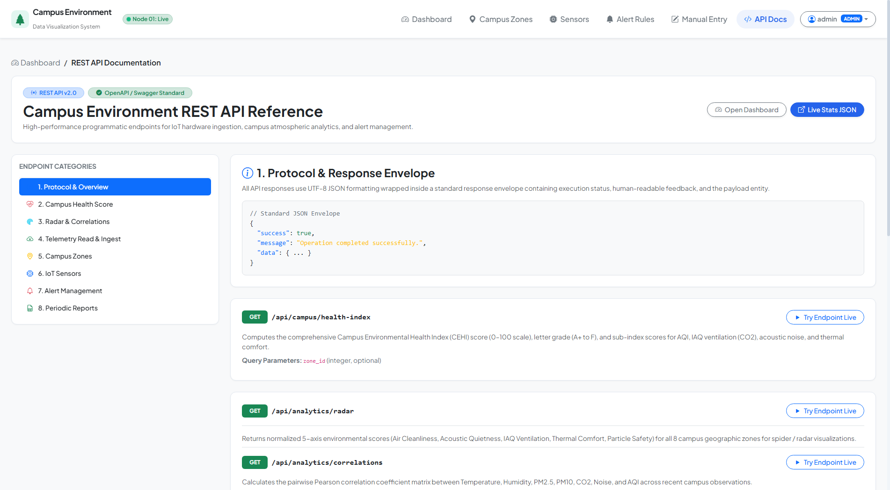
09 / INTEGRATION
Designed to grow from demo telemetry into real sensor operations
The current simulator provides realistic data; the API boundary creates a clean path toward hardware and building systems.
Integration surface
RESTful ingestion
Structured JSON endpoints accept readings and expose zones, sensors, alerts, reports, and health indexes.
Manual fallback
A controlled entry view keeps the system demonstrable and usable before hardware is connected.
Future-ready
MQTT, BACnet, HVAC automation, and predictive forecasting can connect without changing the user-facing thesis.
CAMPUS ENVIRONMENT DATA VISUALIZATION SYSTEM
10

Slide 11
10 / VALIDATION
The prototype is tested as a system, not just as a screen
Automated checks cover data, logic, access control, interactions, and live HTTP behavior.
27
100%
14.56 s
<50 ms
TEST CASES EXECUTED
PASS RATE
FULL SUITE RUNTIME
REPORTED API RESPONSE
Coverage map
What the result means
Authentication & RBAC
Telemetry & API
The core workflow is repeatable: the same request, calculation, storage path, and response can be exercised automatically.
AQI / CEHI algorithms
Analytics & callbacks
Database integrity
Runtime E2E audit
Evidence from the project test suite and thesis evaluation.
CAMPUS ENVIRONMENT DATA VISUALIZATION SYSTEM
11

Slide 12
11 / ROADMAP
A credible foundation for the next research iteration
The current scope is intentionally focused; the extension path is clear and technically coherent.
NOW
Validated monitoring platform
Python full stack · simulated telemetry · explainable scores · operational dashboard
NEXT
Connect the physical campus
MQTT / BACnet adapters · calibration workflows · real sensor health and discovery
LATER
Move from reactive to predictive
2–4 hour forecasts for PM and CO₂ · anomaly detection · demand-controlled ventilation
The approval decision unlocks the next step: pilot the platform against a small set of real campus sensing points.
CAMPUS ENVIRONMENT DATA VISUALIZATION SYSTEM
12

Slide 13
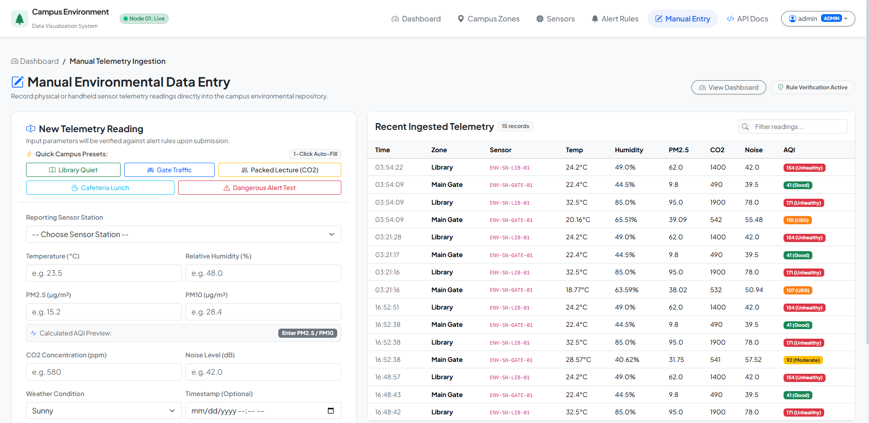
12 / REQUEST FOR APPROVAL
A practical smart-campus
platform with a clear
research runway.
The project combines a meaningful campus problem, a complete working implementation, explainable analytics, and measurable verification.
Approval requested: accept the system for university presentation, evaluation, and pilot discussion.
Thank you
Questions and discussion

