Slide 1
Final Project Progress Report Team Spoopy
Jenna Turcotte, Manuela Panuccio, Jake Sinfield, Kaye Leigh Morin, Sierra Crowell

Slide 2
Progress
Desktop mockups are completed for all pages
Mobile mockups are completed
Bootstrap has been started, and code is starting to be added
Currently only the homepage is being coded

Slide 3
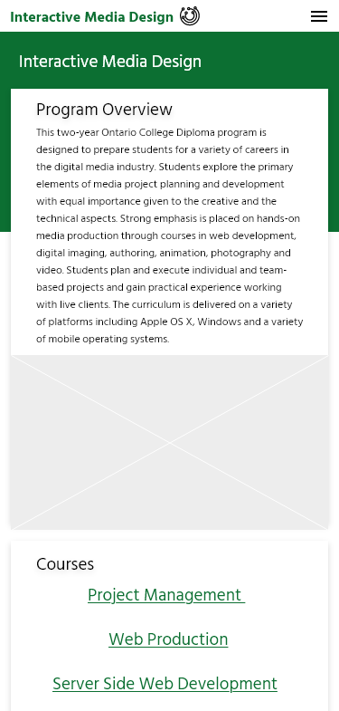
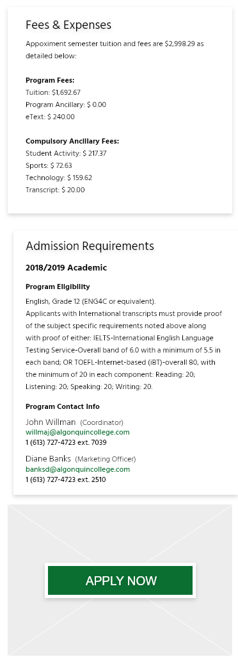
Mockups (Overview-Mobile)

Slide 4
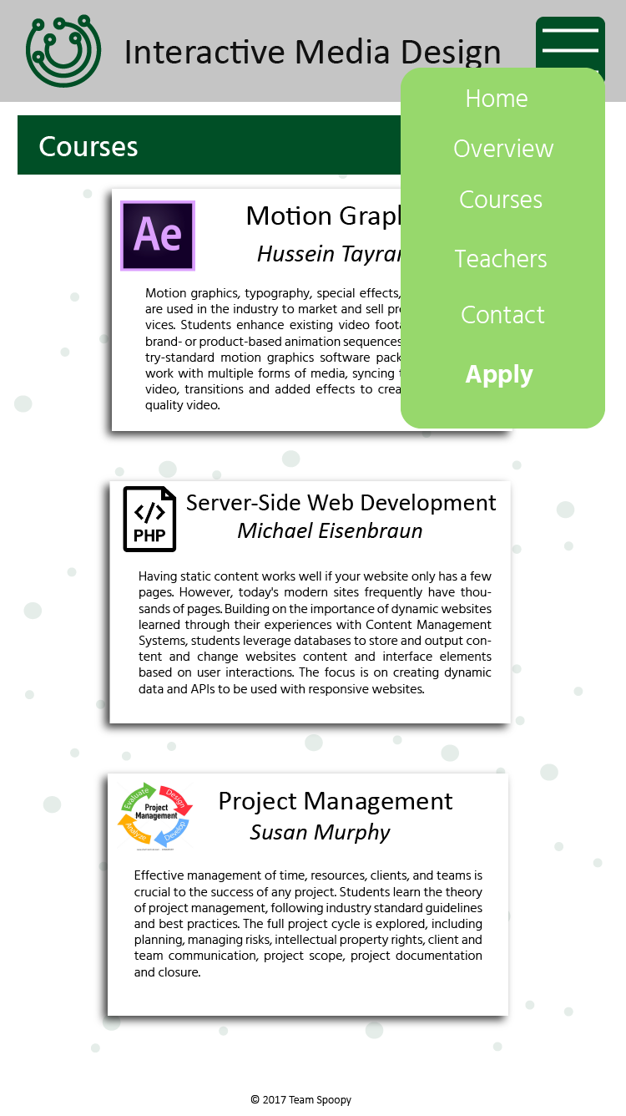
Mockups (Courses-Mobile)

Slide 5
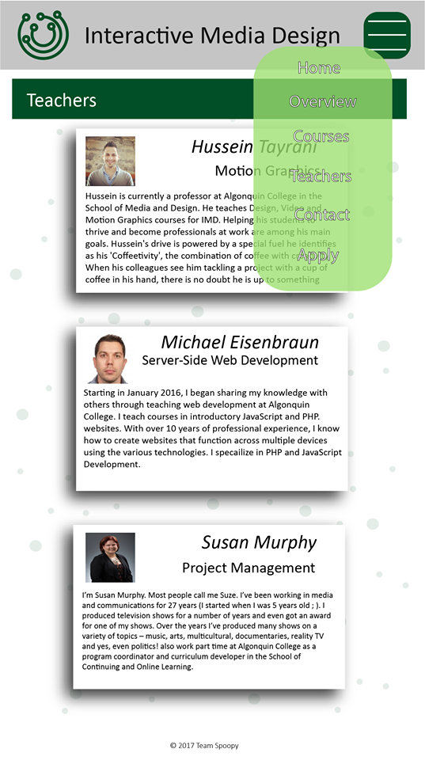
Mockups (Teachers-Mobile)

Slide 6
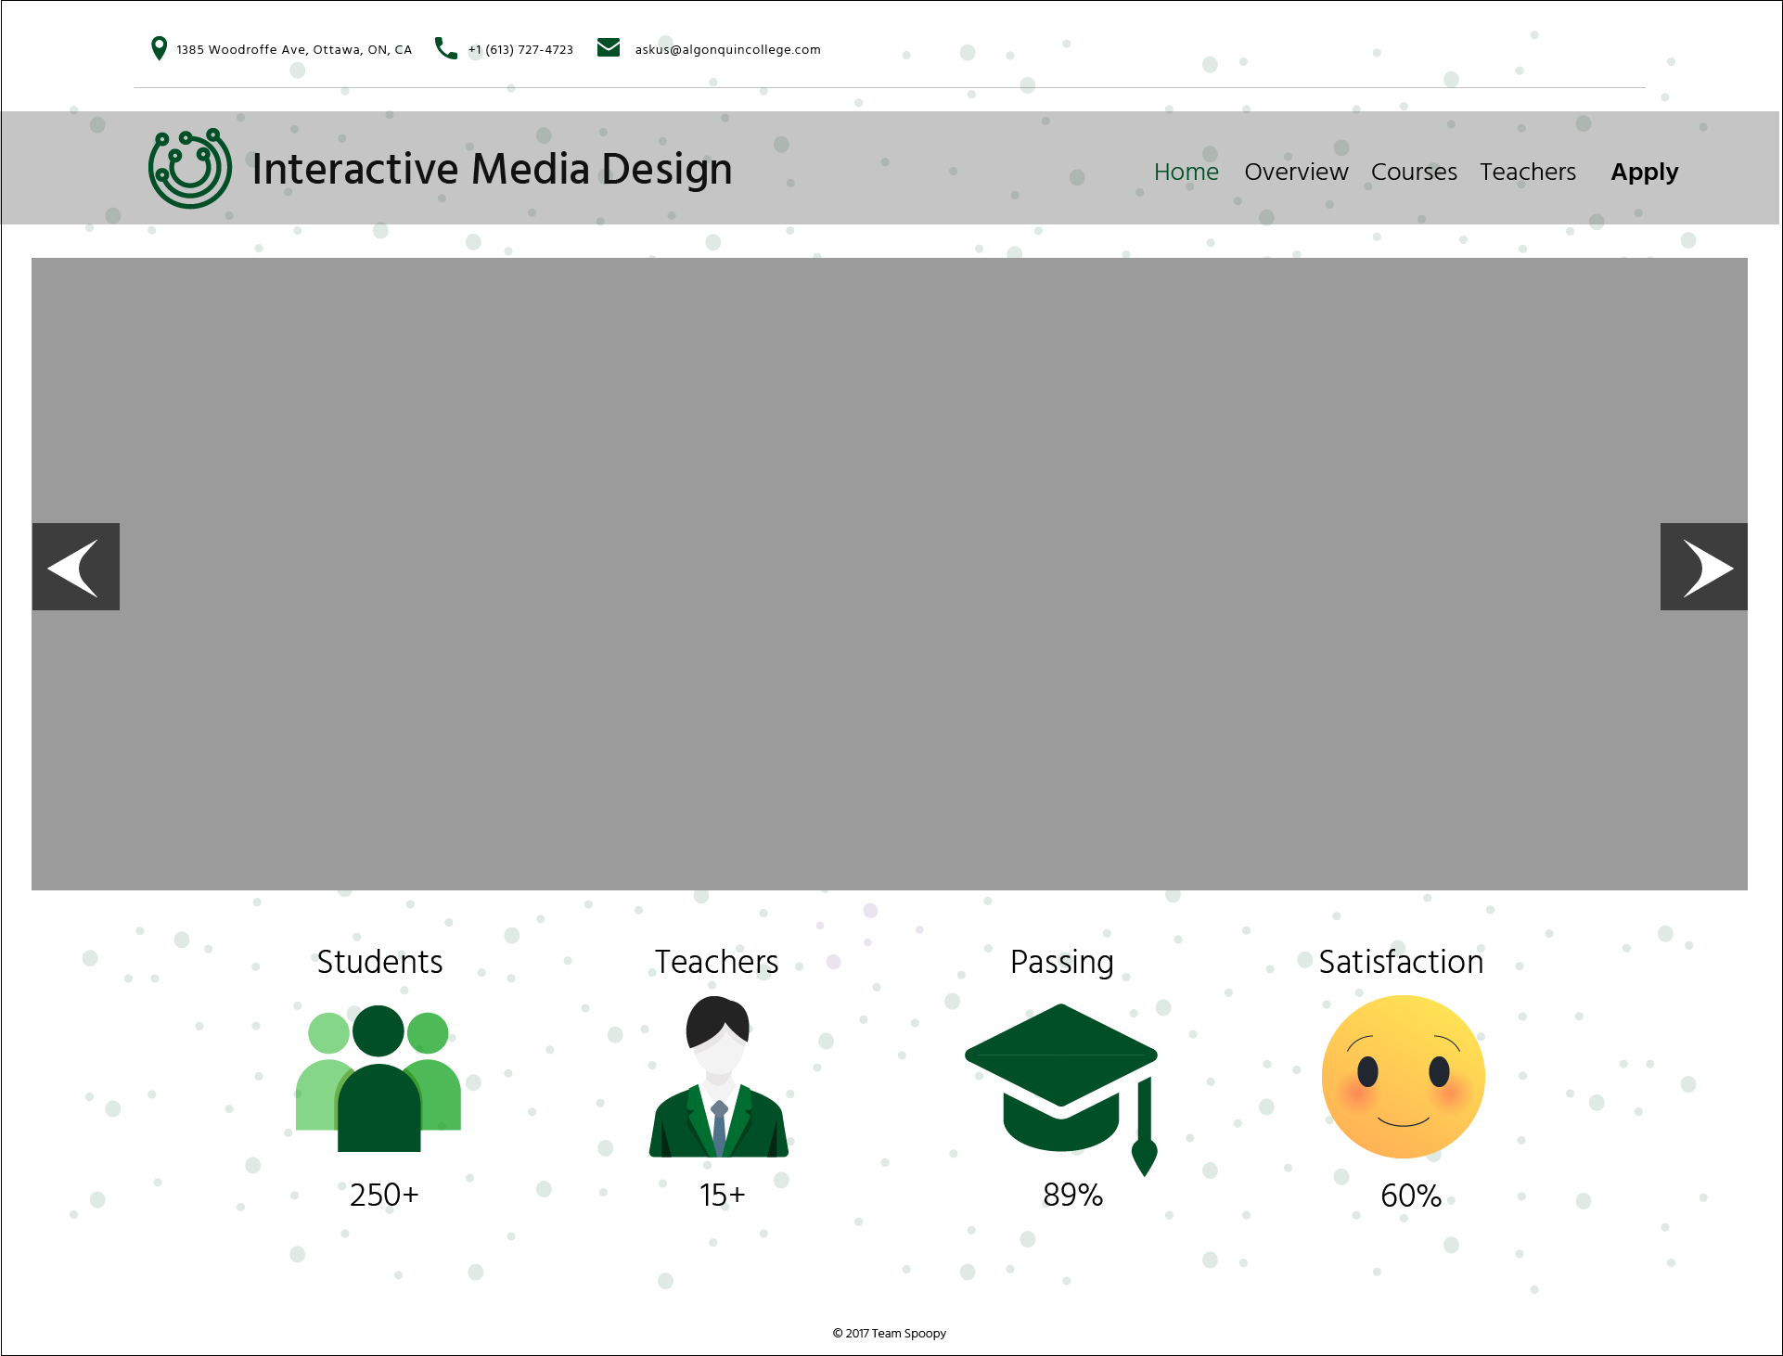
Mockups (Home-Desktop)

Slide 7
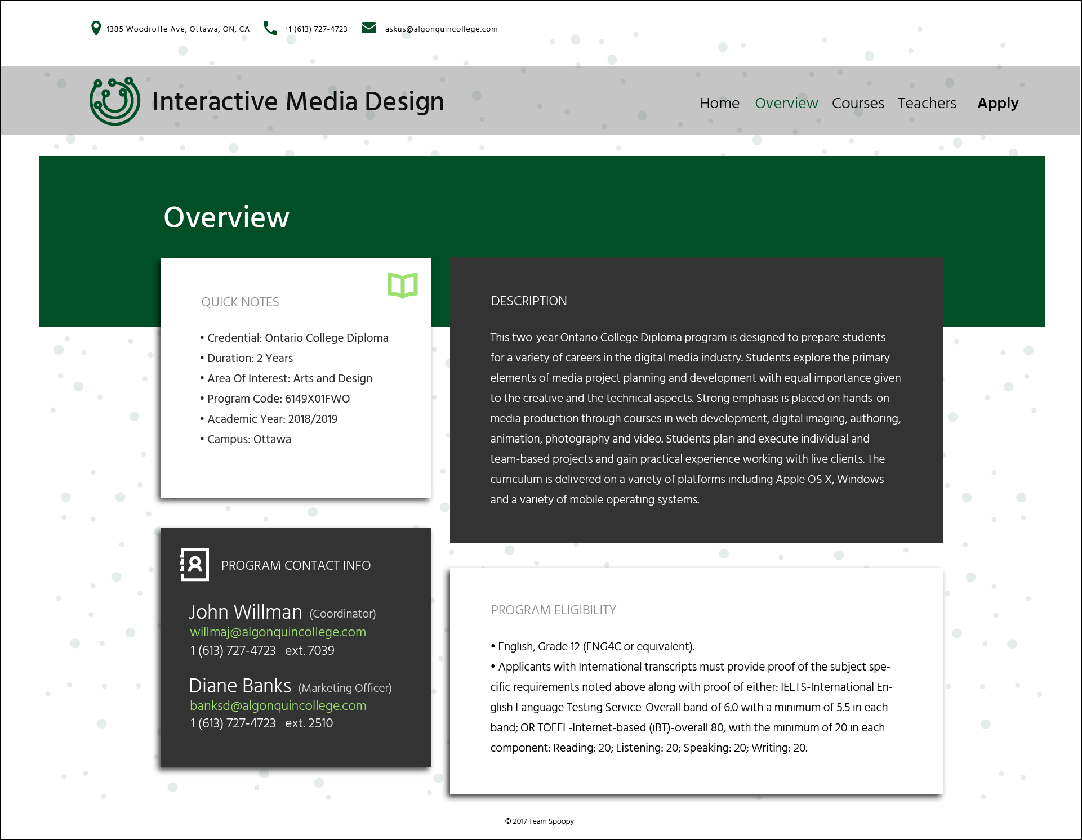
Mockups (Overview-Desktop)

Slide 8
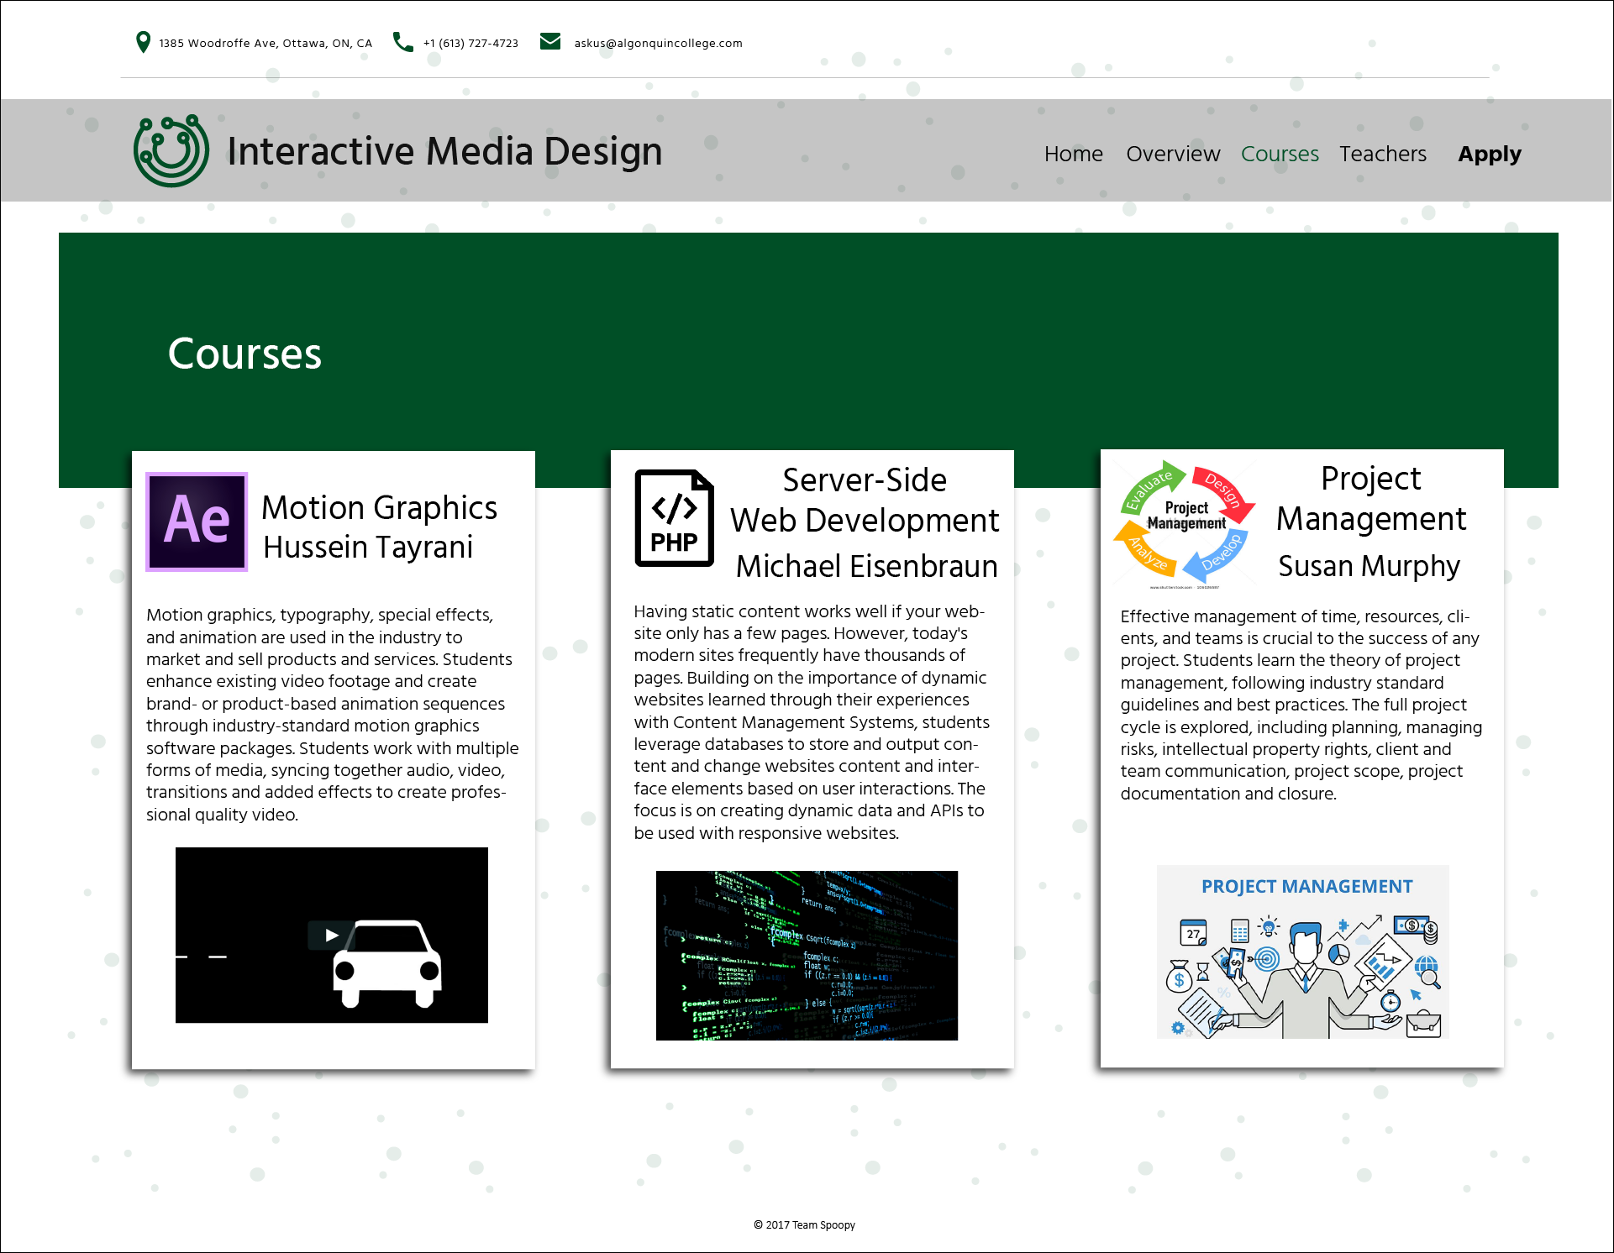
Mockups (Courses-Desktop)

Slide 9
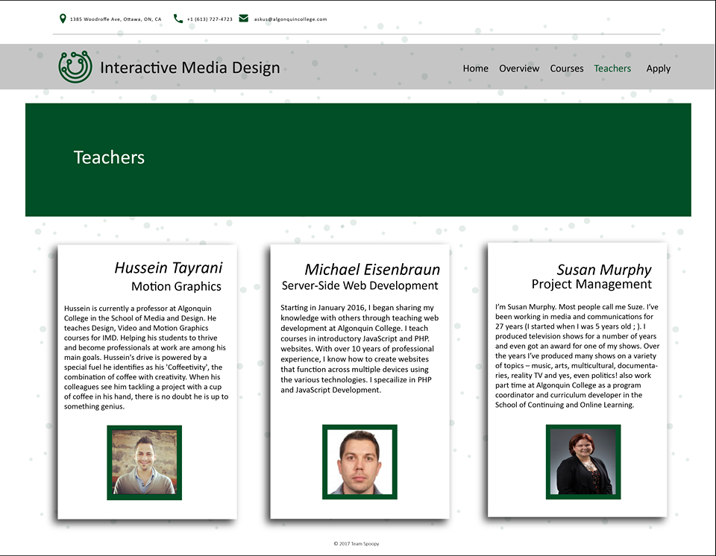
Mockups (Teachers-Desktop)

Slide 10
Mockups Added (Schedule Desktop)

Slide 11
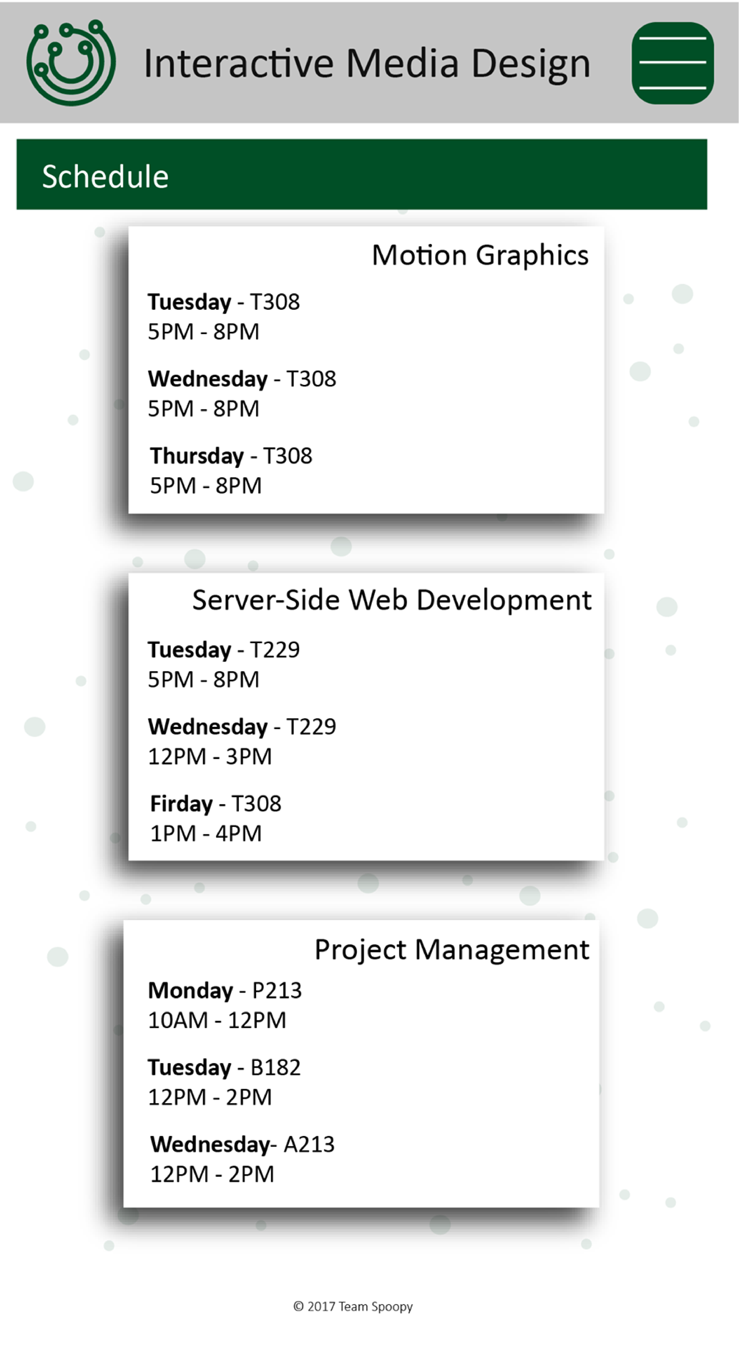
Mockups Added (Schedule Mobile)

Slide 12
To Be Completed
Assign a page of the website to each team member to start coding — to be completed by the end of class
Update GitHub issues — to be completed by the end of class
Familiarize the rest of my group with bootstrap for those who haven’t used it before — end of class/ by December 24th
Make minor adjustments to the homepage design as I currently have placeholder images on the mockups — by December 27th
Code the rest of the website (finish homepage, and rest of pages) — by January 5th
Upload website to GitHub repository — January 5th

Slide 13
Problems & Solutions
Unsure of everyone’s technical ability to use Bootstrap, as I know at least a couple of them haven’t used it before
Solution: Going over with each team member how to use Bootstrap
Generally none of us are overly confident in the use of Sass
Solution: Going over Sass and working on implementing it into our code

