Slide 1
Team 17
IMD Progress report
Josh | Sabrina | Celine | Brianna | Shane

Slide 2
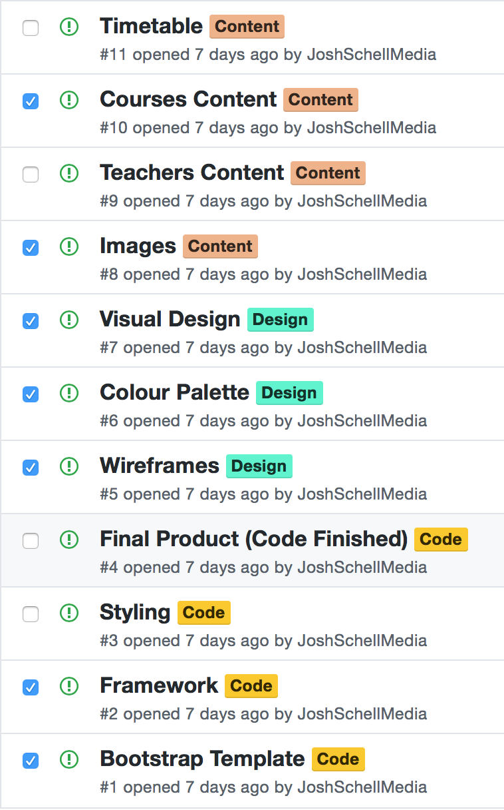
Progress
----------------------------------------------------------------
Content Visual Coding
Design

Slide 3
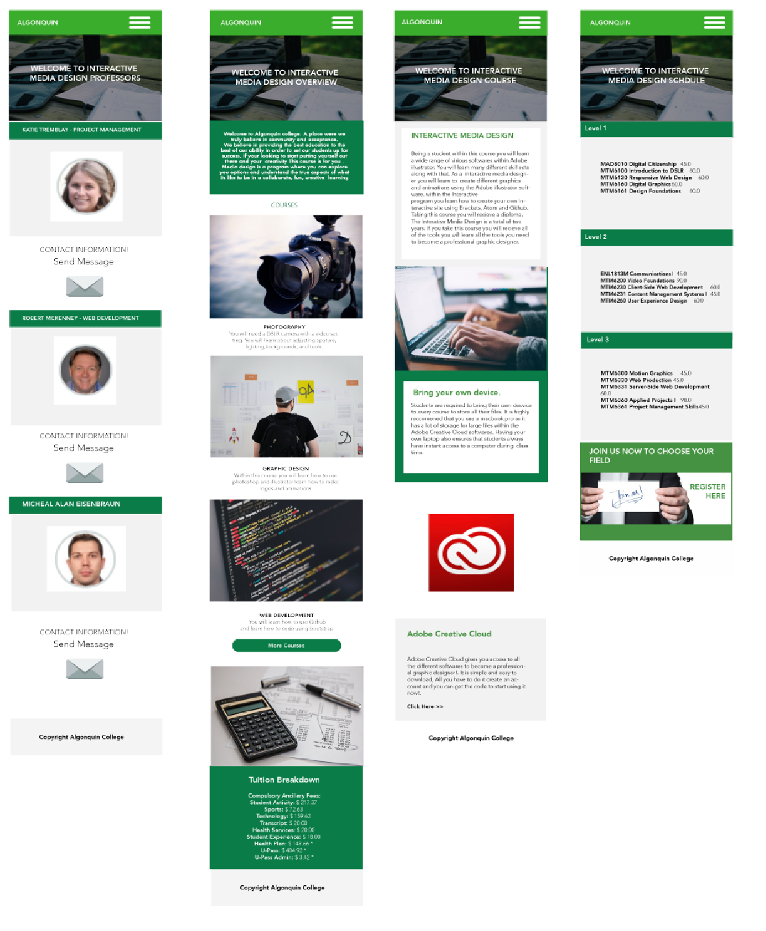
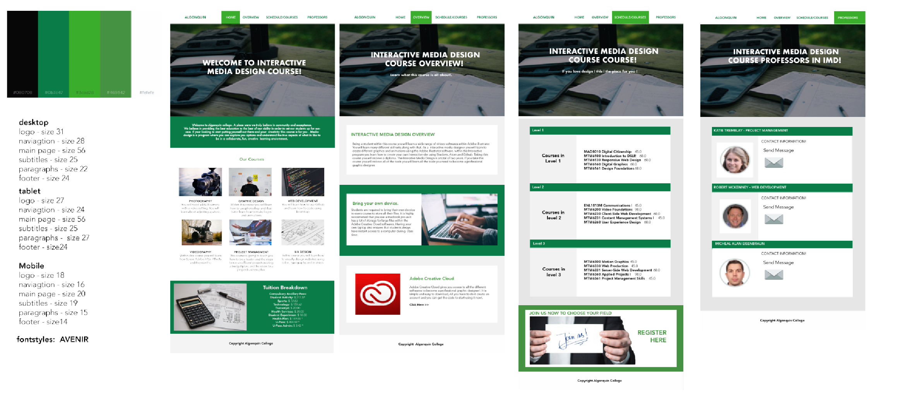
Visual Design
Desktop Size
Logo: 31
Nav: 28
H1: 42
H2: 30
P: 22
Footer: 24
Tablet Size
Logo: 27
Nav: 24
H1: 38
H2: 32
P: 27
Footer: 14
Mobile Size
Logo: 18
Nav: 16
H1:28
H2: 22
P: 15
Footer: 14
Font style: AVENIR

Slide 5
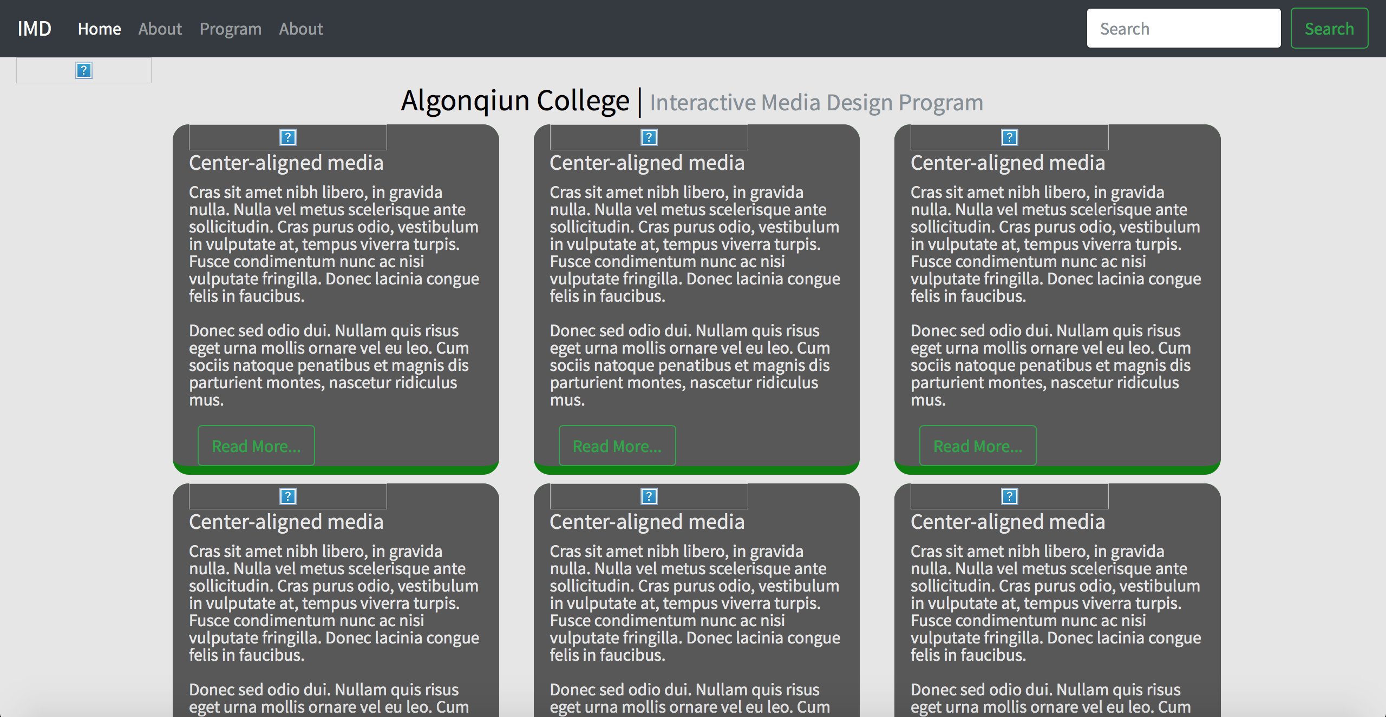
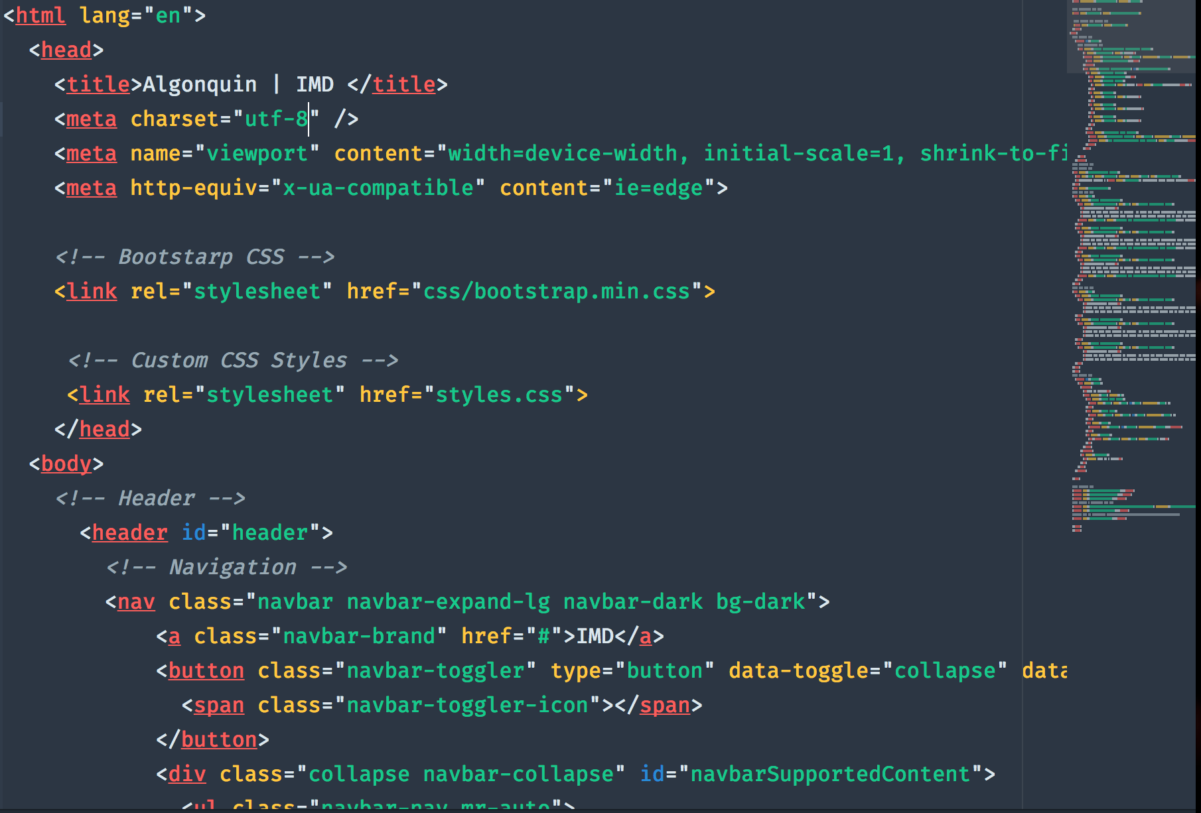
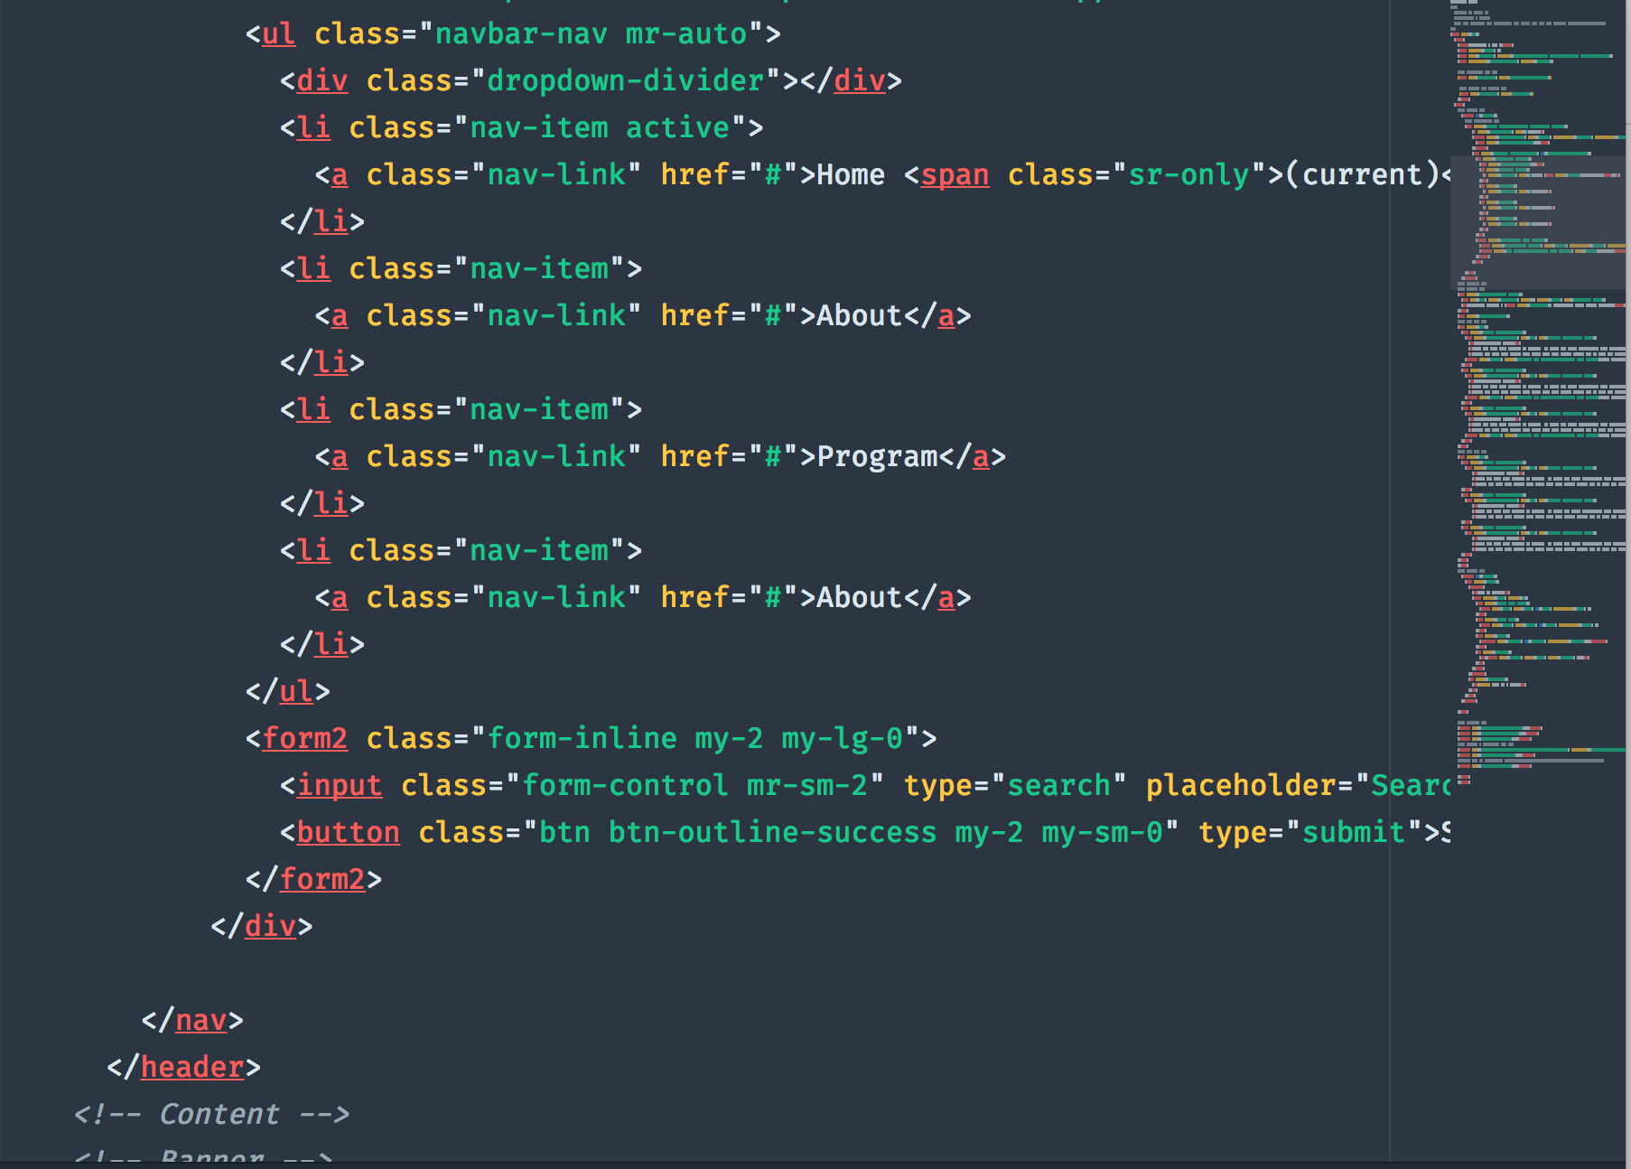
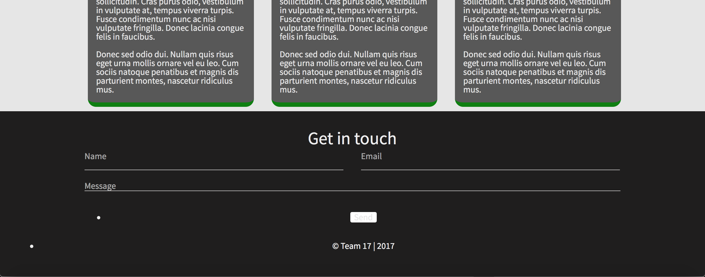

Slide 6
To COMPLETE
Visual Design Hand off (to Developer) Dec 22
Framework Jan 2
Content Collection Jan 2
Sass/Styling Jan 11

Slide 7
Problems & Impediments
Repository Problems
File Sharing & Submitting

Slide 8
Team 17
IMD Progress report
Josh | Sabrina | Celine | Brianna | Shane

