Slide 1
Security Framework Overview
Author: Kyle C. Quest
March 1st, 2010

Slide 2
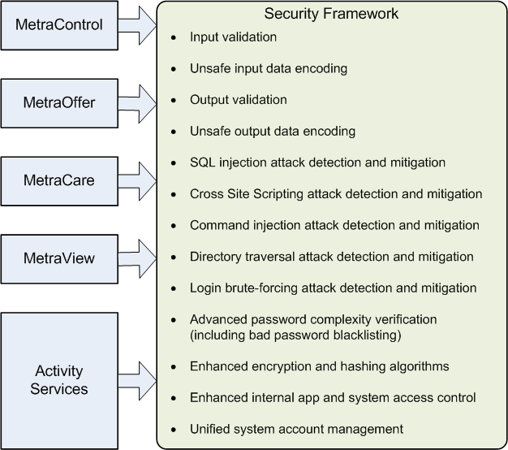
HIGH LEVEL PRODUCT INTEGRATION OVERVIEW

Slide 3
KEY LEGACY PRODUCT PROBLEMS
Partial/insufficient/ad-hoc input data validation and encoding
Insufficient output data validation and encoding
Some internal application resources are exposed to external users allowing them to access or modify resources they don’t own
Insufficient access control
Hard to change default accounts and passwords

Slide 4
KEY SECURITY FRAMEWORK BENEFITS (FOR PCI-DSS)
Built-in web application firewall functionality satisfies PCI-DSS requirement 1 (use firewalls)
Core functionality satisfies PCI-DSS requirement 6 (develop secure apps)
Unified system account management simplifies PCI-DSS requirement 2 compliance (don’t use default passwords and account settings)

Slide 5
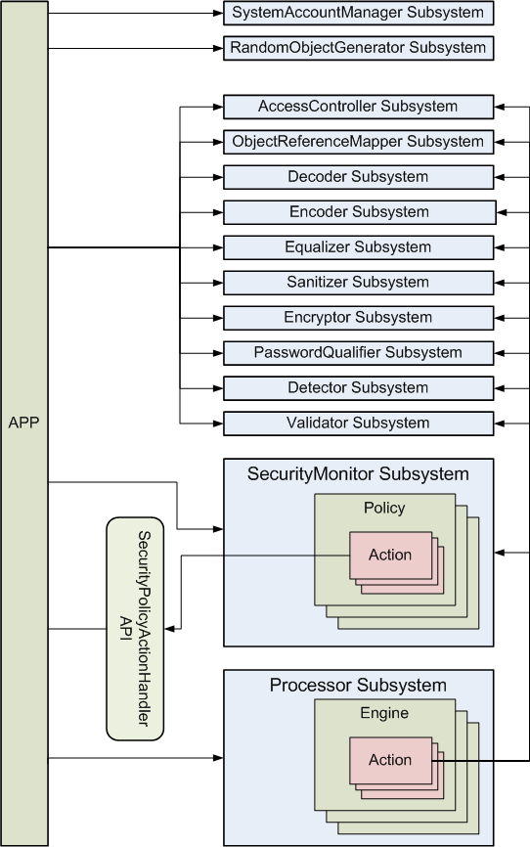
HIGH LEVEL ARCHITECTURE OVERVIEW

Slide 6
KEY API USE CONCEPTS
Flexible API that provides access to low level security functions while providing high level processing sequence functionality
Processor Subsystem provides the ability to chain together multiple processing actions including the ability to automatically report security events to the SecurityMonitor Subsystem
SecurityMonitor Subsystem is configured with a set of policies that define how to respond to various security events.
Application can register security policy action handlers with the SecurityMonitor subsystem to execute policy actions
Policy actions include: blocking operation, blocking user, blocking address, logging, logging user out, sending security warning, etc

Slide 7
Detector Subsystem Use Example (SQL injection)
Initialize the Security Kernel during application startup:
SecurityKernel.Initialize(<PathToSfPropertiesXmlFile>);
SecurityKernel.Start();
Call the Detector Subsystem:
string testInputParam = "500' OR 1=1--";
testInputParam.DetectSql();
If the inspected data is not safe report a security event to the Security Monitor Subsystem:
Catch(DetectorInputDataException x)
{ x.Report(); }
Shutdown the Security Kernel:
SecurityKernel.Stop();
SecurityKernel.Shutdown();

Slide 8
Encoder Subsystem Use Example
Call the Encoder Subsystem:
string test = "<script>alert('hi')</script>";
test.EncodeForUrl();
Result => %3cscript%3ealert%28%27hi%27%29%3c%2fscript%3e
test.EncodeForHtml();
Result => &#60;script&#62;alert&#40;&#39;hi&#39;&#41;&#60;&#47;script&#62;
test.EncodeForHtmlAttribute();
Result => &#60;script&#62;alert&#40;&#39;hi&#39;&#41;&#60;&#47;script&#62;
test.EncodeForCss();
Result => \003cscript\003ealert\0028\0027hi\0027\0029\003c\002fscript\003e
test.EncodeForJavaScript();
Result => '\x3cscript\x3ealert\x28\x27hi\x27\x29\x3c\x2fscript\x3e'
test.EncodeForXml();
Result => &#60;script&#62;alert&#40;&#39;hi&#39;&#41;&#60;&#47;script&#62;
test.EncodeForXmlAttribute();
Result => &#60;script&#62;alert&#40;&#39;hi&#39;&#41;&#60;&#47;script&#62;

