Slide 1


AR Integration Milestone
www.metratech.com
6/21/2002

Slide 2
Milestone goals
End to End integration of components
Create Accounts
Create Territories, Sales Persons

Slide 3
Agenda
Integration Architecture
Create Territories via Script
Create Sales Persons via Stage
Update Territories via Stage
Create Accounts via MAM
Demonstrate transactionality

Slide 4
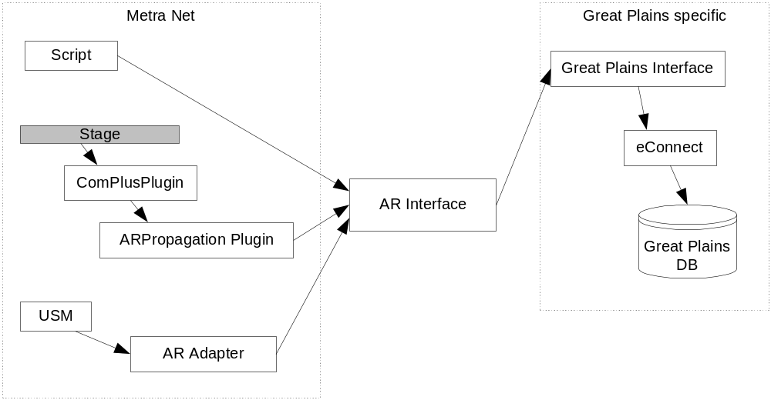
AR Integration Architecture

Slide 5

Enjoy the ride!
This demo is real.
Not all Germans are cheaters!

