Slide 1

Serverless Portfolio with React JS
Robin Norwood

Slide 2
Takeaways

Slide 3
What did you learn?
How to host and deploy serverless applications with Amazon Web Services
Source Control: Git and GitHub
Security and Access Control: Identity Access Manager
DNS Management: Route 53
Object Storage: S3
Content Distribution: CloudFront
Build Tools: CodeBuild & CodePipeline
Functions as a Service: Lambda

Slide 4
What did you learn? (2)
How to create front-end applications with React
Page Structure: HTML
Look and feel: CSS
Interactivity: Javascript (React)
Cross-Browser Compatability: Babel
Bundling & Asset Management: Webpack
Package Management: NPM
Testing: Jest (or Chai & Mocha)

Slide 5
Architecture

Slide 6














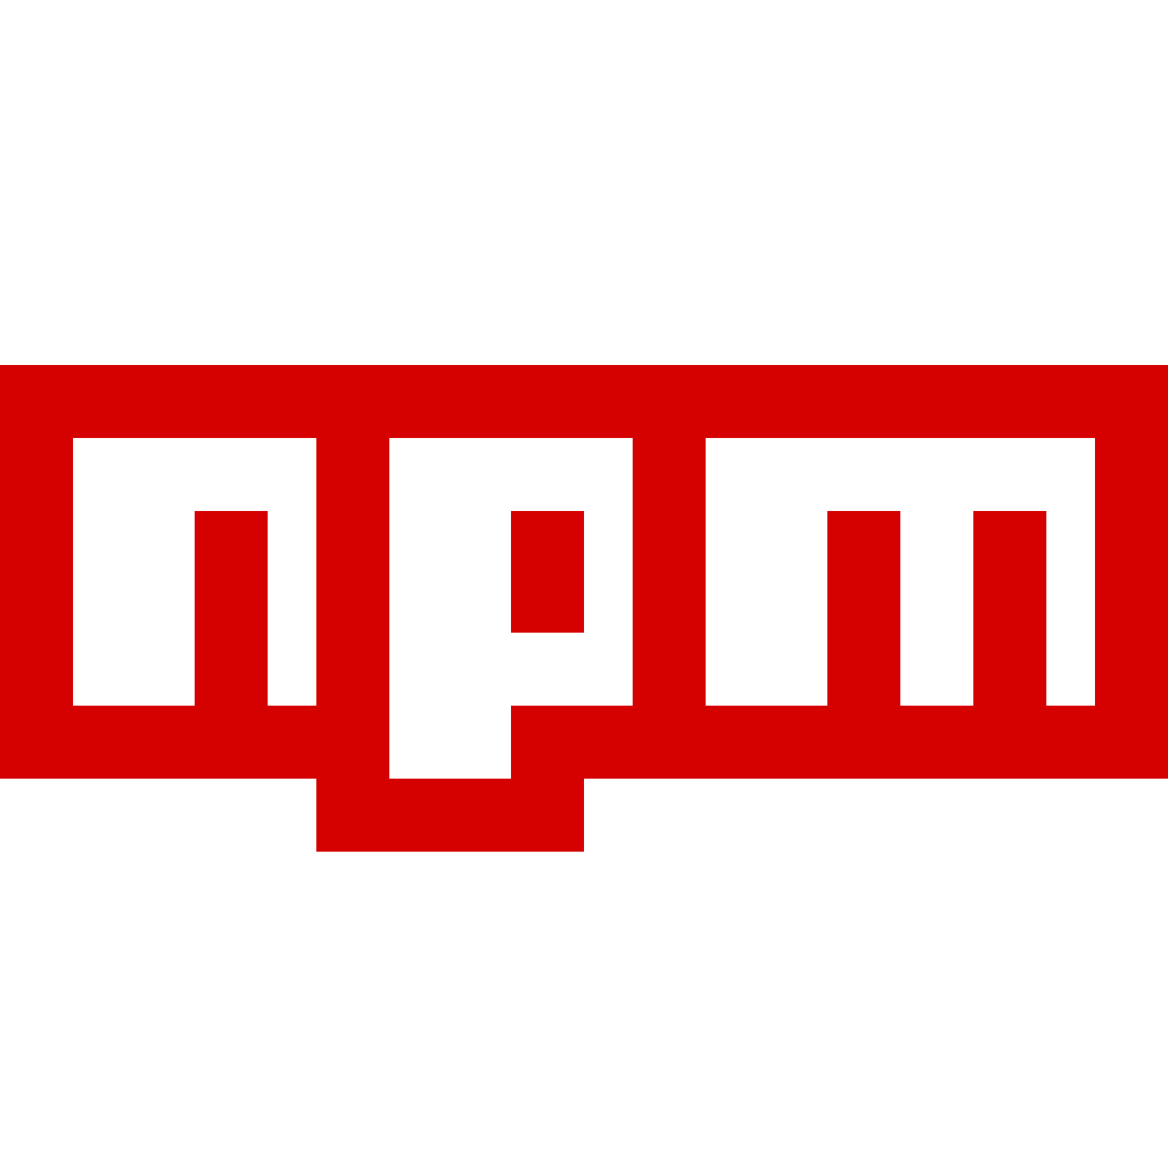


Architecture
Route 53
CloudFront
S3
Visitors
+
Lambda
SNS
CodePipeline
S3
You
GitHub
CodeBuild
,
,
,

Slide 7
Architecture
Route 53
CloudFront
S3
Visitors
+
Lambda
SNS
CodePipeline
S3
You
GitHub
CodeBuild
,
,
,

Slide 8
Architecture
Route 53
CloudFront
S3
Visitors
+
Lambda
SNS
CodePipeline
S3
You
GitHub
CodeBuild
,
,
,

Slide 9
Architecture
Route 53
CloudFront
S3
Visitors
+
Lambda
SNS
CodePipeline
S3
You
GitHub
CodeBuild
,
,
,

Slide 10
Architecture
Route 53
CloudFront
S3
Visitors
+
Lambda
SNS
CodePipeline
S3
You
GitHub
CodeBuild
,
,
,

Slide 11
Architecture
Route 53
CloudFront
S3
Visitors
+
Lambda
SNS
CodePipeline
S3
You
GitHub
CodeBuild
,
,
,

Slide 12
Architecture
Route 53
CloudFront
S3
Visitors
+
Lambda
SNS
CodePipeline
S3
You
GitHub
CodeBuild
,
,
,

Slide 13
Architecture
Route 53
CloudFront
S3
Visitors
+
Lambda
SNS
CodePipeline
S3
You
GitHub
CodeBuild
,
,
,

Slide 14
Architecture
Route 53
CloudFront
S3
Visitors
+
Lambda
SNS
CodePipeline
S3
You
GitHub
CodeBuild
,
,
,

Slide 15
Architecture
Route 53
CloudFront
S3
Visitors
+
Lambda
SNS
CodePipeline
S3
You
GitHub
CodeBuild
,
,
,

Slide 16
Architecture
Route 53
CloudFront
S3
Visitors
+
Lambda
SNS
CodePipeline
S3
You
GitHub
CodeBuild
,
,
,

Slide 17
Architecture
Route 53
CloudFront
S3
Visitors
+
Lambda
SNS
CodePipeline
S3
You
GitHub
CodeBuild
,
,
,

Slide 18
Architecture
Route 53
CloudFront
S3
Visitors
+
Lambda
SNS
CodePipeline
S3
You
GitHub
CodeBuild
,
,
,

Slide 19
Architecture
Route 53
CloudFront
S3
Visitors
+
Lambda
SNS
CodePipeline
S3
You
GitHub
CodeBuild
,
,
,

Slide 20
Architecture
Route 53
CloudFront
S3
Visitors
+
Lambda
SNS
CodePipeline
S3
You
GitHub
CodeBuild
,
,
,

Slide 21
Architecture
Route 53
CloudFront
S3
Visitors
+
Lambda
SNS
CodePipeline
S3
You
GitHub
CodeBuild
,
,
,

Slide 22
Architecture
Route 53
CloudFront
S3
Visitors
+
Lambda
SNS
CodePipeline
S3
You
GitHub
CodeBuild
,
,
,

Slide 23
Architecture
Route 53
CloudFront
S3
Visitors
+
Lambda
SNS
CodePipeline
S3
You
GitHub
CodeBuild
,
,
,

Slide 24
Architecture
Route 53
CloudFront
S3
Visitors
+
Lambda
SNS
CodePipeline
S3
You
GitHub
CodeBuild
,
,
,

Slide 25
Architecture
Route 53
CloudFront
S3
Visitors
+
Lambda
SNS
CodePipeline
S3
You
GitHub
CodeBuild
,
,
,

Slide 26
Architecture
Route 53
CloudFront
S3
Visitors
+
Lambda
SNS
CodePipeline
S3
You
GitHub
CodeBuild
,
,
,

Slide 27
Architecture
Route 53
CloudFront
S3
Visitors
+
Lambda
SNS
CodePipeline
S3
You
GitHub
CodeBuild
,
,
,

Slide 28
Next Steps

Slide 29
Next Steps
What to do next?
Get Certified: https://acloud.guru/learn/aws-certified-developer-associate
Learn the Serverless Framework: https://serverless.com
Learn about the Serverless Application Model:
http://docs.aws.amazon.com/lambda/latest/dg/deploying-lambda-apps.html
Build an Alexa Skill: https://acloud.guru/learn/intro-alexa

Slide 30
All Done!

Slide 31
No, seriously. That was the last slide.

