Slide 1
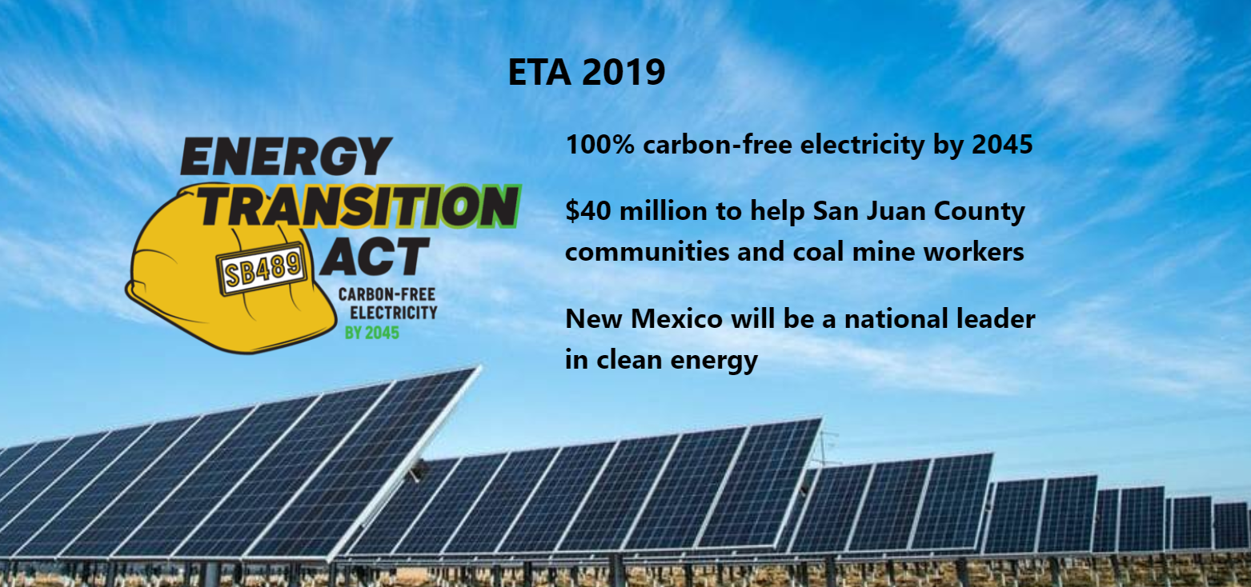
Feasibility Assessment: Clean Energy Goal in New Mexico
Presented By: Eduardo, Ruth, Manuel & Matt

Slide 2
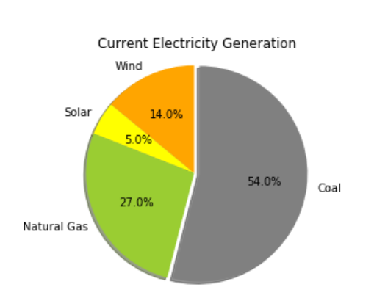
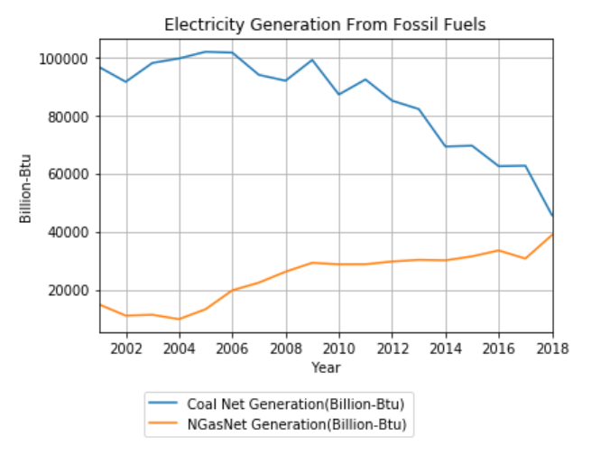
New Mexico’s Energy Transition Act
Signed Friday, March 22, 2019
50% Carbon-Free Electricity by 2030
100% Carbon-Free Electricity by 2045

Slide 3
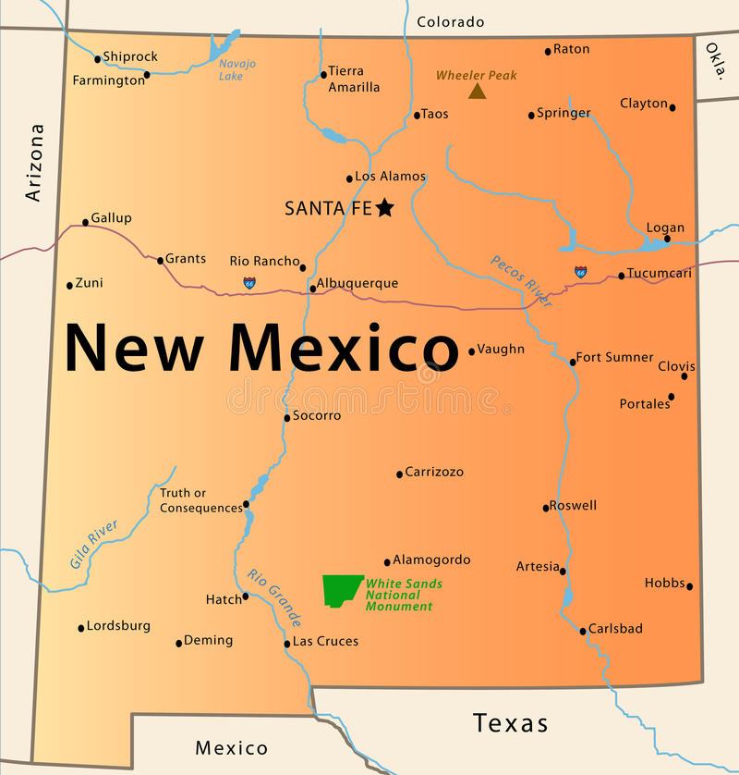
Why Renewable Energy?
New Mexico has much to offer:
#2 Sunniest State
#12 Windiest State
#7 Geothermal Potential
#5 Largest State by Area
#6 Least Densely Populated
1:4 New Mexicans live in Albuquerque
Job Creation and Income
Improved Air Quality and Health
Lower Health Care and Energy Costs

Slide 4
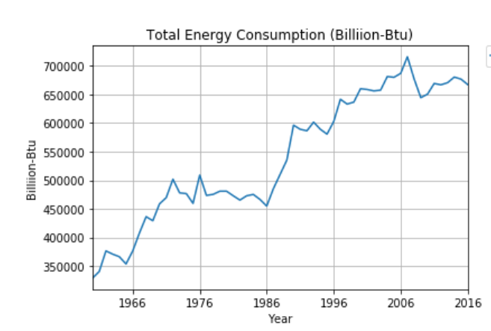
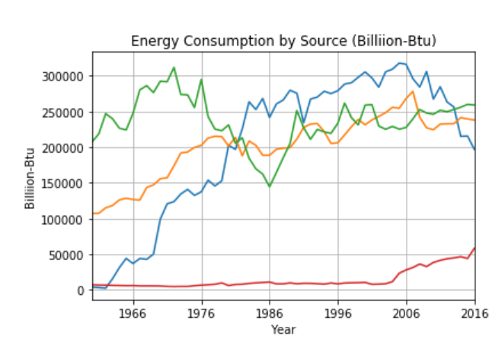
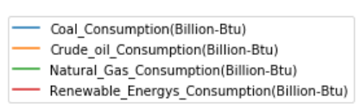

New Mexico: Today's Energy Consumption Profile
#3 Crude Oil producer
#9 Natural Gas producer
#12 Coal producer

Slide 5
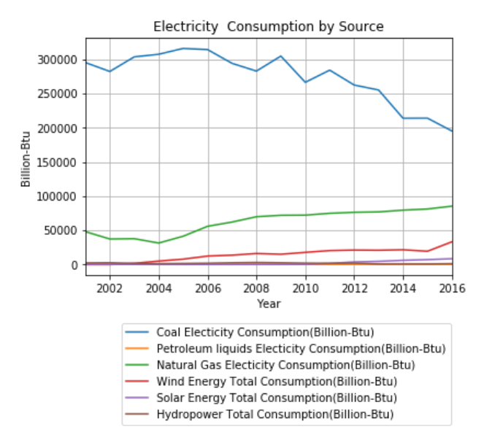
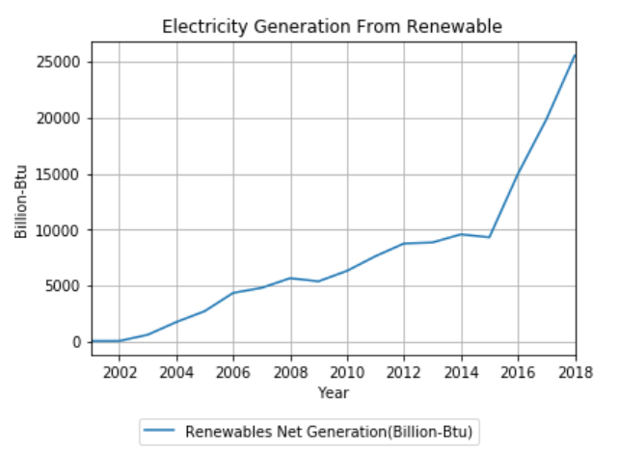
Energy Consumption Profile
Current electricity consumption from coal is 197,083 B-Btu
Current electricity generation from renewables is 25,556 B-Btu
26 years to move to renewables

Slide 6
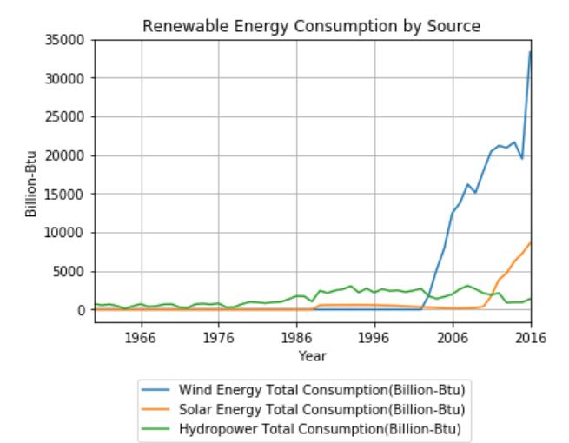
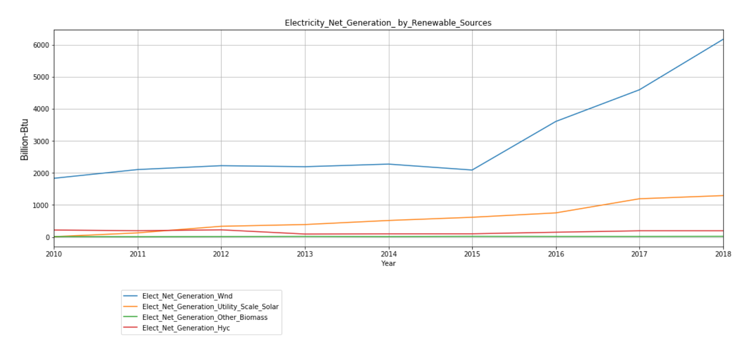
Looking at Renewables
Wind energy is the major contributor

Slide 7
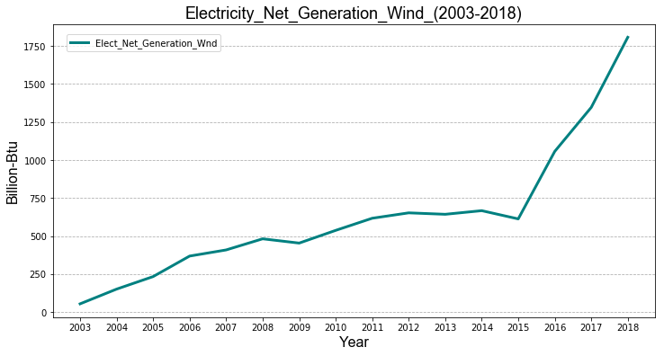
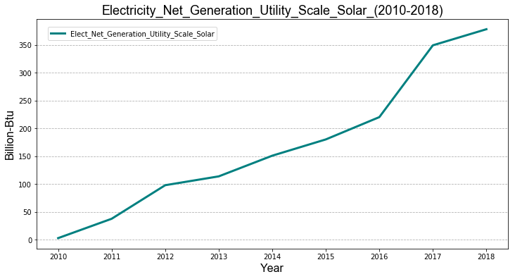
New Mexico’s Renewable Elect. Generation
Renewable sources by Billon-Btu Generated
Wind 1st
Solar 2nd

Slide 8
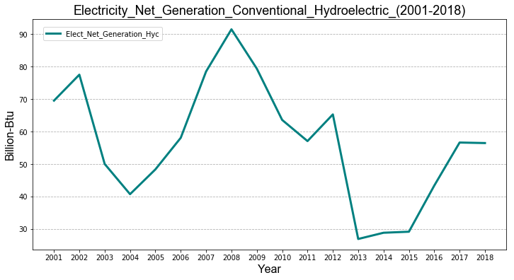
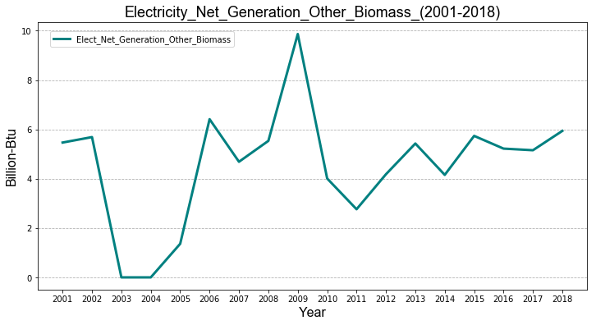
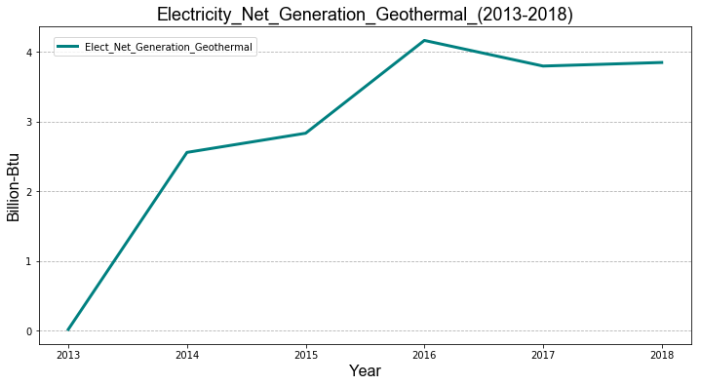
New Mexico’s Renewable Elect. Generation
Renewable sources by Billon-Btu generated
Hydroelectric 3rd
Biomass 4th
Geothermal 5th

Slide 9
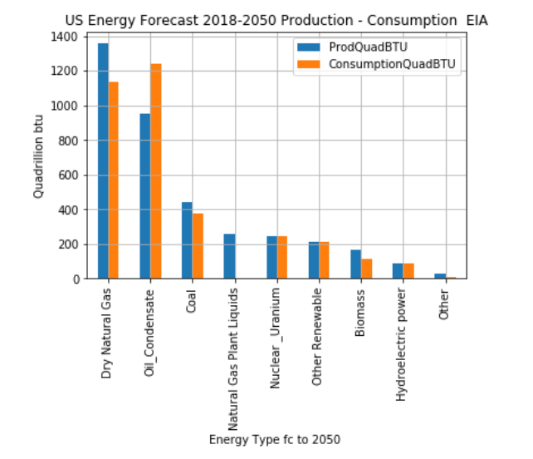
Total Energy Forecast by Type

Slide 10
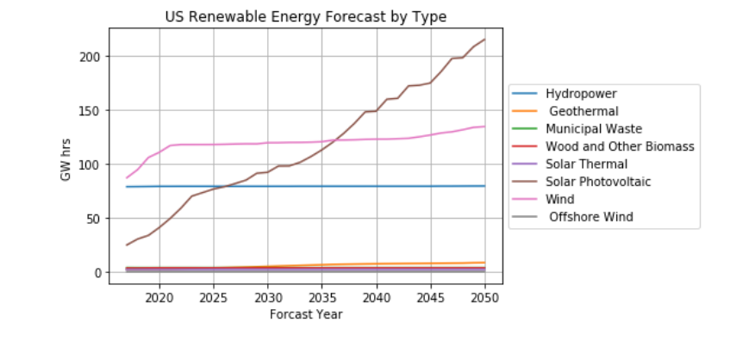
Renewable Energy Electric Power Sector Forecast
Renewable trend shows overall INCREASE:
Solar source crosses Hydro power and then Wind in coming 15 years to lead this trend
EIA expects this that this portfolio will lead to more renewables

Slide 11
Conclusion

Slide 12
Sources
Slide 1 image: https://www.ucsusa.org/clean-energy/increase-renewable-energy/new-mexico-renewables
Slide 3 image: https://agoabq.org/about-us/
Data: eia.gov
API: https://www.eia.gov/opendata/register.php

