Slide 1
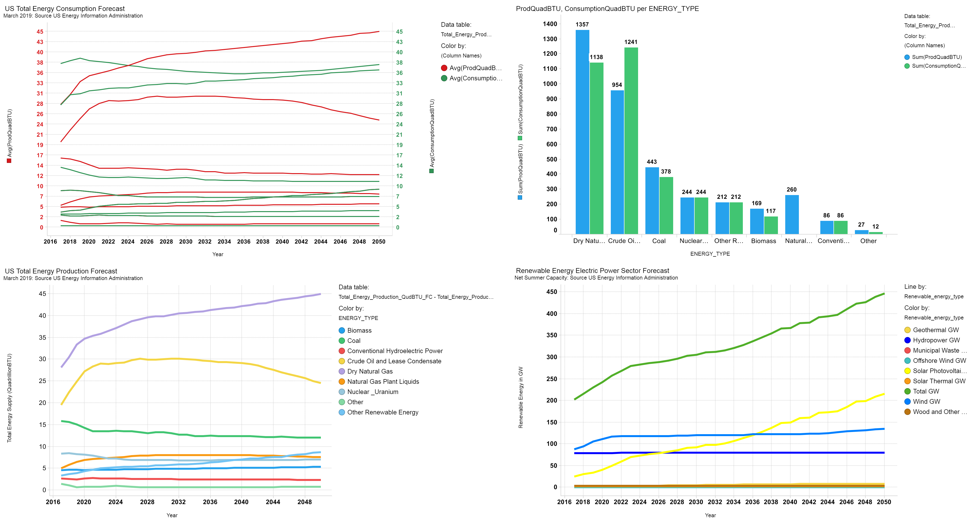

Slide 2
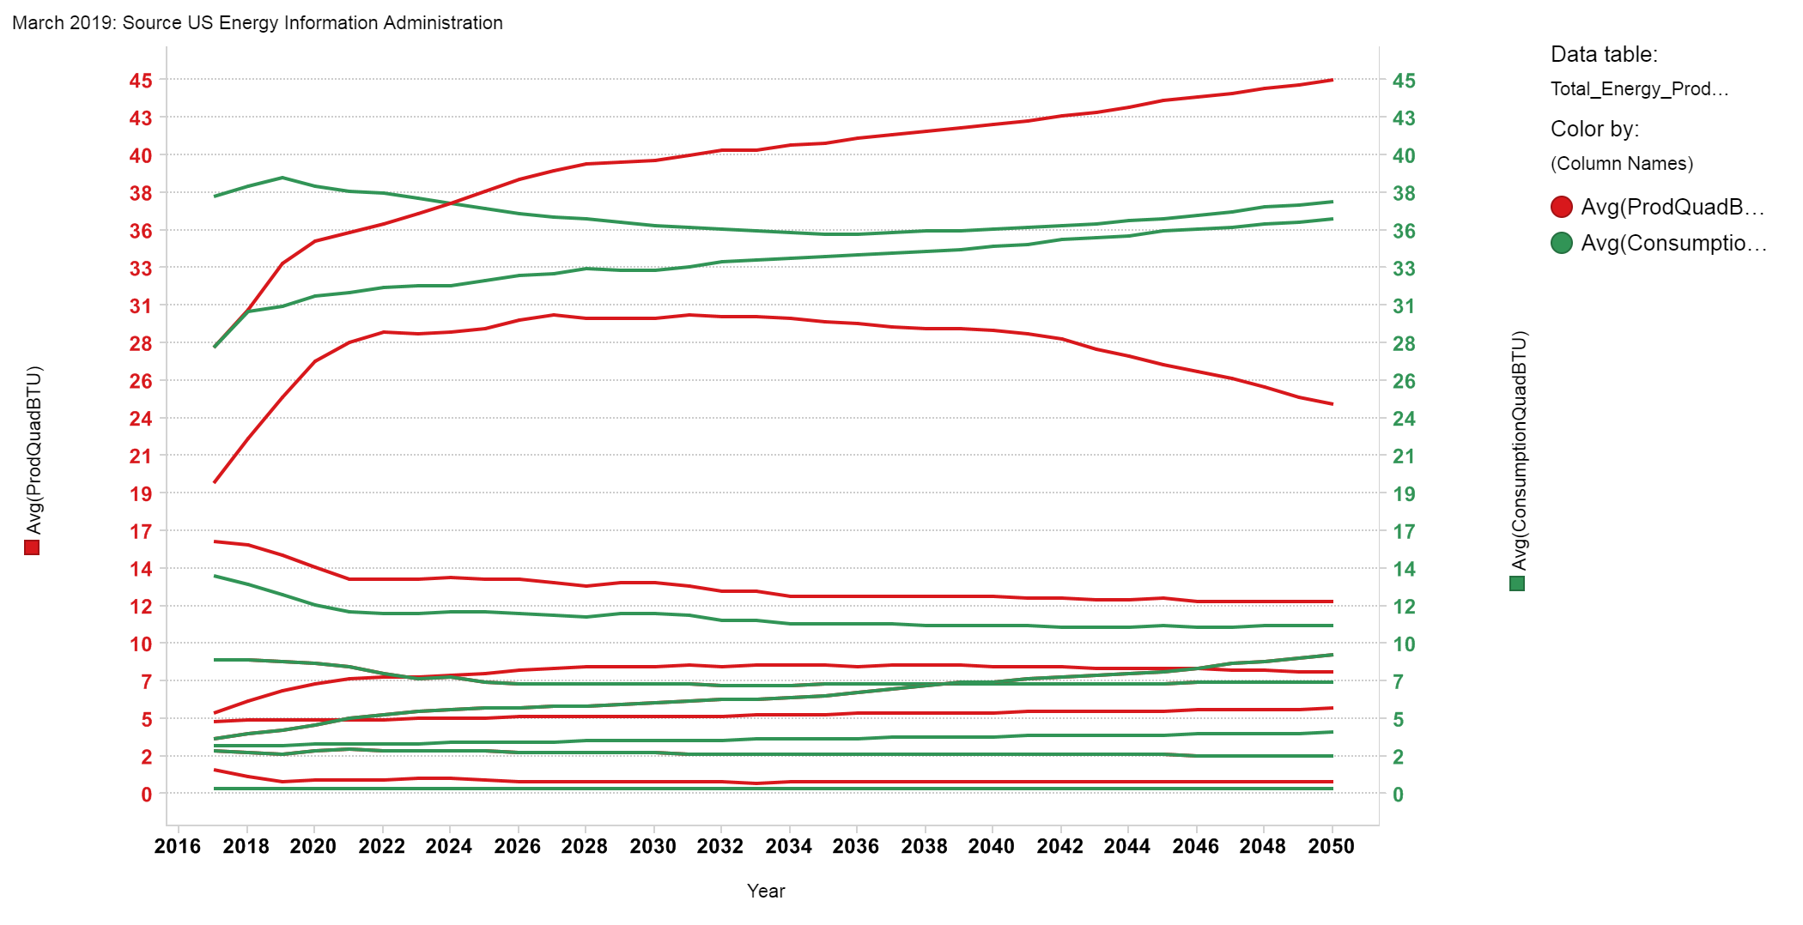
Page
US Total Energy Consumption Forecast

Slide 3
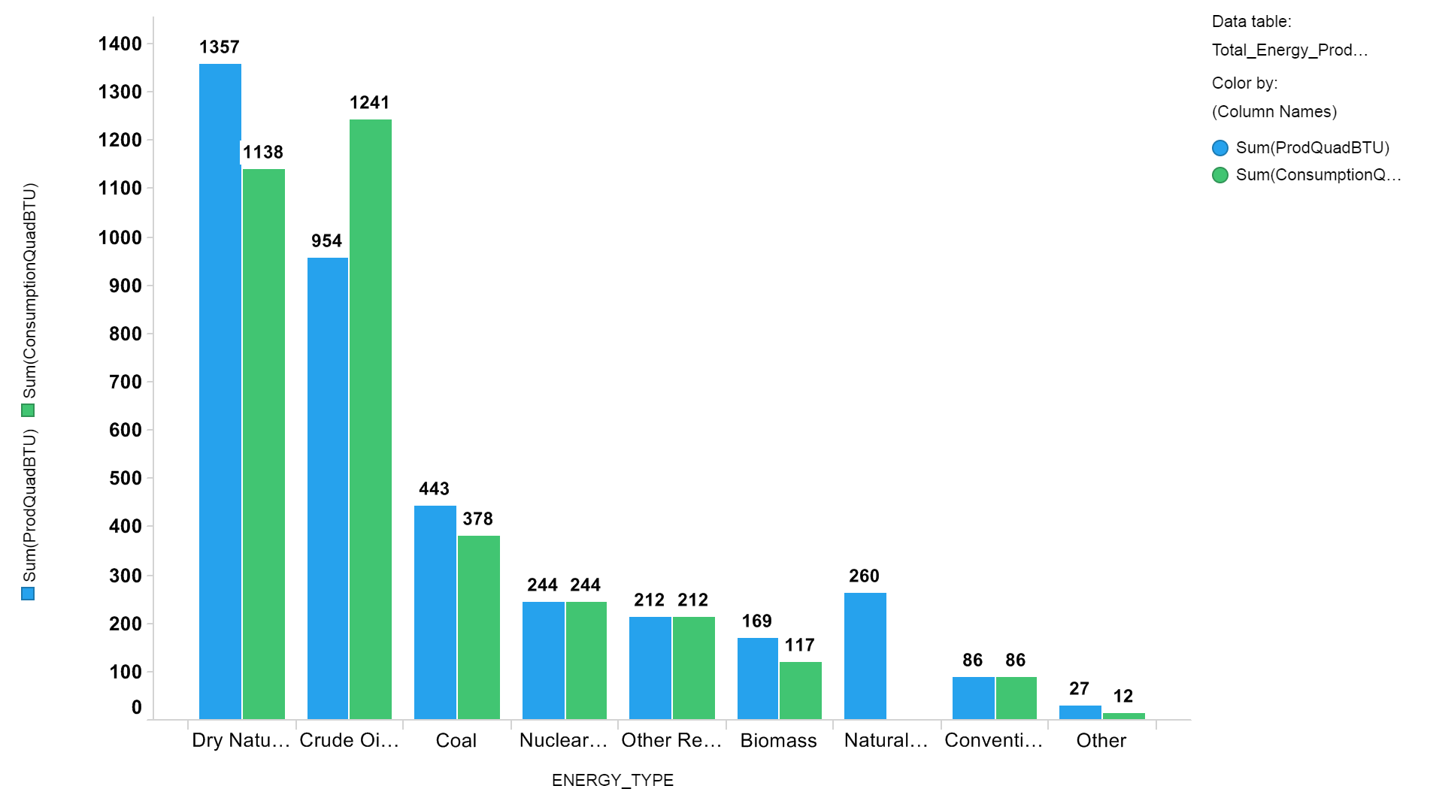
Page
ProdQuadBTU, ConsumptionQuadBTU per ENERGY_TYPE

Slide 4
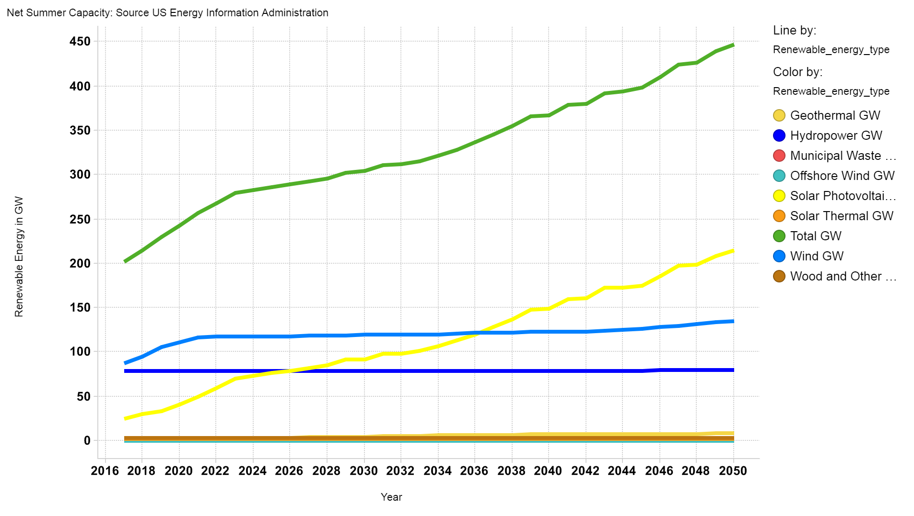
Page
Renewable Energy Electric Power Sector Forecast

Slide 5
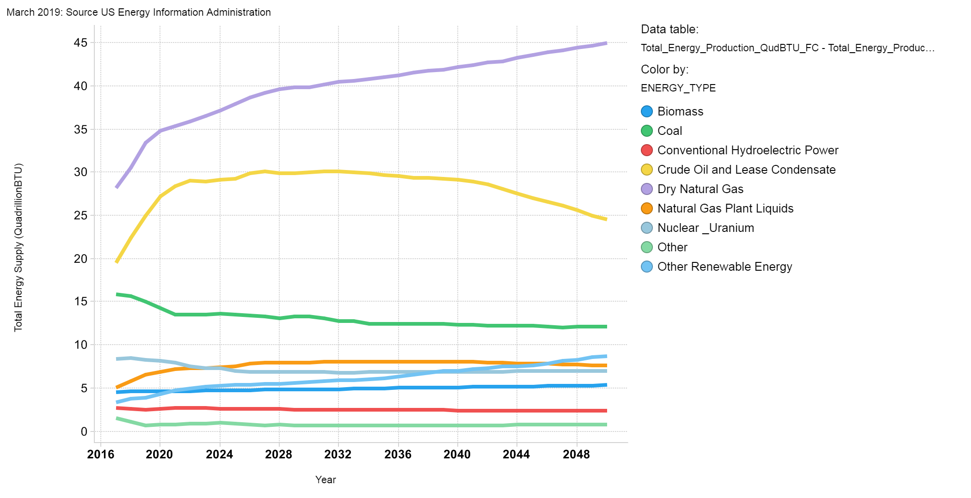
Page
US Total Energy Production Forecast

