Slide 1
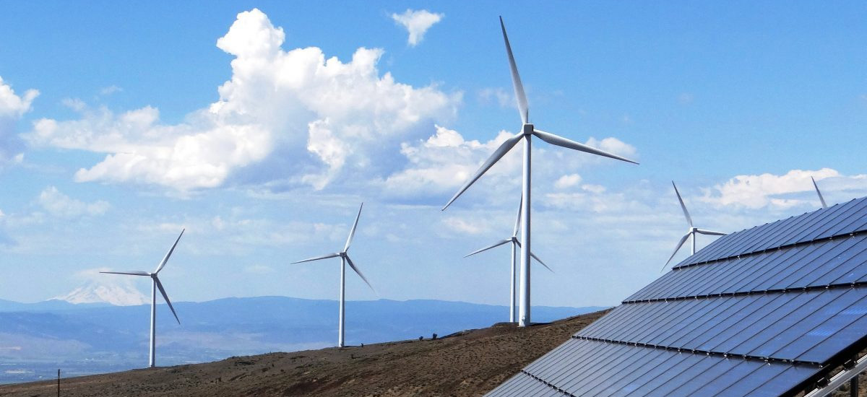
Clean Energy in New Mexico
Presented By: Eduardo, Ruth, Manuel & Matt

Slide 2
New Mexico’s Energy Transition Act
Signed Friday, March 22, 2019
50% Carbon-Free Electricity by 2030
100% Carbon-Free Electricity by 2045

Slide 3
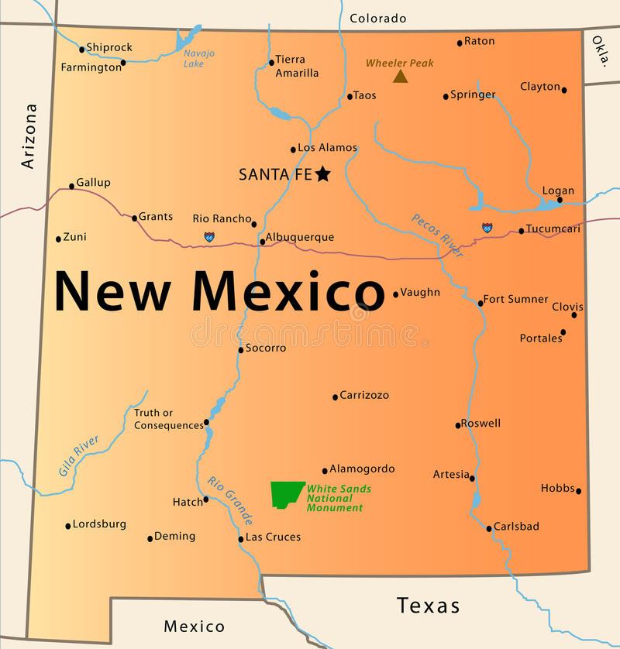
Why Renewable Energy?
New Mexico has much to offer:
#2 Sunniest State
#12 Windiest State
#7 Geothermal Potential
#5 Largest State by Area
#6 Least Densely Populated
1:4 New Mexicans live in Albuquerque
Job Creation
Improved Air Quality and Health
Lower Health Care and Energy Costs

Slide 4
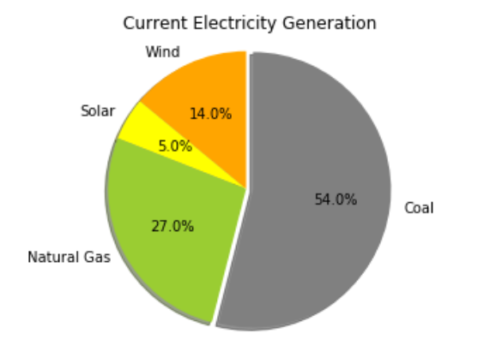
Current Breakdown of Generation
(As of December 2018)

Slide 5
Sources
Slide 1 image: https://www.ucsusa.org/clean-energy/increase-renewable-energy/new-mexico-renewables
Slide 3 image: https://agoabq.org/about-us/
Data: eia.gov
API: https://www.eia.gov/opendata/register.php

