Slide 1
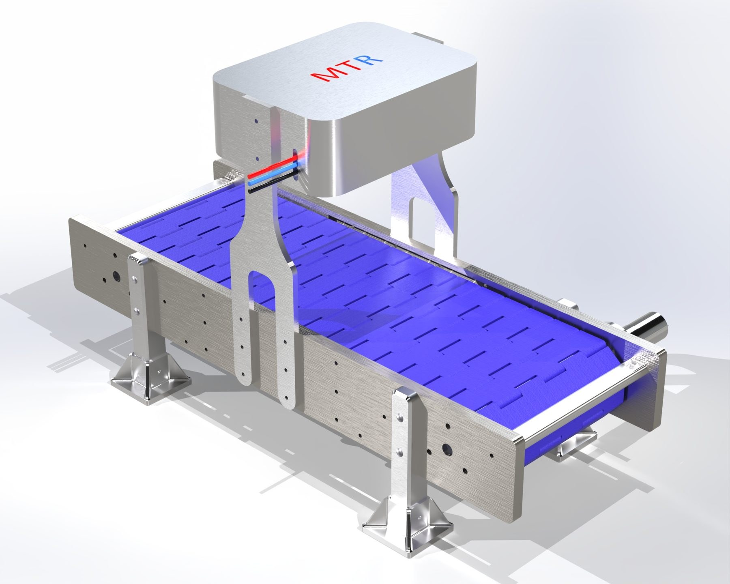
MTROBOTIX
MetriQ
Installed in hours.
Zero downtime.
Catch any defect, instantly.
Notes:
I'm Thong Huynh, founder of MTRobotix. MetriQ mounts over the conveyor you already run, goes live in hours, and catches defects the moment they pass.

Slide 2
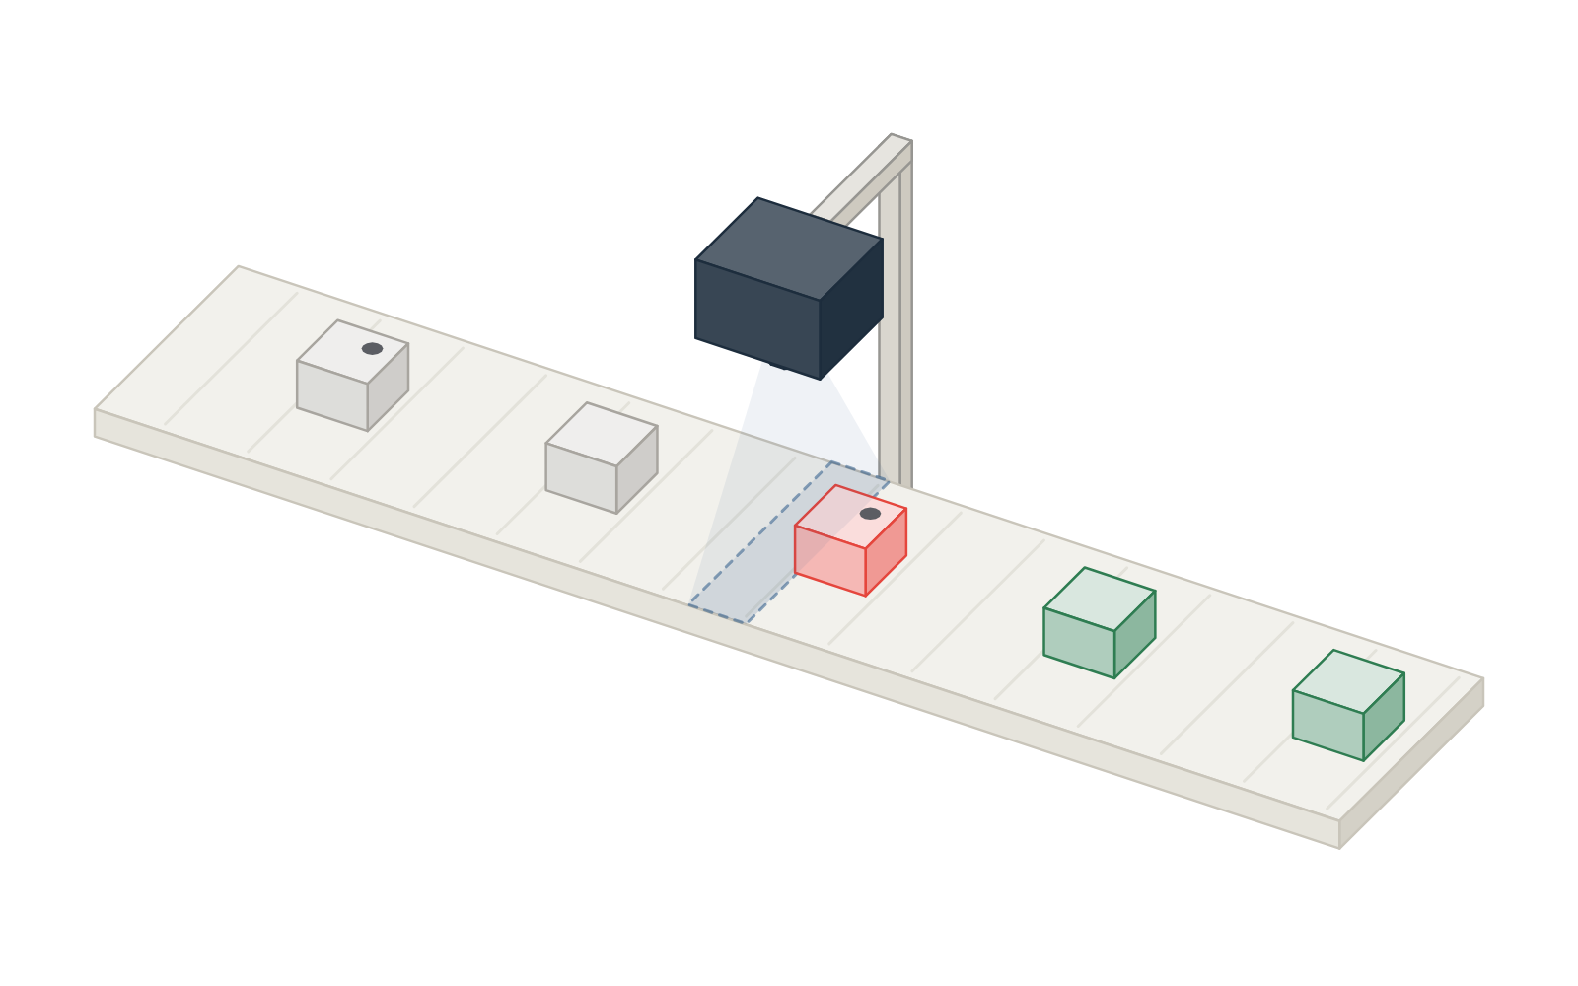
Every unit inspected. Defects removed.
HOW IT WORKS
1
Camera checks each part
at line speed.
2
Good goes green, defects red
with the defect named.
3
Defects removed
by our pusher or your reject system.
← All capabilities
Notes:
One loop: the camera checks each part, grades it, and the pusher add-on removes defects. MetriQ can also drive the reject system the customer already has.

Slide 3
PERFORMANCE
Built for line speed
100+
<1 mm
>99.5%
Hours
parts per second
smallest defect caught
of defects caught
from install to live
Your best QC inspector. On every unit, every shift.
Notes:
Throughput, smallest defect, catch rate, time to go live.

Slide 4
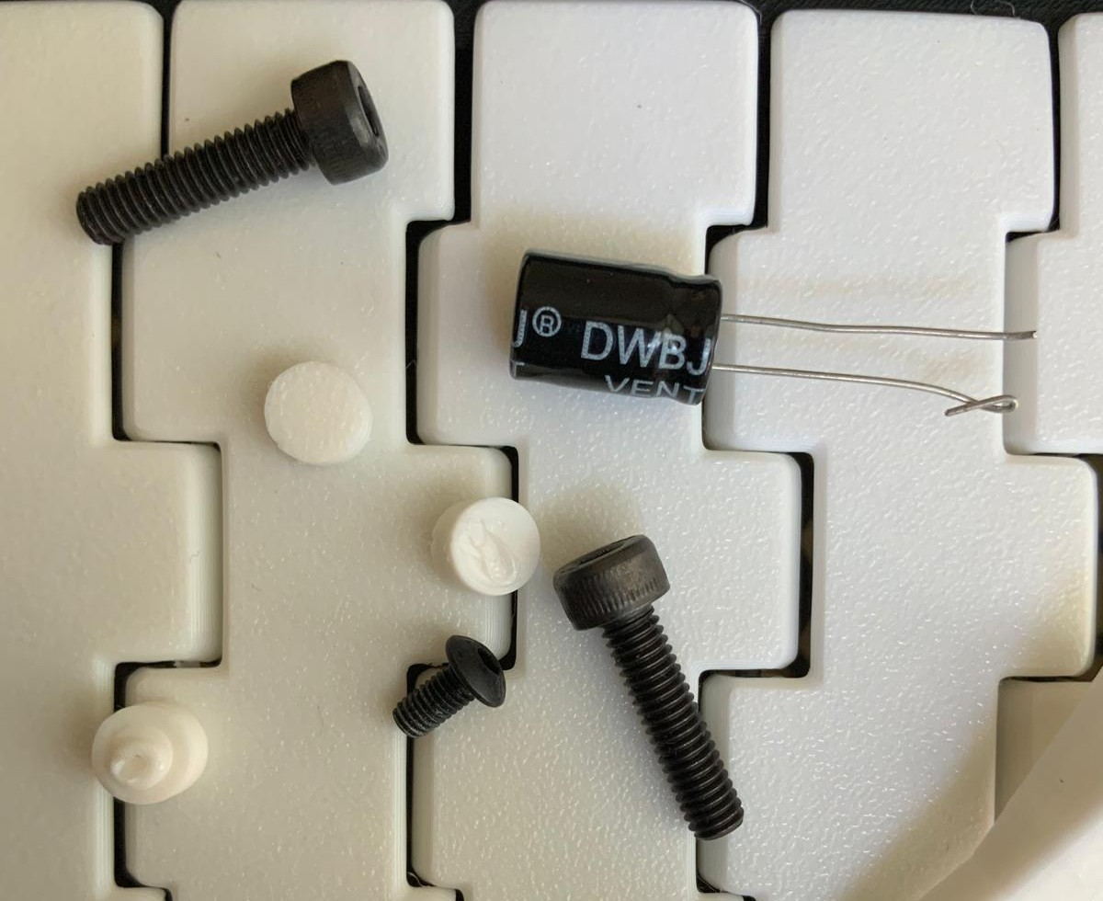






One frame. Every check.
WHAT IT DOES
M4×20
Pass
Pass 3 · Reject 4
Count & identify
7 parts: 2 M4×20, 1 M3×6, 3 plastic, 1 unknown.
20.1 mm
Measure
Length of every screw, in mm.
Unknown
Foreign object
Reject
ΔE 1.2
Plastic
Colour
Finish against the black-oxide reference.
ΔE 63.8
Broken bolt
Reject
ΔE 64.1
Defects
2 broken bolts, 1 in the wrong orientation.
Broken bolt
Reject
Plastic
M4×20
Pass
Anomalies
1 object it was never shown.
Plastic
Wrong orientation
Reject
19.9 mm
ΔE 0.9
Verdict
3 pass, 4 rejected. Logged to the shift report.
M3×6
6.0 mm
ΔE 1.4
Pass
ΔE 62.5
Real frame, MetriQ readings drawn for illustration.
Notes:
One camera frame of mixed fasteners: MetriQ counts and identifies every part, measures each screw, checks the finish colour, finds the two broken bolts and the one lying the wrong way up, flags the capacitor it was never taught, and gives the verdict. Readings drawn on a real photo for illustration.

Slide 5
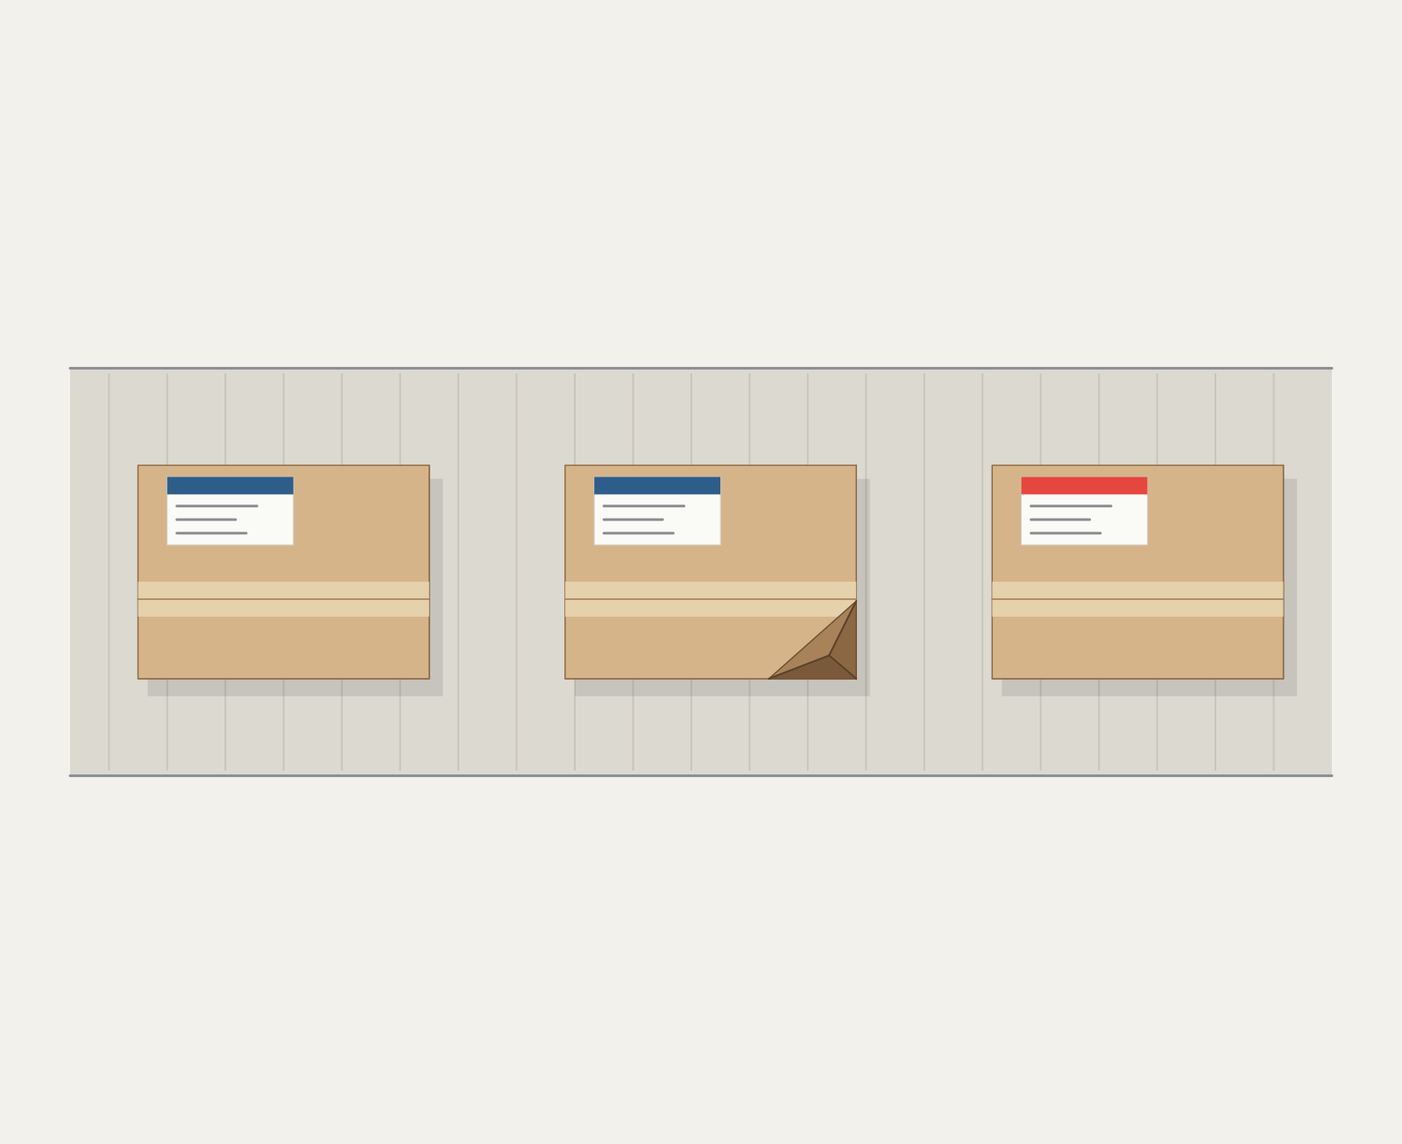
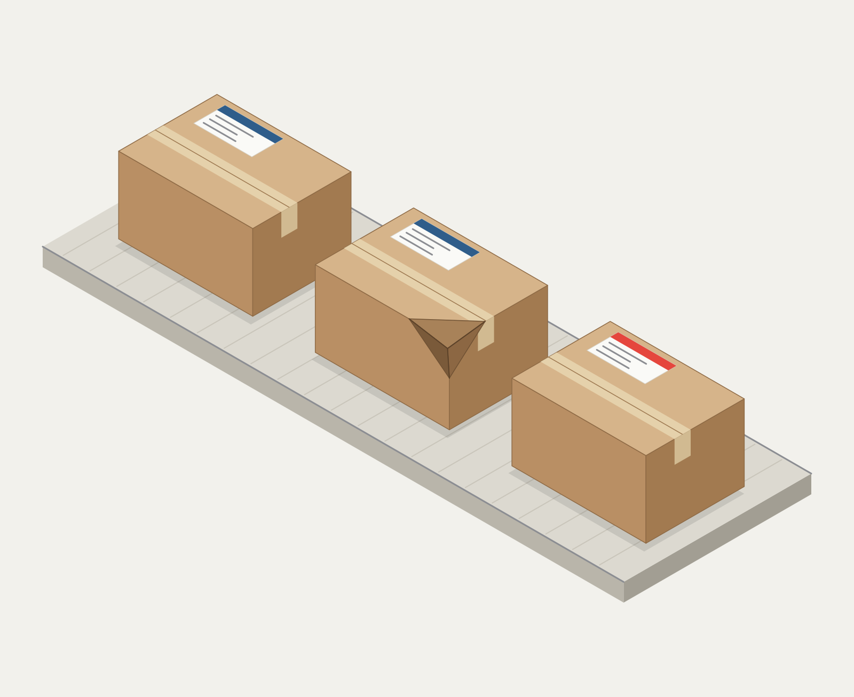

Every check on every unit.
WHAT IT DOES
Pass 1 · Reject 2
Count & identify
3 cartons, an ID each.
Pass
Length & width
From above: 30 × 22 cm, in range.
H 17 cm
Reject · crushed
Carton 1
Carton 2
Carton 3
Label
Label colour against the brand reference.
ΔE 1.3
ΔE 1.1
ΔE 41.0
Crushed corner · 7 cm low
Reject · wrong label
W 22 cm
Height, in 3D
17 cm, in range.
L 30 cm
Crushed corner
Found by height: one corner 7 cm low.
Verdict
1 pass, 2 rejected. Logged to the shift report.
Generated product, MetriQ readings drawn for illustration.
Notes:
From above, MetriQ counts the cartons, checks length and width and the label colour. Then the view turns 3D: it checks height, finds the crushed corner by its height, and gives the verdict.

Slide 6
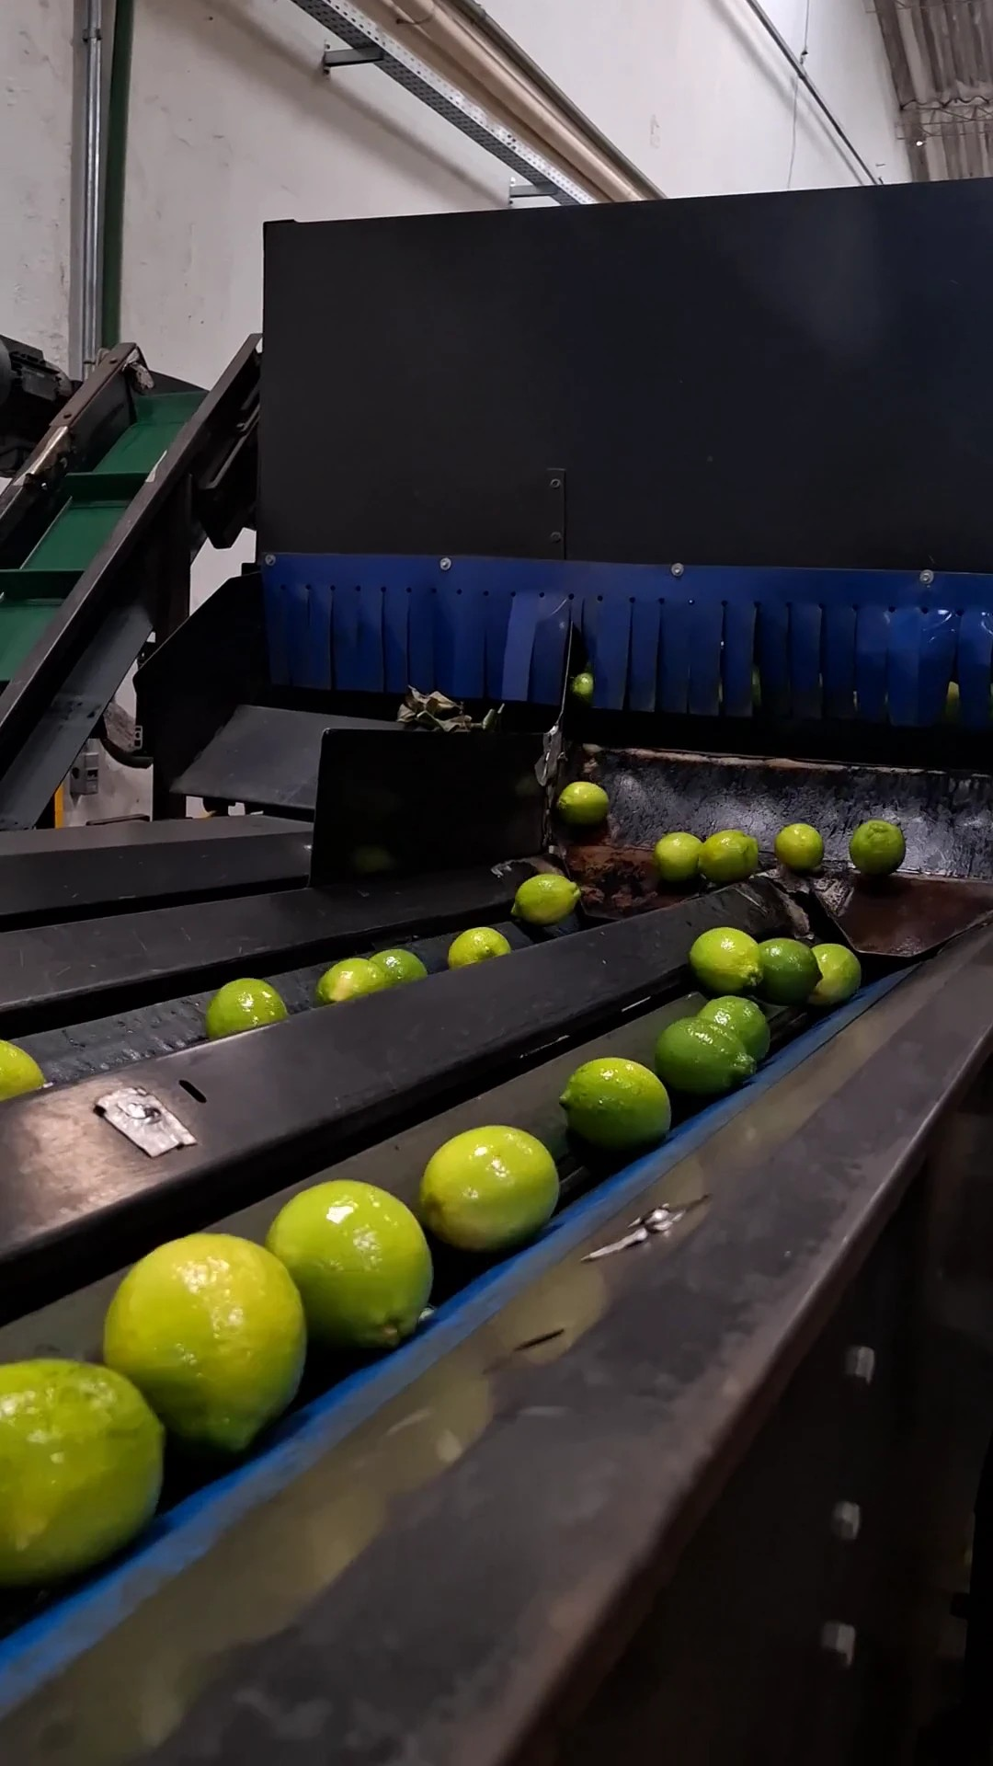
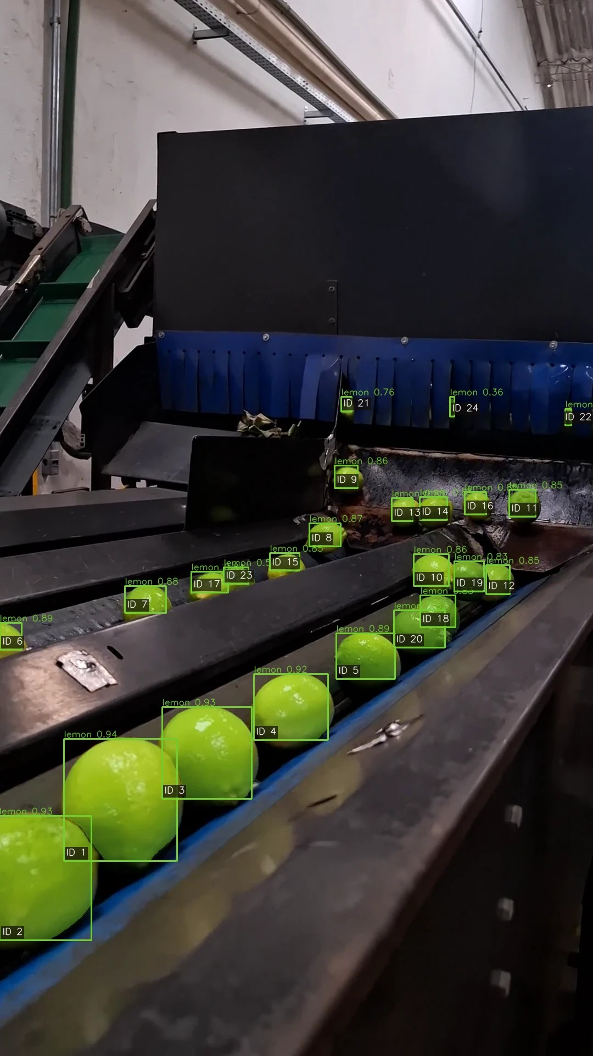

Instant deploy. Any defect, any line.
INSTANT DEPLOY
Minutes
to teach MetriQ a new product.
Instant training: name it or show a few images.
Raw camera
MetriQ AI
← All capabilities
Notes:
Real footage from a customer line. Setup was naming the product. Every unit gets an ID, so each is counted once. The same works for any product.

Slide 7
Grades colour like a lab, on every unit
COLOUR
Measured in CIELAB
the colour space labs use.
Calibrated to your reference
one click against a patch.
Steady under changing light
light adaptation built in.
Rejects by ΔE
e.g. under-ripe lemons above ΔE 8.
> 8 rejected as under-ripe. Sample data.
← All capabilities
Notes:
Colour is measured in CIELAB against a calibrated reference, so the grade is a number, not an opinion.

Slide 8
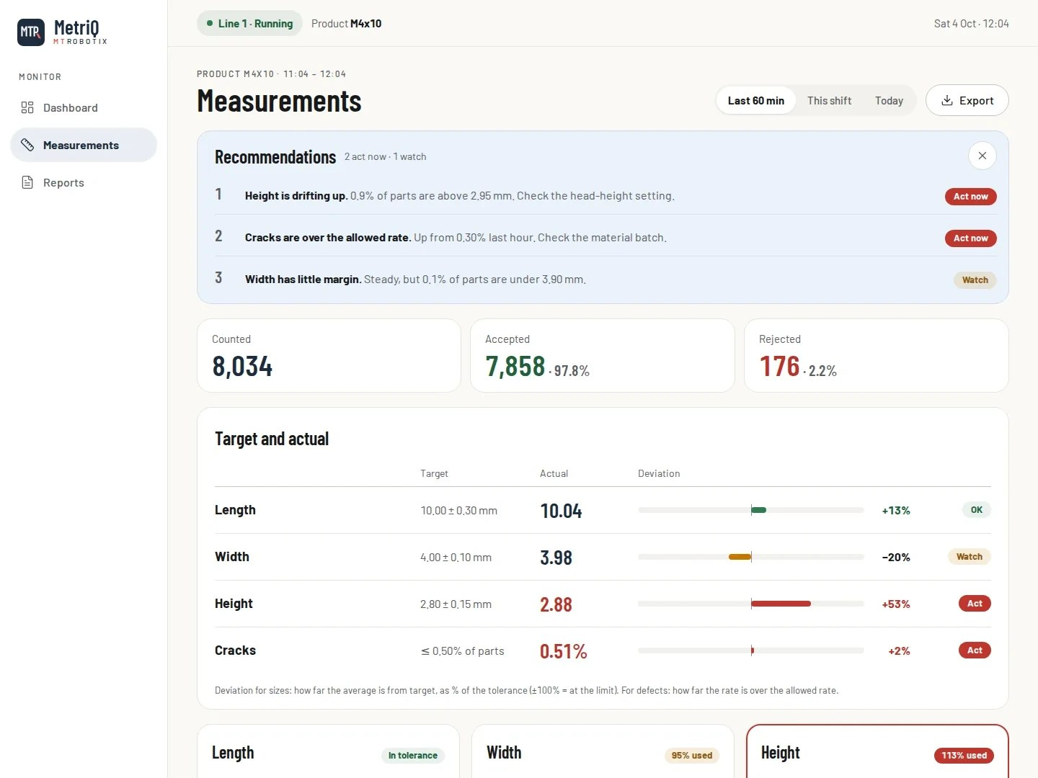
Sees drift before parts fail
MEASUREMENT · LIVE DATA
1
Measures every part
length, width, height, count and colour.
2
AI recommendations
ranks what needs attention and what to check.
3
Flags drift before parts fail
every part against its tolerance.
4
Exports every part
to CSV or Excel.
Measurements screen, sample data.
← All capabilities
Notes:
MetriQ tells the supervisor what is drifting and what to check, before parts start failing.

Slide 9
Live the same day. No integration project.
TIME AND COST
$150k
Integrator-built vision
Weeks to months · $30k–150k
$100k
First-year cost per station
AI vision platforms
1–4 weeks · ≈ $16k–87k
$50k
MetriQ
Same day · no integrator fees
$0
Same day
1 week
1 month
3 months
6 months
Time to go live
Notes:
Lower left is faster and cheaper. An integrator-built station takes weeks to months and $30k–150k in its first year; AI vision platforms take 1–4 weeks and roughly $16k–87k. MetriQ is installed by us and live the same day, with no integrator fees.

Slide 10



From install to live in one day
INTEGRATION
Mount
Calibrate
Teach
Live
No downtime.
Scale, colour and light.
Show MetriQ a few reference images.
Runs on your line and reports the same day.
Notes:
We mount the camera over the running line, calibrate scale, colour and light, teach MetriQ with a few reference images, and it is live and reporting the same day.

Slide 11
The QC station, without the project
HOW WE COMPARE
Manual QC
Rule-based vision
AI vision platforms
MetriQ
Time to go live
Hire and train
Weeks to months
1–4 weeks
Same day
New product or defect
Retrain people
Integrator reprograms
Relabel and retrain
Teach MetriQ in minutes
Recipe switching
Re-brief the shift
Reprogram per product
Switch job by hand or PLC
Automatic: recognises the product
Defects never seen before
Depends on the person
Only what rules describe
Varies by tool
Anomaly detection
Data
Paper logs
Pass / fail signal
Pass / fail and images
Dashboard, reports, AI advice
Hardware
—
Integrator's choice
Vendor's cameras
Customized to your line
Click to reveal MetriQ. Typical market figures; projects vary.
Notes:
Walk the three columns first, then click to reveal MetriQ.

Slide 12
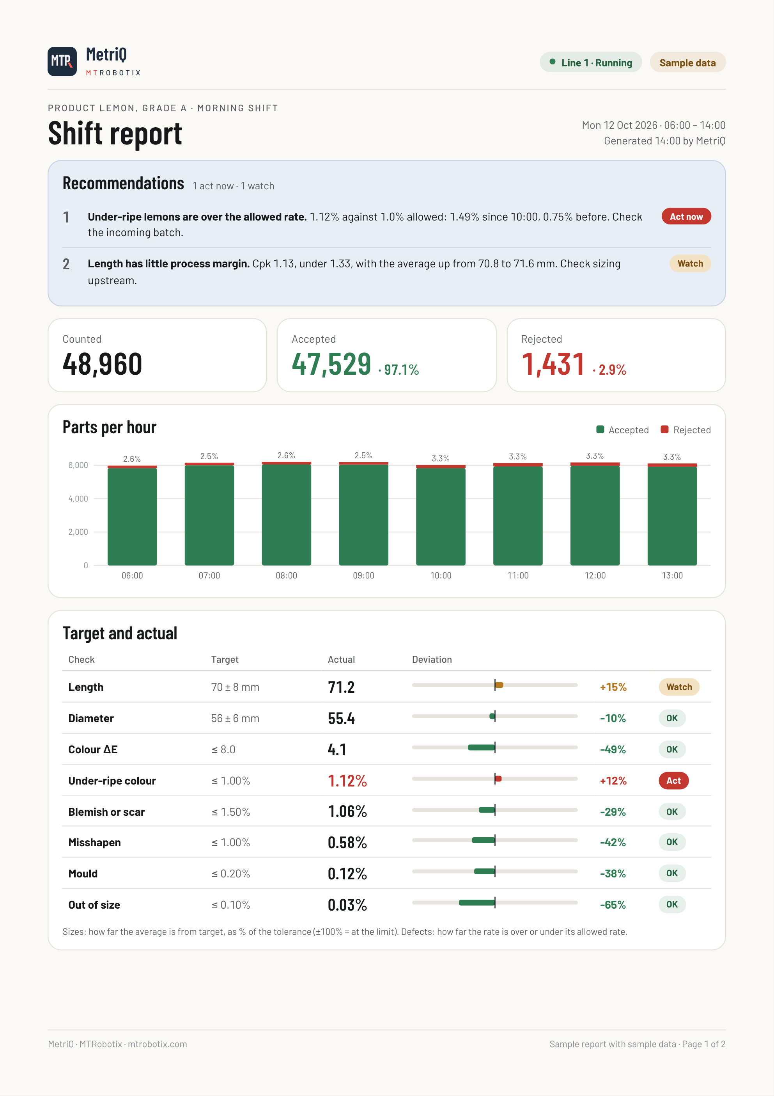
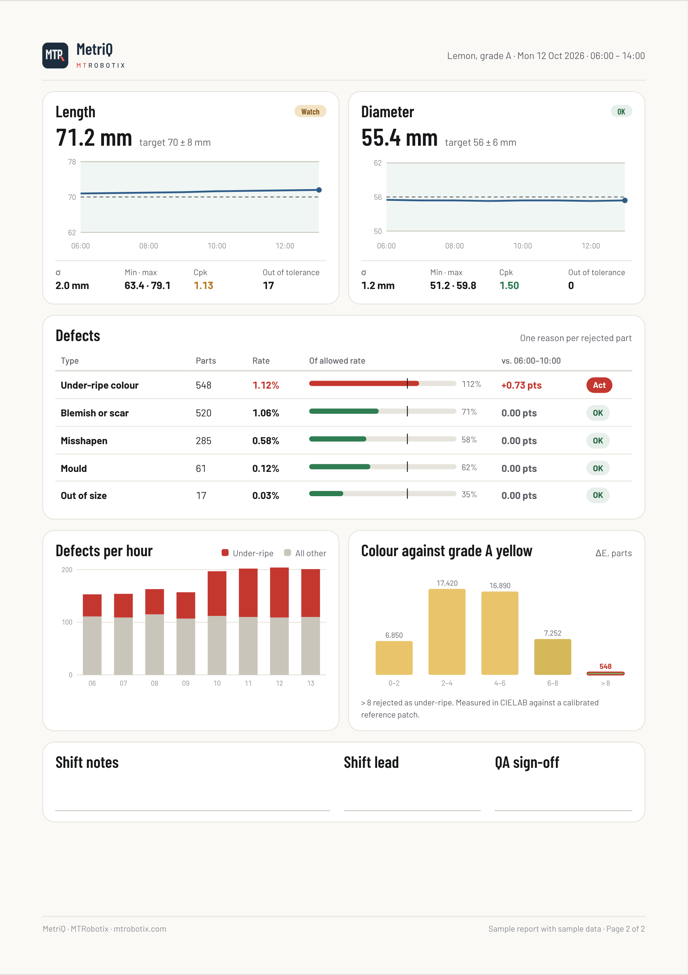
Every shift ends with a report
REPORTING
Counts and reject rate
per hour.
Target against actual
OK, Watch or Act for every check.
Cpk and drift per size
fix the process, not just the part.
Recommendations
ranked, with what to check.
Sample data.
← All capabilities
Notes:
The shift report MetriQ produces from the same numbers as the Measurements screen. Sample data for a lemon grading line.

Slide 13




Built around your line
CUSTOMIZATION
Camera
Line-scan, area-scan or 3D, for your part.
Frame and lighting
Sized to your conveyor. No line changes.
Checks
Your defects, tolerances and reject rules.
Connection
OPC UA, SQL, PLC reject signal, Excel.
Compute
GPU PC, industrial PC or Jetson edge.
Notes:
Every MetriQ is configured for the customer's product, conveyor and plant systems.

Slide 14




MTROBOTIX
See MetriQ on your product
A 30-minute demo on your parts.
mtrobotix@gmail.com
MetriQ
+84 835 760 735 · +1 905 924 5498
mtrobotix.com
Ho Chi Minh City · Toronto
Notes:
Close on the ask: a demo on their parts. Offer two dates.

