Slide 1
Team and Use Case
Team Name | Team Member Name | Mail Id
Code Wizards | Tammy Sri Krishna M (TL) | mtskrishnaofficial@gmail.com
 | Pushpalatha G | pushpaviru4@gmail.com
 | Praveen Alexander S | praveenalexander5@gmail.com
Use Case description | WasteWise helps people sort waste correctly using AI reducing mistakes, saving money, and improving recycling.
Our Solution Objective | Sort the trash before it ever becomes trash Turning everyday trash into smart decisions, traceable actions, and cleaner outcomes for everyone involved

Slide 2
Use Case
The Problem: A Broken System
Widespread Contamination:
Recyclable materials are frequently mixed with non-recyclable items or are not properly cleaned due to mistakes people make when sorting their trash. A single contaminated item can ruin an entire batch of otherwise good recyclables, making them unusable and leading to them being sent to a landfill. This results in low recycling rates because less material can be repurposed.
Costly & Inefficient:
Contamination forces waste management facilities to spend more money and effort to sort through the waste. In some cases, they have to throw away entire batches of recyclables, which wastes both materials and the resources used for collection and transportation. This inefficiency makes the overall process more expensive and less effective.

Slide 3
Use Case
Goal: Sort the trash before it ever becomes trash.
Intelligent Automation:
This is the brain of the operation. By using AI, WasteWise takes the guesswork out of sorting. It can accurately identify and classify materials, ensuring that a plastic bottle never ends up in a paper recycling bin again. This turns a complex, error-prone task into a seamless, automated process.
Waste Management:
This feature allows for a proactive approach to waste collection, preventing bin overflows, reducing environmental contamination, and improving the quality of life for residents in these communities.
Intelligent Bin Monitoring:
Our AI model analyzes the fill levels of bins located in apartments and flat communities. This moves beyond a general dashboard to provide hyper-localized, real-time data.

Slide 4
Use Case
Goal: Sort the trash before it ever becomes trash.
Capacity Analysis & Location Tracking:
The system will use this analysis to identify bins that are full. The exact location of these bins will be displayed on a map, providing waste management teams with a precise and actionable overview.
Optimized Collection Routes:
By knowing which bins are full and their exact locations, the system can automatically generate the most efficient collection routes, reduce unnecessary trips and save on fuel and labor costs.

Slide 5
Use Case
Goal: Sort the trash before it ever becomes trash.
Waste Generation Prediction and Personal Database
The system can predict and store the amount of waste generated by each individual user. This data is stored in a personal database, allowing for a detailed record of waste disposal habits. This feature enhances accountability and provides users with a clear understanding of their environmental impact.
Credit system:
The sample prototype for the credit system has been included for reference.

Slide 6
Use Case
Project's Impact
Increased Recycling Rates:
The system tackles contamination at the source through intelligent automation, which maximizes the amount of material that can be successfully recycled. This leads to a substantial increase in a community's recycling output.
Reduced Operating Costs:
The solution's efficiency and accuracy result in direct financial savings. By reducing contamination and streamlining the collection process, the costly practice of sorting spoiled batches is eliminated, which saves resources and boosts profitability for waste management facilities.
Actionable Management Insights:
A real-time dashboard provides managers with a clear overview of the entire operation. They can instantly view performance trends, pinpoint problem areas, and make data-driven decisions that continuously enhance the system. This transforms waste management from a reactive process into a proactive, strategic one.

Slide 7
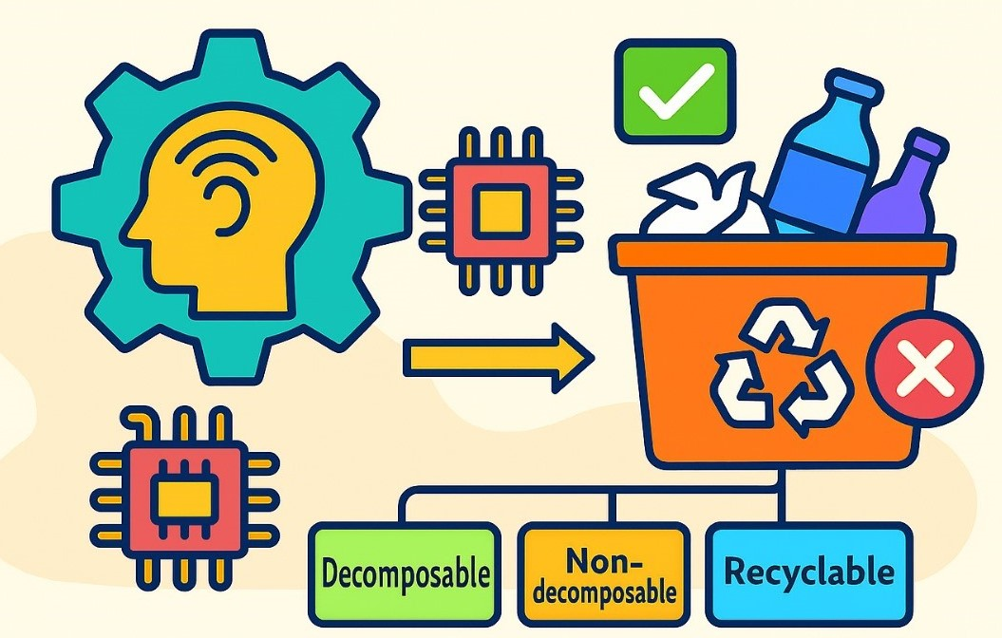

Use Case

Slide 8
Solution Architecture
A Symphony of Services
Our project is a well-orchestrated system, where each component plays a unique and vital role to deliver a seamless, end-to-end experience.
The User Interface : Frontend (Streamlit for prototype)
The Public-Facing Dashboard: This is the interface where users can upload files and view the resulting classifications.
The Collector's App: A purpose-built, lightweight application for waste collectors, making it easy to provide feedback in the field.
The Operations Dashboard: This is where raw information is transformed into actionable intelligence, a powerful analytics tool that equips waste management professionals with clear insights into system performance.

Slide 9
Solution Architecture
A Digital Ecosystem
We've built a digital ecosystem where each service is a vital organ, from the brain (LLM) to the heart (Backend), all working in unison to ensure a healthier planet.
The Brain : LLM:
The LLM is the intelligent core of our project. It is a dedicated, separate service that houses a local Large Language Model. The backend communicates with this LLM to perform the crucial task of classifying items. The LLM acts as the ultimate authority on where each item belongs.
The Conductor : Backend (FastAPI):
At the heart of our system lies the backend, powered by FastAPI. It's the central nervous system that manages all the business logic, acting as the conductor of our symphony. It directs traffic, processes data, and ensures every service works in perfect harmony.

Slide 10
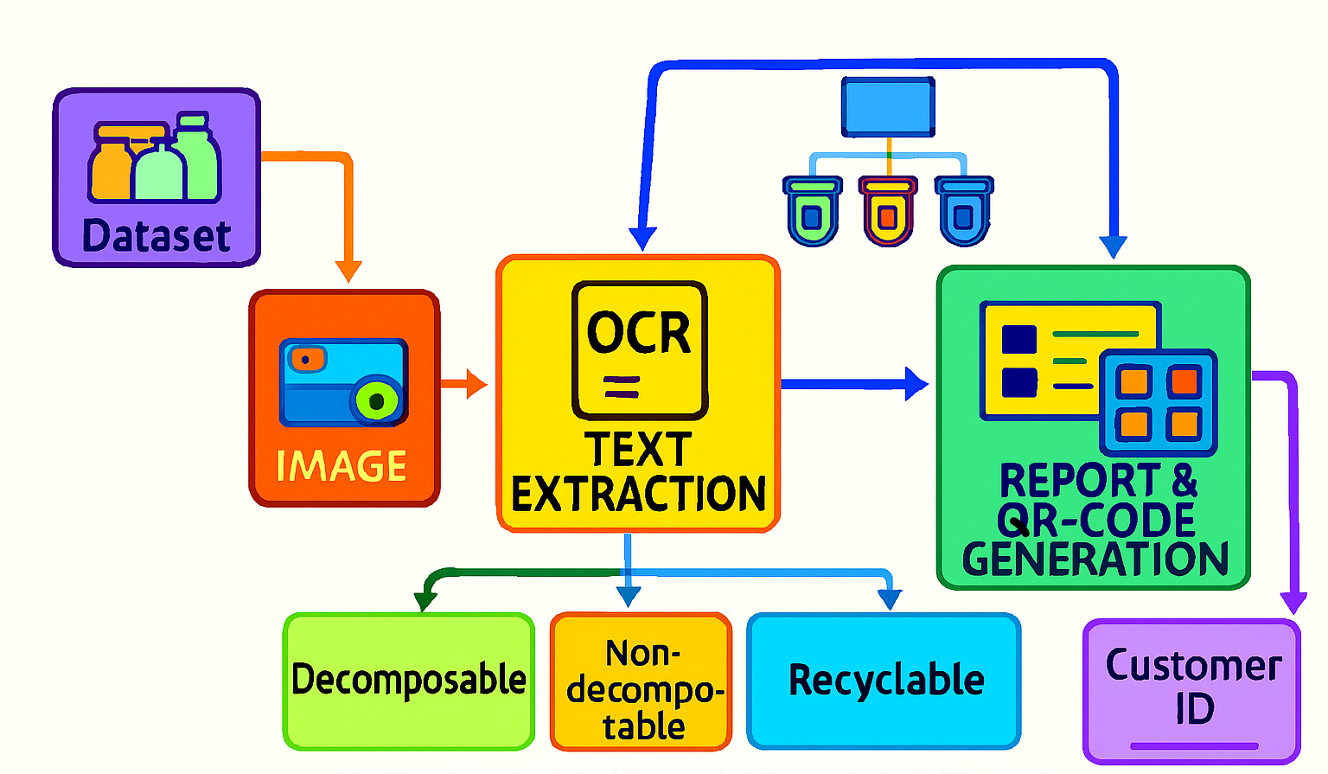
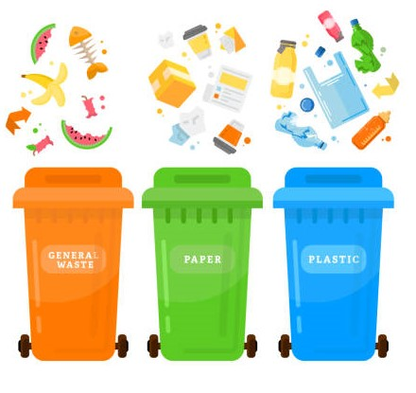
Solution Architecture

Slide 11
Technology Stack
The Foundation: Backend & Frontend
Python: The core language that binds our project together.
FastAPI & Uvicorn: For our backend, we use this modern, high-performance framework to build a robust and lightning-fast API.
Streamlit: Our choice for the frontends, allowing us to build elegant, interactive, and user-friendly dashboards with pure Python.

Slide 12
Technology Stack
The Intelligence: LLM & Data
LLM: We've integrated this local Large Language Model to give our system the power to classify any item, providing a flexible and powerful classification engine.
pack_graph.json: This simple, yet effective, JSON-based knowledge graph acts as a fast, lightweight database for known items, reducing processing costs and improving accuracy.
Pandas & Matplotlib: These libraries are the engine behind our analytics, helping us process complex data and generate clear, visual insights for our users.

Slide 13
Technology Stack
The Utilities: Our Support System
PyPDF2, python-docx, pytesseract:
These libraries serve as versatile tools for file processing, enabling our system to efficiently read and interpret data across multiple formats, including PDFs and images.
QR code & requests:
These tools are crucial for connecting the physical and digital worlds, enabling a system where each bin's QR code can be used to verify that it contains waste, which ensures seamless communication between services.

Slide 14
Key highlights of solution
Intelligence That Understands Packaging
Our system doesn’t just read item names, it understands them. Using a hybrid of rule-based logic and advanced classification, WasteWise knows whether a shampoo bottle belongs in recycling or if a chip packet needs special disposal.
Smart Bag Recipes for Every Home
Forget the old “wet vs dry” confusion. WasteWise generates custom bag instructions tailored to your purchase. Whether it’s compostable, recyclable, or hazardous, each item finds its rightful place.
Visual Clarity That Drives Action
With dynamic pie charts and impact-level bar graphs, users instantly see how their waste stacks up, what’s safe, what’s risky, and what needs urgent attention. It’s not just data; it’s a call to action.

Slide 15
Key highlights of solution
QR-Linked Traceability
Every Bin gets a unique digital ID and QR code, QR-linked traceability leverages QR codes to enable seamless tracking and visibility of bin capacity and utilization across the entire lifecycle. By embedding QR codes on bins or storage units, organizations can capture and access real-time data on fill levels, movement, and status, ensuring efficient monitoring, optimized capacity usage, and improved transparency.
Real-Time Insights for Environmental Stewards
Our project focuses on empowering Environmental Stewards, the teams managing collection and sustainability, with real-time visibility into bin capacity and waste flow. By integrating QR-linked traceability with smart bin monitoring, we enable efficient operations, data-driven decisions, and improved accountability in waste management.

Slide 16
Future Enhancements
Credit System for Recycling
A credit-based system will be implemented to reward users for proper waste sorting. Users will earn points for correctly disposing of recyclable materials.
WasteWise Smart Card
A physical or digital card will be provided to users. This card can be swiped at a smart waste disposal unit to track and accumulate the points they earn.
Redemption and Rewards
The points earned through the credit system can be redeemed in two ways:
Monetary Conversion: Points can be converted into money, providing a direct financial incentive for responsible waste management.
Online Shopping Integration: Points can be used for online shopping, partnering with e-commerce platforms to offer discounts or direct payment options using the accumulated points.

Slide 17
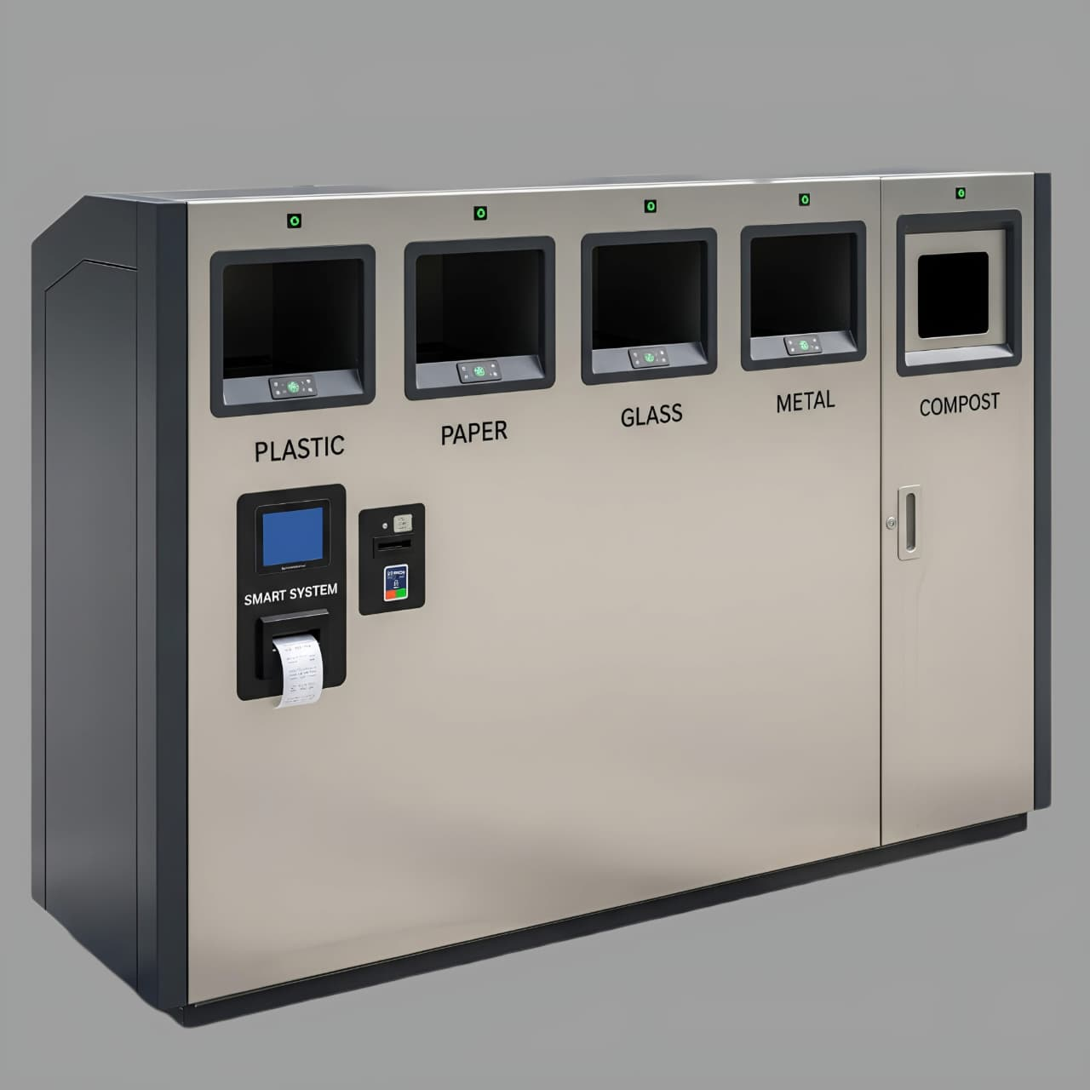
Future Enhancements

Slide 18
Thank you

