Slide 1
CSP - examples

Slide 2
The following constraint network represents a coloring problem with five variables and one, two, or three colors in the domain of each variable. Lines represent constraints requiring that two variables have different colors.

Slide 3
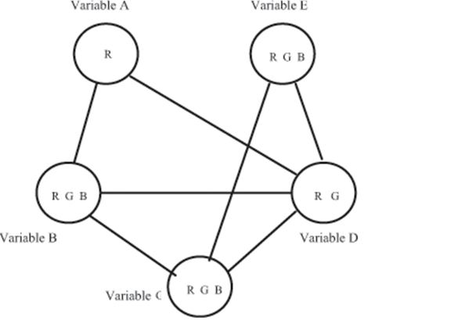

Slide 4
If we run full constraint propagation,
what are the resulting domains of the
variables?
Arcs | A | B | C | D | E
A-B | R | G B
A-D | R |  |  | G
B-C |  | G B | R G B
B-D |  | B |  | G
C-D |  |  | R B | G
C-E |  |  | R B |  | R G B
D-E |  |  |  | G | R B
B-C |  | B | R
C-E |  |  | R |  | B

Slide 5


Slide 6
Apply backtracking to the above figure. Examine variables in alphabetical order (A, B, C, D, E) and values in reverse alphabetical order (R, G, B). For every node in your tree, draw only its valid descendents. Write down the values assigned to each variable satisfying the conditions

Slide 7
