Slide 1
Games - examples

Slide 2
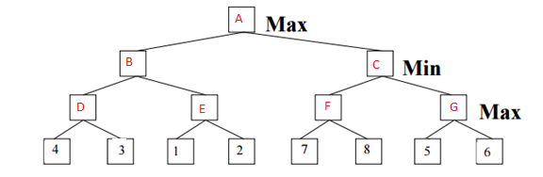
Consider the game tree in which the evaluation function values are shown
below each leaf node. Assume that the root node corresponds to the
maximizing player. Assume that the search always visits children
left-to-right.

Slide 3
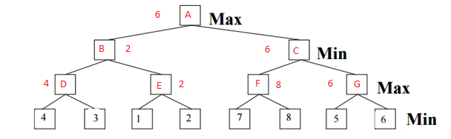
Compute the backed-up values computed by the minimax algorithm.
Show your answer by writing values corresponding to each letter (A-G)

Slide 4
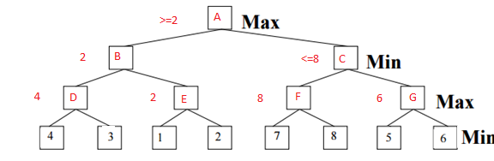
Which nodes will not be examined by the alpha-beta
pruning algorithm? Check the nodes which are pruned
No cut-off

Slide 5
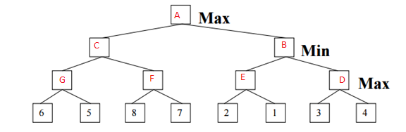
Now consider the tree below where the leaves are reversed.

Slide 6
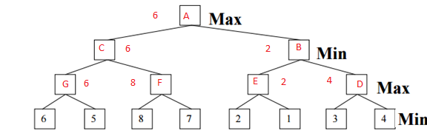
Compute the backed-up values computed by the minimax algorithm.
Show your answer by writing values corresponding to each letter (A-G)

Slide 7
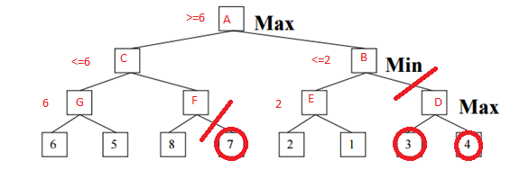
Which nodes will not be examined by the alpha-beta
pruning algorithm? Check the nodes which are pruned

Slide 8
In general (not just for the above tree), if the search always visits children right-to-left instead of left-to-right,
(Yes or No) The minimax value computed at the root will be changed.
FALSE
(Yes or No) The number of nodes pruned will be changed.
TRUE

Slide 9
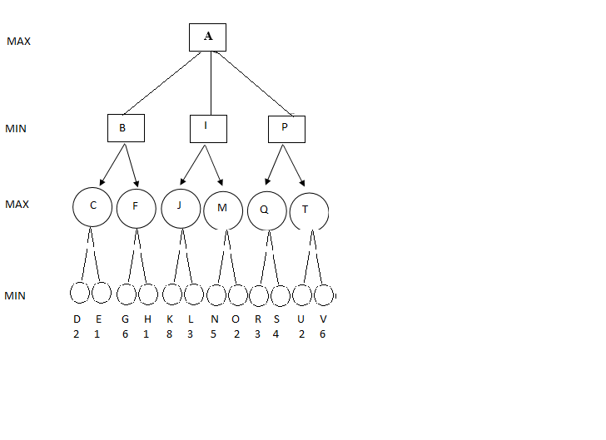
Consider the game tree. Note that, the leaves correspond to MIN's moves.
Apply alpha beta pruning. Write the name of the nodes that are pruned.
How many alpha and beta cut-offs are there? Specify the alpha and beta cutoffs by writing the pair of nodes corresponding to the edge.

Slide 10
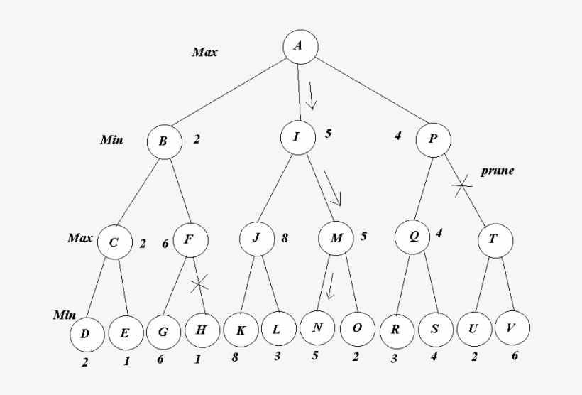

Slide 11
Pruned nodes
H
T U V
Alpha cutoff
F-H
Beta cutoff
P-T

