Slide 1

This week’s agenda
Linear Differential Equations
Obtaining Transfer Functions
Block Diagrams
An Introduction to Stability for
Transfer Functions
Concept of Feedback and Closed Loop
Basic Control Actions, P-I-D Effects
2/17

Slide 2
P-2 Linear Differential Equations
Why do we need differential equations?
To characterize the dynamics
To obtain a model (which may not be unique)
To be able to analyze the behavior
Finally, to be able to design a controller
Model may depend on your perspective and the goals of the design
Simplicity versus Accuracy tradeoff arises
•
•
•
•
•

Slide 3
When is a dynamics linear?
u₁(t)
SYSTEM
y₁(t)
u₂(t)
SYSTEM
y₂(t)
u₁(t)+ u₂(t)
SYSTEM
y₁(t)+y₂(t)
The system is linear if the principle of
superposition applies

Slide 4
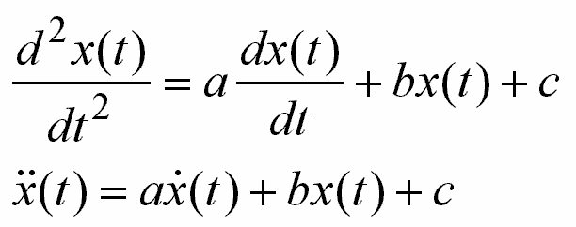

Linear Time Invariant (LTI) Systems
Linear Time Varying (LTV) Systems
A differential equation is linear if the coefficients
are constants or functions only of the independent
variable (e.g. time below).
LTI
LTV

Slide 5
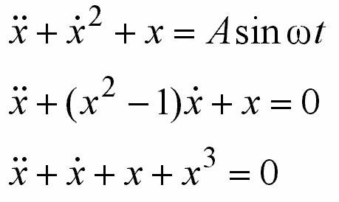
Nonlinear Systems
A system is nonlinear if the principle of
superposition does not apply

Slide 6
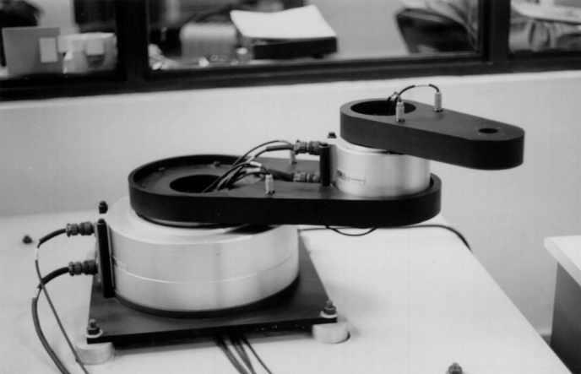

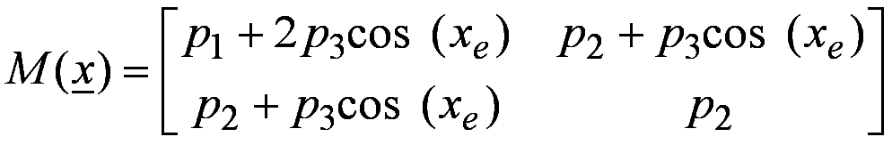
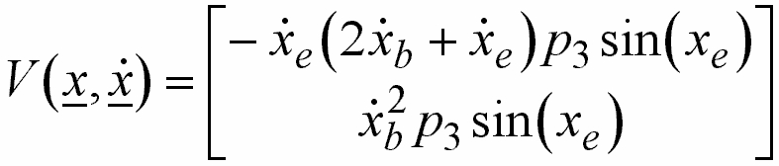
A More Realistic Example - 2DOF Robot
Dynamics is characterized by
where
Control
Inputs
u

Slide 7
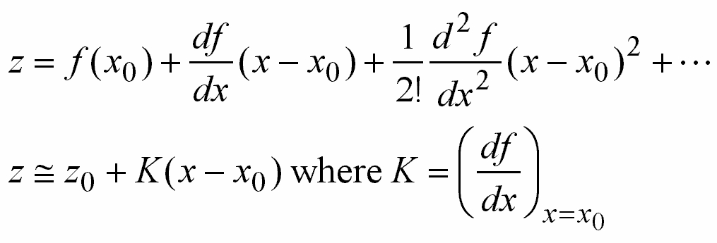
Linearization of z=f (x)
•
Consider z=f (x) is the system
(x₀,z₀) is the operating point
Perform Taylor series expansion around the
operating point
•
•
Only if these terms are negligibly small!

Slide 8
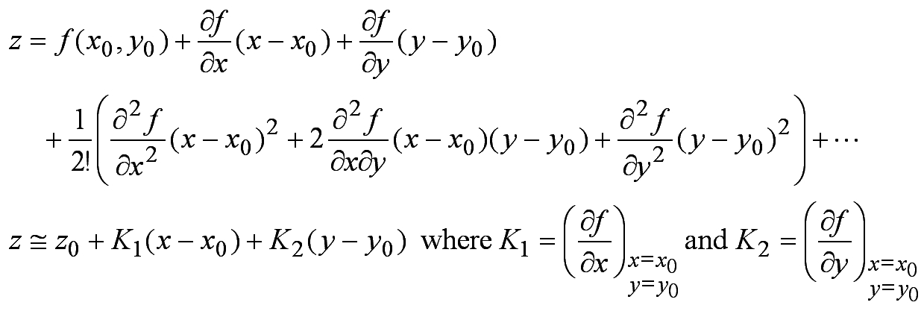
Linearization of z=f (x,y)
•
Consider z=f (x,y) is the system
(x₀,y₀,z₀) is the operating point
Perform Taylor series expansion around the
operating point
•
•
Only if these terms are negligibly small!

Slide 9
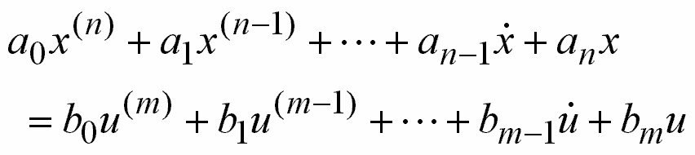
P-2 Obtaining Transfer Functions
Consider the system, whose dynamics is given by
the following differential equation
where, x is the output, u is the input

Slide 10
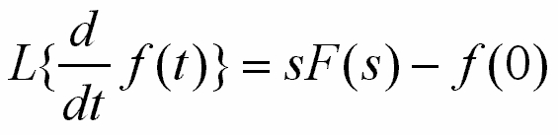

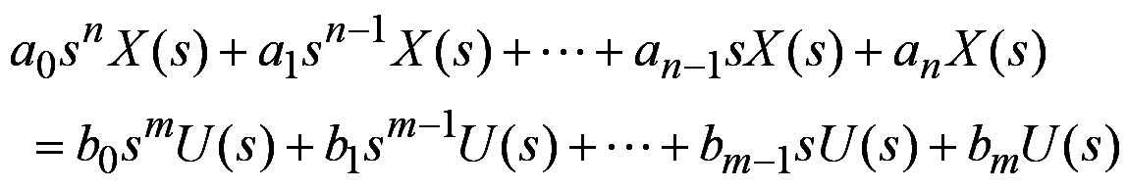
Assume all initial conditions are zero and take the
Laplace transform. Remember
Real Differentiation

Slide 11
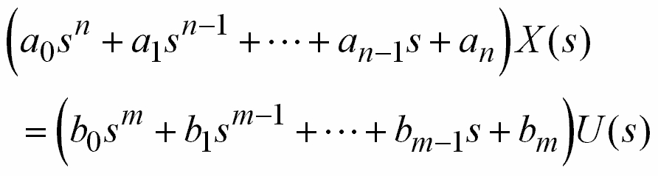
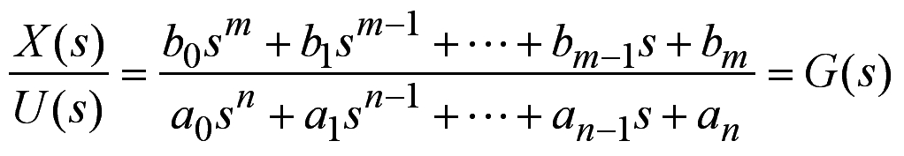
We get
Transfer function is G(s)

Slide 12

Note that while studying with transfer
functions all initial conditions are assumed
to be zero
What does a transfer function tell us?

Slide 13
Transfer function (TF)
•
TF states the relation between input and output
TF is a property of system, no matter what the input is
TF does not tell anything about the structure of the system
TF enables us to understand the behavior of the system
TF can be found experimentally by studying the response of the system for various inputs
TF is the Laplace transform of g(t), the impulse response of the system
•
•
•
•
•

Slide 14
Transfer function (TF)
•
Above TF, i.e. G(s), is n^{th} order
We assume that n≥m
If a₀=1, the denominator polynomial is said to be monic
If b₀=1, the numerator polynomial is said to be monic
•
•
•

Slide 15
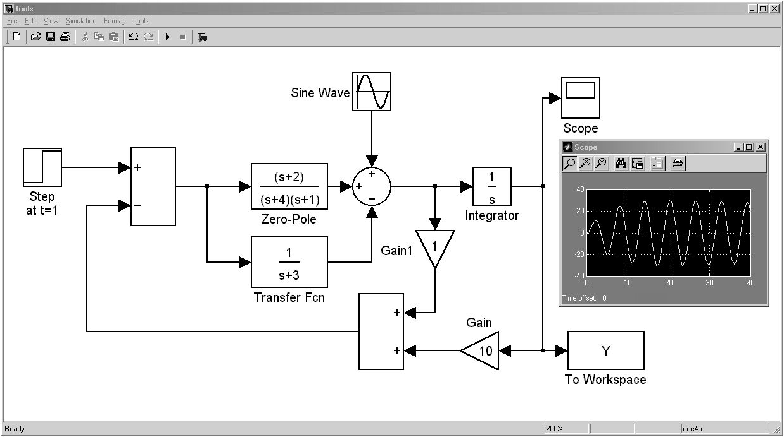
P-2 Block Diagrams
Tools we will mainly use (Matlab-Simulink)

Slide 16
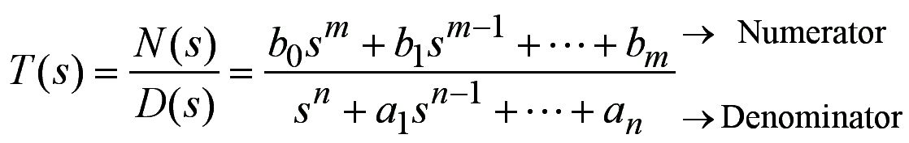
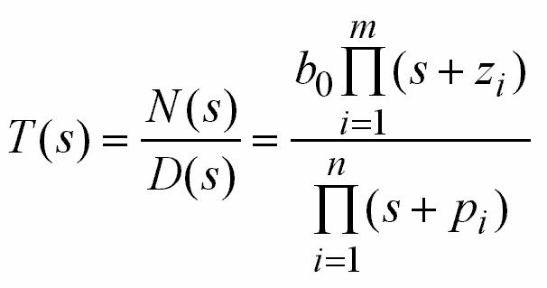
P-2 An Introduction to Stability for
Transfer Functions
Consider
Rewrite this as
s =− z_{i} for i=1,2,…,m are
the zeros of the system
s =− p_{i} for i=1,2,…,n are
the poles of the system

Slide 17
Stability in terms of TF poles
If the real parts of the poles are negative,
then the transfer function is stable
Re(− p_{i})<0
Re( p_{i})>0
TF Stable

Slide 18
What is the meaning of this?
Poles with zero imaginary parts
Im
h(t)
s-plane
Stable
x
Re
Re(− p_{i})<0
t
Im
h(t)
s-plane
Unstable
x
Re
Re(− p_{i})>0
t

Slide 19
What is the meaning of this?
Poles with nonzero imaginary parts
Im
h(t)
s-plane
Stable
x
Re
t
x
Re(− p_{i})<0
Im
h(t)
s-plane
Unstable
x
Re
t
x
Re(− p_{i})>0

Slide 20
What is the meaning of this?
Poles on the imaginary axis
Im
h(t)
s-plane
x
Re
Re(− p_{i})=0
t
Im
h(t)
s-plane
x
Re
t
x
Re(− p_{i})=0
Neither stable nor unstable

Slide 21
A TF is said to be stable if all the roots of
the denominator have negative real parts
Poles determine the stability of a TF
Zeros may be stable or unstable as well,
but the stability of the TF is determined
by the poles

Slide 22
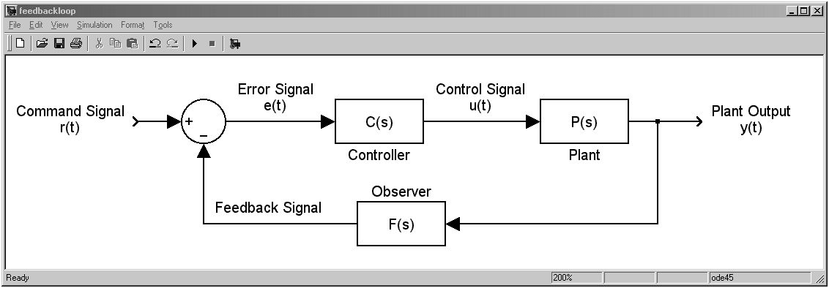
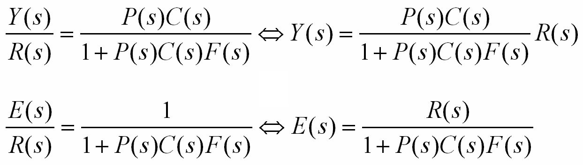
P-2 Concept of Feedback and Closed Loop

Slide 23
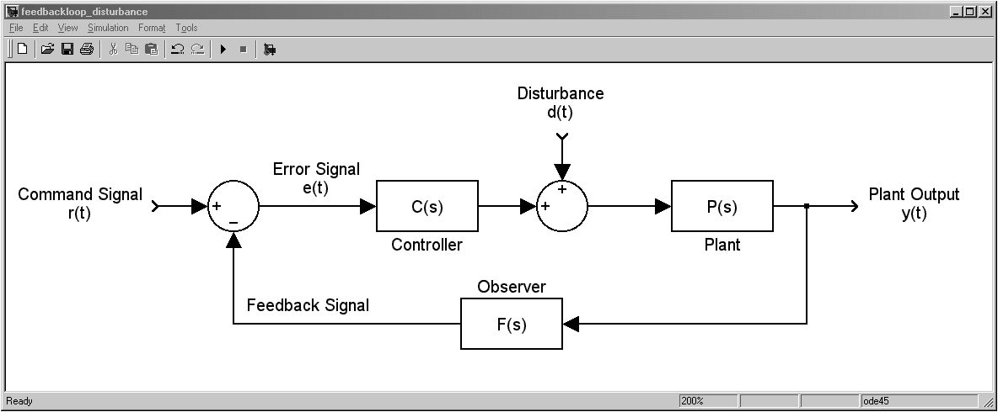
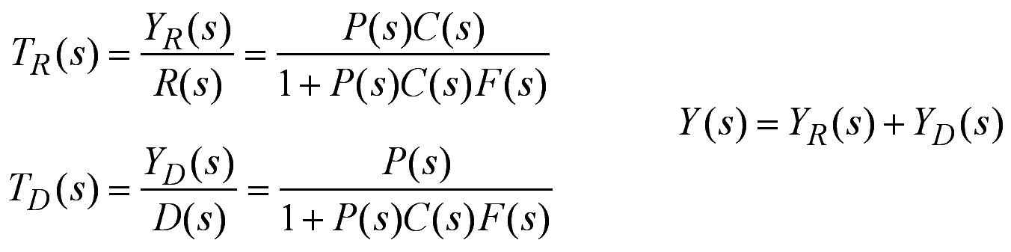
What are the advantages of feedback?
Superposition!

Slide 24
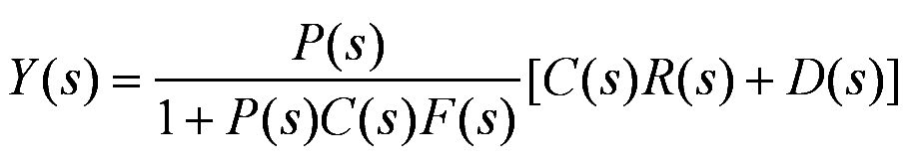

Slide 25
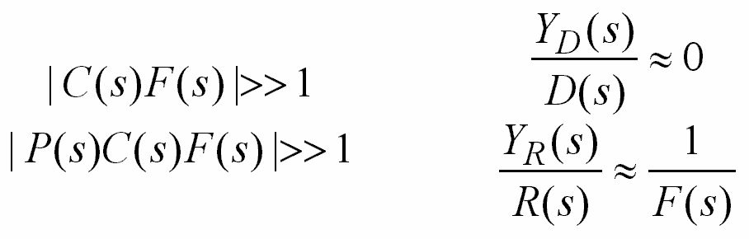
Effect of disturbance is suppressed considerably
Variations on P(s) and C(s) do not affect the closed loop TF. Think about the case when F(s)=1

Slide 26
P-2 Basic Control Actions, P-I-D Effects
• On-Off Controller
• Proportional (P) Controller
• Integral (I) Controller
• Proportional-Integral (PI) Controller
• Proportional-Derivative (PD) Controller
• Proportional-Integral-Derivative (PID)
Controller

Slide 27
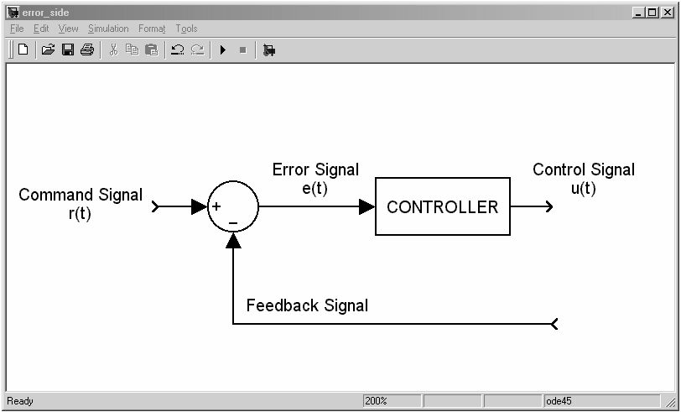
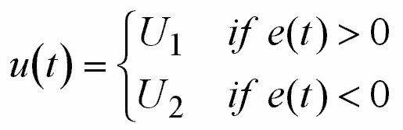
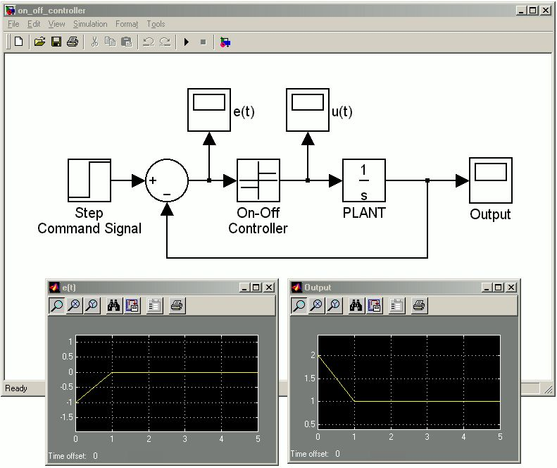
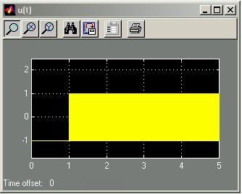
On-Off Controller
u(t)
e(t)
y(t)

Slide 28
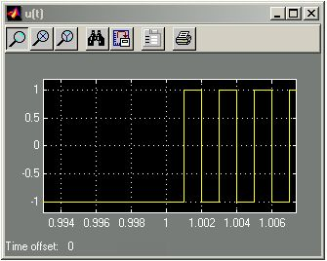
On-Off Controller
• Initial condition was 2.0
• Reference input was 1.0 (step input at t=0)
• Calculated error = -1.0 (0≤ t <1)
• Apply minimum (U₂) control value (U₁=1, U₂=-1)
• This would bring the output to 1 (Command Sig.)
• Around zero output, what is your control?

Slide 29
On-Off Controller
Remarks on Simulation
• Ideally, the switching frequency is infinity!
• Simulation step size was 1 msec
• This example shows how On-Off type
controller works

Slide 30
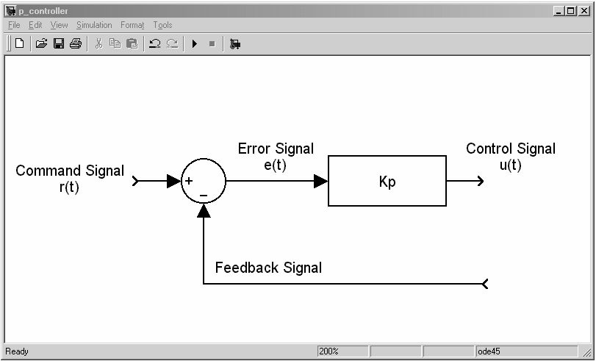

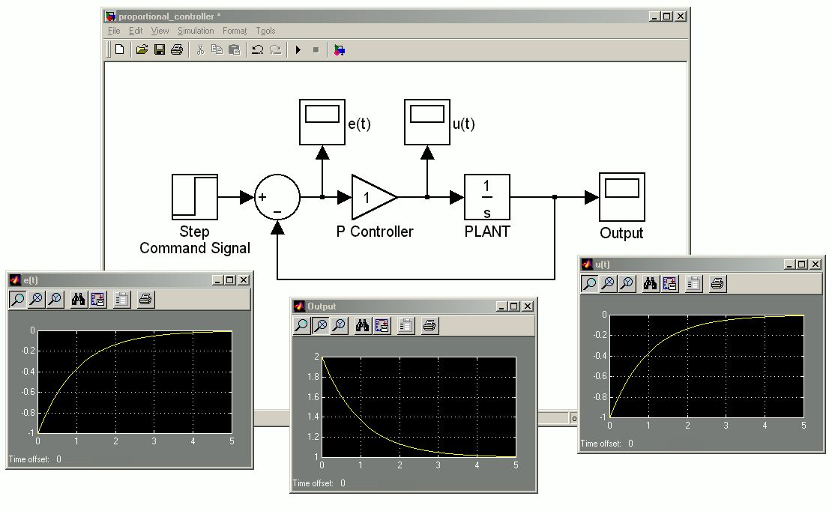
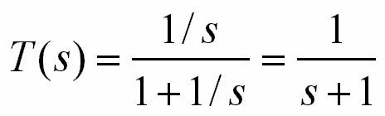
Proportional (P) Controller
Closed loop
is stable!
e(t)
y(t)
u(t)

Slide 31
Proportional (P) Controller
Remarks
• Initial condition was 2.0
• Reference input was 1.0 (step input at t=0)
• Calculated error converges to zero
• This would bring the output to 1 (Command Sig.)

Slide 32
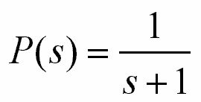
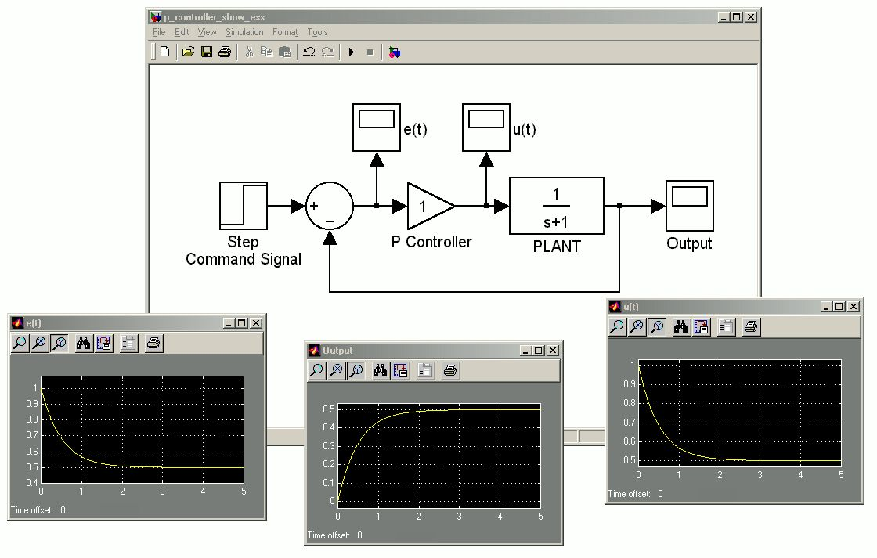
Integral (I) Controller
First see what P controller performs with the plant
e(t)
u(t)
y(t)

Slide 33
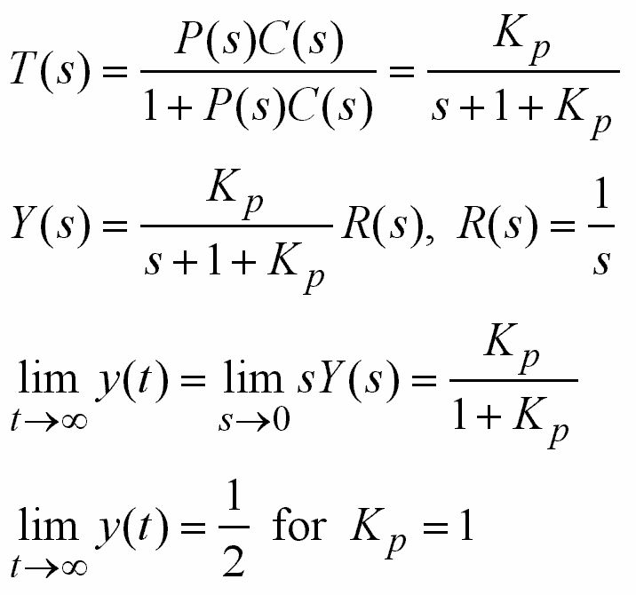

When is this
stable?
Here is what happened inside...
PLANT
CONTROLLER
≠ 1
Steady State
Error!

Slide 34
Integral (I) Controller
• When there is steady state error, integral action
is required
• Transfer functions having no integrator (no pole
at s=0) would output steady state error to step
input
• We will turn back to this later… Now consider
the same simulation with C(s)=K_{i}/s (Set K_{i}=1)

Slide 35
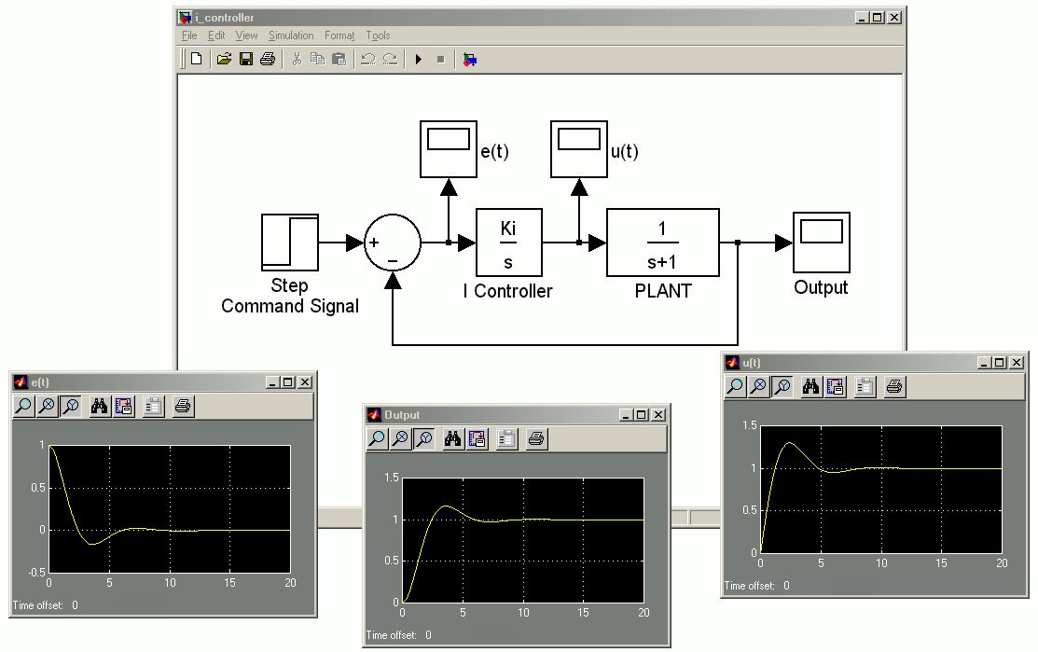
Integral (I) Controller
K_{i}=1
e(t)
u(t)
y(t)

Slide 36
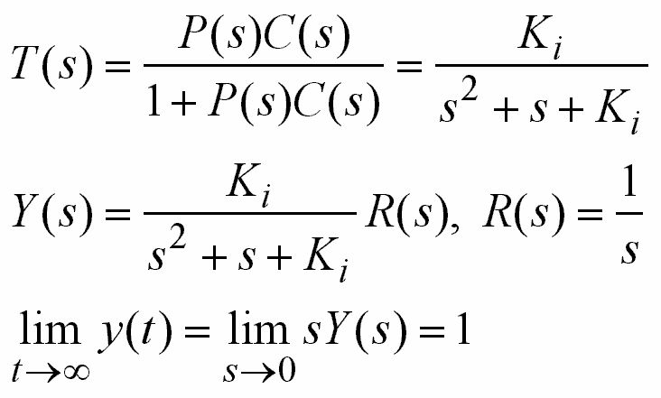
Integral (I) Controller
When is this
TF stable?
r(t) = 1

Slide 37
Note that
• P controller calculates the control input based on
the current value of the error
• I controller calculates the control input based on
the accumulated (integrated) value of the error
• A combination of both would possess the two
properties collectively. This type of a controller is
called PI controller

Slide 38
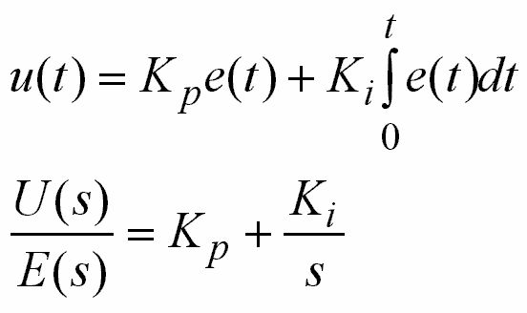
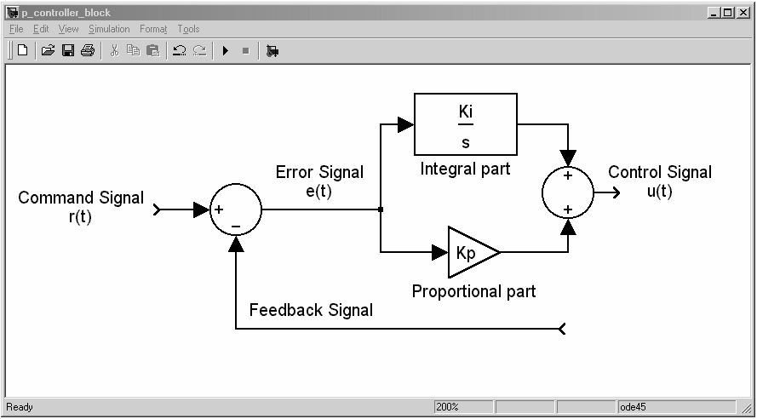
Proportional-Integral (PI) Controller

Slide 39
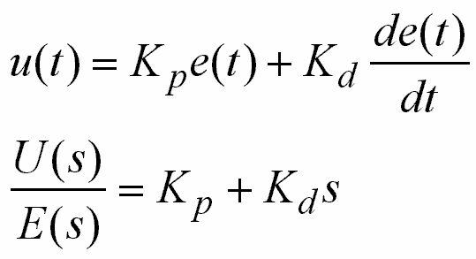

Proportional-Derivative (PD) Controller

Slide 40
Note that
• If the feedback signal is noisy, e(t) will be noisy
• Differentiation of a noisy signal can lead to an
excessively large output! Several modifications
can be proposed...
• Derivative action introduces anticipatory
behavior since it is based on the slope of the
error signal
• A combination of P-D actions would possess the
two properties collectively. This type of a
controller is called PD controller

Slide 41
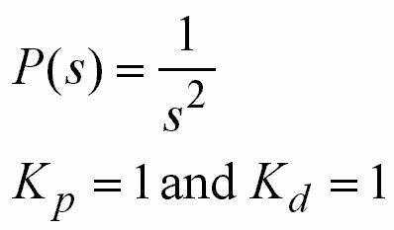
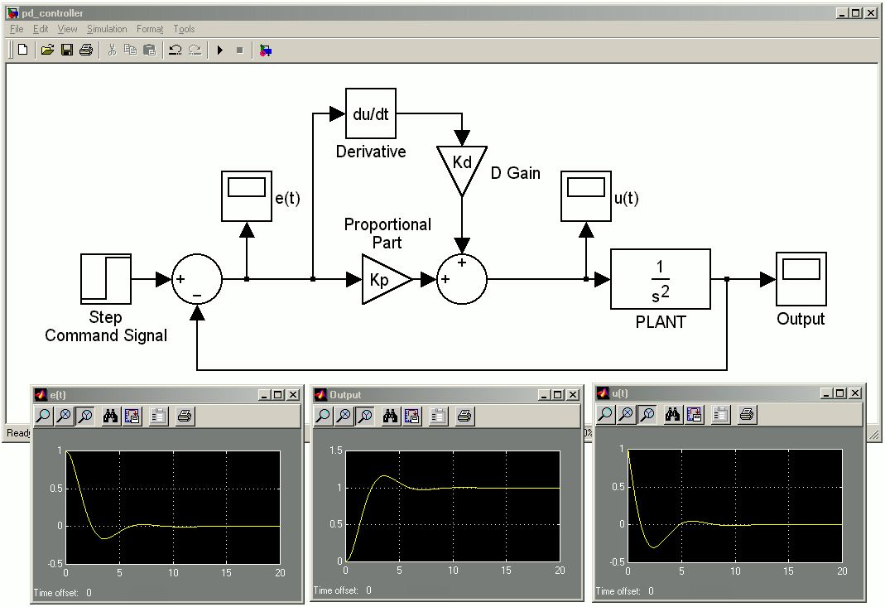
Proportional-Derivative (PD) Controller
An Example
e(t)
y(t)
u(t)

Slide 42
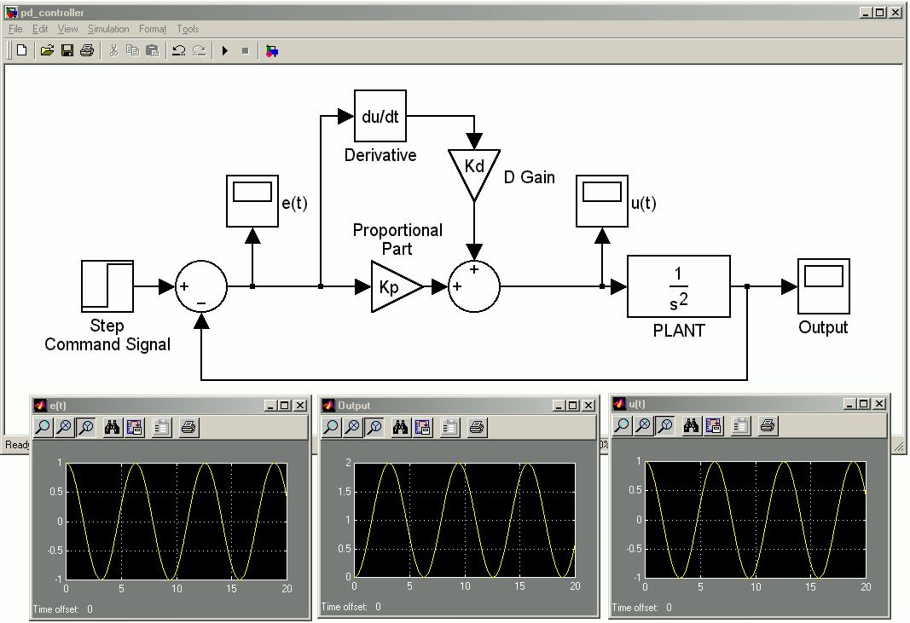
Proportional-Derivative (PD) Controller
An Example: Now set K_{d}=0
Input is
unit step!
e(t)
y(t)
u(t)

Slide 43
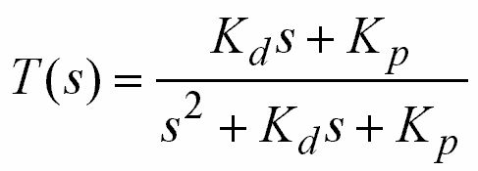
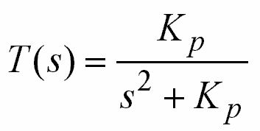
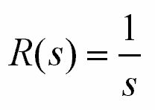
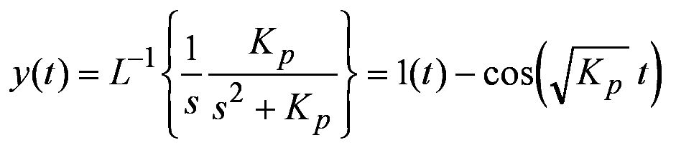
Proportional-Derivative (PD) Controller
An Example: Let’s analyze what happened...
CL Transfer Function
CLTF with K_{d}=0
Unit Step
With only proportional controller, the output oscillates in response to constant input

Slide 44
Proportional-Derivative (PD) Controller
An Example: Let’s see in terms of stability
Im
T(t)
s-plane
x
Re
t
x
Re(− p_{i})=0

Slide 45
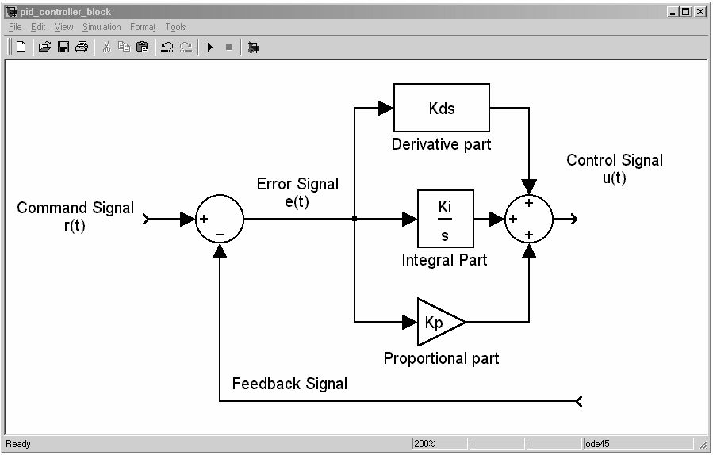
Proportional-Integral-Derivative (PID) Controller

Slide 46
Proportional-Integral-Derivative (PID) Controller
• Over 95% of the controllers operating in industry
are of type PID
• PID Controller utilizes the information contained
in the current value, accumulated value and the
tendency of the error signal
• Hardware/Software implementation of the PID
controller is easy

Slide 47
Proportional-Integral-Derivative (PID) Controller
• If the plant transfer function is changing, PID
controller may not account for the entire set of
combinations

Slide 48
PID Controller
Questions & Answers
Q: Can we so freely assign the controller
parameters?
A: NO
Q: What constraints do we have in designing a
PID controller?
A: First requirement is the stability, then the
design specifications must be met
Q: How to check stability compactly?
What are design specifications?
A: Next week’s agenda...

