Slide 1

This week’s agenda
Concept of Stability
Stability Analysis of the Closed Loop
System by Routh Criterion
State Space Representation and Stability
2/17

Slide 2
P-3 Concept of Stability
What is stability?
Stability is a property of the system regardless
of the signals at the inputs and outputs
Stability is an underlying requirement in every
control system
•
•
Why do we need to analyze stability?
An unstable system is potentially dangerous!
When the power is turned on, the output will
increase (decrease/oscillate) indefinitely…
Eventually this will damage the physical setup
•
•
•

Slide 3
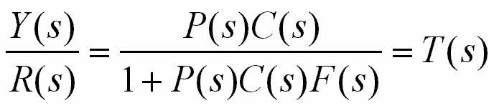
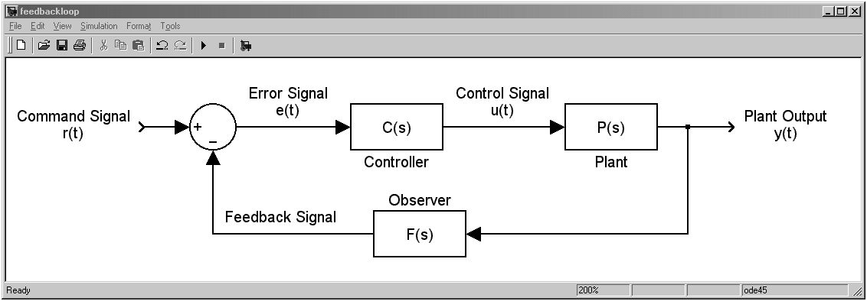
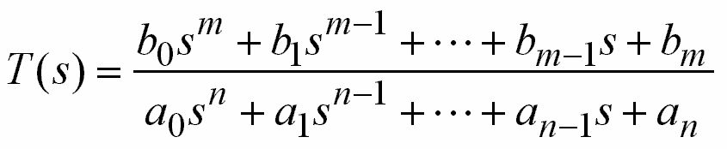
P-3 Stability Analysis of the Closed Loop
System by Routh Criterion
Consider the feedback loop
,
,
,
,

Slide 4
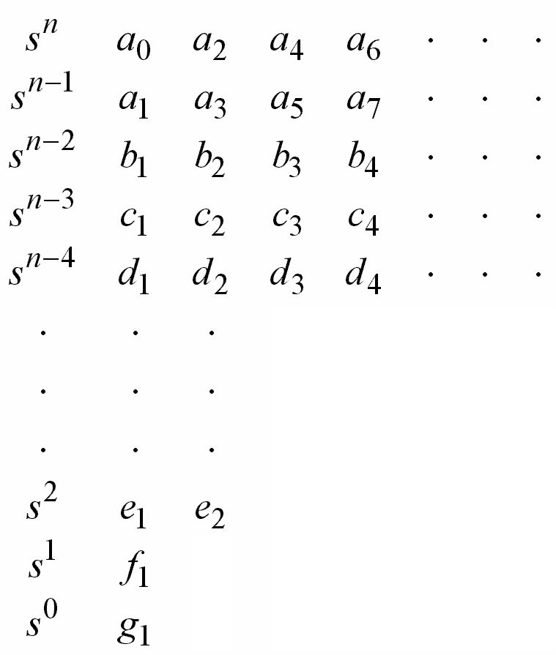
T(s) will let you first
place these terms
,
,
,
,

Slide 5
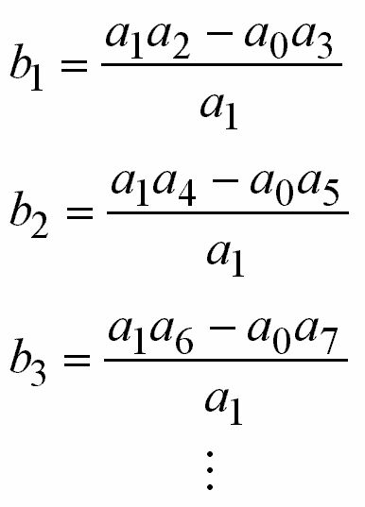
ROW #3
Evaluate till the remaining bs are all zero

Slide 6
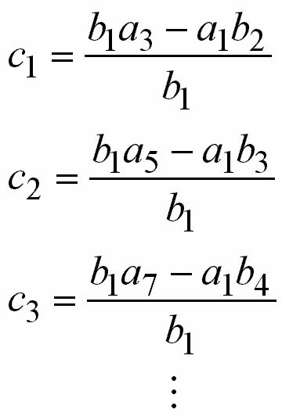
ROW #4
Evaluate till the remaining cs are all zero

Slide 7
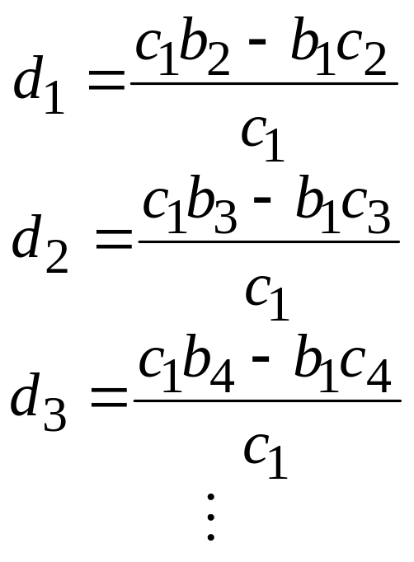
ROW #5
Evaluate till the remaining bs are all zero

Slide 8
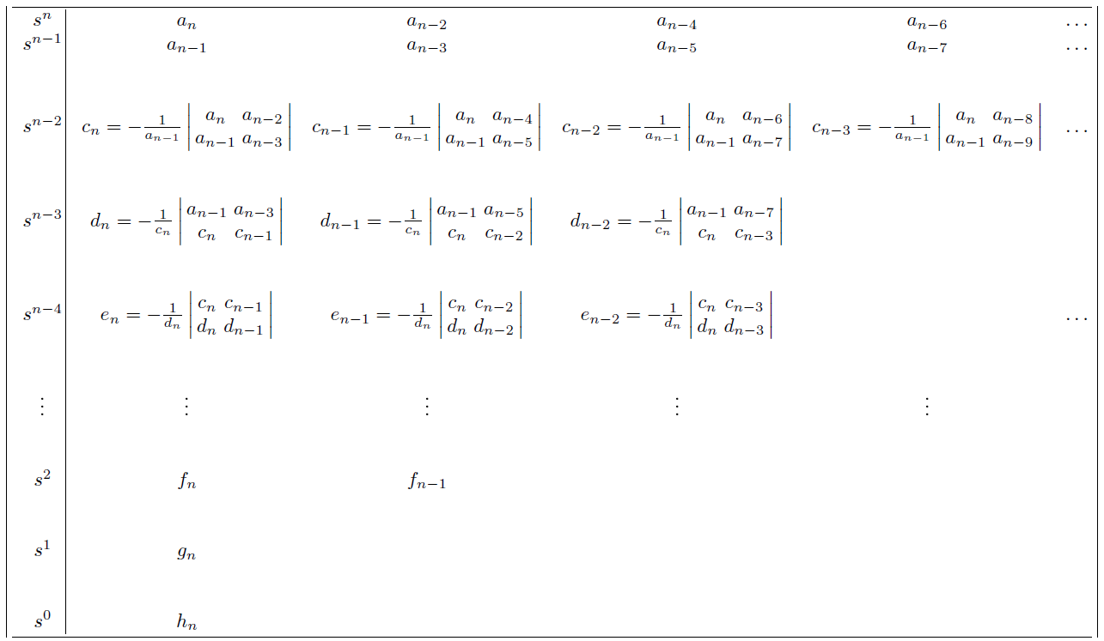
Routh table

Slide 9

Remarks
Repeat the same pattern till you reach the
end i.e. g₁
The complete array of coefficients is triangular
Dividing or multiplying any row by a positive
number can simplify the calculation without
altering the stability conclusion

Slide 10

Routh’s stability criterion states that
,
,
,
,
For
The number of poles on the right hand s-plane is equal to the number of sign changes in the first column of the table
Note that, we only need the signs of the numbers in the first column

Slide 11
In other words...
These terms must have the same signs for stability

Slide 12
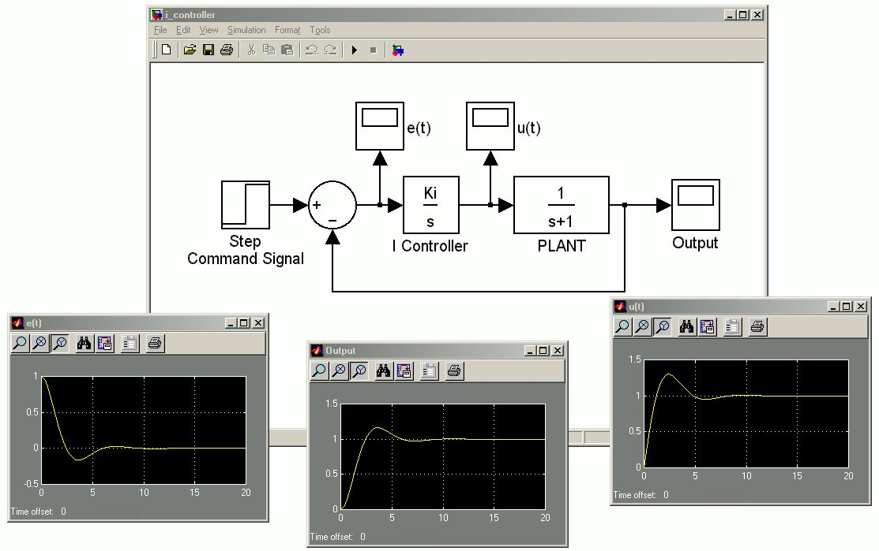
First Example
Recall that we analyzed the following diagram in I-Controller
K_{i}=1

Slide 13
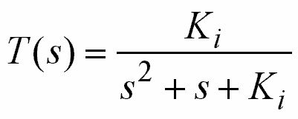
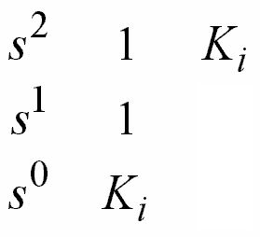
First Example
Did we have to choose K_{i}=1?
NO!
For no sign change in the first column,
K_{i}>0 is required. Any positive integral
gain would work fine

Slide 14
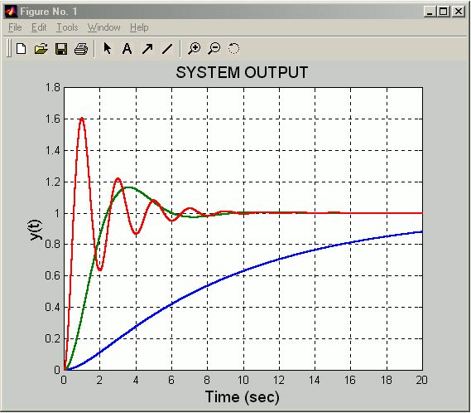
First Example - System Output
Notice that what
they do ultimately
are the same, but
how they do differ.
K_{i}=10
K_{i}=1.0
K_{i}=0.1
Small K_{i} ⇒ Overdamped (Approaches very slowly)
Large K_{i} ⇒ Underdamped (More quickly but with oscillations)

Slide 15
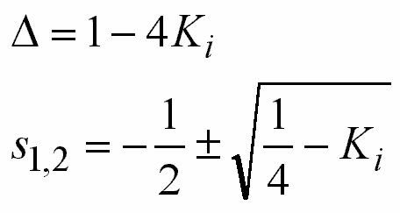
First Example
Where do the oscillations come from?
Im
x
Re
x
X
x
-1
0
x
K_{i}=0
K_{i}=1/4
K_{i}>1/4

Slide 16
First Example
Where do the oscillations come from?
Im
0<K_{i}<1/4
Distinct real poles
K_{i}=1/4
Double poles at
s=-1/2
K_{i}>1/4
Complex conjugate
poles with real parts
-1/2
x
Re
x
X
x
-1
0
x
K_{i}=0
K_{i}=1/4
K_{i}>1/4

Slide 17
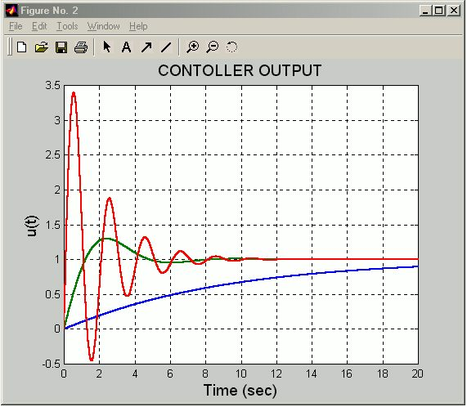
First Example - Controller Output
0<u(t)<1 for K_{i}=0.1
0<u(t)<1.3 for K_{i}=1
-0.45<u(t)<3.4 for K_{i}=10
K_{i}=10
As the controller gain is
increased, the range of
control signal expands.
K_{i}=1.0
• Can your physical
controller provide it?
• Is that control signal
applicable?
K_{i}=0.1
Small K_{i} ⇒ Overdamped (Approaches very slowly)
Large K_{i} ⇒ Underdamped (More quickly but with oscillations)

Slide 18
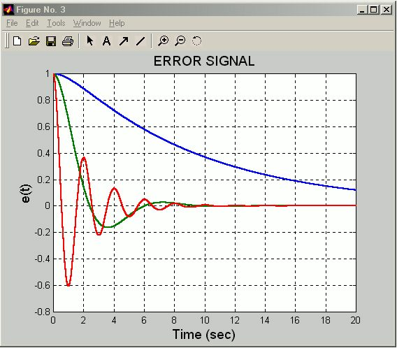
First Example - Error Signals
How fast you want the
error signal come down
to zero?
This signal is the input
to the controller. Is that
physically applicable to
your controller?

Slide 19
First Example - Remarks
We learned how to check stability of the
closed loop (CL) TF
A set of controller gains (K_{i} for this example) can result in stable CL. We analyzed what happens with different values
We learned what questions to ask in the design phase

Slide 20

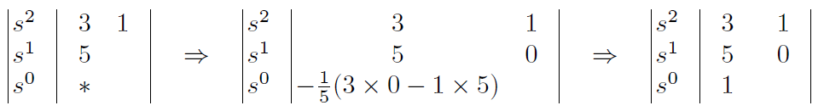
Example-2

Slide 21

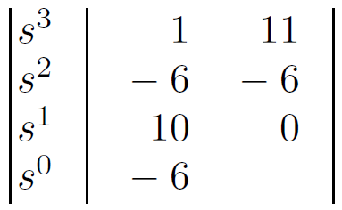

Example-3

Slide 22
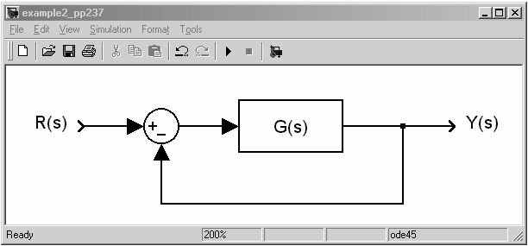
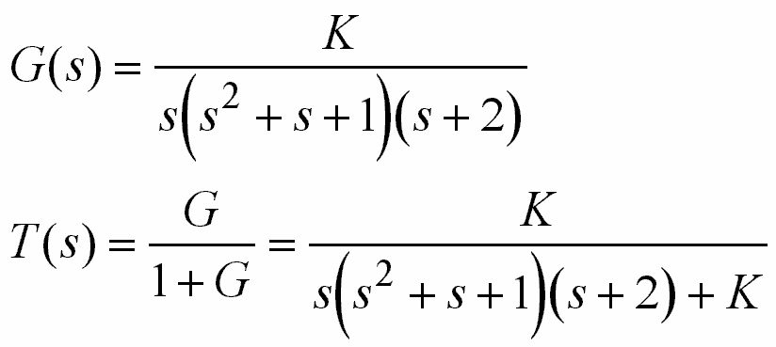

Example-4
Determine the range of K for stability
The characteristic equation is

Slide 23
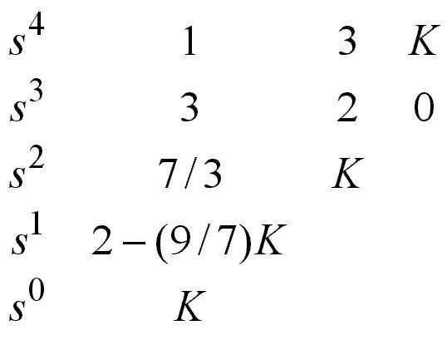
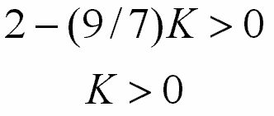
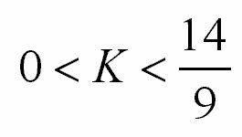
Example-4 (Textbook Ogata 3rd Ed. p.237)

Slide 24

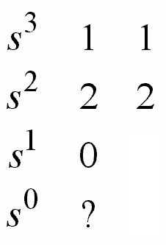
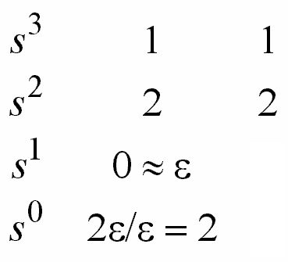
Handling the special cases - Example 1
A zero in the first column
Consider
Insert ε for 0
ε>0

Slide 25
Handling the special cases - Example 1
A zero in the first column
No sign change means no roots on the right half s-plane
In this example, two roots were at s=±j

Slide 26

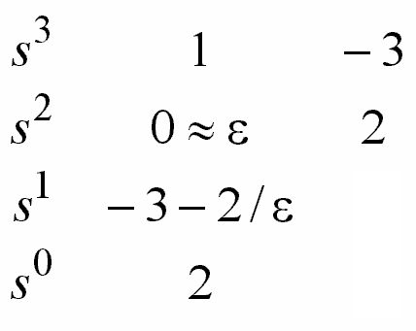

Handling the special cases - Example 2
A zero in the first column
One sign change
One sign change
Two sign changes mean two roots on the right half s-plane

Slide 27

Handling the special cases - Remarks
No sign change, i.e. no roots
on the right half s-plane
But, there are a pair of
imaginary roots
positive
0≈ε
positive

Slide 28
Handling the special cases - Remarks
One sign change, i.e.
there is one root on the right half
s-plane from
this change
positive
negative
0≈ε
0≈ε
or
negative
positive

Slide 29
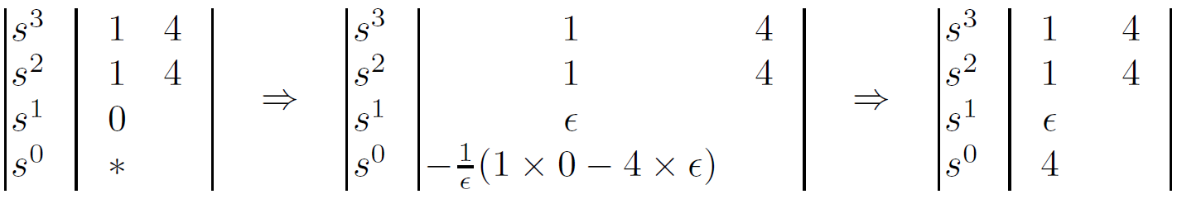
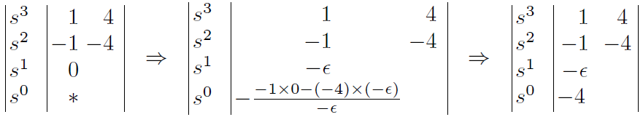
Example-3 and Example 4: Use of Epsilon

Slide 30
Handling the special cases
A row is entirely zero
…
…
…
…
0
0
0
0
This row is
entirely zero!
…
…
You cannot proceed to
calculate these terms!
…

Slide 31
Handling the special cases
A row is entirely zero
…
…
…
Determine the auxiliary
polynomial A(s) from
this row
…
?
?
?
?
…
…
…

Slide 32
Handling the special cases
A row is entirely zero
…
…
a
b
c
d
…
Determine the auxiliary
polynomial A(s) from
this row
…
?
?
?
?
…
…
…

Slide 33
Handling the special cases
A row is entirely zero
…
…
…
…
Insert the coefficients
of dA(s)/ds into this
row, then continue...
…
…
…

Slide 34

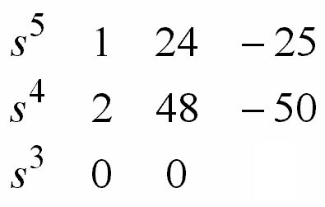

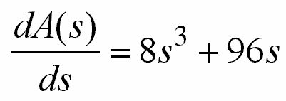
Handling the special cases - An Example
A row is entirely zero

Slide 35
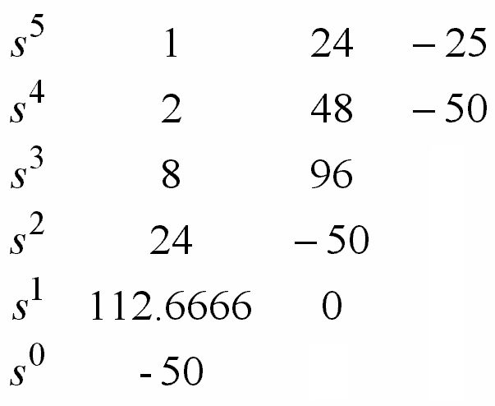
Handling the special cases - An Example
A row is entirely zero
One sign change: One
of the roots is in the
right half s-plane

Slide 36
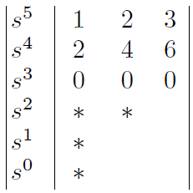


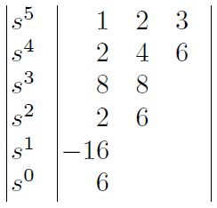
An Example

Slide 37

Another Example

Slide 38
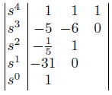
Yet Another Example

Slide 39
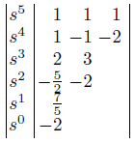
Handling the special cases – Example 3
A row is entirely zero

Slide 40
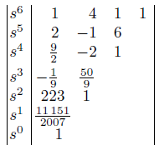
A Final Example

Slide 41
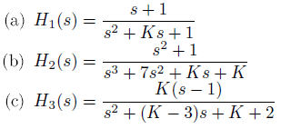
Build the Routh Table and Find Proper K

Slide 42
Final Remarks on Routh Criterion
The goal of using Routh stability criterion
is to explain whether the characteristic
equation has roots on the right half s-plane.
A parameter (e.g. a gain) may change the
locations of the CL poles, and Routh criterion
lets us know for which range the CL system
is stable.

Slide 43

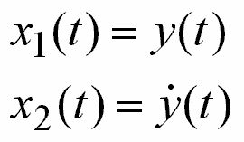
P-3 State Space Representation and Stability
Consider the mass-spring-damper system. Laws of physics lead us to
k
u(t)
m
Let us define the state as
b
y(t)

Slide 44
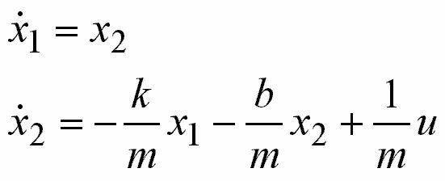

State Space Representation
State
Dynamics
k
u(t)
State equation
m
b
y(t)
Output equation

Slide 45
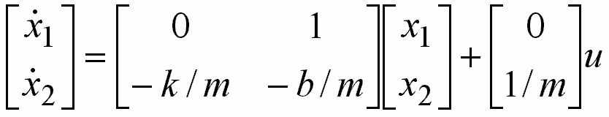
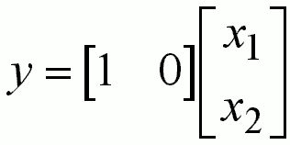
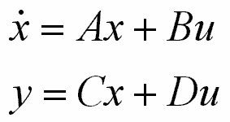
State Space Representation
k
u(t)
m
b
y(t)

Slide 46
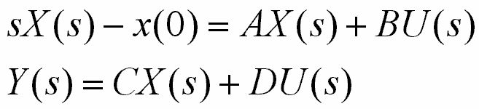
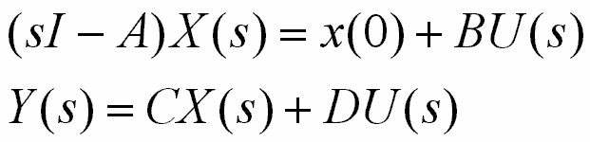
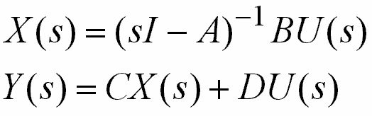
Correlation between State Space
Representations and Transfer Functions
k
u(t)
m
b
y(t)

Slide 47
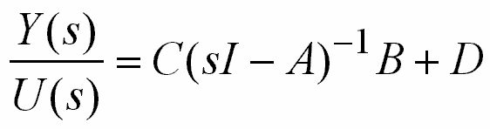
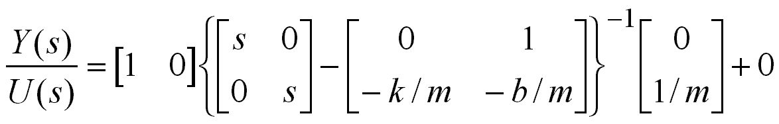
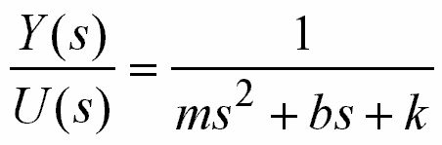
Correlation between State Space
Representations and Transfer Functions
Transfer function
Time Domain Dynamics

Slide 48
Relation between State Space
Representations and Transfer Functions
What does this tell us?
Time Domain
Dynamics
Transfer Function
State Space
Representation

Slide 49
Relation between State Space
Representations and Transfer Functions
The dynamics of a linear system can be
expressed in any of the forms
Differential equations
Transfer functions
State space representation
One has to note that given the TF for a system, state space representation is not unique. Different realizations can be performed.

Slide 50
State Space Representation
State:
The essence of past that influences
the future. State is the smallest set
of variables to describe the dynamics
of a system
State Variables
The dimension of the state
vector is fixed for a given
system

Slide 51
State Space Representation
The dynamics of the system can uniquely be determined with the knowledge of x₁(t₀), x₂(t₀) and u(t) for t ≥ t₀
The state space is a space whose axes are the states. For the above example, axes are x₁ axis and x₂ axis.

Slide 52
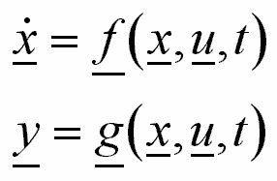
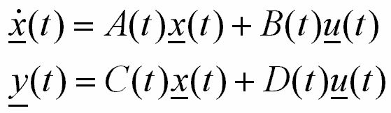
State Space Representation
In general we have a set
of differential equations
We linearize
them and get
The elements of the matrices
may be time-varying

Slide 53
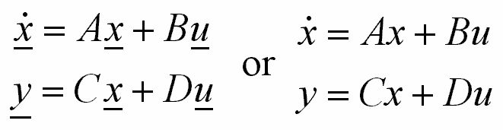
State Space Representation
We simply dropped the underlines. Clearly the state will be a vector if its dimension is larger than one.
Or may be time invariant

Slide 54
State Space Representation and Stability
Assume you are
given the system
The stability of this system can be determined by checking the eigenvalues of the matrix A
Those eigenvalues are the poles of the transfer function

Slide 55



State Space Representation and Stability
If Re{λ_{i}}<0 for i=1,2,…,n
Then the system is stable
If Re{λ_{i}}>0 for some i
Then the system is unstable
If Re{λ_{i}}=0 for some i
Then the system has poles
on the imaginary axis

Slide 56
State Space Representation and Stability
In summary...
D(t)
•
+
+
x(t)
x(t)
+
u(t)
B(t)
Σ
∫
C(t)
Σ
y(t)
+
A(t)
Check the real parts
of the eigenvalues
of A(t)

Slide 57


An Example on Stability
Determine the range of a for stability

Slide 58

An Example on Stability

Slide 59


An Example on Stability

Slide 60

An Example on Stability

Slide 61
An Example on Stability

Slide 62


An Example on Stability
Remember what to do now!

Slide 63

An Example on Stability

Slide 64

An Example on Stability
This term becomes negative
a < 0

Slide 65
An Example on Stability
a > 1/[1+2/ε]
ε > 0 and ε ≈ 0
a > 0
This term becomes negative

Slide 66

An Example on Stability
The system is unstable regardless of the value of a. In other words, A has at least one eigenvalue in the right half s-plane

Slide 67

Can this system have poles on the
imaginary axis?
Assume the answer is yes… Then for s=jα the denominator must be zero, i.e.
No value of a can
lead to zero real
and imaginary
parts simultaneously

Slide 68
Can this system have complex conjugate
poles on the imaginary axis?
The answer is no. Only one pole passes
through the origin when a=0.

Slide 69

Watch now...
Left half s-plane
Right half s-plane
IMAGINARY AXIS
REAL AXIS

