Slide 1


This week’s agenda
Transient Response Analysis
First order systems
Second Order Systems
Using Matlab with Simulink
Steady State Errors
2/17

Slide 2

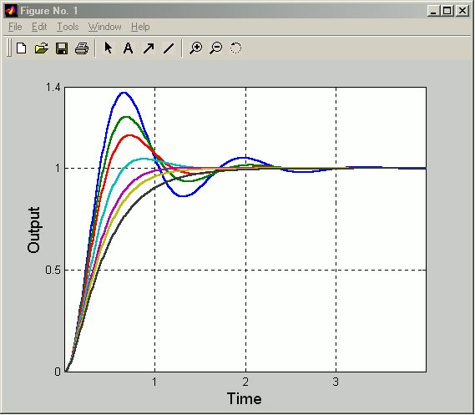
P-4 Transient Response Analysis
Transient response is the evolution of
the signals in a control system until the
final behavior is reached.
The final values for all curves are the same but the way they converge differ
Transient
period

Slide 3
Transient Response Analysis
Transient response is the evolution of
the signals in a control system until the
final behavior is reached.
Which one best suits your needs?
Transient
period

Slide 4
Transient Response Analysis
What are our needs?
We have to quantify the result with a
set of performance specifications
Which one best suits your needs?
Transient
period

Slide 5
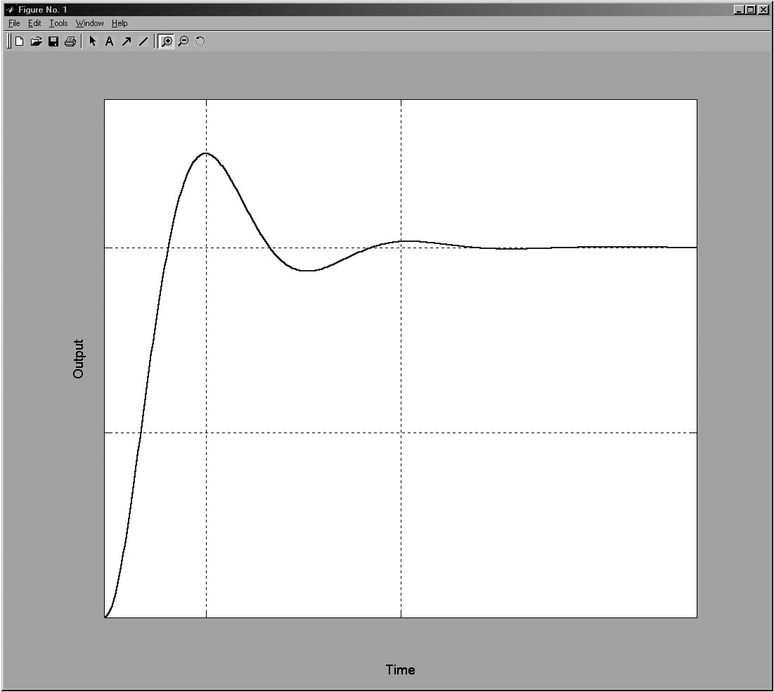
Allowable tolerance
0.05 or 0.02
M_{p}
1.0
t_{r}
t_{d}
0.5
t_{p}
t_{s}
0.0

Slide 6
Transient Response Analysis
Did it have to be the response to a step
input?
The answer is no. We select several
reasonable test signals to study/improve
the transient response.

Slide 7
Transient Response Analysis
What inputs are reasonable?
Those you may encounter in the practical
implementation of your control system
are reasonable to study

Slide 8
Transient Response Analysis
More explicitly
Impulse function to study the effects of
shock inputs
Step input to study sudden disturbances
Ramp input to study gradually changing
inputs
Input
Input
Input
Time
Time
Time

Slide 9
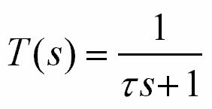
Transient Response Analysis
First Order Systems
R(s)
T(s)
Y(s)
We will study
The unit step response, R(s)=1/s
The unit ramp response, R(s)=1/s²
The unit impulse response, R(s)=1
Clearly, Y(s)=T(s)R(s)

Slide 10
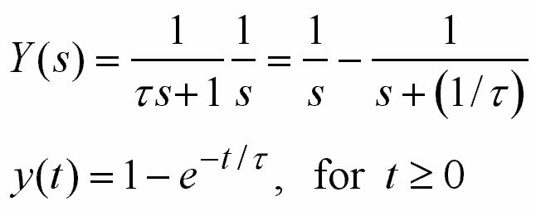
Transient Response Analysis
First Order Systems, R(s)=1/s
Unit step response of
a first order system
y(t)
1
0.982
0.632
0
t
τ
2τ
3τ
4τ

Slide 11
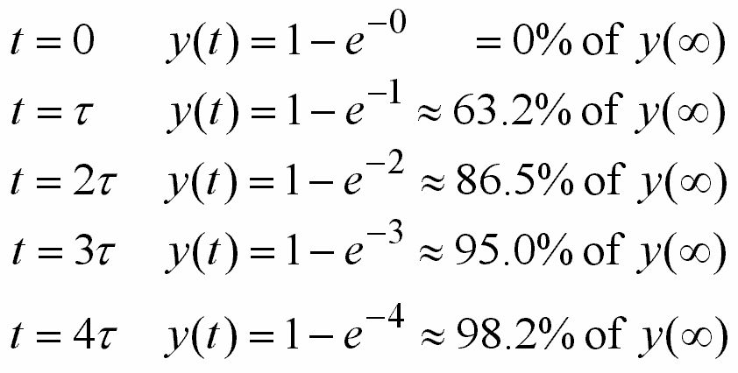
Transient Response Analysis
First Order Systems, R(s)=1/s
y(t)
Within 2%
of y(∞)=1
1
0.982
0.632
0
t
τ
2τ
3τ
4τ

Slide 12
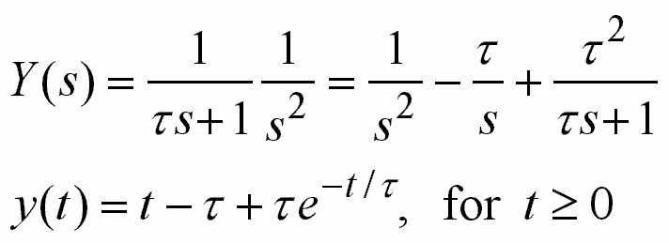
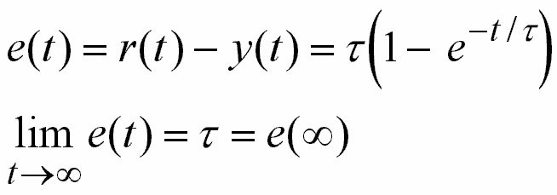
Transient Response Analysis
First Order Systems, R(s)=1/s²
Unit ramp response of a first order system

Slide 13
Transient Response Analysis
First Order Systems, R(s)=1/s²
r(t), y(t)
r(t)
y(t)
τ
t
Unit ramp response of a first order system

Slide 14
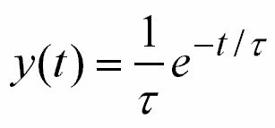
Transient Response Analysis
First Order Systems, R(s)=1
Unit impulse response of a first order system
y(t)
1/τ
Y(s)=T(s)
0
t
τ
2τ
3τ
4τ
for t ≥ 0

Slide 15
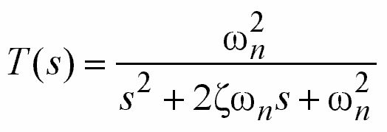
Transient Response Analysis
Second Order Systems
R(s)
T(s)
Y(s)
We will study
The unit step response, R(s)=1/s
The unit ramp response, R(s)=1/s²
The unit impulse response, R(s)=1
Clearly, Y(s)=T(s)R(s)

Slide 16
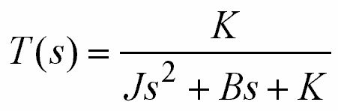
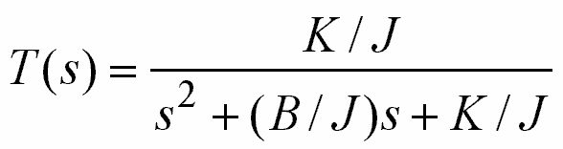
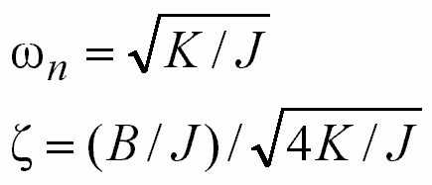
Transient Response Analysis
Second Order Systems
Note that

Slide 17
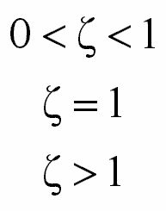
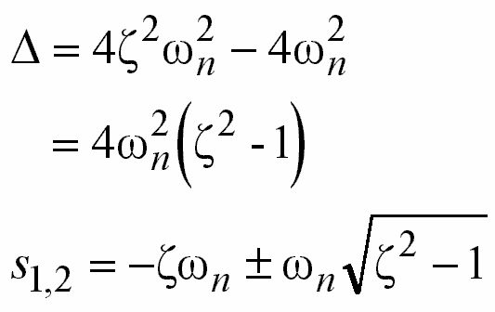
Transient Response Analysis
Second Order Systems
Underdamped
Critically Damped
Overdamped

Slide 18
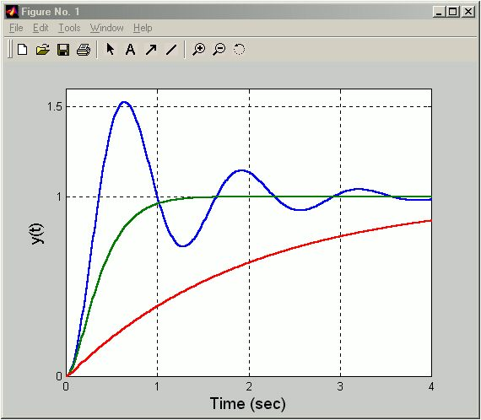
Transient Response Analysis
Second Order Systems, R(s)=1/s
ω_{n}=5
Suspension system in a car needs to be critically damped
Underdamped
ζ=0.2
Critically Damped
ζ=1
Overdamped
ζ=5

Slide 19

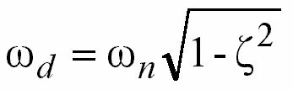
Transient Response Analysis
Second Order Systems, R(s)=1/s
Underdamped Case (0<ζ<1)
Damping ratio
Natural frequency
Damped natural frequency

Slide 20
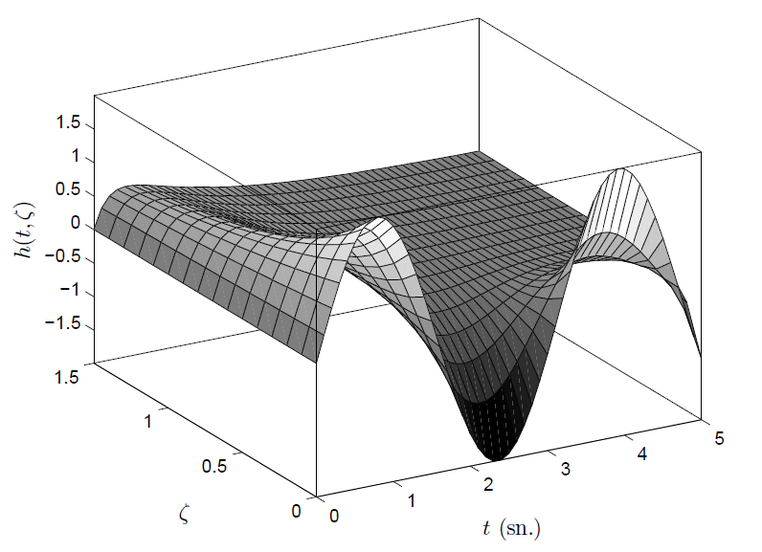
Unit impulse reponse of a system, with
w_{n}=2 rad/s and 0≤ ζ ≤1.5 and 0≤ t ≤ 5 sec.

Slide 21
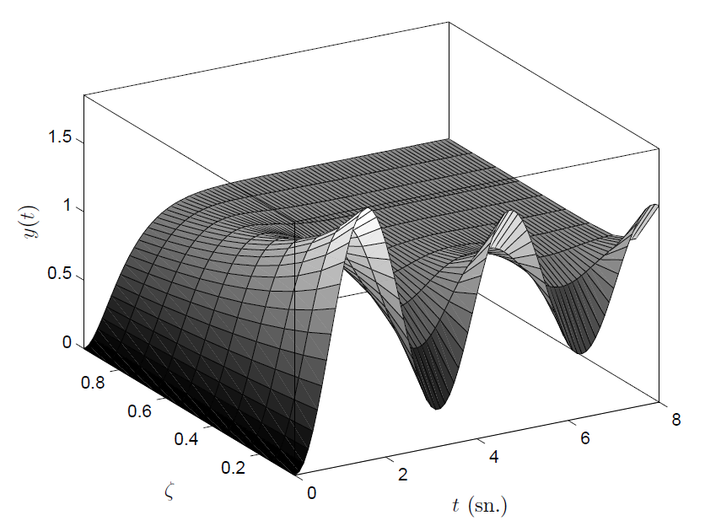
Unit step response of a system, with
w_{n}=2 rad/s and 0.05≤ ζ ≤0.95 and 0 ≤ t ≤ 8 sec.

Slide 22
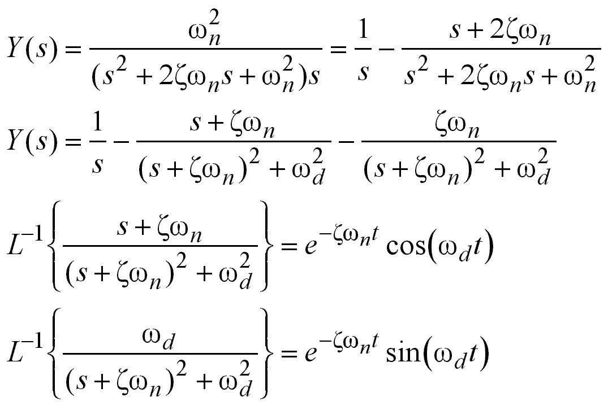
Transient Response Analysis
Second Order Systems, R(s)=1/s
Underdamped Case (0<ζ<1)

Slide 23
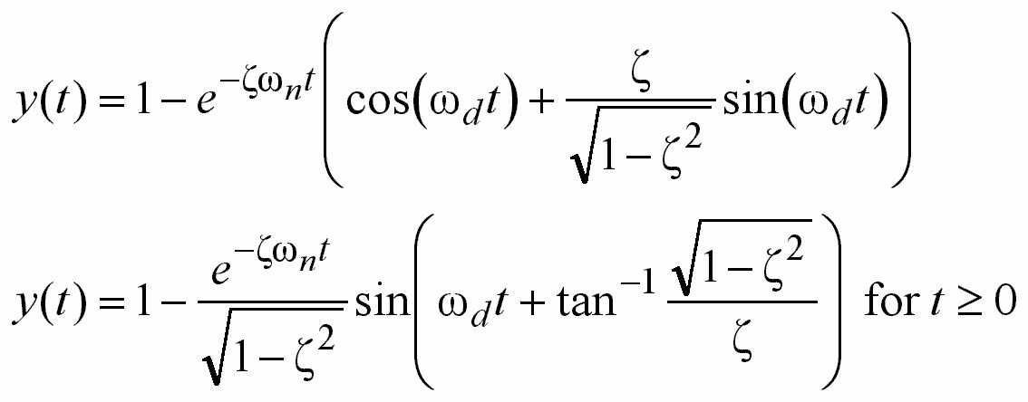
Transient Response Analysis
Second Order Systems, R(s)=1/s
Underdamped Case (0<ζ<1)

Slide 24
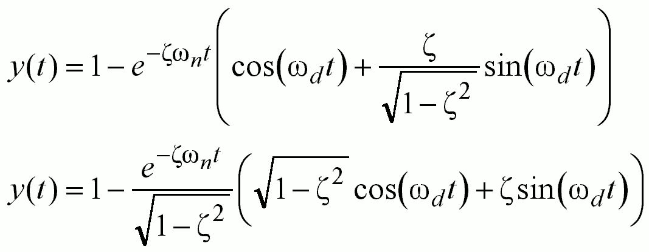
Transient Response Analysis
Second Order Systems, R(s)=1/s
Underdamped Case (0<ζ<1) -  Digression
sin(θ)
cos(θ)

Slide 25
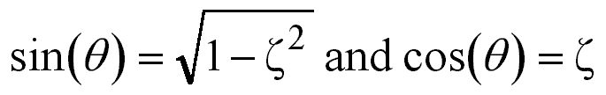
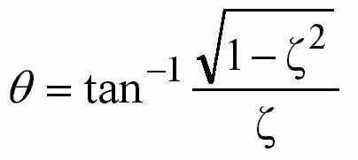
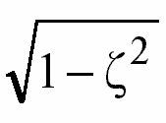

Transient Response Analysis
Second Order Systems, R(s)=1/s
Underdamped Case (0<ζ<1) - Digression
1
θ

Slide 26
Transient Response Analysis
Second Order Systems, R(s)=1/s
Underdamped Case (0<ζ<1) - Digression
 End of digression

Slide 27
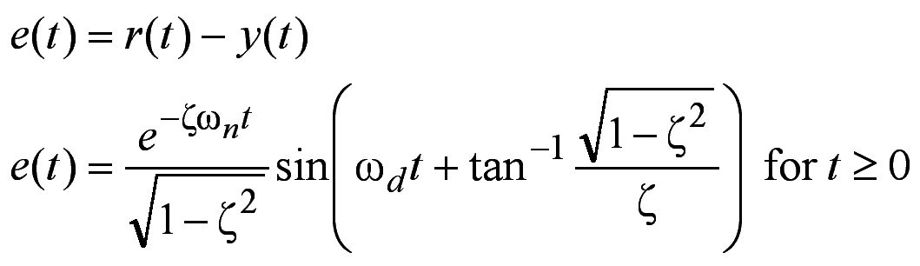
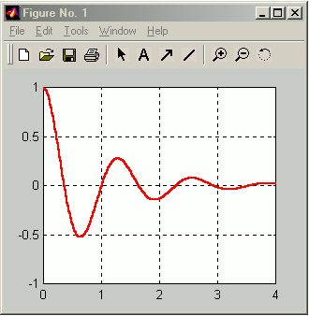
Transient Response Analysis
Second Order Systems, R(s)=1/s
Underdamped Case (0<ζ<1)
Oscillation frequency is ω_{d}
Damped sinusoidal
oscillation converges
to zero, e(t)→0
ω_{n}=5
ζ=0.2

Slide 28
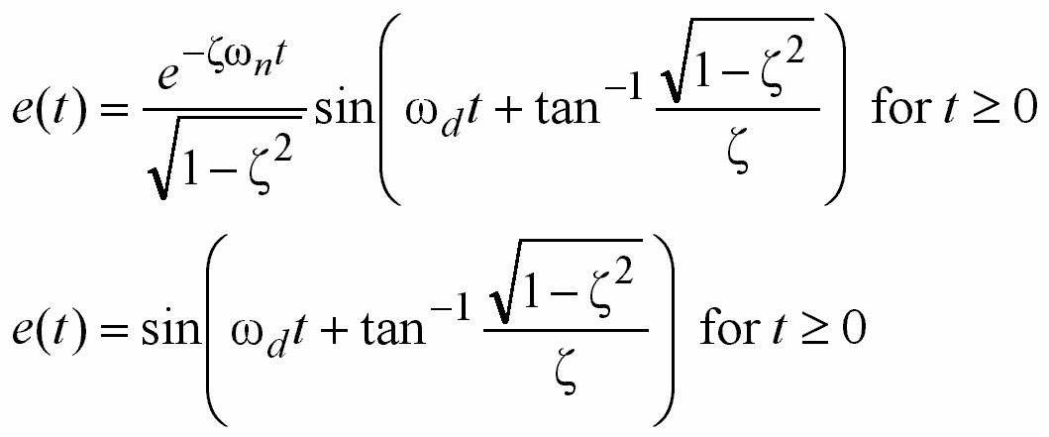
Transient Response Analysis
Second Order Systems, R(s)=1/s
Extreme Case (ζ=0, Undamped)
Oscillations continue indefinitely

Slide 29
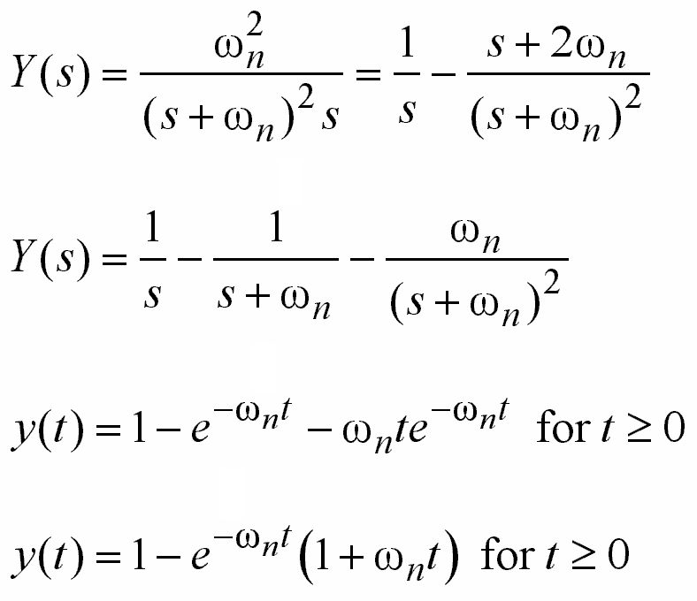
Transient Response Analysis
Second Order Systems, R(s)=1/s
Critically Damped Case (ζ=1)

Slide 30
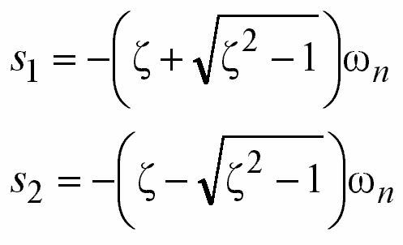
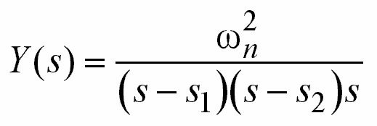
Transient Response Analysis
Second Order Systems, R(s)=1/s
Overdamped Case (ζ>1)
Two distinct poles on
the negative real axis

Slide 31
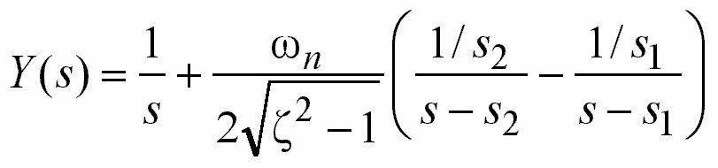
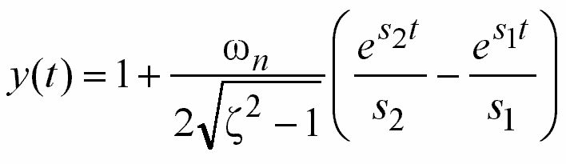
Transient Response Analysis
Second Order Systems, R(s)=1/s
Overdamped Case (ζ>1)

Slide 32
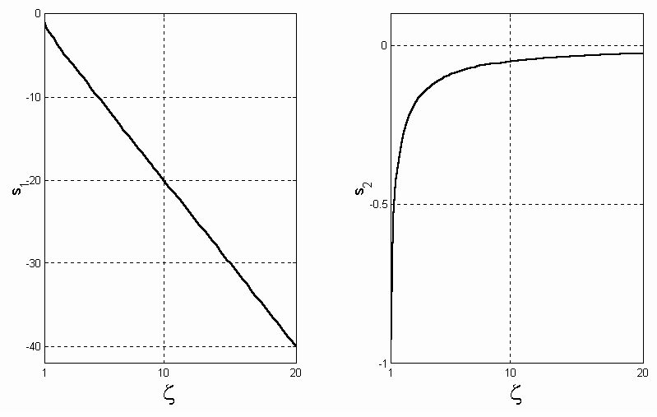
Transient Response Analysis
Second Order Systems, R(s)=1/s
Overdamped Case (ζ>1). See s_{1,2} for ω_{n}=1
As ζ increases, s₂ determines the response dominantly, because it approaches the jω axis

Slide 33
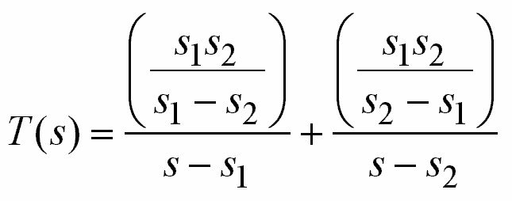
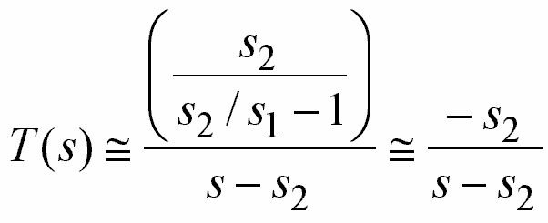

Transient Response Analysis
Second Order Systems, R(s)=1/s
Overdamped Case (ζ>>1)
When ζ>>1
s₁ → −2ζω_{n}
s₂ → 0
≈0
y(0)=0, y(∞)=1 are satisfied by an approximate
dominant first order dynamics

Slide 34
Transient Response Analysis - Definitions
Second Order Systems, R(s)=1/s
Maximum overshoot
M_{p}
1.0
t_{r}
Rise time
t_{d}
0.5
Delay time
t_{p}
Peak time
t_{s}
Settling time
0.0

Slide 35
Transient Response Analysis - Definitions
Second Order Systems, R(s)=1/s
Delay Time (t_{d}): The time required to reach the
half of the final value. Note that delay time is the
time till first reach is observed.

Slide 36
Transient Response Analysis - Definitions
Second Order Systems, R(s)=1/s
Rise Time (t_{r}): The time required to rise from
10% to 90% or 5% to 95% or 0% to 100%
of the final value.
Generally for
overdamped
systems
Generally for underdamped
2nd order systems

Slide 37
Transient Response Analysis - Definitions
Second Order Systems, R(s)=1/s
Peak Time (t_{p}): The time required for the response
to reach the first peak of the overshoot.

Slide 38
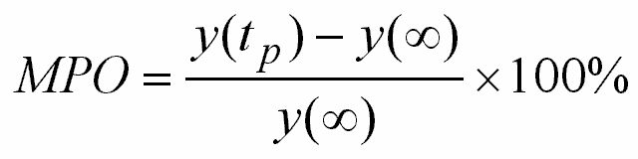
Transient Response Analysis - Definitions
Second Order Systems, R(s)=1/s
Maximum (percent) Overshoot (M_{p}): The maximum
peak value measured from the steady state value.
This is a measure of relative
stability of the system

Slide 39
Transient Response Analysis - Definitions
Second Order Systems, R(s)=1/s
Settling Time (t_{s}): The time required for the
response to remain within a desired percentage
(2% or 5%) of the final value.

Slide 40

Transient Response Specifications
Second Order Systems, R(s)=1/s
In a control system, the designer may want to observe some set of predefined transient response characteristics. This section focuses on the computation of the variables of transient response and their relevance to closed loop transfer function. Ultimately, this relevance will bring a set of constraints for the design of the controller.

Slide 41
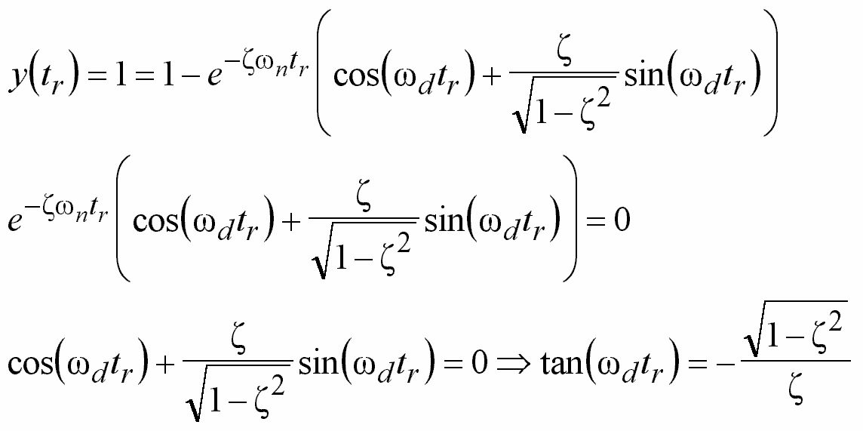
Transient Response Specifications
Second Order Systems, R(s)=1/s
Calculation of Rise Time (t_{r})

Slide 42
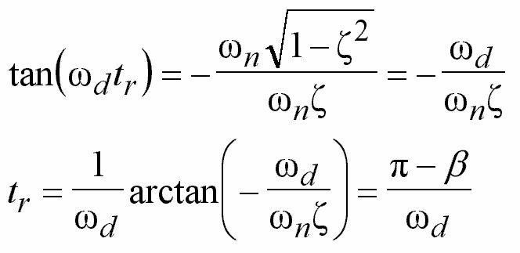
Transient Response Specifications
Second Order Systems, R(s)=1/s
Calculation of Rise Time (t_{r})
jω
jω_{d}
ω_{d}
β
σ
ω_{n}ζ

Slide 43
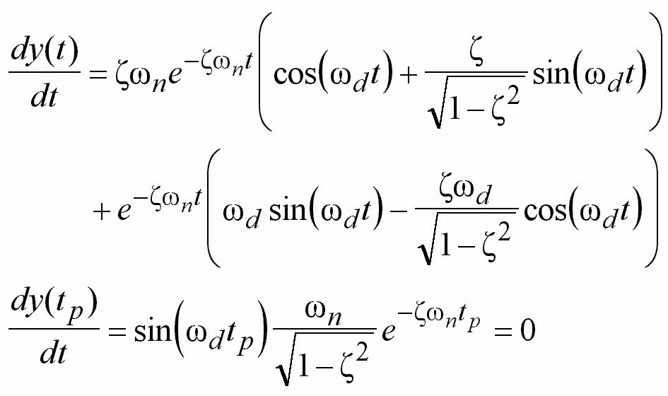
Transient Response Specifications
Second Order Systems, R(s)=1/s
Calculation of Peak Time (t_{p})
At t=t_{p}, dy/dt=0

Slide 44
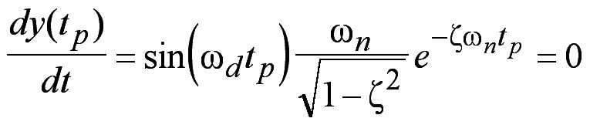
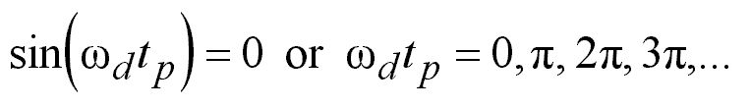
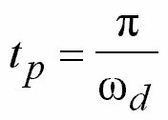
Transient Response Specifications
Second Order Systems, R(s)=1/s
Calculation of Peak Time (t_{p})

Slide 45
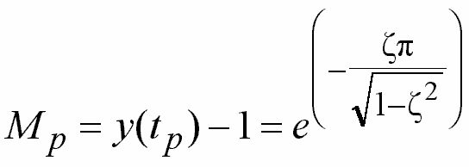
Transient Response Specifications
Second Order Systems, R(s)=1/s
Calculation of Maximum Overshoot (M_{p})
Note that maximum overshoot occurs at t=t_{p}

Slide 46
Transient Response Analysis - Definitions
Damping Ratio and Mp
Mp | ln(Mp) | ln(Mp)^2 | Zeta |  | Zeta | Mp
0,05 | -3,00 | 8,97 | 0,6901 |  | 0,05 | 0,85
0,10 | -2,30 | 5,30 | 0,5912 |  | 0,10 | 0,73
0,15 | -1,90 | 3,60 | 0,5169 |  | 0,15 | 0,62
0,20 | -1,61 | 2,59 | 0,4560 |  | 0,20 | 0,53
0,25 | -1,39 | 1,92 | 0,4037 |  | 0,25 | 0,44
0,30 | -1,20 | 1,45 | 0,3579 |  | 0,30 | 0,37
0,35 | -1,05 | 1,10 | 0,3169 |  | 0,35 | 0,31
0,40 | -0,92 | 0,84 | 0,2800 |  | 0,40 | 0,25
0,45 | -0,80 | 0,64 | 0,2463 |  | 0,45 | 0,21
0,50 | -0,69 | 0,48 | 0,2155 |  | 0,50 | 0,16
0,55 | -0,60 | 0,36 | 0,1869 |  | 0,55 | 0,13
0,60 | -0,51 | 0,26 | 0,1605 |  | 0,60 | 0,09
0,65 | -0,43 | 0,19 | 0,1359 |  | 0,65 | 0,07
0,70 | -0,36 | 0,13 | 0,1128 |  | 0,70 | 0,05
0,75 | -0,29 | 0,08 | 0,0912 |  | 0,75 | 0,03
0,80 | -0,22 | 0,05 | 0,0709 |  | 0,80 | 0,02
0,85 | -0,16 | 0,03 | 0,0517 |  | 0,85 | 0,01
0,90 | -0,11 | 0,01 | 0,0335 |  | 0,90 | 0,00
0,95 | -0,05 | 0,00 | 0,0163 |  | 0,95 | 0,00

Slide 47
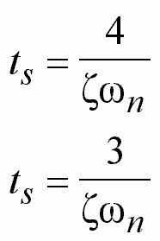
Transient Response Specifications
Second Order Systems, R(s)=1/s
Calculation of Settling Time (t_{s})
2% Criterion
5% Criterion

Slide 48
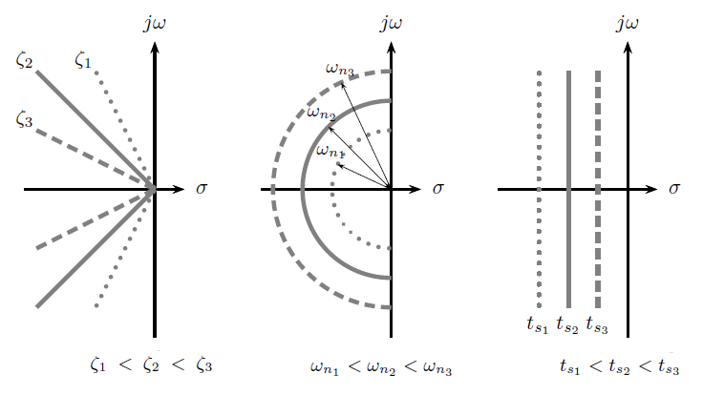
Transient Response Specifications
Implications on the complex plane

Slide 49
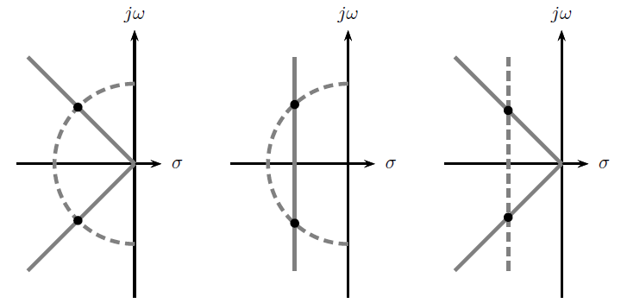
Transient Response Specifications
Implications on the complex plane
w_{n} and ζ specified w_{n} and t_{s} specified t_{s} and ζ specified

Slide 50
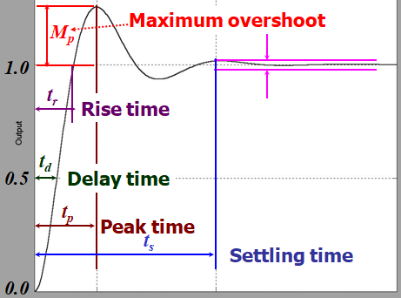

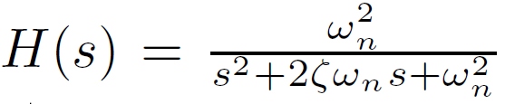
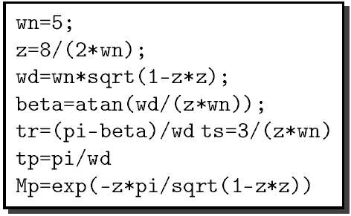

Example
t_{s}<t_{p} ! What is the meaning of this?

Slide 51
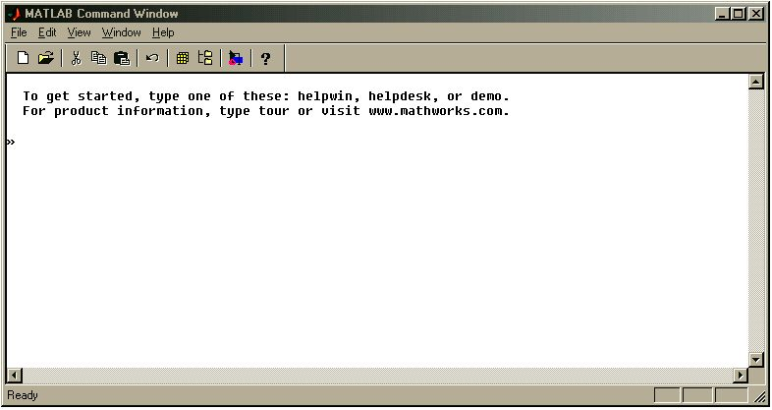
Using Matlab with Simulink
1. Set your path
3. Create a
new m-file
6. Run Simulink
4. Open an
existing m-file
2. Enter the commands here

Slide 52

Using Matlab with Simulink
Try these first, see the results
»inv(A)
»det(A)
»eig(A)
»A.^2
»A^2
»A*A
»sum(A)
»sum(sum(A))
»A’
»A(:,1)
»A(2,:)
»diag(A)
»A(1,1)*A(1,2)
»A^3
»i*A
»A+eye(2,2)

Slide 53
Using Matlab with Simulink
Useful commands/examples
» clc
» clear
» figure
» help {keyword}
» close all
» size(A)
» rand(3,2)
» real(a)
» imag(a)
» grid
» zoom
» clf
» max(A)
» min(A)
» flops
» who
» whos
» sin(pi/2)
» cos(1.34)
» atan(1.34)
» abs(-2)
» log(3)
» log10(3)
» sign(-2)
» save
» zeros(3,1)
» ones(2,4)
» ceil(1.34)
» floor(1.34)
» ezplot(‘sin(x)’,[0,2])
» helpdesk
» roots([1 7 10])
» ltiview
» rlocus
» nyquist
» bode
» margin

Slide 54


Using Matlab with Simulink
A command line demo - Step Response
Numerator
Denominator
Transfer
Function
Step
Response

Slide 55


Using Matlab with Simulink
A command line demo - Impulse Response
Numerator
Denominator
Transfer
Function
Impulse
Response

Slide 56
Using Matlab with Simulink
Type »help toolbox/control
To see all control systems related
functions and library tools
Type »help elmat
To see elementary matrix operators
and related tools

Slide 57

Using Matlab with Simulink
Simulink
Opens Simulink
Creates a new model

Slide 58

Using Matlab with Simulink
Simulink
4. Run the model
1. Drag & Drop!
2. Connect the components
3. Double click to set the internal
parameters (e.g. magnitude or
phase of sine wave, initial value of
the integrator etc.)

Slide 59
P-4 Steady State Errors
Steady state response is the manner in which the system output behaves as time approaches infinity
This is the steady
state value

Slide 60

Steady State Errors
Steady state
response
Steady state
error
Transient response

Slide 61
Steady State Errors
Control systems can be classified according
to their ability to follow several test inputs.
We will analyze the steady state error for
certain types of inputs, such as step, ramp
or parabolic commands.
Most input signals can be written as
combinations of these signals, so the
classification is reasonable.

Slide 62

Steady State Errors
Whether a given control system will exhibit
steady state error for a given type of input
depends on the type of open loop transfer
function of the system.
Type of open loop transfer function is the
number of integrators contained.

Slide 63



Steady State Errors
We will consider only
E(s)
N=0
N=1
N=2
Type 0
Type 1
Type 2

Slide 64

Steady State Errors
E(s)
Final Value Theorem

Slide 65

Steady State Errors
Regardless of the corresponding physics, we will consider position, velocity and acceleration outputs
Position
Velocity
Acceleration
Pressure
Pressure
Change
Change in
Pressure Change
Temperature
Temperature
Change
Change in
Temperature Change

Slide 66

Steady State Errors
Static Position/Velocity/Acceleration
Error Constants
The larger the constants, the smaller the e_{ss}

Slide 67

Steady State Errors
Static Position/Velocity/Acceleration
Error Constants
Input
Type
System
Type

Slide 68
Transient Response
Steady State Response
We analyzed the characteristics of the response of the closed loop system. In any practical design, you will have a number of design specifications, which may impose penalties on transient or steady state characteristics.

Slide 69




An Example
R(s)
Y(s)
Σ
CONTROLLER
C(s)
ACTUATOR
A(s)
PLANT
P(s)
TRANSDUCER
B(s)
+
_
Open Loop
Transfer Function

Slide 70


An Example
Design a PD controller such that
The closed loop system becomes stable
The closed loop system follows the unit ramp
with minimum possible steady state error
Response of the closed loop for unit step input
exhibits maximum overshoot M_{p}=0.1
•
•
•
These are the specifications of the design...

Slide 71





An Example
Stability Requirement
Choose controller as
Open Loop TF
Closed Loop
TF

Slide 72

An Example
Steady State Error Requirement
Obtain minimum e_{ss} for ramp input
Should you choose K as large as possible?

Slide 73







An Example
Maximum Overshoot Requirement
Closed Loop
TF

Slide 74

An Example
Justification of the Design
CONTROLLER

Slide 75

An Example
Justification of the Design
Zoom

Slide 76

An Example
Justification of the Design

Slide 77
An Example
Remarks
Controller is
Open Loop
TF is
The product of them cancels out the pole at
s=−K₂. Never cancel an unstable pole!
Since K₂>0, we could do it. If K₂ were negative,
an imperfect cancellation would result in
instabilities in the long run; and in practice,
we are always faced to imperfections!

Slide 78


Unstable Pole-Zero Cancellation
Looks fine but remember P(s) is a model, not the truth!

Slide 79

Unstable Pole-Zero Cancellation
This is what you expect
Let a=1, K=1
Looks fine but remember P(s) is a model, not the truth!

Slide 80

Unstable Pole-Zero Cancellation
Reality is a little different
Denominator is not first order!

Slide 81

Unstable Pole-Zero Cancellation
Let a=1, K=1 and Δ=0.001

Slide 82

Unstable Pole-Zero Cancellation
Let a=1, K=1 and Δ=0.001
Unstable pole is cancelled by an unstable zero and the result is unstable due to the model imperfections

Slide 83



Steady State Error Examples

Slide 84

Steady State Error Examples

Slide 85

Steady State Error Examples

Slide 86

Steady State Error Examples

Slide 87

Steady State Error Examples
Pole zero cancellation
Note that we changed K_{v} from K₁/a₁ to K₁K₂/a₂.

Slide 88

Steady State Error Examples
Addition of a special term
Note that we changed K_{v} from K/a to 10K/a, which is better!

Slide 89
Steady State Error Examples
Typical design steps require
Check stability
Meet desired transient characteristics
Meet desired steady state characteristics
Validate your design

